Slide 1
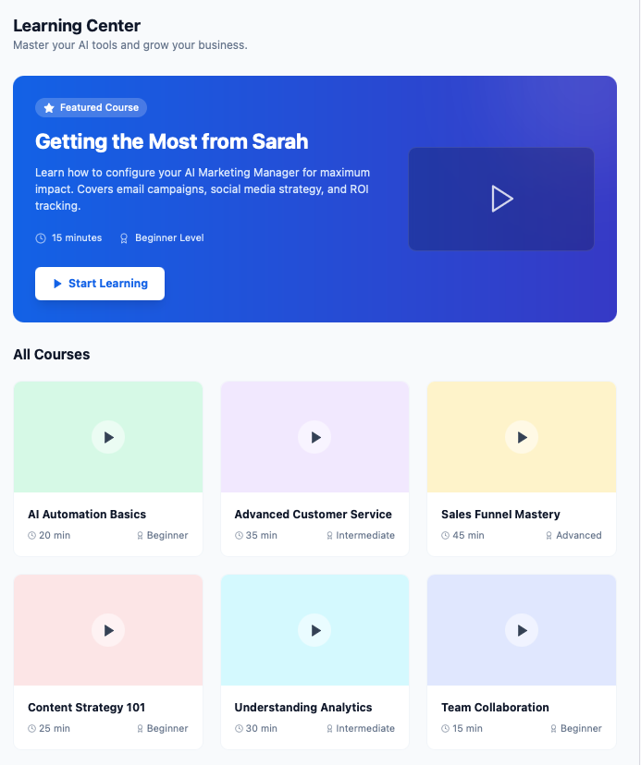
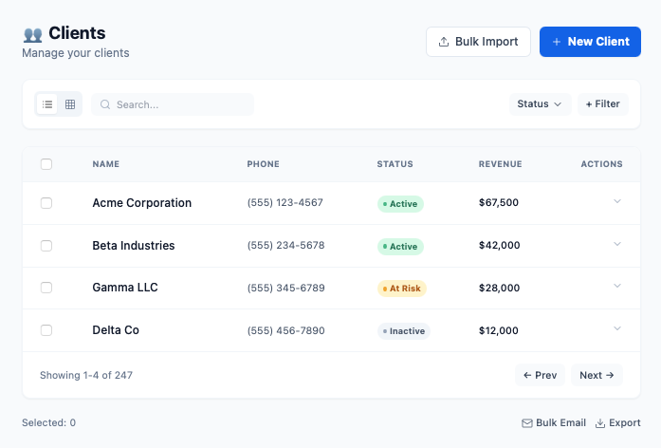
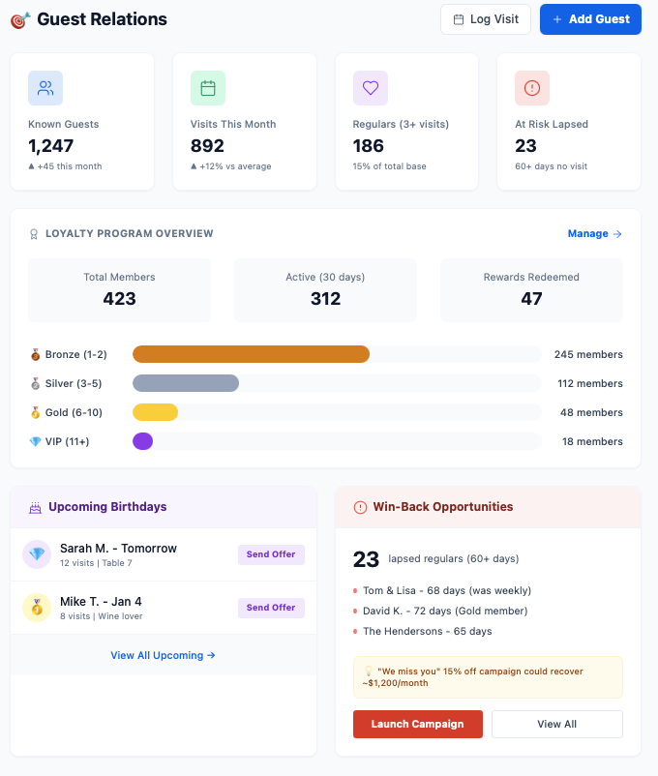
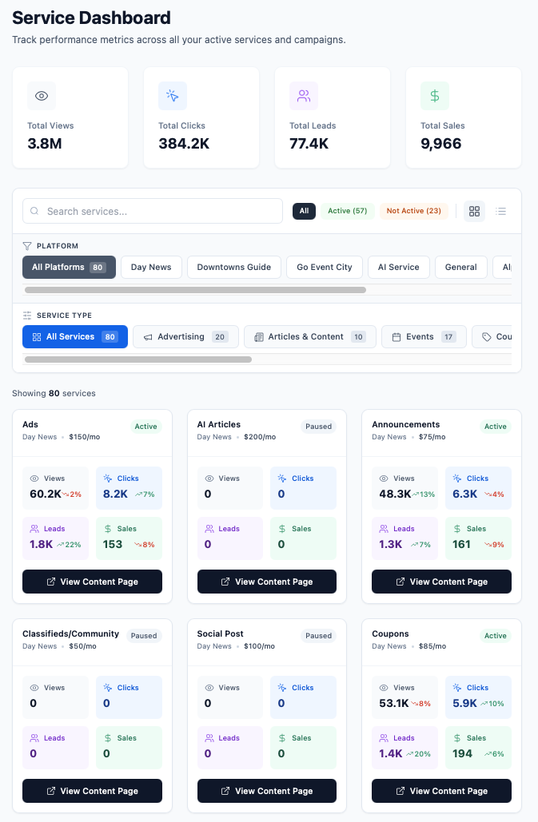
AI

Slide 2
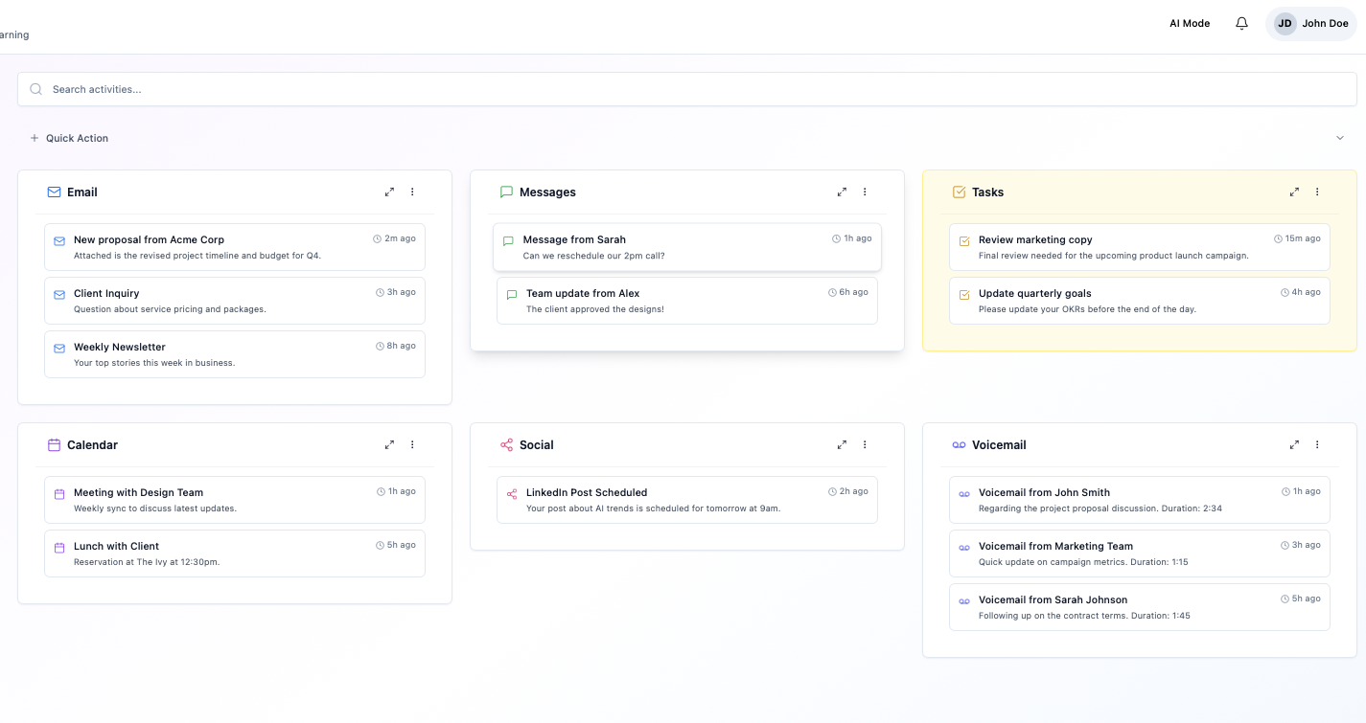

MY SERVICES
Clients
Articles
Tasks
LEARNING CENTER
Client Details
Eventss
Email
Messages
Calendar
Social
Voicemail

Slide 3
