Slide 1
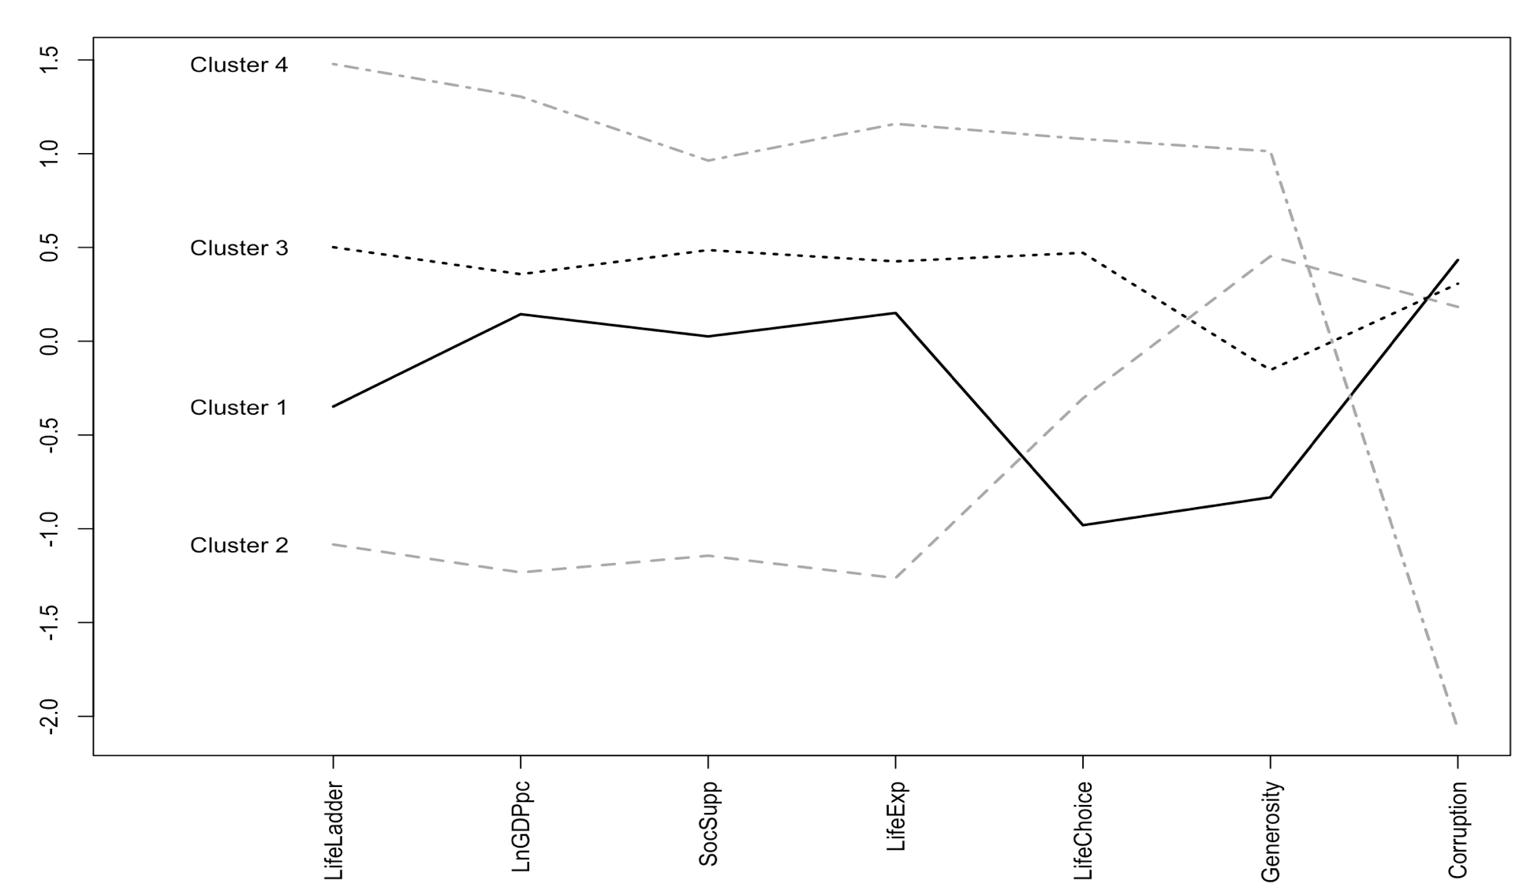
Optimal Model Presentation
Our group chooses the k-means model with Life Ladder as the most meaningful model, mainly because it is more interpretable and takes both subjective and objective factors into consideration
In addition, prepare a two-slide PowerPoint presentation that summarizes the clusters you ultimately defined. One slide should show either a heatmap or a centroid profile plot, and the other should list the names of representative countries in each cluster.

Slide 2
Representative Countries in Each Cluster
Countries in the database are distributed among four clusters, and what present in the following chart complies with our judgement towards the happy level of these countries based on what we know day-to-day
Clusters | Countries | Label
Cluster 4 (Happiest Countries) | Australia, Belgium, Norway, Netherlands, Luxembourg | high economic development/ low corruption
Cluster 3 (Moderately Happy Countries) | France, Japan, Thailand, Mexico, United States | moderate economic development/ high life choice
Cluster 1 (Moderately Happy Countries) | Bulgaria, China, Egypt, Greece, Italy | moderate economic development/ low life choice
Cluster 2 (Least Happy Countries) | Afghanistan, Central African Republic, Haiti, Indonesia, Ethiopia | poor economic development/ high generosity

