Slide 1
 | OSI Model | Layer Number | TCP/IP Layer | Other protocol
Alligator | Application |  | HTTP | SSH, FTP Telnet, SMTP, POP3
Pet | Presentation
Steve’s | Session
Touch | Transport |  | TCP | UDP,SCTP
Not | Network |  | IP | IPv6, ARP
Do | Data Link |  | Ethernet | HDLC, Frame Relay
Please | Physical

Slide 2
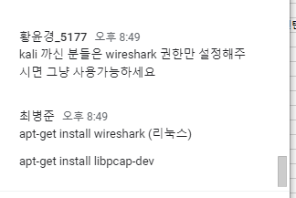
레포지토리 하나더 생성
Ppt, png하나
패킷리스트-패킷디테일-패킷바이츠
https://gilgil.gitlab.io/2019/07/25/1.html
apt-get install wireshark (리눅스)
apt-get install libpcap-dev
https://gitlab.com/gilgil/sns/-/wikis/osi-and-tcp/osi-and-tcp

