Slide 1
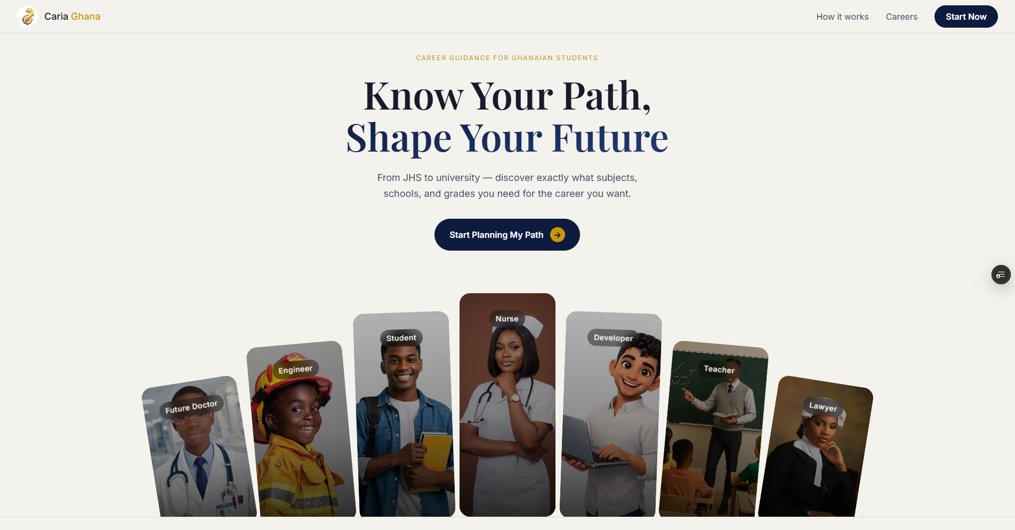

AI-POWERED CAREER GUIDANCE FOR GHANA
CARIA
Career & Academic Roadmap Intelligence for Africa
caria-ghana.vercel.app
Hackathon 2026
Notes:
Introduce CARIA — what it stands for and why it was built. Keep it under 30 seconds. Let the URL speak for itself.

Slide 2



THE PROBLEM
No clear path
Geography gaps
Admission confusion
Most Ghanaian students from JHS to SHS don't know which subjects, electives, or programs lead to their career goals.
Students in Greater Accra and Central Region lack easy access to information about which nearby schools offer the right programs.
BECE aggregates, WASSCE credit grades, and university cutoffs are poorly understood — students make costly mistakes choosing SHS programs.
Notes:
Walk through each card. Emphasise that this is a real, daily problem for hundreds of thousands of Ghanaian students and their families. No digital solution exists that is specific to Ghana's education structure.

Slide 3

THE SOLUTION
Tell CARIA your career goal.
Get your complete academic roadmap —
from BECE all the way to university.
AI chat interface powered by Llama 3.3 70B via Groq
Career → SHS program → electives mapping
Live visual roadmap: JHS → BECE → SHS → WASSCE → University
School recommendations for Greater Accra & Central Region
Built in 48 hours · React + Node/Express + MongoDB + Groq
Notes:
Show the live site here if possible. Point out the split-panel layout — chat on the left, roadmap on the right. The roadmap updates live as the agent responds.

Slide 4




HOW IT WORKS
1. Student enters career goal
2. AI agent asks their region
3. Agent recommends SHS program
4. WASSCE & university guidance given
5. Roadmap panel updates live
e.g. 'I want to be a doctor'
Greater Accra or Central Region
Science, Arts, Business, or TVET
Grades needed, aggregate cutoffs
Visual path from JHS to University
Notes:
This is the full user journey in 5 steps. Emphasise that the AI remembers the whole conversation — the student doesn't need to repeat themselves. The roadmap panel is the differentiator.

Slide 5
TECH STACK
FRONTEND
KNOWLEDGE BASE
React.js
Structured JSON
Chat UI + live roadmap panel
20 careers, Ghana-specific data
BACKEND
HOSTING
Node.js + Express
Vercel
API routes, session handling
caria-ghana.vercel.app
DATABASE
STYLING
MongoDB Atlas
CSS Variables + Inter/Playfair
Session & message persistence
Navy & gold design system
AI / LLM
COST
Groq — Llama 3.3 70B
GHS 0
Career guidance reasoning
100% free tier stack
Notes:
Highlight the zero-cost angle — this whole system runs on free tiers. Groq's free tier gives 1,000 requests/day which is more than enough to demo and test. The knowledge base is a JSON file, not a vector database — deliberately simple for a hackathon.

Slide 6
THE KNOWLEDGE BASE
20
4
3
2
Careers mapped
SHS streams covered
Universities referenced
Regions: Accra & Central
Science & Health
Doctor · Nurse · Pharmacist · Biomedical Eng · Environmental Scientist · Agricultural Scientist
Engineering & Tech
Software Developer · Civil Eng · Electrical Eng · Mechanical Eng · Telecoms Eng
Business
Accountant · Banker · Marketing Manager · Supply Chain Manager
Arts, Law & TVET
Lawyer · Journalist · Teacher · Automotive Technician · Building & Construction Tech
Notes:
This slide shows the depth of the knowledge base. Each of the 20 careers has: SHS program, specific electives, WASSCE grade requirements, BECE aggregate guidance, and university programs with cutoffs. All Ghana-specific, all researched.

Slide 7
LIVE DEMO
caria-ghana.vercel.app
I want to be a Medical Doctor
JHS
Foundation
Great choice! What region are you in?
BECE
Aggregate 8–18
I am in Central Region
You need General Science at SHS. Target Biology, Chemistry & Physics. Aim for UCC Medical School with aggregate 8–12...
SHS
General Science
WASSCE
Credits in 6 subjects
University
UCC Medical School
AI Chat
Live Roadmap
Notes:
Open the live site here. Type 'I want to be a doctor' and show the roadmap updating in real time. If internet is unreliable, this mockup tells the story clearly.

Slide 8
IMPACT & NEXT STEPS
WHY IT MATTERS
NEXT STEPS
Over 400,000 students write BECE in Ghana annually
01
Expand to all 16 regions of Ghana
Most lack access to structured career guidance counsellors
02
Add BECE & WASSCE grade calculator
Wrong SHS program choice wastes 3 years and blocks university entry
03
Integrate GES & CSSPS official school database
CARIA gives every student a personal career adviser — for free
04
Mobile app for offline use in low-connectivity areas
Aligned with SDG 4: Quality Education for all
05
Partner with GES, WAEC, and schools for adoption
Try it now → caria-ghana.vercel.app
Notes:
Close with the impact numbers — 400,000 BECE writers per year is the headline. Then walk the next steps quickly. End by asking judges / audience to scan the URL or visit the site.

