Slide 1

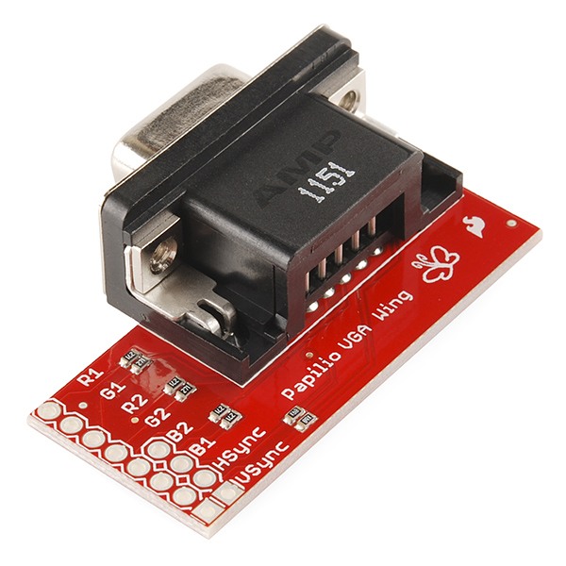
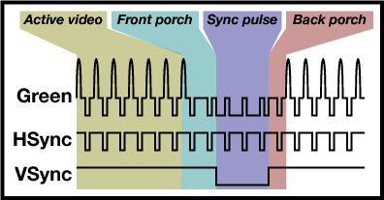
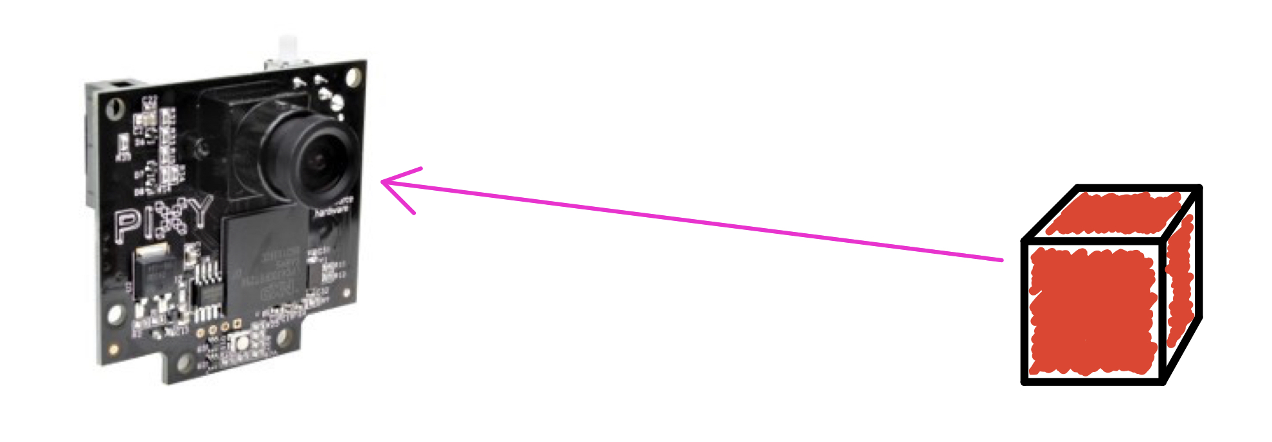
EECS373
Design of Microprocessor-Based Systems
STEP
ON
THE
WHITE
TILES
!
Kun Huang, Shiyu Liu, Jingliang Ren, Zhihao Ruan
{huangkun, shiyuliu, meow, ruanzh}@umich.edu
Project Overview:
“Step on the White Tiles” is a game implemented using SmartFusion with several peripherals under its control. This game is designed with the intension of utilizing what we have learnt in EECS373 throughout this semester and have some fun at the same time!
Block Diagram:
Technical Details:
VGA Display
Although VGA is a relatively aged method for static and dynamic display, its frequency (60Hz per frame) is good enough for our display purpose. Vertical sync and horizontal sync will be generated periodically to indicate position of scan point in the frame. At the same time, RGB signals will be generated sequentially for the pixel on current scan point. All these signals will be passed to a VGA wing, essentially a DAC (Digital-to-Analog Converter), and lastly received by the projector as analog signals.
Interrupt Service Routine and Handler
Interrupt is used to update all VGA display, including tiles, health point and score. Every time the scan point mentioned in the above section goes through the whole frame, an interrupt will be triggered for updating display, i.e., RGB values of each pixel.
Serial Interfaces
As shown in the block diagram, communications between SmartFusion board and peripherals have to be established using serial interfaces. Two protocols are used in this project. UART is used for data transmission from SmartFusion to the LCD and SPI is used for data transmission from PIXY(camera) to SmartFusion.
Memory-mapped I/O & Advanced Peripheral Bus
Instead of real memory at a given memory address, we have I/O devices respond. To control these ”memories”, we use APB as interface on peripherals. APB makes controlling signals with C code possible and simplify Verilog codes.
MASTER
MSS
TX
LCD
RX
APB
simplified UART protocol
VGA
Controller
Sound Board
MSS
SCK
MOSI
MISO
SS
PIXY
SCK
MOSI
MISO
SS
FYI: How to Play this Game:
Before stepping into the gaming area, please put on a pair of shoe covers with different colors. This is very important for the position detection of out camera. Then, the controller will be handed to you so that you can choose the game speed and the song as you like. After you make the selections, stand on the back of the displaying area and the game will start when you are prepared.
simplified SPI protocol
PIXY
Pixy is used for locating the player’s feet in our project. The working mechanism of Pixy is based on color recognition. As long as Pixy recognizes certain objects with a specific color, it will return the x, y positions of the objects, along with their heights and widths.
VGA wing
demonstration of how
sync. signals work
Conclusion:
“Step on the White Tiles” is a game based on the knowledge of embedded systems. In this project, a number of important concepts and techniques are implemented and used, and then they are integrated to form the entire project.
Making everything work individually and then collaborate together is not a easy thing, and a large number of conditions and restrictions need to be considered. Nevertheless, it is more than rewarding to have what are taught in class implemented in the real world. Beyond the course contents, we learned ways to perform reasonable analyses and make practical decisions.
Interrupt is triggered after the signal of a whole frame has been sent.
The interrupt handler refreshes the frame

