Slide 1

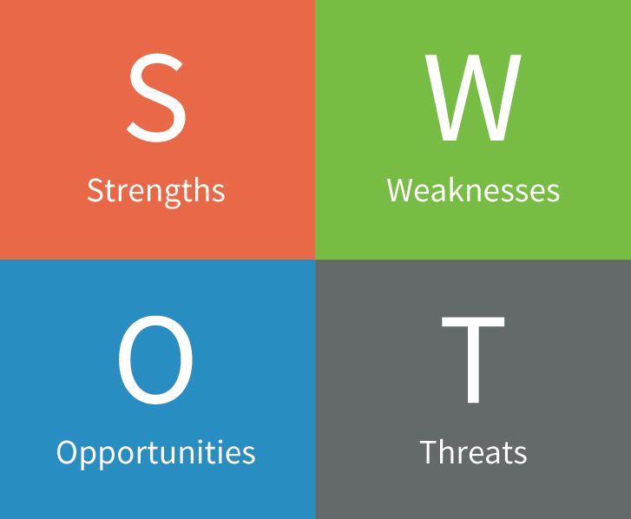
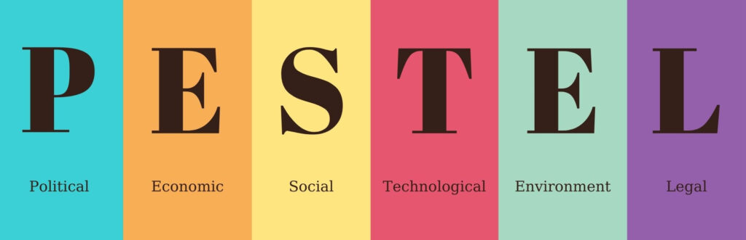

Slide 2
POLITICAL

Slide 3
ECONOMIC

Slide 4
SOCIAL

Slide 5
TECHNOLGICAL

Slide 6
ENVIRONMENTAL

Slide 7
LEGAL

Slide 8
Strengths

Slide 9
Weaknesses

Slide 10
Opportunities

Slide 11
Threats

Slide 12
Conclusion & Recommendation

