Slide 1
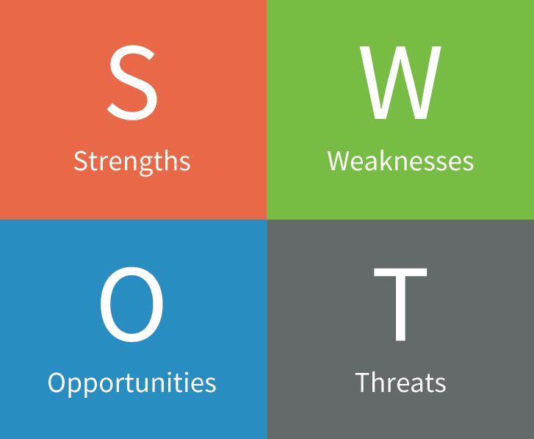


Slide 2
Strengths

Slide 3
Weaknesses

Slide 4
Opportunities

Slide 5
Threats

