Slide 1
Decision-chain
3f1j

Slide 2
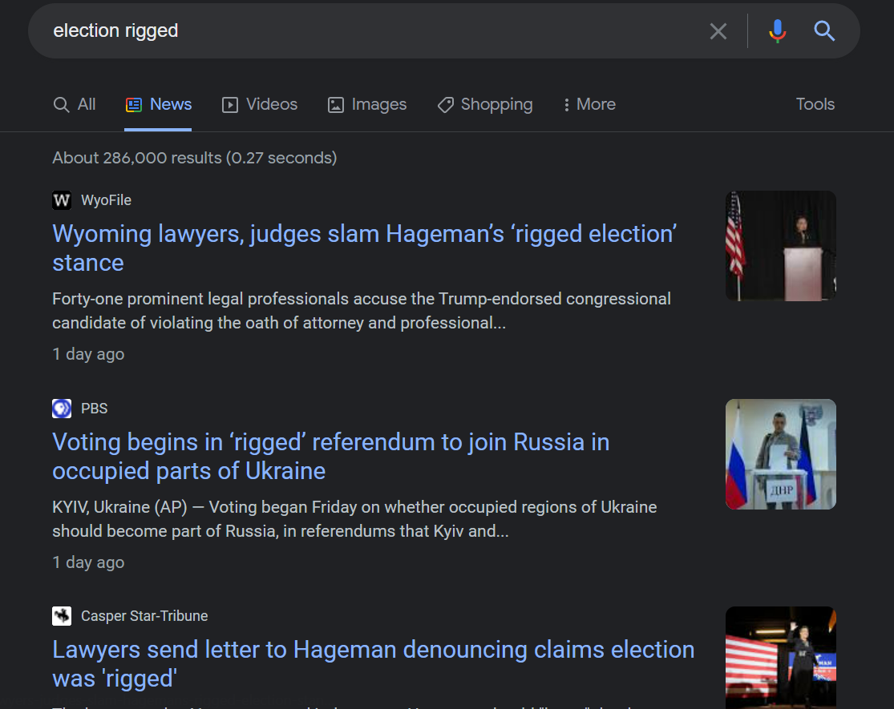
Voting in 2022

Slide 3

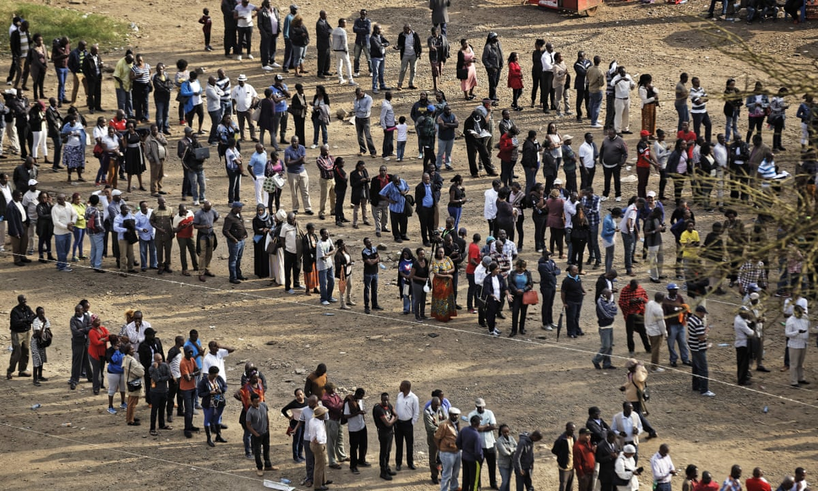
Problems of traditional voting
1
Vote counting delays/errors
2
Mass logistics inefficiencies

Slide 4



Electronic Voting
Efficient and fast
Anonymity of voter
Security of votes
Notes:
Trust in central authority to accurately distribute bike

Slide 5
Why Blockchain?
Decentralized
Notes:
Remark: also potential applications directly in contracts – government policies.

Slide 6
Why Blockchain?
Decentralized
Automated
Notes:
Automated

Slide 7
Why Blockchain?
Decentralized
Automated
Security/Privacy
Notes:
Remark: also potential applications directly in contracts – government policies.

Slide 8
Why Blockchain?
Decentralised
Transparency/Traceability
Automated
Security/Privacy
Notes:
Remark: also potential applications directly in contracts – government policies.

Slide 9




DecisionChain
1
Votes deployed and distributed as tokens
2
Vote cast to candidates (safe token transfer)
Notes:
So what is DecisionChain and how does it work?

Slide 10

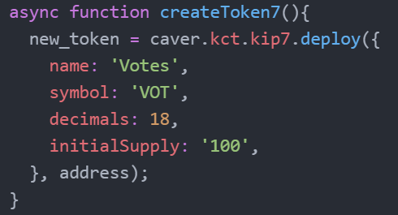
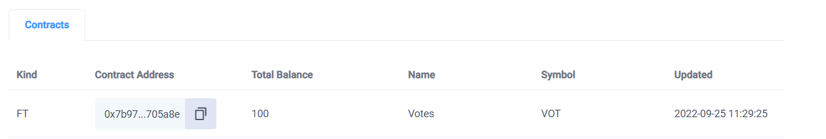
Demo – Votes as tokens
Node.js
KAS Console

Slide 11
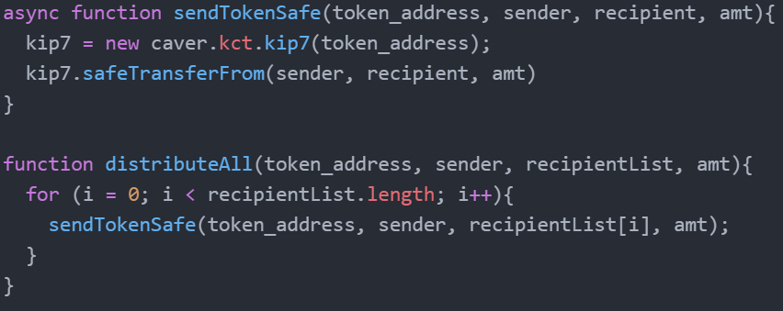
Demo – Vote distribution
Node.js

Slide 12
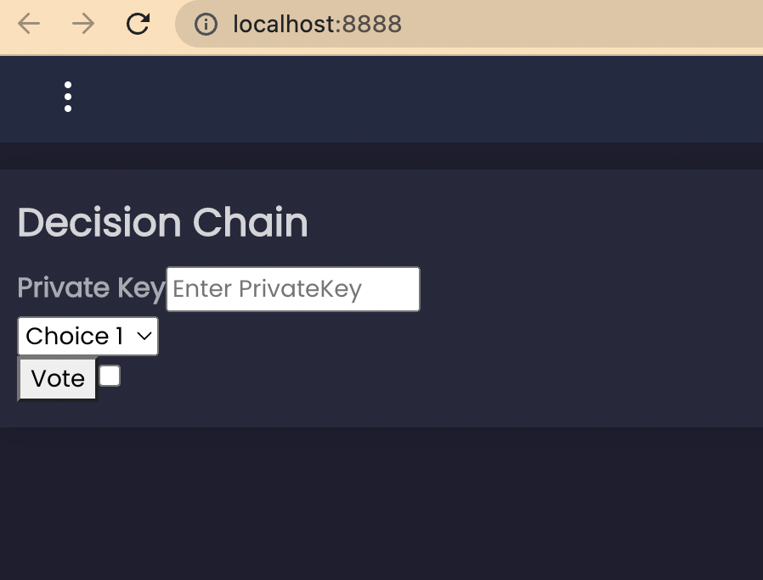
Demo – Voting Process

Slide 13
Applications of DecisionChain
1
Committee decision of company policy
2
Deciding lunch location in a friend group
3
Multiple-choice quizzes

Slide 14
References
Anthoula Malkopoulou (2020) Compulsory voting and right-wing populism: mobilisation, representation and socioeconomic inequalities, Australian Journal of Political Science, 55:3, 276-292, DOI: 10.1080/10361146.2020.1774507
Jafar U, Aziz MJA, Shukur Z. Blockchain for Electronic Voting System-Review and Open Research Challenges. Sensors (Basel). 2021 Aug 31;21(17):5874. DOI: 10.3390/s21175874. PMID: 34502764; PMCID: PMC8434614.
https://www.csuc.cat/en/serveis/vot-electronic-e-vot
https://www.nytimes.com/2020/11/03/us/elections/mail-ballot-counting-vote.html
https://www.theguardian.com/world/2017/aug/08/kenyans-queue-for-hours-to-vote-amid-fears-of-post-election-violence

