Slide 1
LLVM
Developed by University of
Illinois at Urbana-Champaign CIS dept
Cisc 471
Matthew Warner

Slide 2
LLVM Compiler System
LLVM = Low Level Virtual Machine
The LLVM Compiler Infrastructure
  Provides reusable components for building compilers
  Reduce the time/cost to build a new compiler
  Build static compilers, JITs, trace-based optimizers, ...
The LLVM Compiler Framework
  End-to-end compilers using the LLVM infrastructure
  C and C++ are robust and aggressive:
    Java, Scheme and others are in development
  Emit C code or native code for X86, Sparc, PowerPC

Slide 3
Three primary LLVM components
The LLVM Virtual Instruction Set
  The common language- and target-independent IR
  Internal (IR) and external (persistent) representation
A collection of well-integrated libraries
  Analyses, optimizations, code generators, JIT compiler, garbage collection support, profiling, …
A collection of tools built from the libraries
  Assemblers, automatic debugger, linker, code generator, compiler driver, modular optimizer, …

Slide 4
The LLVM C/C++ Compiler
From the high level, it is a standard compiler:
  Compatible with standard makefiles
  Uses GCC 3.4 C and C++ parser
Distinguishing features:
  Uses LLVM optimizers, not GCC optimizers
  .o files contain LLVM IR/bytecode, not machine code
  Executable can be bytecode (JIT’d) or machine code
C file
llvmgcc
.o file
llvm linker
executable
C++ file
llvmg++
.o file
Compile Time
Link Time

Slide 5
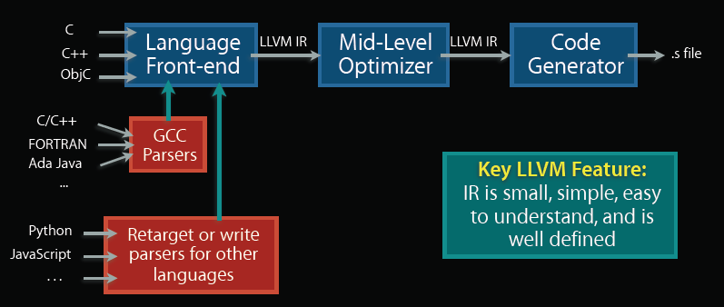
The LLVM C/C++ Compiler (cont)
Standard compiler organization, which uses LLVM as midlevel IR:
– Language specific front-end lowers code to LLVM IR
– Language/target independent optimizers improve code
– Code generator converts LLVM code to target (e.g. IA64) code

Slide 6
Looking into events at compile-time
C file
llvmgcc
.o file
C++ file
llvmg++
.o file
C to LLVM Frontend
Compile-time Optimizer
C++ to LLVM Frontend
Compile-time Optimizer
“cc1”
“gccas”
“cc1plus”
“gccas”
LLVM IR Parser
LLVM Verifier
40 LLVM Analysis & Optimization Passes
LLVM .bc File Writer
Modified version of GCC
Emits LLVM IR as text file
Lowers C AST to LLVM
Modified version of G++
Emits LLVM IR as text file
Lowers C++ AST to LLVM
Dead Global Elimination, IP Constant Propagation, Dead Argument Elimination, Inlining, Reassociation, LICM, Loop Opts, Memory Promotion, Dead Store Elimination, ADCE, …

Slide 7
Example Intermediate Representation
; Declare the string constant as a global constant...@.LC0 = internal constant [13 x i8] c"hello world\0A\00" ; [13 x i8]*
; External declaration of the puts functiondeclare i32 @puts(i8 *) ; i32(i8 *)*
; Definition of main functiondefine i32 @main() { ; i32()*
; Convert [13x i8 ]* to i8 *... %cast210 = getelementptr [13 x i8 ]* @.LC0, i64 0, i64 0 ; i8 *
; Call puts function to write out the string to stdout...
call i32 @puts(i8 * %cast210)
ret i32 0
}

Slide 8
Current Uses/Projects made with LLVM
Register Allocation solving by Using Puzzle Solving techniques
Scheme compiler
JIT Compiler for LLVM bytecode

Slide 9
Future of LLVM
Currently a partial version of the Java compiler exists and need to be extended
Improve optimizations for performance
  Most of LLVM’s current optimizations are performance based, need optimizations for size

