Slide 1
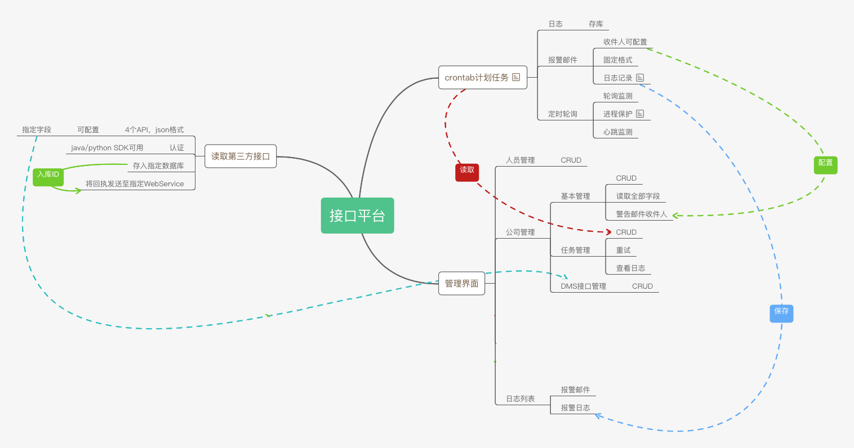

Slide 2
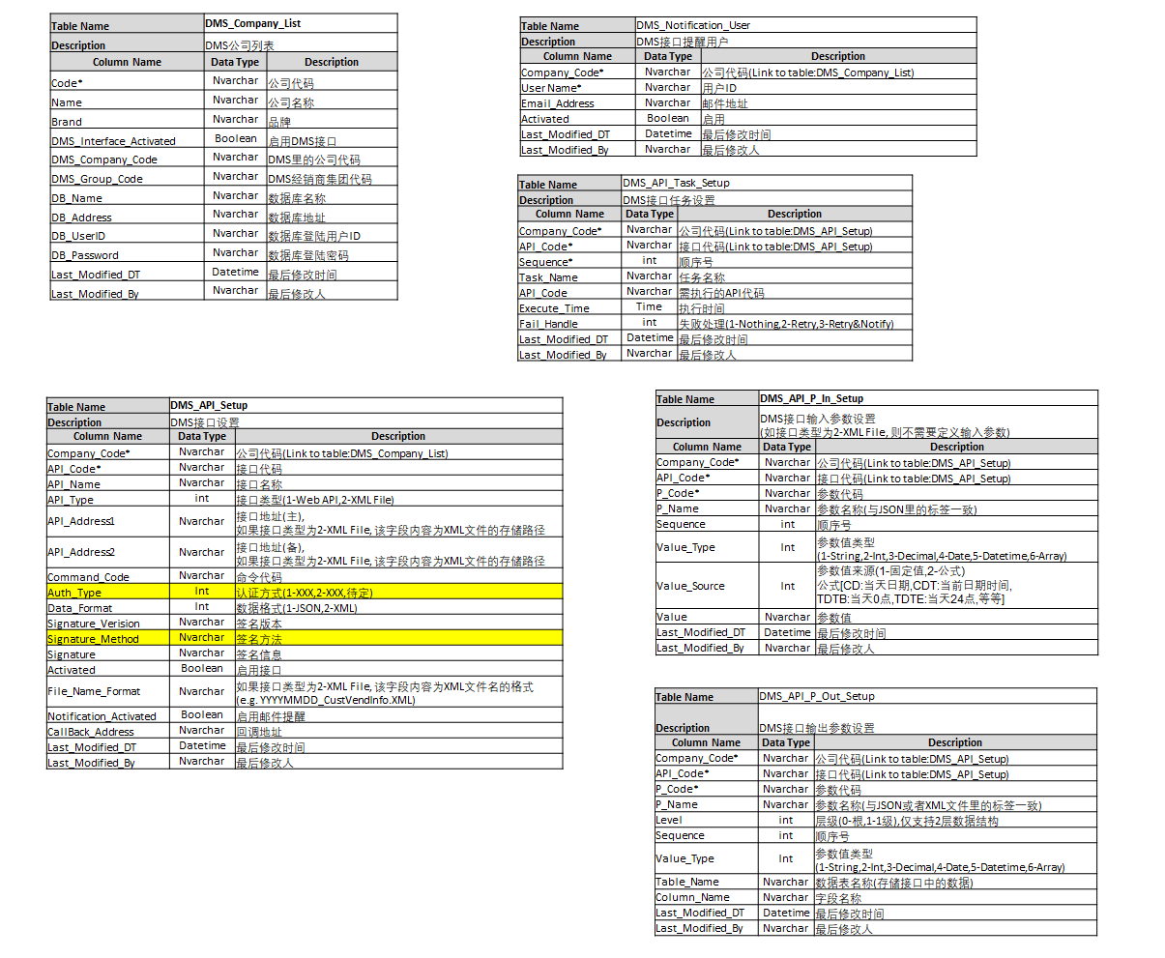
DMS Interface

Slide 3
System

Slide 4
NAV Table (CustVendBuffer & FABuffer)

Slide 5
NAV Table (InvoiceHeaderBuffer, InvoiceLineBuffer & OtherBuffer)

