Slide 1
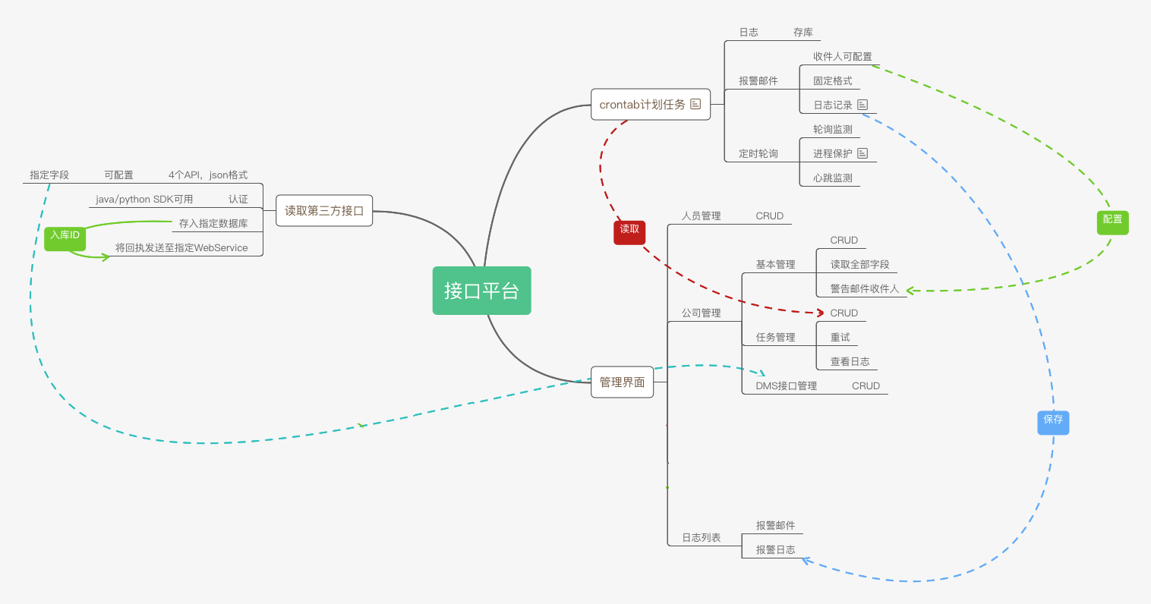

Slide 2
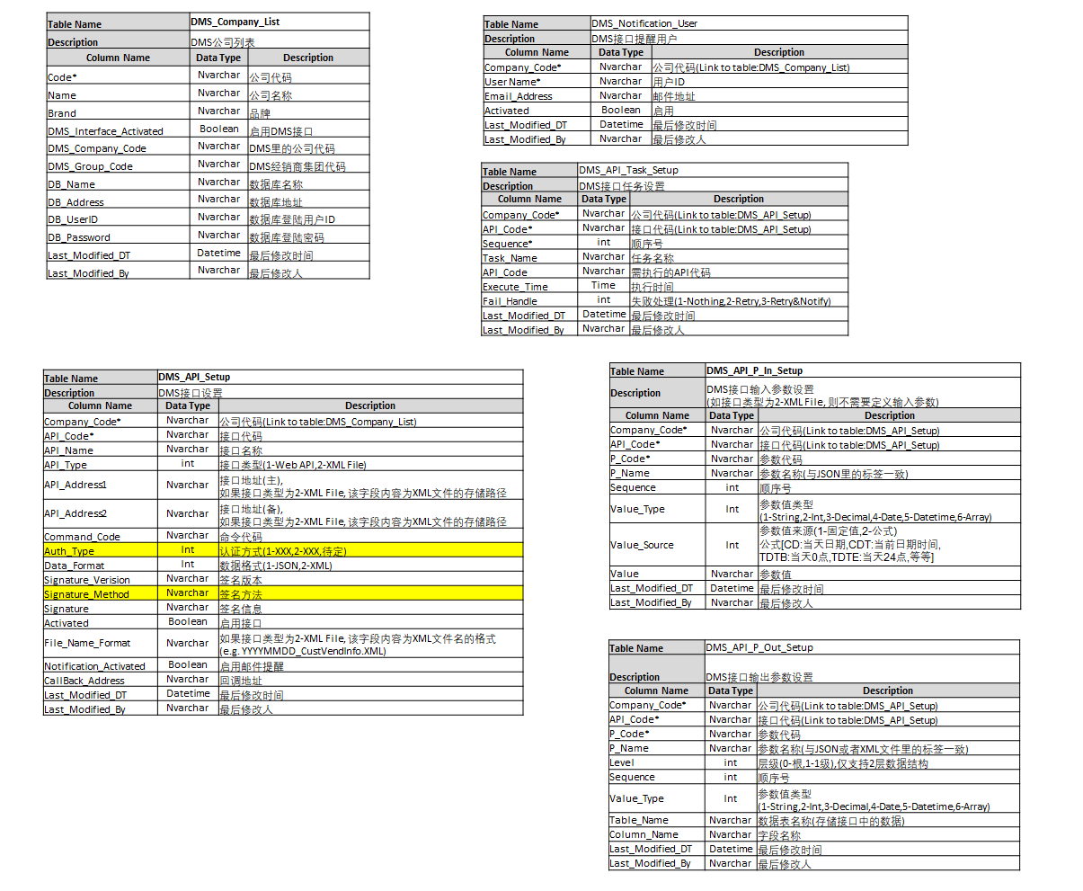
DMS Interface

Slide 3
System

Slide 4
NAV Table (CustVendBuffer & FABuffer)

Slide 5
NAV Table (InvoiceHeaderBuffer, InvoiceLineBuffer & OtherBuffer)

Slide 6
NAV Web API (SOAP)
RUL: http://62.234.26.35:7047/DynamicsNAV/WS/Codeunit/DMSWebAPI
UserID:NAVWebUser
Passowrd:Hytc_1qaz@WSX
Example: http://62.234.26.35:7047/DynamicsNAV/WS/K302%20Zhuhai%20JJ/Codeunit/DMSWebAPI
HandleCVInfoWithEntryNo
Parameter In:
EntryNo
CalledBy: (0-System,1-Form)
HandleFAWithEntryNo
Parameter In:
EntryNo
CalledBy: (0-System,1-Form)
HandleInvoiceWithEntryNo
Parameter In:
EntryNo
CalledBy: (0-System,1-Form)
HandleOtherWithEntryNo
Parameter In:
EntryNo
CalledBy: (0-System,1-Form)

