Slide 1
Secure data hiding in images using Steganography
CAPSTONE PROJECT
Presented By: Lakshminarayanan P S
Student Name : Lakshminarayanan P S
College Name & Department : Nitte Meenakshi Institute of Technology (Diploma CS)

Slide 2
OUTLINE
Problem Statement
Technology used
Wow factor
End users
Result
Conclusion
Git-hub Link
Future scope

Slide 3
Problem Statement
Digital data protection is of utmost importance, especially for sensitive data. Conventional encryption is complicated and needs to be stored separately. This project provides an easy-to-use image-based encryption and decryption process, hiding messages securely within images. Password protection guarantees access to authorized persons only. It overcomes the issues of insecure text dissemination, plaintext data exposure, and the unavailability of accessible encryption for non-technical users.

Slide 4
Technology used
Programming Language:
Python – Used for building encryption and decryption logic.
Libraries & Frameworks:
OpenCV – Handles image processing and manipulation.
Numpy – Supports array-based operations for embedding messages.
PyQt6 – Creates a user-friendly GUI for encryption and decryption.
Platforms:
Runs on Windows, Linux and macOS with python and the above frameworks installed

Slide 5
Wow factors
Steganography-based encryption – Instead of traditional encryption, the message is embedded within the pixel values of an image.
User-friendly GUI – No need for command-line operations; everything is handled through an interactive interface.
Password protection - The message can only be decrypted with the correct password, adding a layer of security.
Error Handling with QMessageBox - The code includes error handling for various scenarios
Sequential Data Embedding - he way in which the data is embedded is sequential. The length of the password, then the length of the message, then the password itself, and then the message itself are all written to the image in order.

Slide 6
End users
Cybersecurity specialist – Storing confidential information.
Cybersecurity Enthusiasts – To explore encryption steganography techniques.
Students & Researchers - Learn about cryptography and image processing.
Photography & Designers – Protect copyright information within images.
General Users – Hide private messages or data securely within images.

Slide 7
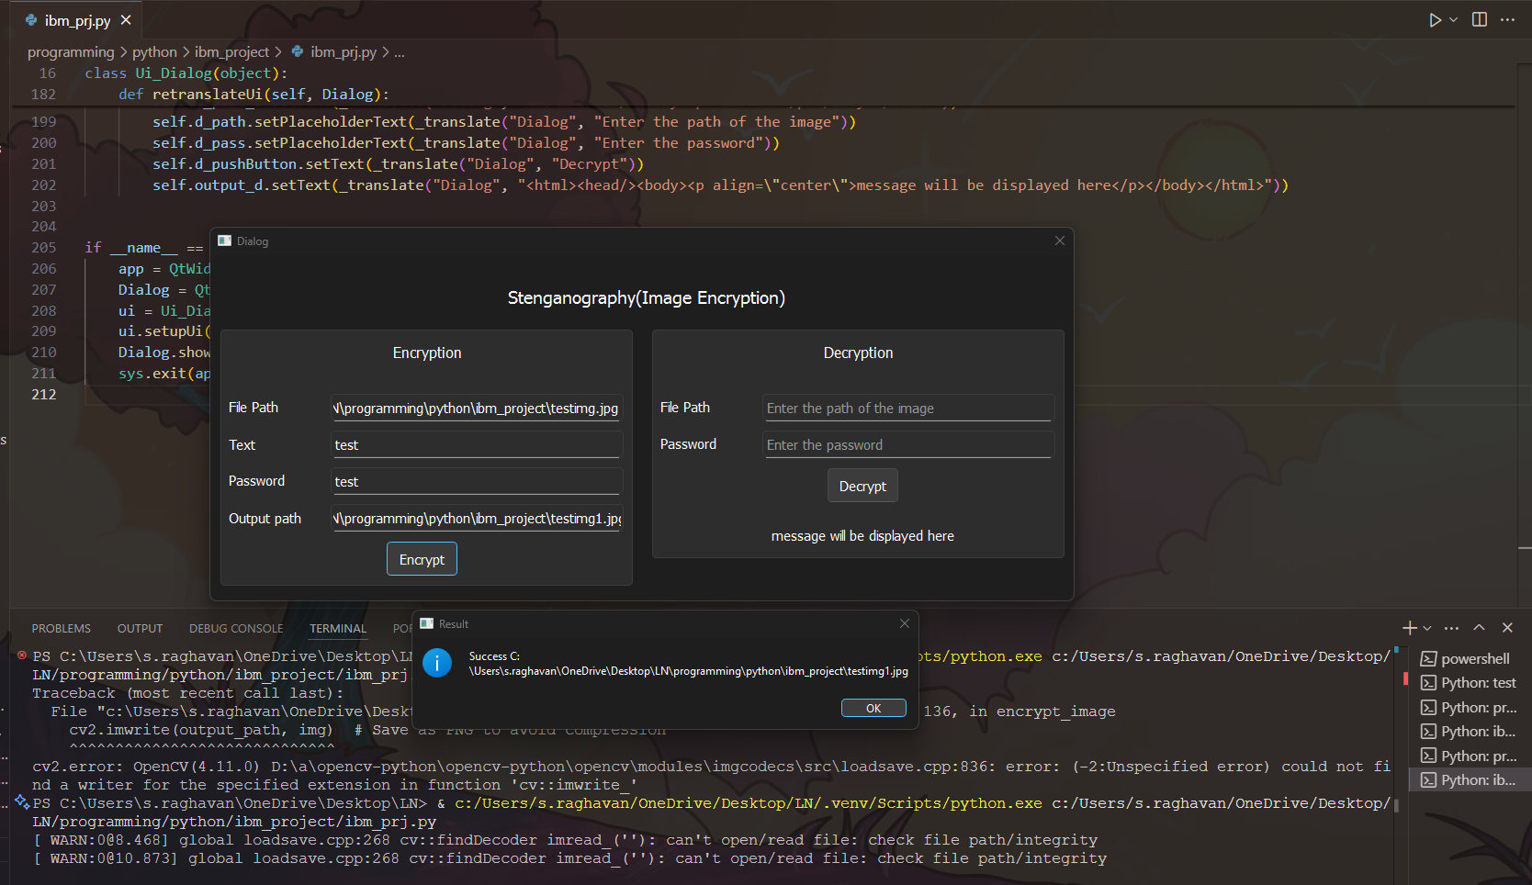
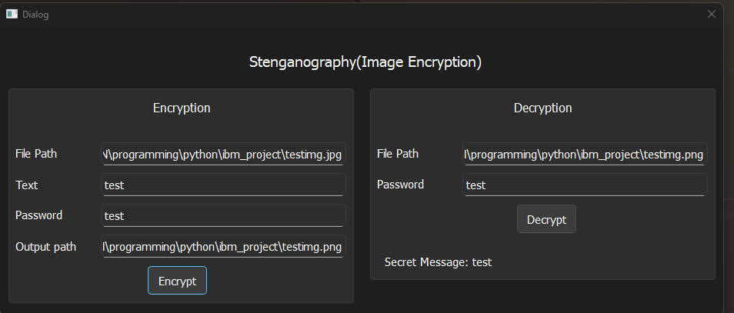
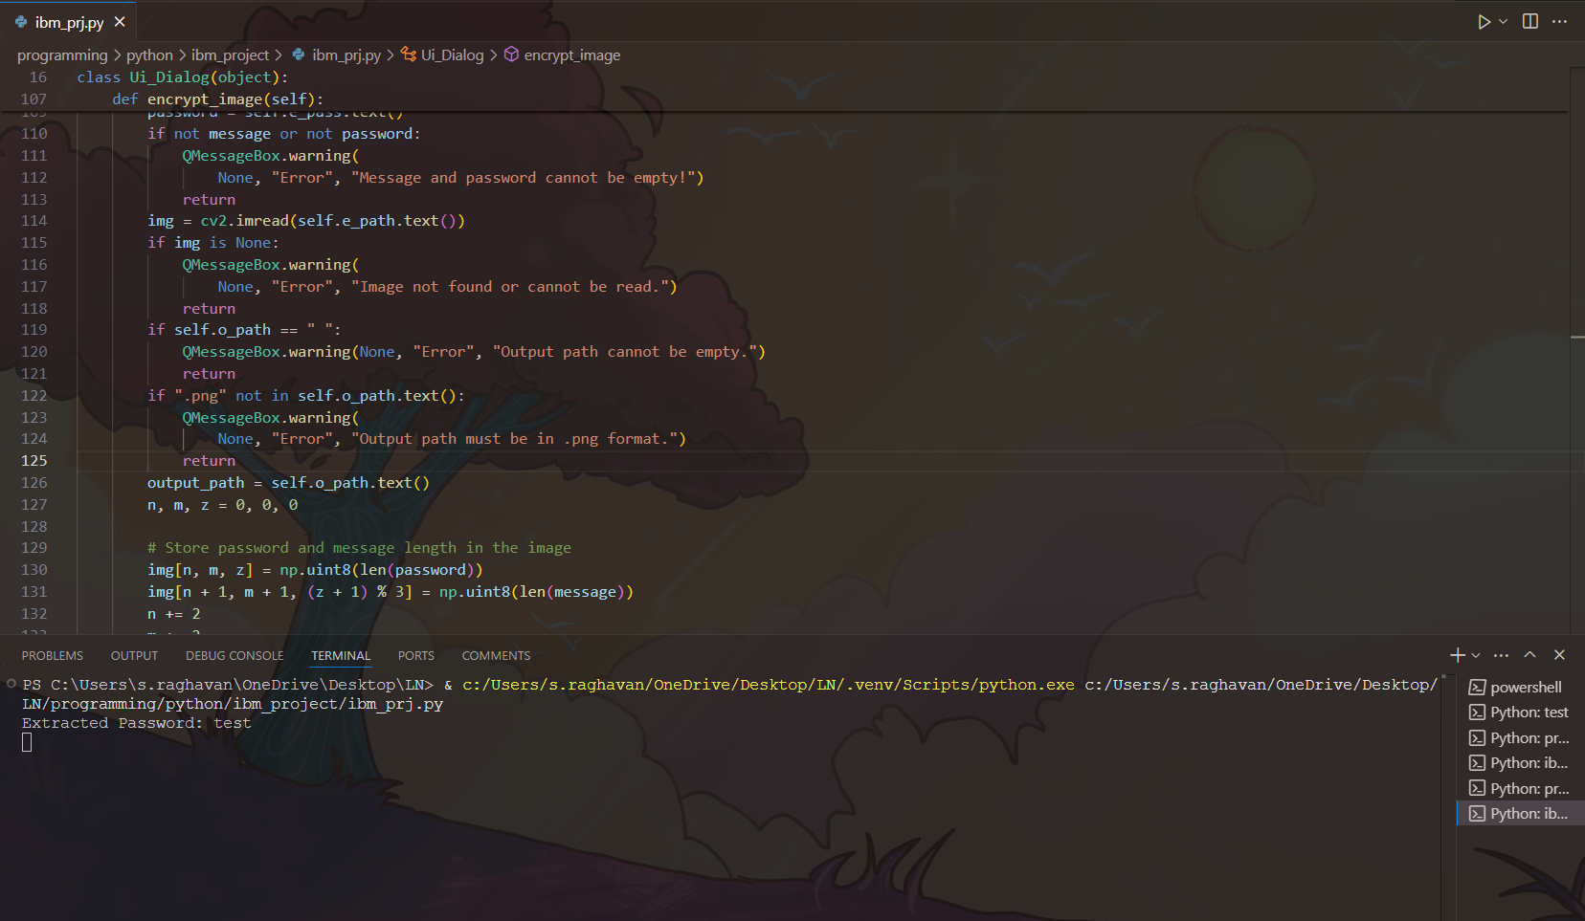
Results
Encryption
Decryption
Password extraction(for password matching)

Slide 8
Conclusion
This project offers an easy-to-use method for securely hiding messages inside images, using steganography and password protection. Its intuitive graphical interface makes it accessible to everyone, regardless of technical skill. Leveraging OpenCV and NumPy ensures quick and efficient message embedding and retrieval without noticeably altering the image. This project showcases a practical application of image-based cryptography for secure communication.

Slide 9
GitHub Link
https://github.com/shinigami42-42/AICTE_Steganography.git
Encrypted image couldn’t be added as it was too large.

Slide 10
Future scope(optional)
Implement more robust encryption algorithms.
Include support for additional image types.
Enhance input validation and error handling.
Improve the GUI to have progress bars and more informative feedback.
Include a choice to choose the image file through a file dialog.
Include provisions to add more pixel data to use, to expand message capacity.

Slide 11
THANK YOU

