Slide 1
基于Clang的LLVM前端简析
中科院软件所PLCT实验室 史宁宁
2023-07-15

Slide 2
Contents
Structure of Clang
FrontendAction
Preprocessor && Lexer
Parser
Sema
CodeGen
Clang Tools

Slide 3
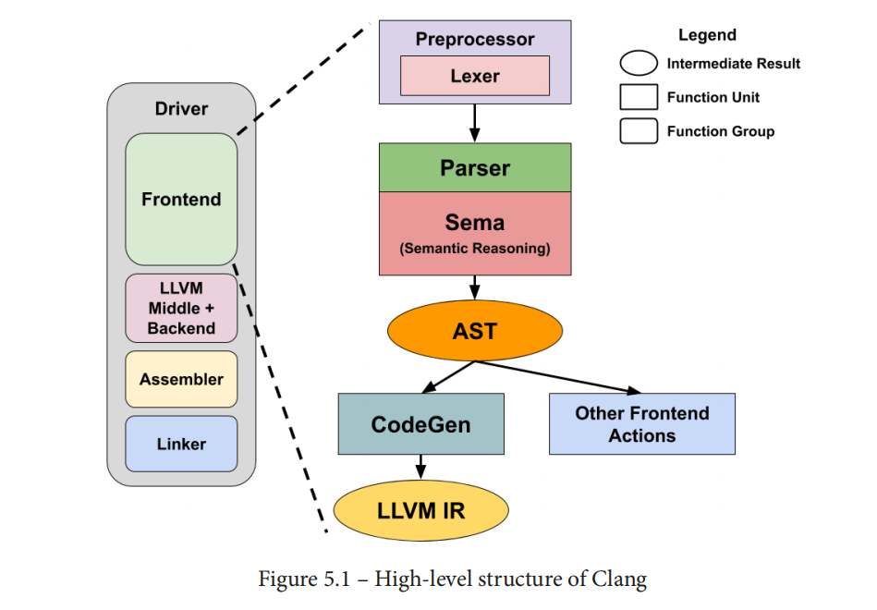
High-level structure of Clang
From: <LLVM Techniques, Tips, and Best Practices – Clang and Middle-End Libraries> P75

Slide 4
Contents
Structure of Clang
FrontendAction
Preprocessor && Lexer
Parser
Sema
CodeGen
Clang Tools

Slide 5
FrontendAction
Abstract base class for actions which can be performed by the frontend.[1]
源代码：
llvm/clang/include/clang/Frontend/FrontendAction.h
llvm/clang/lib/ Frontend/FrontendAction.cpp
子类：
clang::ASTFrontendAction
clang::PreprocessorFrontend
[1]. https://clang.llvm.org/doxygen/classclang_1_1FrontendAction.html

Slide 6
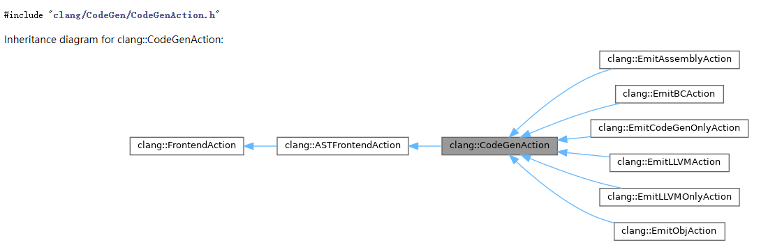
CodeGenAction
Create a new code generation action.[1]
From: https://clang.llvm.org/doxygen/classclang_1_1CodeGenAction.html

Slide 7
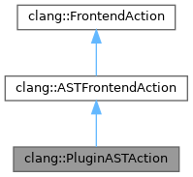
PluginASTAction
From: https://clang.llvm.org/doxygen/classclang_1_1PluginASTAction.html

Slide 8
Contents
Structure of Clang
FrontendAction
Preprocessor && Lexer
Parser
Sema
CodeGen
Clang Tools

Slide 9
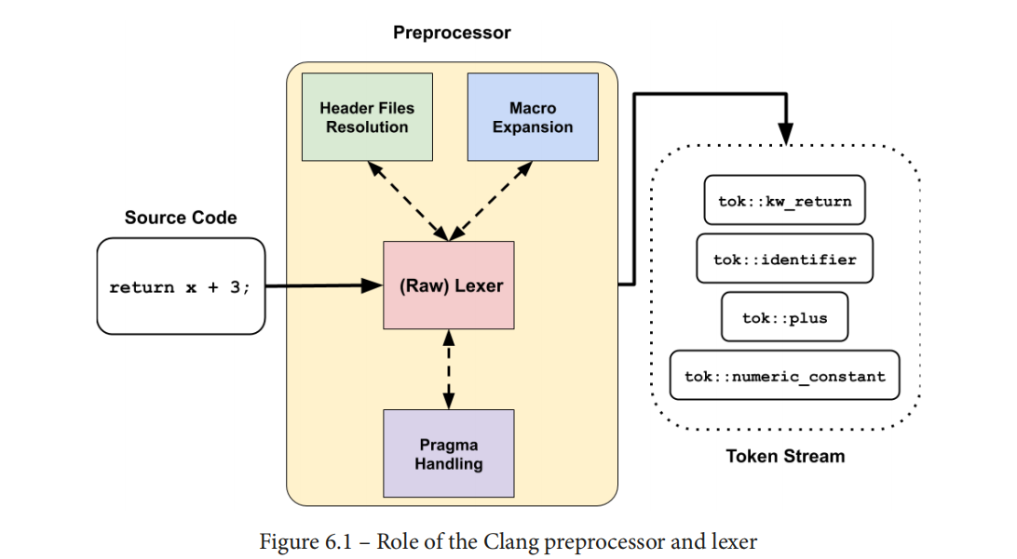
Preprocessor and Lexer
From: <LLVM Techniques, Tips, and Best Practices – Clang and Middle-End Libraries> P92

Slide 10
Contents
Structure of Clang
FrontendAction
Preprocessor && Lexer
Parser
Sema
CodeGen
Clang Tools

Slide 11
Abstract Syntax Tree(AST)
The result of the parsing process is an AST. The AST is another compact representation of the input program. [1]
The AST is constructed during parsing. The semantic analysis checks that the tree adheres to the meaning of the language (for example, that used variables are declared) and possibly augments the tree. After that, the tree is used for code generation. [1]
[1]. <Learn LLVM 12> P58

Slide 12
TranslationUnitDecl
This class represents an input source file, also called a translation unit (most of the time). It contains all the top-level declarations – global variables, classes, and functions, to name a few – as its children, where each of those top-level declarations has its own subtree that recursively defines the rest of the AST.[1]
[1]. <LLVM Techniques, Tips, and Best Practices – Clang and Middle-End Libraries> P113

Slide 13
ASTContext
As its name suggests, this class keeps track of all the AST nodes and other metadata from the input source files. If there are multiple input source files, each of them gets its own TranslationUnitDecl, but they all share the same ASTContext.[1]
[1]. <LLVM Techniques, Tips, and Best Practices – Clang and Middle-End Libraries> P113

Slide 14
AST Nodes
The AST nodes – can be further classified into three primary categories: declaration, statement, and expression. The nodes in these categories are represented by subclasses derived from the Decl, Expr, and Stmt classes.[1]
[1]. <LLVM Techniques, Tips, and Best Practices – Clang and Middle-End Libraries> P113

Slide 15
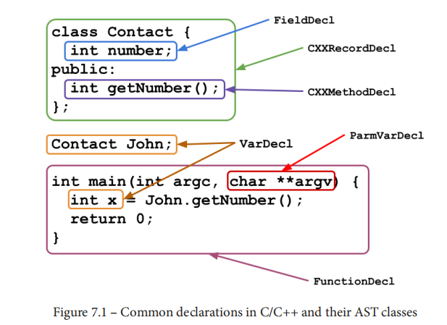
AST Nodes -- Declarations
[1]. <LLVM Techniques, Tips, and Best Practices – Clang and Middle-End Libraries> P114

Slide 16
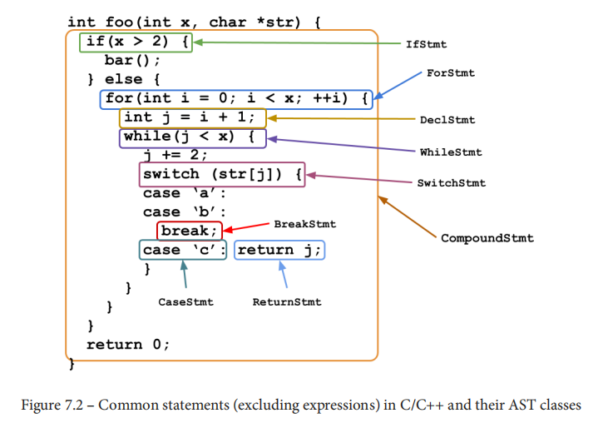
AST Nodes -- Statements
[1]. <LLVM Techniques, Tips, and Best Practices – Clang and Middle-End Libraries> P115

Slide 17
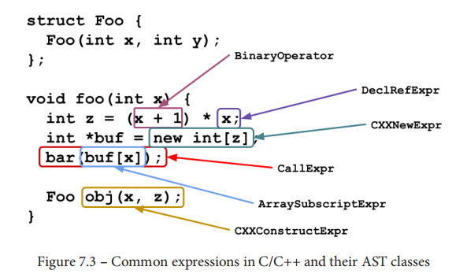
AST Nodes -- Expressions
[1]. <LLVM Techniques, Tips, and Best Practices – Clang and Middle-End Libraries> P116

Slide 18
AST’s Type System 1
The core of Clang AST's type system is the clang::Type class.
Each source code type is actually represented by a subclass of Type.
From: <LLVM Techniques, Tips, and Best Practices – Clang and Middle-End Libraries> P117

Slide 19
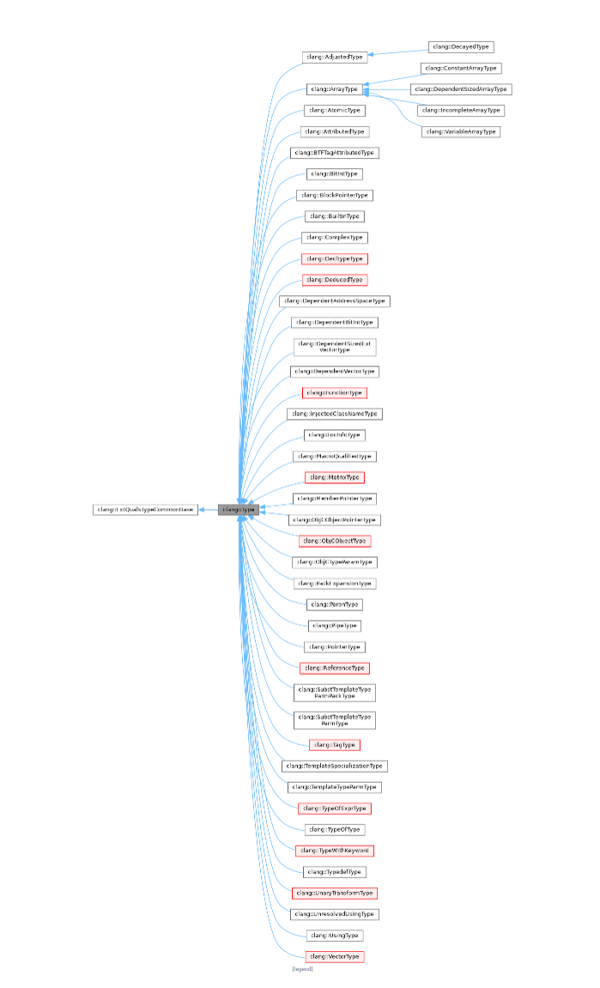
AST’s Type System 2
From: https://clang.llvm.org/doxygen/classclang_1_1Type.html

Slide 20
AST’s Type System 3
BuiltinType: For primitive types such as int, char, and float.
PointerType: For all the pointer types. It has a function called PointerType::getPointee() for retrieving the source code type being pointed to by it.
ArrayType: For all the array types. Note that it has other subclasses for more specific arrays that have either a constant or variable length.
RecordType: For struct/class/union types. It has a function called RecordType::getDecl() for retrieving the underlying RecordDecl.
FunctionType: For representing a function's signature; that is, a function's argument types and return type (and other properties, such as its calling convention).
From: <LLVM Techniques, Tips, and Best Practices – Clang and Middle-End Libraries> P117

Slide 21
ASTMatcher
ASTMatcher is the utility that helps you write AST pattern matching logic via a clean, concise, and efficient Domain-Specific Language (DSL).[1]
There are three different basic categories of matchers:
Node Matchers: Matchers that match a specific type of AST node.
Narrowing Matchers: Matchers that match attributes on AST nodes.
Traversal Matchers: Matchers that allow traversal between AST nodes.[2]
Matching the Clang AST https://clang.llvm.org/docs/LibASTMatchers.html
[1]. <LLVM Techniques, Tips, and Best Practices – Clang and Middle-End Libraries> P119
[2]. AST Matcher Reference https://clang.llvm.org/docs/LibASTMatchersReference.html

Slide 22
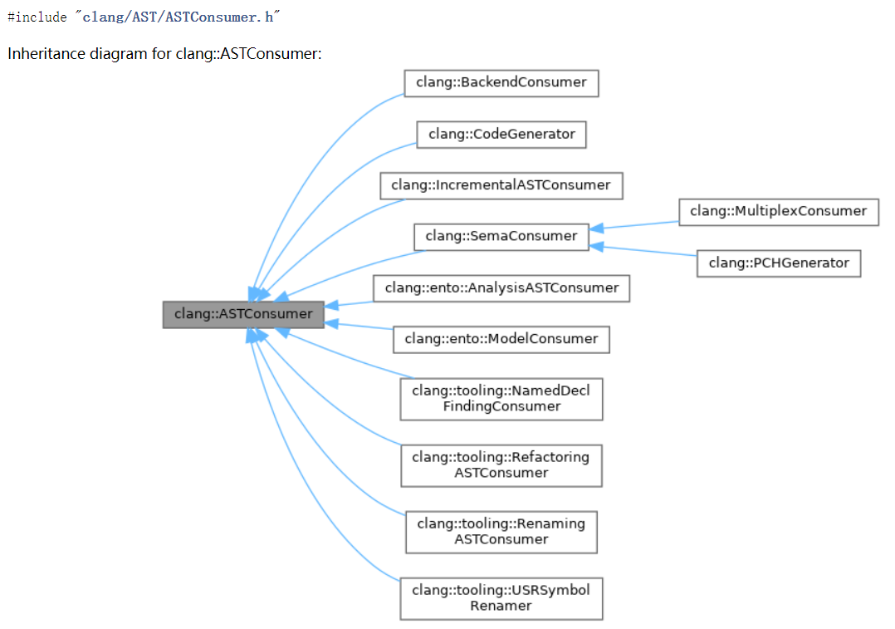
ASTConsumer
This is an abstract interface that should be implemented by clients that read ASTs.
From: https://clang.llvm.org/doxygen/classclang_1_1ASTConsumer.html

Slide 23
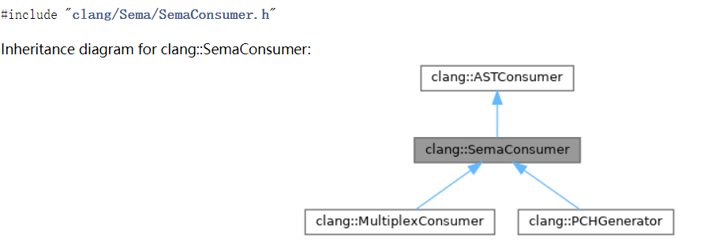
SemaConsumer
An abstract interface that should be implemented by clients that read ASTs and then require further semantic analysis of the entities in those ASTs.
From: https://clang.llvm.org/doxygen/classclang_1_1SemaConsumer.html

Slide 24
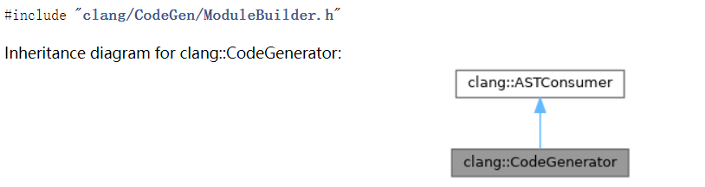
CodeGenerator
The primary public interface to the Clang code generator.
From: https://clang.llvm.org/doxygen/classclang_1_1CodeGenerator.html

Slide 25
Contents
Structure of Clang
FrontendAction
Preprocessor && Lexer
Parser
Sema
CodeGen
Clang Tools

Slide 26
Semantic
The semantic analyzer walks the AST and checks for various semantic rules of the language. [1]
Clang, on the other hand, does not traverse the AST after parsing. Instead, it performs type checking on the fly, together with AST node generation.[2]
[1]. <Learn LLVM 12> P61
[2]. <Getting Started with LLVM Core Library> P98

Slide 27
Contents
Structure of Clang
FrontendAction
Preprocessor && Lexer
Parser
Sema
CodeGen
Clang Tools

Slide 28
CodeGen
If the compiler driver used the CodeGenAction frontend action, this client will be BackendConsumer, which will traverse the AST while generating LLVM IR that implements the exact same behavior that is represented in the tree. The translation to LLVM IR starts at the top-level declaration, TranslationUnitDecl.[1]
[1]. <Getting Started with LLVM Core Library> P99

Slide 29
CodeGenAction
Create a new code generation action.[1]
From: https://clang.llvm.org/doxygen/classclang_1_1CodeGenAction.html

Slide 30
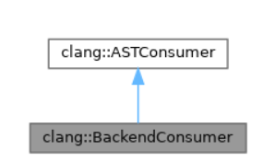
BackendConsumer
llvm/clang/lib/CodeGen/CodeGenAction.cpp
https://clang.llvm.org/doxygen/classclang_1_1BackendConsumer.html

Slide 31
CodeGenerator
The primary public interface to the Clang code generator.
From: https://clang.llvm.org/doxygen/classclang_1_1CodeGenerator.html

Slide 32
Contents
Structure of Clang
FrontendAction
Preprocessor && Lexer
Parser
Sema
CodeGen
Clang Tools

Slide 33
Clang Plugins
Clang Plugins make it possible to run extra user defined actions during a compilation. [1]
A Clang plugin allows you to dynamically register a new FrontendAction (more specifically, an ASTFrontendAction) that can process the AST either before or after, or even replace, the main action of clang. [2]
[1]. https://clang.llvm.org/docs/ClangPlugins.html
[2]. <LLVM Techniques, Tips, and Best Practices – Clang and Middle-End Libraries> P82

Slide 34
libTooling
LibTooling is a library to support writing standalone tools based on Clang.[1]
Tools built with LibTooling, like Clang Plugins, run FrontendActions over code.[1]
LibTooling is a library that provides features for building standalone tools on top of Clang‘s techniques. [2]
[1]. https://clang.llvm.org/docs/LibTooling.html
[2]. <LLVM Techniques, Tips, and Best Practices – Clang and Middle-End Libraries> P83

Slide 35
libclang
The C Interface to Clang provides a relatively small API that exposes facilities for parsing source code into an abstract syntax tree (AST), loading already-parsed ASTs, traversing the AST, associating physical source locations with elements within the AST, and other facilities that support Clang-based development tools.[1]
This C interface to Clang will never provide all of the information representation stored in Clang's C++ AST, nor should it: the intent is to maintain an API that is relatively stable from one release to the next, providing only the basic functionality needed to support development tools.[1]
Source code: llvm/clang/tools/libclang
libclang example： https://github.com/shining1984/screader
[1]. https://clang.llvm.org/doxygen/group__CINDEX.html#details

Slide 36
Thanks!

