Slide 1
聊聊我最近读的编译器后端的论文
中科院软件所PLCT实验室 史宁宁
（知乎：小乖他爹）
2022年1月23日

Slide 2
目录
基本情况
寄存器分配
指令选择

Slide 3
目录
基本情况
寄存器分配
指令选择

Slide 4
缘起-写作需要
目前，已经完成了两本编译器领域书籍的书稿，《华为方舟编译器之美》已经出版并且加印一次，《Android Runtime源码解析》将于2022年上半年上市。并且，计划在2022年带领团队完成一本有关OpenJDK for RISC-V的书稿。
在写作的过程中，发现在相关理论解释的时候，展开度不够，旁征博引的内容偏少，不能给读者一个更加宽广的知识面，不能举重若轻的谈笑间指点江山。
自己有希望在将来的书籍写作中能有所改善，能让读者更加轻松快乐的学到更多东西。同时，还希望将来能写一本理论结合实践（代码）的编译器书籍，既要包含基础的理论知识及其简要发展历史，还要有工业界普遍的实现，同时还要不局限于某个编译器/解释器。这就需要大量的理论知识做基础。

Slide 5
缘起-关注点转换
这些年陆陆续续接触了不少工业级别的编译器/解释器：LLVM/Clang、Tenon、方舟编译器、ART、OpenJDK，很多时候自己了解和熟悉的理论方面内容是跟着代码实现在走的，对于理论的发展历史、最初解决问题的方式以及该领域的整体情况，都掌握的不够多，缺乏了解。
随着知识网络的拓宽，补齐自己的知识网络，为之前没有关注的内容补齐基本的内容，也就成了一个急需完成的事情。
同时，关注点一直在工业化的代码层面，也容易让自己的思维被目前这几种固定模式所局限，逐渐复杂化。忘了理论问题的出发点和走过的历程。

Slide 6
阅读原则
不盲目追最新的论文内容
经典的综述论文
领域内最早的论文
领域发展过程中引发转折点的论文
介绍领域发展历程的论文

Slide 7
论文清单
1. A Survey on Register Allocation, Fernando Magno Quintao Pereira. 2008
2. A SURVEY OF REGISTER ALLOCATION TECHNIQUES, Jonathan Protzenko. 2009
3. Survey on Instruction Selection --An Extensive and Modern Literature Review, GABRIEL S. HJORT. 2013
4. Fifty years of peephole optimization, Pinaki Chakraborty. 2015
5. Peephole optimization, W. M. McKeeman. 1965

Slide 8
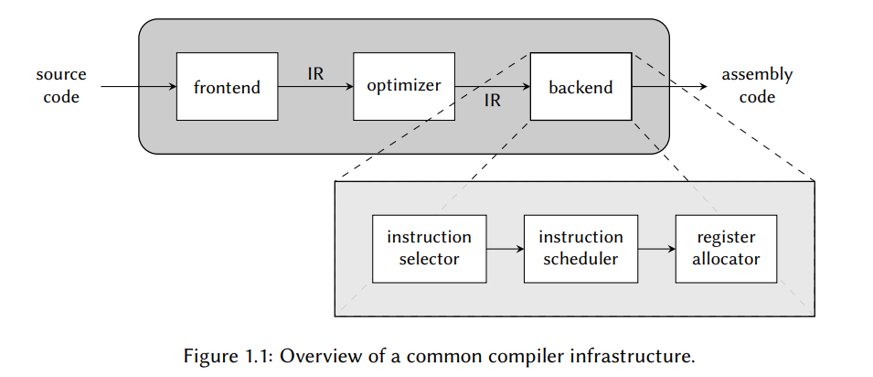
编译器后端
From:< Survey on Instruction Selection >P2

Slide 9
目录
基本情况
寄存器分配
指令选择

Slide 10
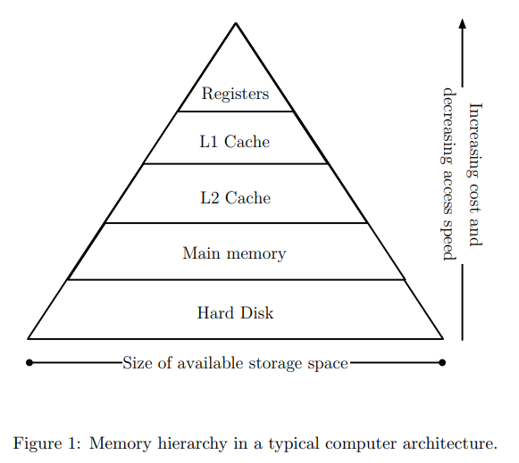
背景
From: A Survey on Register Allocation P2

Slide 11
常见问题
Spilling（溢出）
Coalescing（合并）

Slide 12
常见的方法
Graph Coloring
Linear Scan
Integer Linear Programming
Partitioned Quadratic Programming(Partitioned Boolean Quadratic Problem， PBQP)
Multi-Flow of Commodities(MFC)
SSA based register allocation

Slide 13
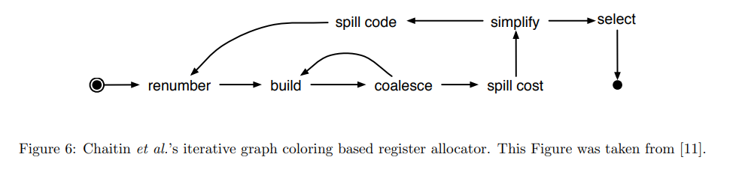
Graph Coloring-Chaitin
From:< A Survey on Register Allocation >P6

Slide 14
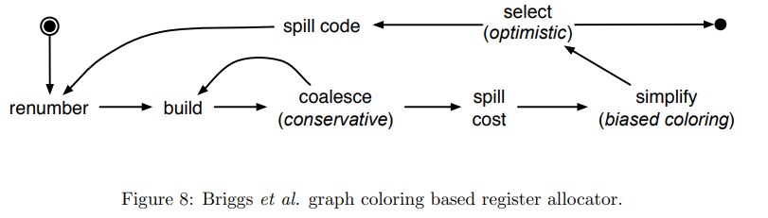
Graph Coloring-Briggs
比之前的Chaitin的算法，采用了更为保守的合并（coalesce）策略，只有当合并不会伤害到干涉图的着色能力时候，才会进行合并。同时，还进行了biased coloring。
图来自:< A Survey on Register Allocation >P7

Slide 15
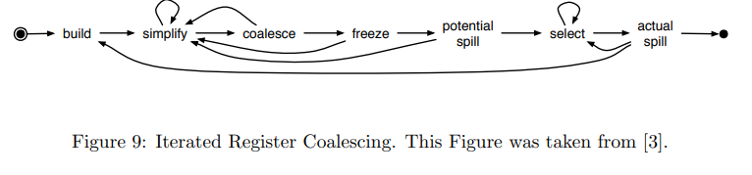
Graph Coloring-Iterated Register Coalescing
目前应用最广的图着色算法。
增量保守策略，只有保持图的着色能力不变时候才会去移除一个特别的移动指令。
图来自:< A Survey on Register Allocation >P8

Slide 16
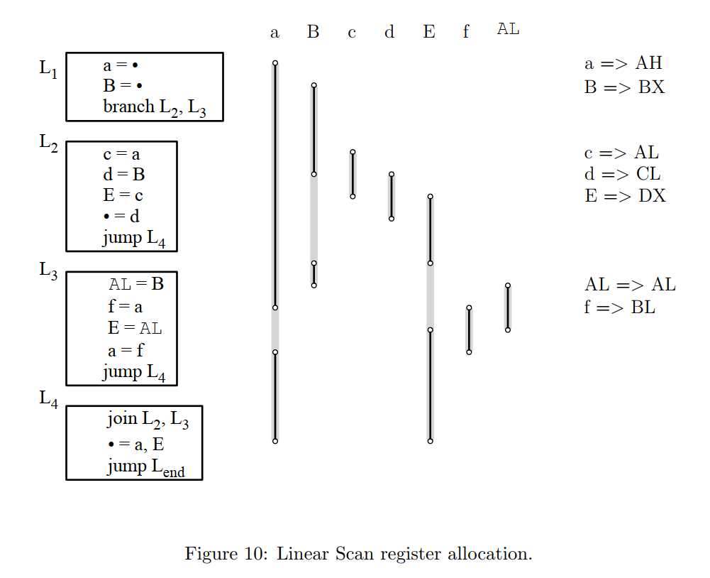
Linear Scan
The main appeal of linear scan is the allocation speed. This fact makes linear scan an attractive option to Just in Time (JIT) compilers, like Java HotSpot and LLVM.
From:< A Survey on Register Allocation >P8-9

Slide 17
Graph Coloring VS Linear Scan
Linear Scan is undoubtedly much faster at compile-time than graph-coloring based approaches.
At runtime, linear scan gives worse results than graph coloring.
Linear scan suffers from many defaults: always slower than iterated register coalescing, it doesn’t even try to coalesce variables.
Moreover, most programs are only compiled very infrequently: the goal of a program is to be run, after all.
From: <A SURVEY OF REGISTER ALLOCATION TECHNIQUES> P5

Slide 18
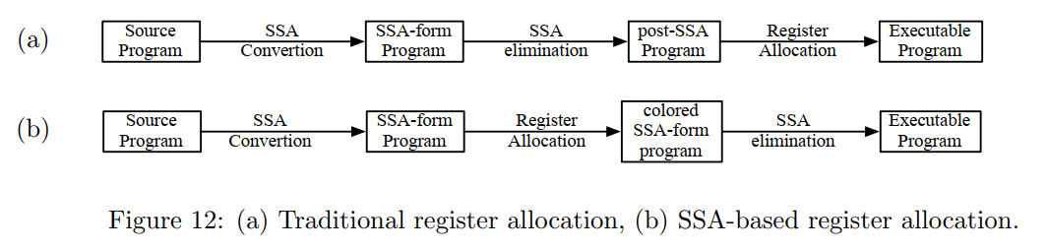
SSA based register allocation
From:< A Survey on Register Allocation >P12

Slide 19
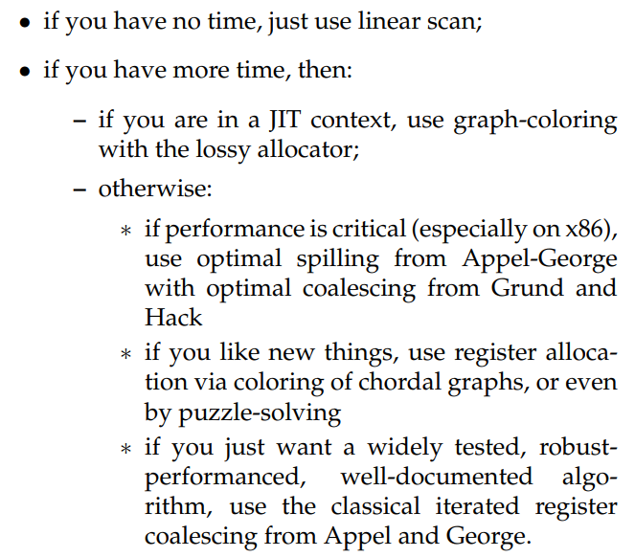
总结
From: <A SURVEY OF REGISTER ALLOCATION TECHNIQUES> P11

Slide 20
目录
基本情况
寄存器分配
指令选择

Slide 21
指令选择基础
To do this we need to decide which machine instructions of the target machine to use for implementing the IR code; this is the responsibility of the instruction selector.
指令选择可以分为两个部分：
pattern matching – detecting when and where it is possible to use a certain machine instruction;
pattern selection – deciding which instruction to choose in situations when multiple options exist.
From:< Survey on Instruction Selection >P3

Slide 22
指令选择分类
Macro expansion
Tree covering
DAG covering
Graph covering
Signle AST or IR node
Multiple AST or IR nodes

Slide 23
Peephole optimization
被替换指令和替换指令是否为同一种指令
中端IR优化
优化
Peephole
后端机器
指令优化
指令选择
所作用于的阶段

Slide 24
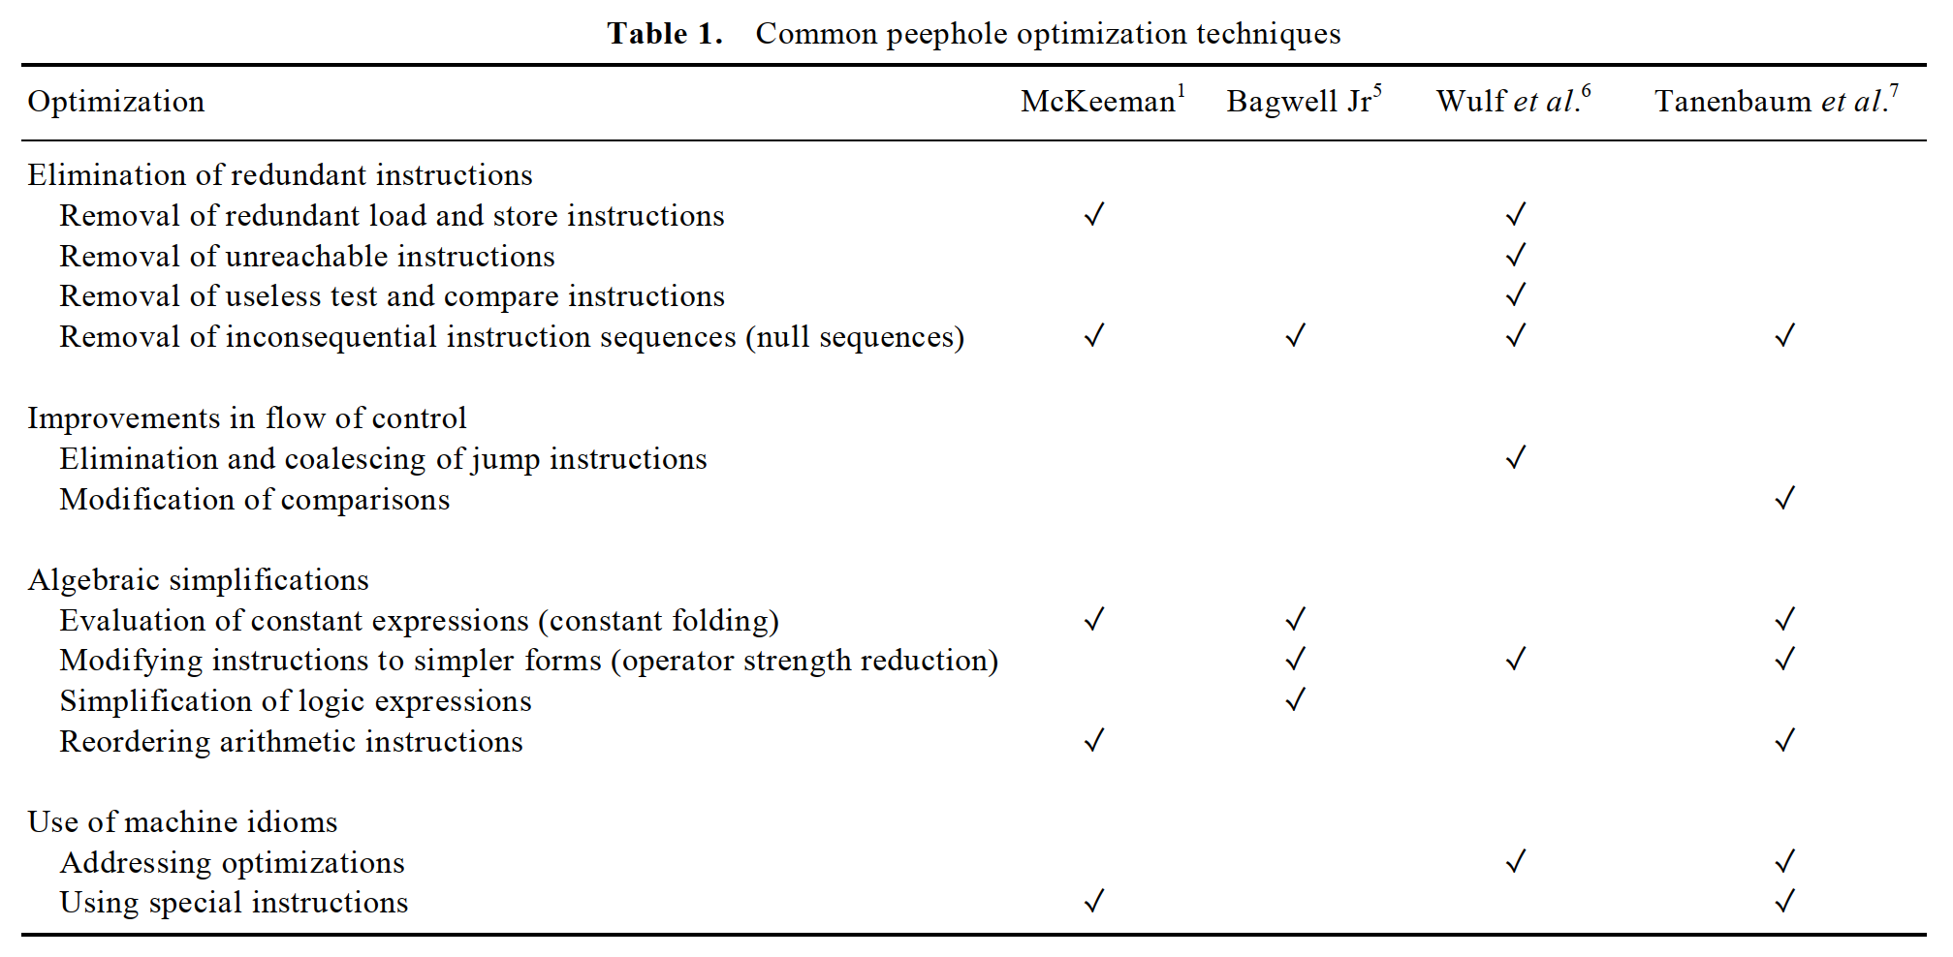
Common peephole optimization techniques
From:< . Fifty years of peephole optimization > P2187

Slide 25
New topics related to peephole optimization
The concept of peephole optimization can be extended from general purpose programing languages to domain-specific languages.
It will be interesting to see how object oriented programing can be used to realize peephole optimization.
Peephole optimization can be applied in just-in-time compilers too.
Peephole optimization can also be used in compilers for parallel computers.
Peephole optimization may be used to replace more energy consuming instruction sequences by equivalent but less energy-consuming instruction sequences.
From:< . Fifty years of peephole optimization > P2189-2190

Slide 26
Thanks！

