Slide 1
LLVM基础及Pass介绍
史宁宁
2019年6月8日

Slide 2


自我介绍
2012年6月开始做LLVM相关的项目
CSDN

Slide 3

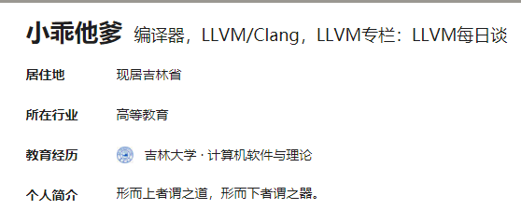
自我介绍
知乎

Slide 4
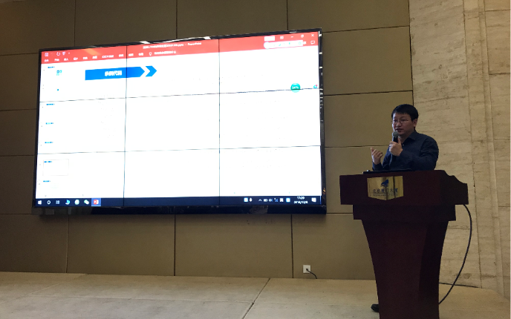
自我介绍
HelloLLVM 2018年上海站、杭州站
OSDT2018

Slide 5
目录
LLVM简介
LLVM IR
LLVM Backend
Pass的简介

Slide 6
LLVM简介

Slide 7
LLVM
The LLVM Project is a collection of modular and reusable compiler and toolchain technologies.
Notes:
http://llvm.org/

Slide 8
The primary sub-projects of LLVM
The primary sub-projects of LLVM
LLVM Core | Clang | LLDB | libc++
compiler-rt | OpenMP | polly | libc++ ABI
libclc | klee | SAFECode | LLD
Notes:
http://llvm.org/

Slide 9
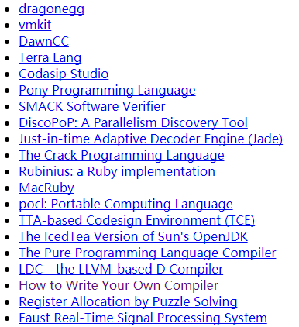
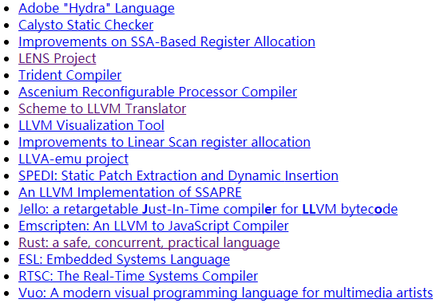
Projects built with LLVM
Projects built with LLVM

Slide 10

LLVM简介
Three Major Components of a Three-Phase Compiler
Notes:
http://www.aosabook.org/en/llvm.html

Slide 11
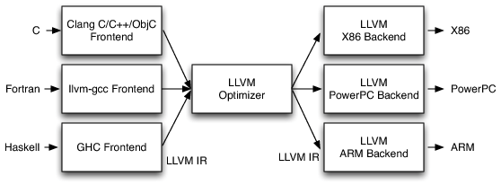
Three-Phase Design
Notes：From LLVM DOC：《Intro to LLVM:Book chapter providing a compiler hacker’s introduction to LLVM》

Slide 12
LLVM所支持的语言
C，C++，Ruby, Python, Haskell, Java, D, PHP, Pure, Lua,

Slide 13
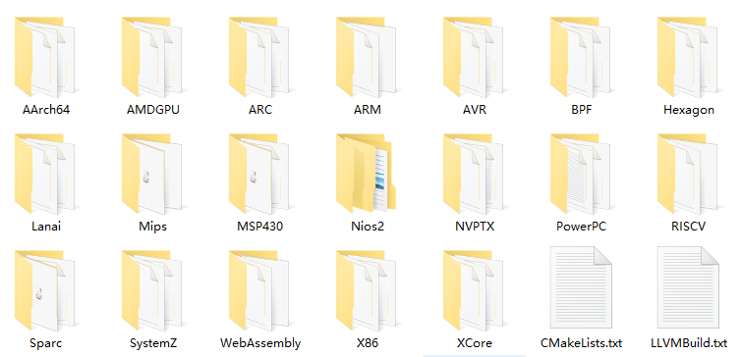
LLVM所支持的后端
Notes：This is the source code dir of LLVM 8.0.0，its location is LLVM/lib/Target/.
Notes:
LLVM8.0.0

Slide 14
LLVM IR

Slide 15
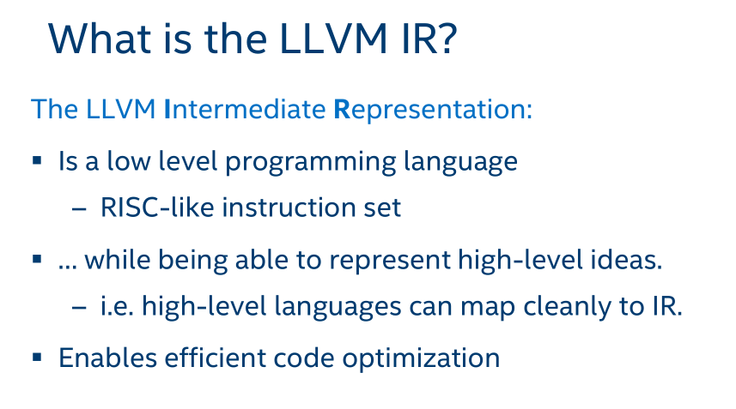
Notes:
Tutorial-Bridgers-LLVM_IR_tutorial.pdf

Slide 16
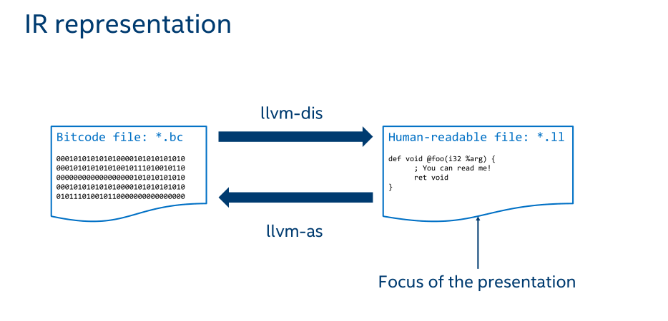
Notes:
Tutorial-Bridgers-LLVM_IR_tutorial

Slide 17
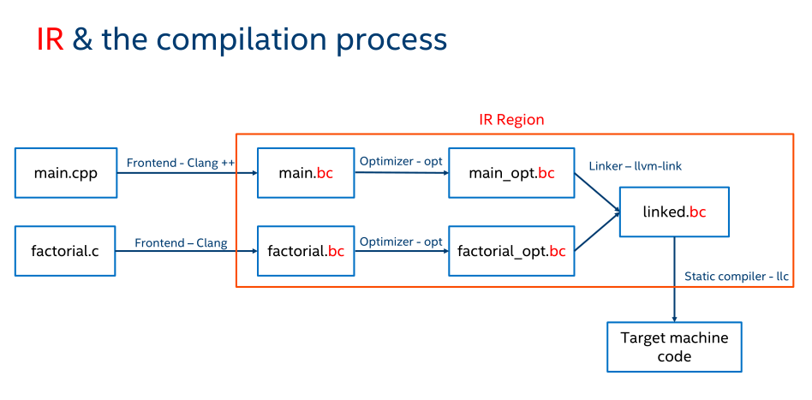

Slide 18
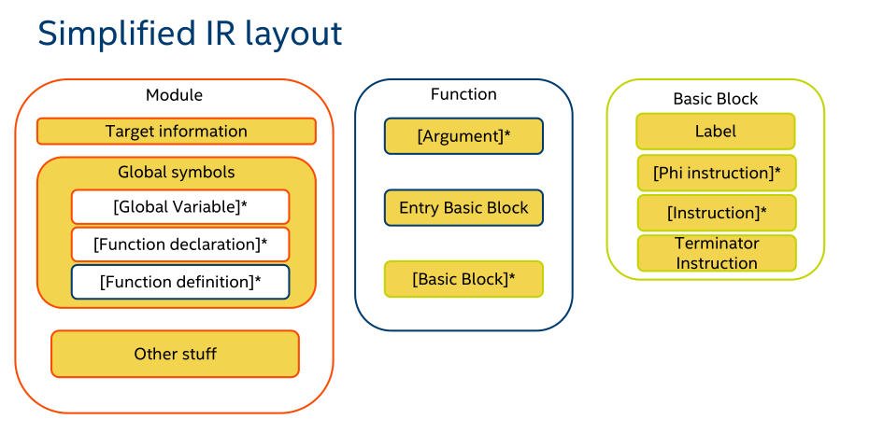

Slide 19
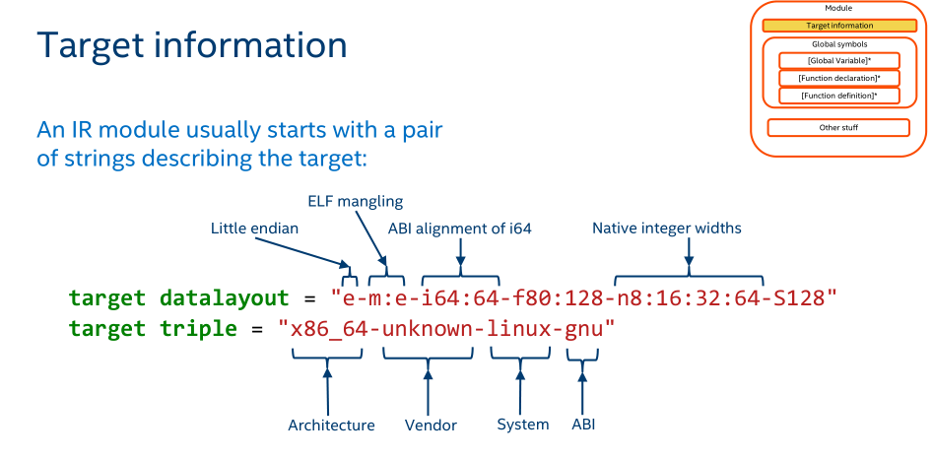

Slide 20
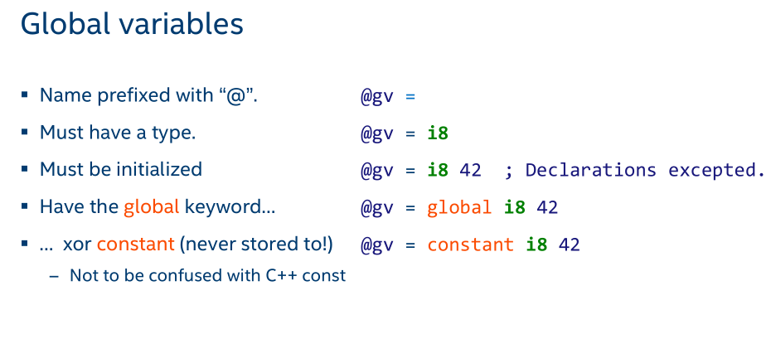

Slide 21
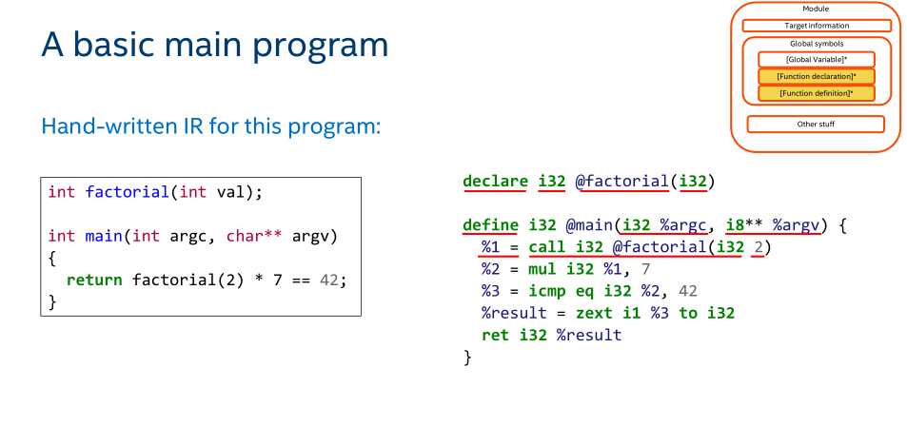

Slide 22
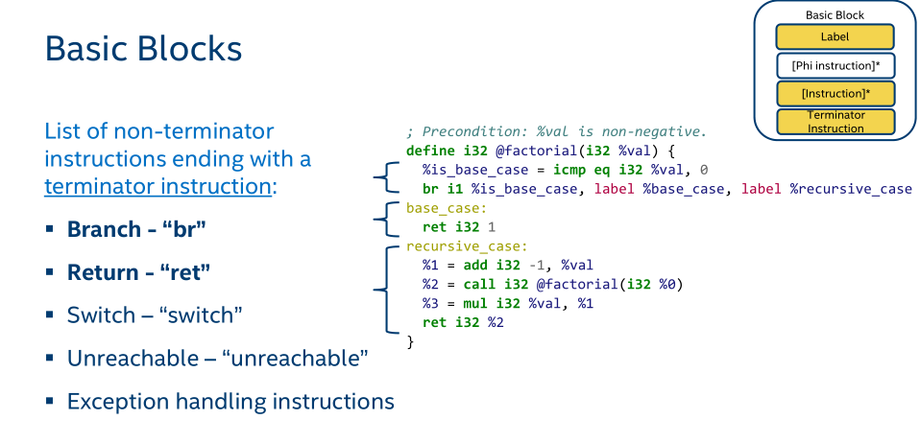

Slide 23
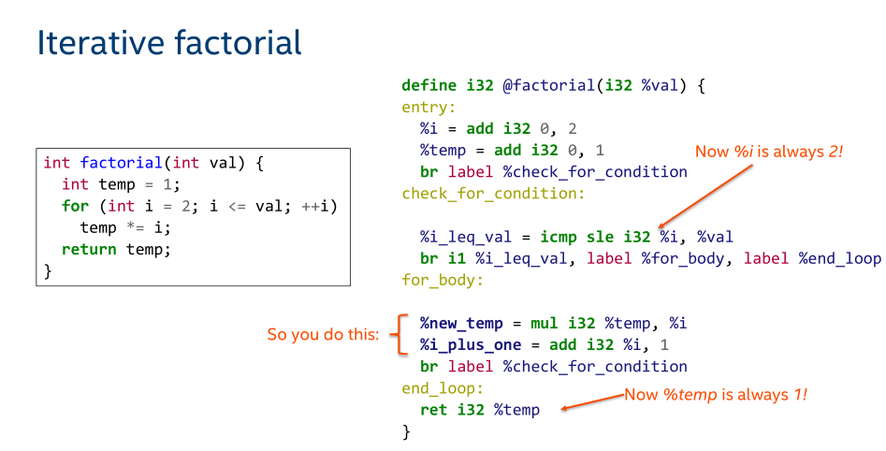

Slide 24
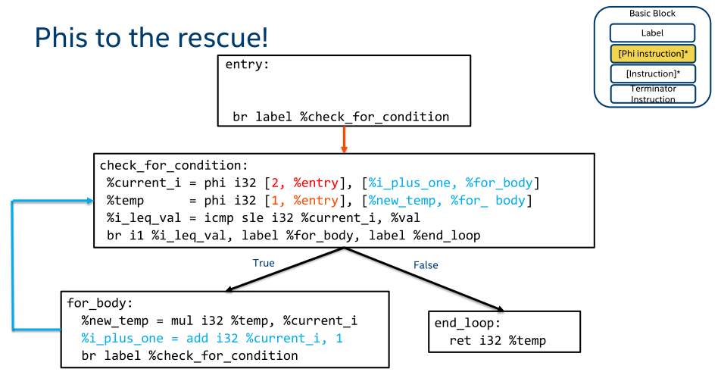

Slide 25
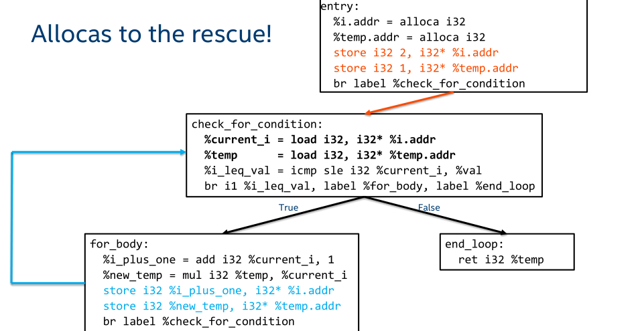

Slide 26
LLVM Backend

Slide 27
LLVM所支持的后端
Notes：This is the source code dir of LLVM 8.0.0，its location is LLVM/lib/Target/.
Notes:
LLVM8.0.0

Slide 28
The Special Backends
CBackend (LLVM3.0)
CPPBackend (LLVM 3.8)
The C backend does not require register allocation, instruction selection, or any of the other standard components provided by the system. As such, it only implements these two interfaces ( TargetMachine and DataLayout ), and does its own thing. Note that C backend was removed from the trunk since LLVM 3.1 release. ——《The LLVM Target-Independent Code Generator》
Notes：The screen shots from http://llvm.org/viewvc/llvm-project/.
Notes:
For example, the C backend does not require register allocation, instruction selection, or any of the other standard components provided by the system. As such, it only implements these two interfaces( TargetMachine and DataLayout ), and does its own thing. Note that C backend was removed from the trunk since LLVM 3.1 release. ——《The LLVM Target-Independent Code Generator》

Slide 29
The Special Backends
Emscripten compiles LLVM bitcode into JavaScript, which makes it possible to compile C and C++ source code to JavaScript (by first compiling it into LLVM bitcode using Clang), which can be run on the web.Emscripten itself is written in JavaScript.
WebAssembly backend is presently under development.
Notes:
http://llvm.org/ProjectsWithLLVM/#emscripten

Slide 30
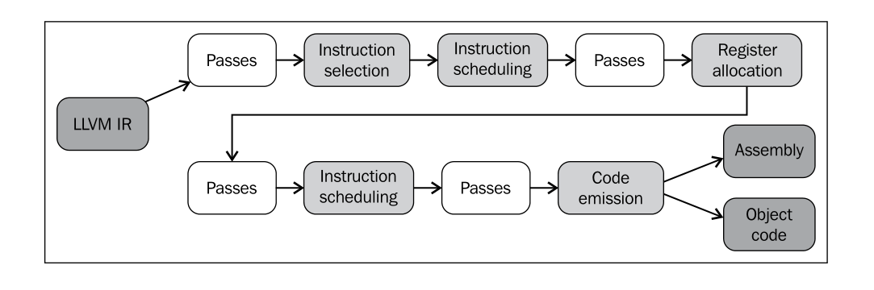
The Steps in LLVM Backend
Notes: 《Getting Started with LLVM Core Libraries》P134.

Slide 31
LLVM Pass

Slide 32
What is a pass
The LLVM Pass Framework is an important part of the LLVM system, because LLVM passes are where most of the interesting parts of the compiler exist. Passes perform the transformations and optimizations that make up the compiler, they build the analysis results that are used by these transformations, and they are, above all, a structuring technique for compiler code.

Slide 33
Pass的分类
Analysis passes compute information that other passes can use or for debugging or program visualization purposes.
Transform passes can use (or invalidate) the analysis passes. Transform passes all mutate the program in some way.
Utility passes provides some utility but don’t otherwise fit categorization.

Slide 34
Pass 实例
lib\Transforms\Hello\Hello.cpp -hello
Hello.cpp

Slide 35
常用的Pass类及其子类
llvm::Pass
llvm::ModulePass
llvm::FunctionPass
llvm::LoopPass
llvm::BasicBlockPass
llvm::CallGraphSCCPass
llvm::RegionPass

Slide 36
Pass类
Pass类的定义 Pass.h
virtual bool doInitialization(Module &) { return false; }
doInitialization - Virtual method overridden by subclasses to do any necessary initialization before any pass is run.
virtual bool doFinalization(Module &) { return false; }
doFinalization - Virtual method overriden by subclasses to do any
necessary clean up after all passes have run.

Slide 37
Pass类
virtual void getAnalysisUsage(AnalysisUsage &) const;
getAnalysisUsage - This function should be overriden by passes that need analysis information to do their job.
If a pass specifies that it uses a particular analysis result to this function, it can then use the getAnalysis<AnalysisType>() function, below.

Slide 38
FunctionPass
FunctionPass源码位置：Pass.h
This class is used to implement most global optimizations. Optimizations should subclass this class if they meet the following constraints:
1. Optimizations are organized globally, i.e., a function at a time.
2. Optimizing a function does not cause the addition or removal of any functions in the module

Slide 39
FunctionPass(文档)
All FunctionPass execute on each function in the program independent of all of the other functions in the program.(遍历)
FunctionPasses do not require that they are executed in a particular order.（无序）
FunctionPasses do not modify external functions.（内部）

Slide 40
FunctionPass（文档）
To be explicit, FunctionPass subclasses are not allowed to:
Inspect or modify a Function other than the one currently being processed.（单一）
Add or remove Functions from the current Module.（添加、删除函数）
Add or remove global variables from the current Module.（添加、删除全局变量）
Maintain state across invocations of runOnFunction (including global data).（不能跨runOnFunction 维持状态）

Slide 41
FunctionPass（文档）
virtual bool doInitialization(Module &M);
virtual bool runOnFunction(Function &F) = 0;
virtual bool doFinalization(Module &M);
FunctionPasses may overload three virtual methods to do their work. All of these methods should return true if they modified the program, or false if they didn’t.

Slide 42
FunctionPass子类实例1
LowerAllocations.cpp
doInitialization - For the lower allocations pass, this ensures that a module contains a declaration for a free function. This function is always successful.
bool LowerAllocations::doInitialization(Module &M) {
const Type *BPTy = Type::getInt8PtrTy(M.getContext());
FreeFunc = M.getOrInsertFunction("free" ,Type::getVoidTy(M.getContext()),
return true;
}

Slide 43
FunctionPass子类实例2
RegionInfo.h
class RegionInfoPass : public FunctionPass {
Detects single entry single exit regions in the control flow graph.
RegionInfo.cpp
void RegionInfoPass::getAnalysisUsage(AnalysisUsage &AU) const {
AU.setPreservesAll();
AU.addRequiredTransitive<DominatorTreeWrapperPass>();
AU.addRequired<PostDominatorTreeWrapperPass>();
AU.addRequired<DominanceFrontierWrapperPass>();
}

Slide 44
FunctionPass子类实例2
bool RegionInfoPass::runOnFunction(Function &F) {
releaseMemory();
auto DT = &getAnalysis<DominatorTreeWrapperPass>().getDomTree();
auto PDT = &getAnalysis<PostDominatorTreeWrapperPass>().getPostDomTree();
auto DF = &getAnalysis<DominanceFrontierWrapperPass>().getDominanceFrontier();
RI.recalculate(F, DT, PDT, DF);
return false;
}

Slide 45
FunctionPass子类实例演示
hello
instcount

Slide 46
Region
/// A simple control flow graph, that contains two regions.
///
/// 1
/// / |
/// 2 |
/// / \ 3
/// 4 5 |
/// | | |
/// 6 7 8
/// \ | /
/// \ |/ Region A: 1 -> 9 {1,2,3,4,5,6,7,8}
/// 9 Region B: 2 -> 9 {2,4,5,6,7}

Slide 47
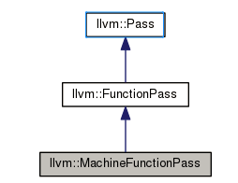
MachineFunctionPass
MachineFunctionPass 子类的结构图

Slide 48
MachineFunctionPass
MachineFunctionPass.h
virtual bool runOnMachineFunction(MachineFunction &MF) = 0;
runOnMachineFunction - This method must be overloaded to perform the desired machine code transformation or analysis.

Slide 49
MachineFunctionPass子类实例
MachineLoopInfo
include/llvm/CodeGen/MachineLoopInfo.h
MachineLoopInfo() : MachineFunctionPass(ID) {
bool runOnMachineFunction(MachineFunction &F) override;

Slide 50
MachineFunctionPass子类实例
MachineLoopInfo
/llvm/lib/CodeGen/MachineLoopInfo.cpp
bool MachineLoopInfo::runOnMachineFunction(MachineFunction &) {
releaseMemory();
LI.analyze(getAnalysis<MachineDominatorTree>().getBase());
return false;
}
MachineFunctionPass子类的使用

Slide 51
Pass Statistic
The Statistic class is designed to be an easy way to expose various success metrics from passes.
These statistics are printed at the end of a run, when the -stats command line option is enabled on the command line.
See the Statistics section in the Programmer’s Manual for details.

Slide 52
PassManager
PassManager
A pass manager is generally a tool to collect a sequence of passes which run over a particular IR construct, and run each of them in sequence over each such construct in the containing IR construct.
One of the main responsibilities of the PassManager is to make sure that passes interact with each other correctly. Because PassManager tries to optimize the execution of passes it must know how the passes interact with each other and what dependencies exist between the various passes.

Slide 53
PassManager
If a pass does not implement the getAnalysisUsage method, it defaults to not having any prerequisite passes, and invalidating all other passes.
The PassManager attempts to get better cache and memory usage behavior out of a series of passes by pipelining the passes together. This means that, given a series of consecutive FunctionPass, it will execute all of the FunctionPass on the first function, then all of the FunctionPasses on the second function, etc… until the entire program has been run through the passes.

Slide 54
PassManager
The PassManager class takes a list of passes, ensures their prerequisites are set up correctly, and then schedules passes to run efficiently. All of the LLVM tools that run passes use the PassManager for execution of these passes.
An important part of work is that the PassManager tracks the exact lifetime of all analysis results, allowing it to free memory allocated to holding analysis results as soon as they are no longer needed.

Slide 55
LLVM的pass注册机制
正常的LLVM中添加Pass，可用的注册方式：
static RegisterPass<Hello> X("hello", "Hello World Pass");
目前其他方式的注册实例：
INITIALIZE_PASS_BEGIN(RegToMem, "reg2mem", "Demote all values to stack slots", false, false)
INITIALIZE_PASS_DEPENDENCY(BreakCriticalEdges)
INITIALIZE_PASS_END(RegToMem, "reg2mem", "Demote all values to stack slots", false, false)

Slide 56
LLVM的pass注册机制
#define INITIALIZE_PASS(passName, arg, name, cfg, analysis) \
static void *initialize##passName##PassOnce(PassRegistry &Registry) { \
PassInfo *PI = new PassInfo( \
name, arg, &passName::ID, \
PassInfo::NormalCtor_t(callDefaultCtor<passName>), cfg, analysis); \
Registry.registerPass(*PI, true); \
return PI; \
}
llvm/include/llvm/PassSupport.h

Slide 57
LLVM的pass注册机制
PassRegistry
This class manages the registration and intitialization of the pass subsystem as application startup, and assists the PassManager
in resolving pass dependencies.
NOTE: PassRegistry is NOT thread-safe. If you want to use LLVM on multiple threads simultaneously, you will need to use a separate PassRegistry on each thread.（非线程安全）
llvm/include/llvm/PassRegistry.h

Slide 58
LLVM的pass注册机制
/lib/Passes/PassRegistry.def
This file is used as the registry of passes that are part of the core LLVM libraries.
This file describes both transformation passes and analyses.
Analyses are registered while transformation passes have names registered that can be used when providing a textual pass pipeline.

Slide 59
参考资料
LLVM doc:《LLVM’s Analysis and Transform Passes》
LLVM doc:《Writing an LLVM Pass》
《Getting Started with LLVM Core Libraries》
《Tutorial Bridgers：LLVM IR tutorial》
《Brief Intro to LLVM Backend》

Slide 60
Q&A

