Slide 1
LLVM架构简析 —— 南盘江计划
中科院软件所PLCT实验室 史宁宁
shiningning@iscas.ac.cn
2023年4月22日

Slide 2
目录
自我介绍与资料推荐
LLVM整体框架
LLVM的前端Clang
LLVM的IR
LLVM的pass
LLVM的后端

Slide 3
目录
自我介绍与资料推荐
LLVM整体框架
LLVM的前端Clang
LLVM的IR
LLVM的pass
LLVM的后端

Slide 4
史宁宁 中科院软件所PLCT实验室
知乎ID：小乖他爹 CSDN ID：snsn1984
LLVM/Clang相关技术文章（写作时间较早）
LLVM每日谈 https://www.zhihu.com/column/llvm-clang
深入研究Clang https://www.zhihu.com/column/clang
LLVM简介 https://llvm-cn.blog.csdn.net/article/details/47039035
LLVM零基础学习 https://blog.csdn.net/snsn1984/category_9261412.html

Slide 5
史宁宁 中科院软件所PLCT实验室（续）
公开报告的PPT和视频 https://github.com/shining1984/talks
《浅谈LLVM的后端》
《浅谈LLVM的异常处理》
《LLVM基础及Pass介绍》
《聊聊我最近读的编译器后端论文》
技术书籍
《华为方舟编译器之美》 2020年
《Android Runtime源码解析》 2022年
《编译器后端理论与实践》 2024年

Slide 6
LLVM书籍介绍
目前LLVM的书共有八本，其中有三本翻译为中文，具体如下：
1. Getting Started with LLVM Core Libraries --Bruno Cardoso Lopes, Rafael Auler
中文版：《LLVM编译器实战教程》
2. LLVM Essentials: Become familiar with the LLVM infrastructure and start using LLVM libraries to design a compiler -- Suyog Sarda, Mayur Pandey
3. LLVM Cookbook --Mayur Pandey, Suyog Sarda
中文版：LLVM Cookbook中文版
4. LLVM Techniques, Tips, and Best Practices—— Clang and Middle-End Libraries
5. Learn LLVM 12
中文版（非官方）GitHub - xiaoweiChen/Learn-LLVM-12: 《Learn LLVM 12》的非专业个人翻译

Slide 7
LLVM书籍介绍（续）
6. Tutorial: Creating an LLVM Backend for the Cpu0 Architecture (Github published) --Chen Chung-Shu
7. Tutorial: Creating an LLVM Toolchain for the Cpu0 Architecture (Github published) --Chen Chung-Shu
8. Learn LLVM Core Libraries, 2nd Edition --Dmitrii Borisenkov / Bruno Lopes / Rafael Auler

Slide 8
LLVM官方资源
https://llvm.org/devmtg/ 历年LLVM会议资料，多数配有视频。
https://llvm.org/docs/ LLVM文档
https://llvm.org/doxygen/ LLVM doxygen文档
https://clang.llvm.org/doxygen/ Clang doxygen文档

Slide 9
目录
自我介绍与资料推荐
LLVM整体框架
LLVM的前端Clang
LLVM的IR
LLVM的pass
LLVM的后端

Slide 10
LLVM
The LLVM Project is a collection of modular and reusable compiler and toolchain technologies. Despite its name, LLVM has little to do with traditional virtual machines. The name "LLVM" itself is not an acronym; it is the full name of the project.
From: https://llvm.org/
Notes:
http://llvm.org/

Slide 11
The primary sub-projects of LLVM
The primary sub-projects of LLVM
LLVM Core | Clang | LLDB | libc++ libc++ ABI
compiler-rt | MLIR | OpenMP | polly
libclc | klee | LLD | BOLT
From: https://llvm.org/
Notes:
http://llvm.org/

Slide 12

LLVM架构
Three Major Components of a Three-Phase Compiler
From: The Architecture of Open Source Applications (Vol 1) LLVM https://aosabook.org/en/v1/llvm.html
Notes:
http://www.aosabook.org/en/llvm.html

Slide 13
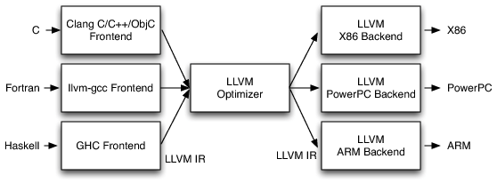
Three-Phase Design
From: The Architecture of Open Source Applications (Vol 1) LLVM https://aosabook.org/en/v1/llvm.html

Slide 14
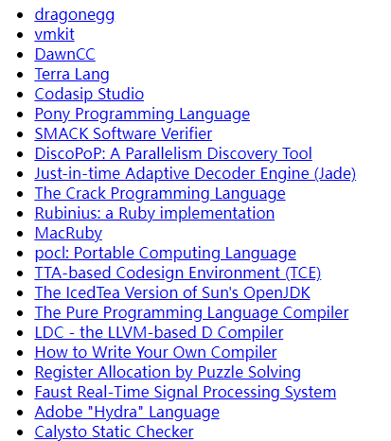
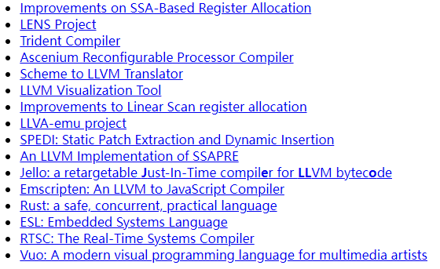
Projects built with LLVM
From: https://llvm.org/ProjectsWithLLVM/

Slide 15
LLVM所支持的语言
Clang: C/C++/Objective-C
projects that use components of LLVM: Ruby, Python, Haskell, Java, D, PHP, Pure, Lua等
From: https://llvm.org/

Slide 16
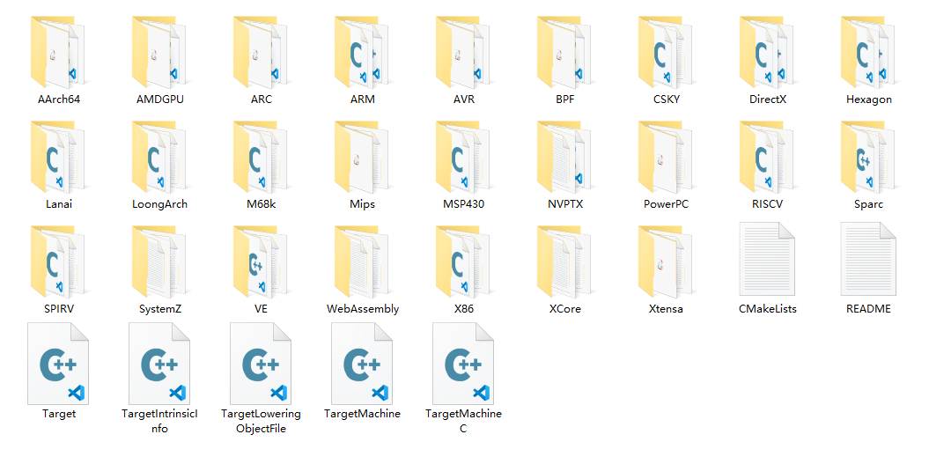
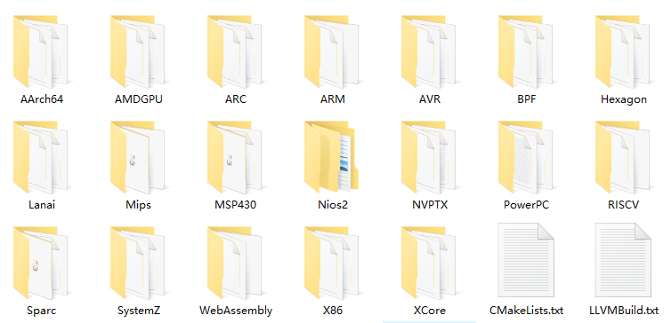
LLVM所支持的后端
Notes：This is the source code dir of LLVM 16.0.0，its location is LLVM/lib/Target/.
Notes:
LLVM8.0.0

Slide 17
目录
自我介绍与资料推荐
LLVM整体框架
LLVM的前端Clang
LLVM的IR
LLVM的pass
LLVM的后端

Slide 18
Clang: a C language family frontend for LLVM
The Clang project provides a language front-end and tooling infrastructure for languages in the C language family (C, C++, Objective C/C++, OpenCL, CUDA, and RenderScript) for the LLVM project. Both a GCC-compatible compiler driver (clang) and an MSVC-compatible compiler driver (clang-cl.exe) are provided
From: https://clang.llvm.org/

Slide 19
Clang的主要环节
Source code
C/C++
lexer
parser
sema
codegen
LLVM IR

Slide 20
Clang的词法分析和语法分析
在现阶段编译器开发实践中，前端部分的词法分析和语法分析的实现，已经越来越依靠Flex和Bison这类工具，很少依靠纯手工去实现。
Clang依然采用C++来手动实现其lexer和parser。

Slide 21
Clang libs
Lexer Library
The Lexer library contains several tightly-connected classes that are involved with the nasty process of lexing and preprocessing C source code.
Parser Library
This library contains a recursive-descent parser that polls tokens from the preprocessor and notifies a client of the parsing progress.
The AST Library
Clang AST nodes (types, declarations, statements, expressions, and so on) are generally designed to be immutable once created.
Sema Library
This library is called by the Parser library during parsing to do semantic analysis of the input.
CodeGen Library
CodeGen takes an AST as input and produces LLVM IR code from it.
From: https://clang.llvm.org/docs/InternalsManual.html

Slide 22
Clang tools
LibClang
LibClang is a stable high level C interface to clang. When in doubt LibClang is probably the interface you want to use.
Clang Plugins
Clang Plugins allow you to run additional actions on the AST as part of a compilation. Plugins are dynamic libraries that are loaded at runtime by the compiler, and they’re easy to integrate into your build environment.
LibTooling
LibTooling is a C++ interface aimed at writing standalone tools, as well as integrating into services that run clang tools.
From: https://clang.llvm.org/docs/Tooling.html

Slide 23
LibClang project
Screader (2014)
The screader is a soure code reading tool based the libclang. It is implemented by the C. The screader can work on the clang-10.0.0 now.
https://github.com/shining1984/screader

Slide 24
目录
自我介绍与资料推荐
LLVM整体框架
LLVM的前端Clang
LLVM的IR
LLVM的pass
LLVM的后端

Slide 25
What is the LLVM IR?
The LLVM Intermediate Representation
线性IR
单层IR
基于SSA
LLVM IR DOC： https://llvm.org/docs/LangRef.html

Slide 26
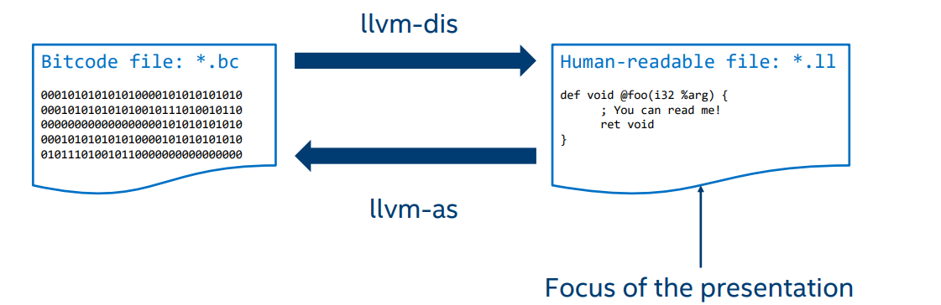
IR 的不同形式
The LLVM code representation is designed to be used in three different forms: as an in-memory compiler IR, as an on-disk bitcode representation (suitable for fast loading by a Just-In-Time compiler), and as a human readable assembly language representation.
From:
LLVM IR DOC： https://llvm.org/docs/LangRef.html
LLVM IR TUTORIAL https://llvm.org/devmtg/2019-04/slides/Tutorial-Bridgers-LLVM_IR_tutorial.pdf

Slide 27
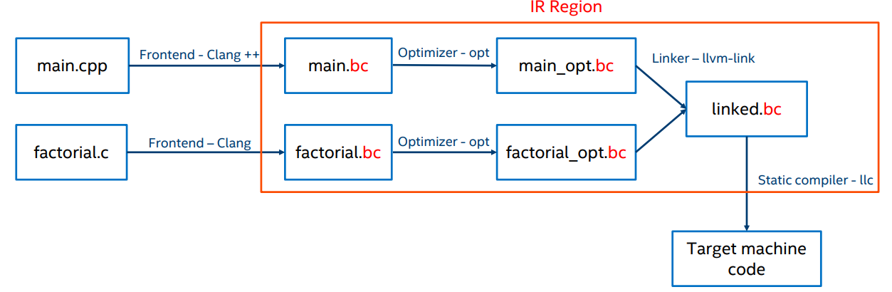
IR & the compilation process
From: LLVM IR TUTORIAL https://llvm.org/devmtg/2019-04/slides/Tutorial-Bridgers-LLVM_IR_tutorial.pdf

Slide 28
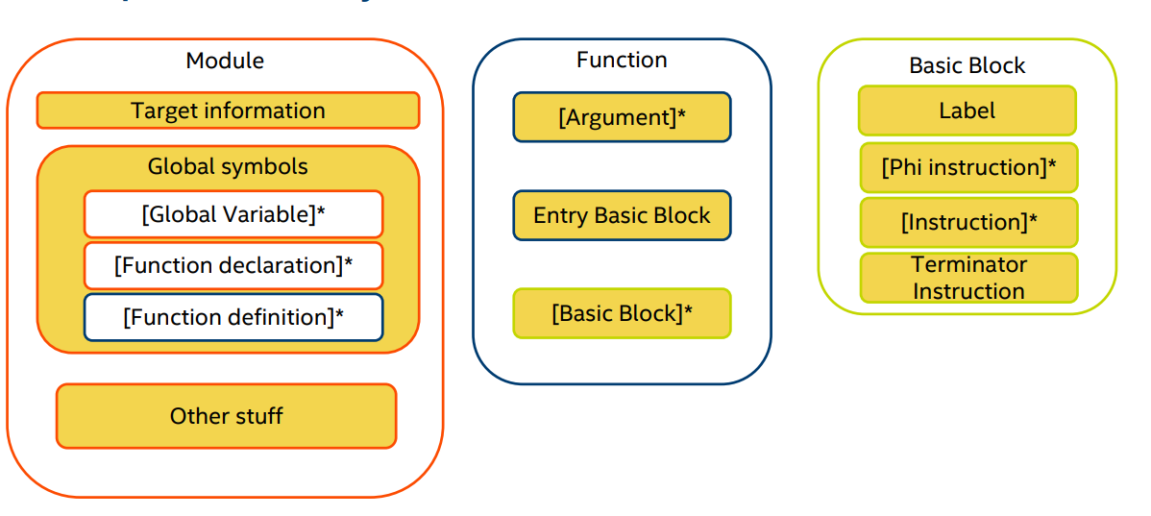
Simplified IR layout
From: LLVM IR TUTORIAL https://llvm.org/devmtg/2019-04/slides/Tutorial-Bridgers-LLVM_IR_tutorial.pdf

Slide 29
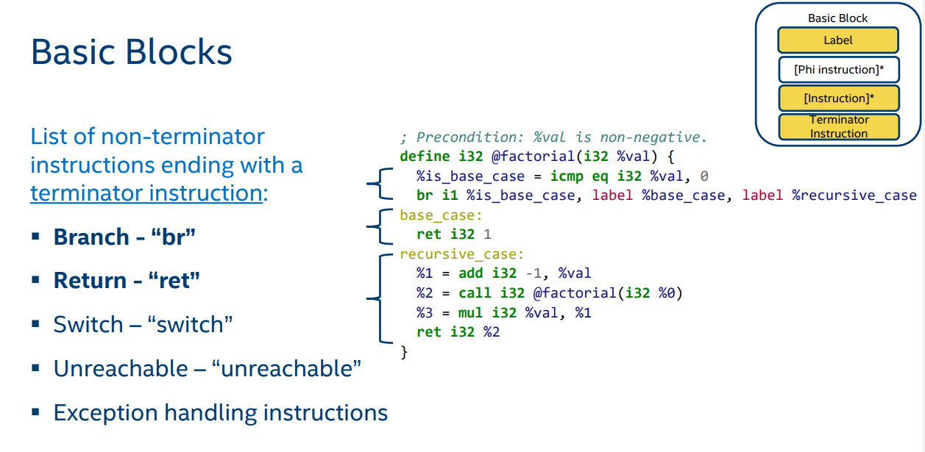
Basic Blocks
From: LLVM IR TUTORIAL https://llvm.org/devmtg/2019-04/slides/Tutorial-Bridgers-LLVM_IR_tutorial.pdf

Slide 30
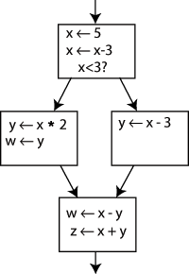
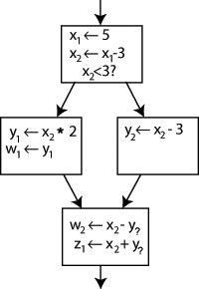
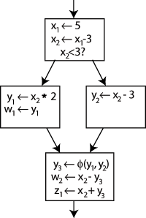
Static Single Assignment(SSA) & Φ (Phi) function
静态单赋值
每个变量都只被赋值一次
From: https://en.wikipedia.org/wiki/Static_single-assignment_form

Slide 31
目录
自我介绍与资料推荐
LLVM整体框架
LLVM的前端Clang
LLVM的IR
LLVM的pass
LLVM的后端

Slide 32
Pass
Optimizations are implemented as Passes that traverse some portion of a program to either collect information or transform the program.
IR
Pass1
Pass2
……
PassX
IR
From: https://llvm.org/docs/Passes.html

Slide 33
Pass分类
Analysis passes
Transform passes
Utility passes
From: https://llvm.org/docs/Passes.html

Slide 34
Analysis Passes
Analysis passes compute information that other passes can use or for debugging or program visualization purposes.
-aa-eval: Exhaustive Alias Analysis Precision Evaluator
-basic-aa: Basic Alias Analysis (stateless AA impl)
-basiccg: Basic CallGraph Construction
-count-aa: Count Alias Analysis Query Responses
-da: Dependence Analysis
-debug-aa: AA use debugger
-domfrontier: Dominance Frontier Construction
-domtree: Dominator Tree Construction
-dot-callgraph: Print Call Graph to “dot” file
From: https://llvm.org/docs/Passes.html

Slide 35
Analysis Passes（续）
-dot-cfg: Print CFG of function to “dot” file
-dot-cfg-only: Print CFG of function to “dot” file (with no function bodies)
-dot-dom: Print dominance tree of function to “dot” file
-dot-dom-only: Print dominance tree of function to “dot” file (with no function bodies)
-dot-post-dom: Print postdominance tree of function to “dot” file
-dot-post-dom-only: Print postdominance tree of function to “dot” file (with no function bodies)
-globalsmodref-aa: Simple mod/ref analysis for globals
-instcount: Counts the various types of Instructions
-intervals: Interval Partition Construction
-iv-users: Induction Variable Users
-lazy-value-info: Lazy Value Information Analysis
From: https://llvm.org/docs/Passes.html

Slide 36
Analysis Passes（续）
-libcall-aa: LibCall Alias Analysis
-lint: Statically lint-checks LLVM IR
-loops: Natural Loop Information
-memdep: Memory Dependence Analysis
-module-debuginfo: Decodes module-level debug info
-postdomfrontier: Post-Dominance Frontier Construction
-postdomtree: Post-Dominator Tree Construction
-print-alias-sets: Alias Set Printer
-print-callgraph: Print a call graph
-print-callgraph-sccs: Print SCCs of the Call Graph
From: https://llvm.org/docs/Passes.html

Slide 37
Analysis Passes（续）
-print-function: Print function to stderr
-print-module: Print module to stderr
-print-used-types: Find Used Types
-regions: Detect single entry single exit regions
-scalar-evolution: Scalar Evolution Analysis
-scev-aa: ScalarEvolution-based Alias Analysis
-stack-safety: Stack Safety Analysis
-targetdata: Target Data Layout
From: https://llvm.org/docs/Passes.html

Slide 38
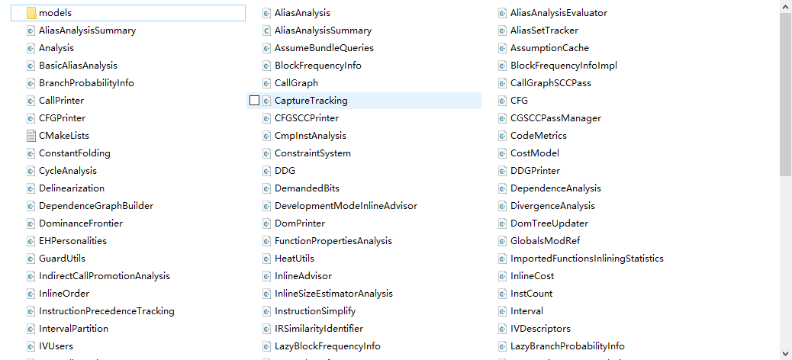
Analysis Passes代码
llvm/lib/Analysis/
Notes：This is the source code of LLVM 16.0.0.

Slide 39
Transform passes
Transform passes can use (or invalidate) the analysis passes. Transform passes all mutate the program in some way.
-adce: Aggressive Dead Code Elimination
-always-inline: Inliner for always_inline functions
-argpromotion: Promote ‘by reference’ arguments to scalars
-bb-vectorize: Basic-Block Vectorization
-block-placement: Profile Guided Basic Block Placement
-break-crit-edges: Break critical edges in CFG
-codegenprepare: Optimize for code generation
-constmerge: Merge Duplicate Global Constants
From: https://llvm.org/docs/Passes.html

Slide 40
Transform passes（续）
-dce: Dead Code Elimination
-deadargelim: Dead Argument Elimination
-deadtypeelim: Dead Type Elimination
-die: Dead Instruction Elimination
-dse: Dead Store Elimination
-function-attrs: Deduce function attributes
-globaldce: Dead Global Elimination
-globalopt: Global Variable Optimizer
-gvn: Global Value Numbering
-indvars: Canonicalize Induction Variables
From: https://llvm.org/docs/Passes.html

Slide 41
Transform passes（续）
-inline: Function Integration/Inlining
-instcombine: Combine redundant instructions
-aggressive-instcombine: Combine expression patterns
-internalize: Internalize Global Symbols
-ipsccp: Interprocedural Sparse Conditional Constant Propagation
-jump-threading: Jump Threading
-lcssa: Loop-Closed SSA Form Pass
-licm: Loop Invariant Code Motion
-loop-deletion: Delete dead loops
-loop-extract: Extract loops into new functions
From: https://llvm.org/docs/Passes.html

Slide 42
Transform passes（续）
-loop-extract-single: Extract at most one loop into a new function
-loop-reduce: Loop Strength Reduction
-loop-rotate: Rotate Loops
-loop-simplify: Canonicalize natural loops
-loop-unroll: Unroll loops
-loop-unroll-and-jam: Unroll and Jam loops
-loop-unswitch: Unswitch loops
-lower-global-dtors: Lower global destructors
-loweratomic: Lower atomic intrinsics to non-atomic form
-lowerinvoke: Lower invokes to calls, for unwindless code generators
From: https://llvm.org/docs/Passes.html

Slide 43
Transform passes（续）
-lowerswitch: Lower SwitchInsts to branches
-mem2reg: Promote Memory to Register
-memcpyopt: MemCpy Optimization
-mergefunc: Merge Functions
-mergereturn: Unify function exit nodes
-partial-inliner: Partial Inliner
-prune-eh: Remove unused exception handling info
-reassociate: Reassociate expressions
-rel-lookup-table-converter: Relative lookup table converter
-reg2mem: Demote all values to stack slots
From: https://llvm.org/docs/Passes.html

Slide 44
Transform passes（续）
-sroa: Scalar Replacement of Aggregates
-sccp: Sparse Conditional Constant Propagation
-simplifycfg: Simplify the CFG
-sink: Code sinking
-strip: Strip all symbols from a module
-strip-dead-debug-info: Strip debug info for unused symbols
-strip-dead-prototypes: Strip Unused Function Prototypes
-strip-debug-declare: Strip all llvm.dbg.declare intrinsics
-strip-nondebug: Strip all symbols, except dbg symbols, from a module
-tailcallelim: Tail Call Elimination
From: https://llvm.org/docs/Passes.html

Slide 45
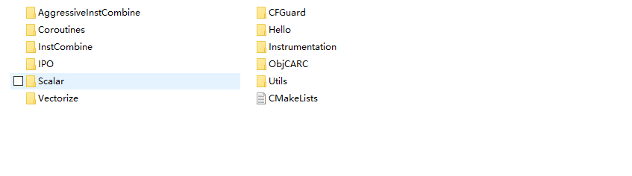
Transform passes代码
llvm/lib/Transforms/
Notes：This is the source code of LLVM 16.0.0.

Slide 46
Utility passes
Utility passes provides some utility but don’t otherwise fit categorization.
-deadarghaX0r: Dead Argument Hacking (BUGPOINT USE ONLY; DO NOT USE)
-extract-blocks: Extract Basic Blocks From Module (for bugpoint use)
-instnamer: Assign names to anonymous instructions
-verify: Module Verifier
-view-cfg: View CFG of function
-view-cfg-only: View CFG of function (with no function bodies)
-view-dom: View dominance tree of function
-view-dom-only: View dominance tree of function (with no function bodies)
-view-postdom: View postdominance tree of function
-view-postdom-only: View postdominance tree of function (with no function bodies)
-transform-warning: Report missed forced transformations
From: https://llvm.org/docs/Passes.html

Slide 47
PassManager
Manages a sequence of passes over a particular unit of IR.
A pass manager contains a sequence of passes to run over a particular unit of IR (e.g. Functions, Modules). It is itself a valid pass over that unit of IR, and when run over some given IR will run each of its contained passes in sequence. Pass managers are the primary and most basic building block of a pass pipeline.
From: https://llvm.org/doxygen/classllvm_1_1PassManager.html

Slide 48
Pass总结
LLVM 的Pass框架是LLVM系统的一个很重要的部分。每个Pass都是做分析或者转变/优化的工作，LLVM的转化/优化工作就是由很多个Pass来一起完成的。
Pass是LLVM系统转化/优化的工作的一个节点，每个节点做一些工作，这些工作加起来就构成了LLVM中端和后端的转化/优化的工作。
Pass架构的可重用性非常好。你可以选择已有的一些Pass，自己去构建出自己想要的分析或者转变/优化。
新建Pass并不用考虑LLVM之前的优化和转化是怎么做的，可以只运行自己新建的Pass，这样可以方便的实现自己想要的效果。
From: https://zhuanlan.zhihu.com/p/26127188

Slide 49
目录
自我介绍与资料推荐
LLVM整体框架
LLVM的前端Clang
LLVM的IR
LLVM的pass
LLVM的后端

Slide 50
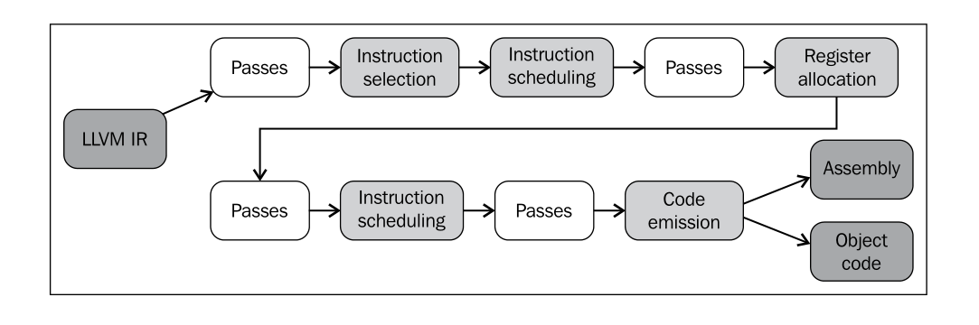
The Steps in LLVM Backend
From: 《Getting Started with LLVM Core Libraries》P134.

Slide 51
The Steps in LLVM Backend（Another version）
SDFSDFFSDF
SSA-based Machine Code Optimizations
Instruction Selection
Scheduling and Formation
Register
Allocation
Prolog/Epilog Code Insertion
Late Machine Code Optimizations
Code
Emission
Notes：According the LLVM DOC《The LLVM Target-Independent Code Generator》 https://llvm.org/docs/CodeGenerator.html.
Notes:
Prolog/Epilog Code Insertion: This stage is responsible for implementing optimizations like frame-pointer elimination and stack packing.

Slide 52
TableGen
TableGen主要是帮助开发者开发和维护特定领域的信息，方便开发者更好的构建这些信息，避免错误。尤其是在面对大量的信息时，用起来比较方便。
TableGen的主要使用者是The LLVM Target-Independent Code Generator和Clang diagnostics and attributes. 前者就是我们通常所讲的LLVM后端。
TableGen有三个backend：LLVM、Clang和通用后端等。TableGen的LLVM后端主要是为了自动为LLVM后端生成指令、调度和架构特征等， TableGen的Clang后端主要为了诊断信息和特征，主要是文本操作。
From: https://zhuanlan.zhihu.com/p/80107428
https://llvm.org/docs/TableGen/
https://llvm.org/docs/TableGen/BackEnds.html

Slide 53
指令选择
The instruction selector must primarily select the machine instructions which implement the same expected behavior as that of the input program, and as a secondary objective it should result in efficient assembly code. We reformulate this as the following subproblems:
1. pattern matching – detecting when and where it is possible to use a certain machine instruction; and
2. pattern selection – deciding which instruction to choose in situations when multiple options exist.
From: <Survey on Instruction Selection> P3
https://arxiv.org/abs/1306.4898

Slide 54
LLVM的指令选择器
FastISel
"Fast" instruction selection is designed to emit very poor code quickly. "Fast" instruction selection is able to fail gracefully and transfer control to the SelectionDAG selector for operations that it doesn’t support.
https://llvm.org/doxygen/FastISel_8cpp_source.html
SelectionDAG
The SelectionDAG provides an abstraction for code representation in a way that is amenable to instruction selection using automatic techniques (e.g. dynamic-programming based optimal pattern matching selectors). Portions of the DAG instruction selector are generated from the target description (*.td) files. Our goal is for the entire instruction selector to be generated from these .td files, though currently there are still things that require custom C++ code.
https://www.llvm.org/docs/CodeGenerator.html#register-allocator
GlobalISel
The initial goal is to replace FastISel on AArch64. The next step will be to replace SelectionDAG as the optimized ISel.
https://llvm.org/docs/GlobalISel/index.html

Slide 55
指令调度
For the selected machine instructions we also need to decide in which order they shall appear in the assembly code, which is taken care of by the instruction scheduler.
From: <Survey on Instruction Selection> P3
https://arxiv.org/abs/1306.4898

Slide 56
LLVM的指令调度选项
-pre-RA-sched
Instruction schedulers available (before register allocation）
llvm/lib/CodeGen/SelectionDAG/SelectionDAGISel.cpp
-enable-misched
Enable the machine instruction scheduling pass.
llvm/lib/CodeGen/ MachineScheduler.cpp
Notes：The code is LLVM 16.0.0.

Slide 57
LLVM的指令调度选项
-enable-post-misched
Enable the post-ra machine instruction scheduling pass.
llvm/lib/CodeGen/ MachineScheduler.cpp
-post-RA-sched
Enable scheduling after register allocation
llvm/lib/CodeGen/PostRASchedulerList.cpp
Notes：The code is LLVM 16.0.0.

Slide 58
LLVM的指令调度实现
SelectionDAGISel
class SelectionDAGISel : public MachineFunctionPass{…}
llvm/include/llvm/CodeGen/SelectionDAGISel.h
Notes：The code is LLVM 16.0.0.

Slide 59
LLVM的指令调度实现（续）
MachineScheduler && PostMachineScheduler
/// Base class for a machine scheduler class that can run at any point.
class MachineSchedulerBase : public MachineSchedContext,
public MachineFunctionPass {…
/// MachineScheduler runs after coalescing and before register allocation.
class MachineScheduler : public MachineSchedulerBase {…
/// PostMachineScheduler runs after shortly before code emission.
class PostMachineScheduler : public MachineSchedulerBase {…
llvm/lib/CodeGen/MachineScheduler.cpp
Notes：The code is LLVM 16.0.0.

Slide 60
LLVM的指令调度实现（续）
PostRAScheduler
class PostRAScheduler : public MachineFunctionPass {…
llvm/lib/CodeGen/PostRASchedulerList.cpp
Notes：The code is LLVM 16.0.0.

Slide 61
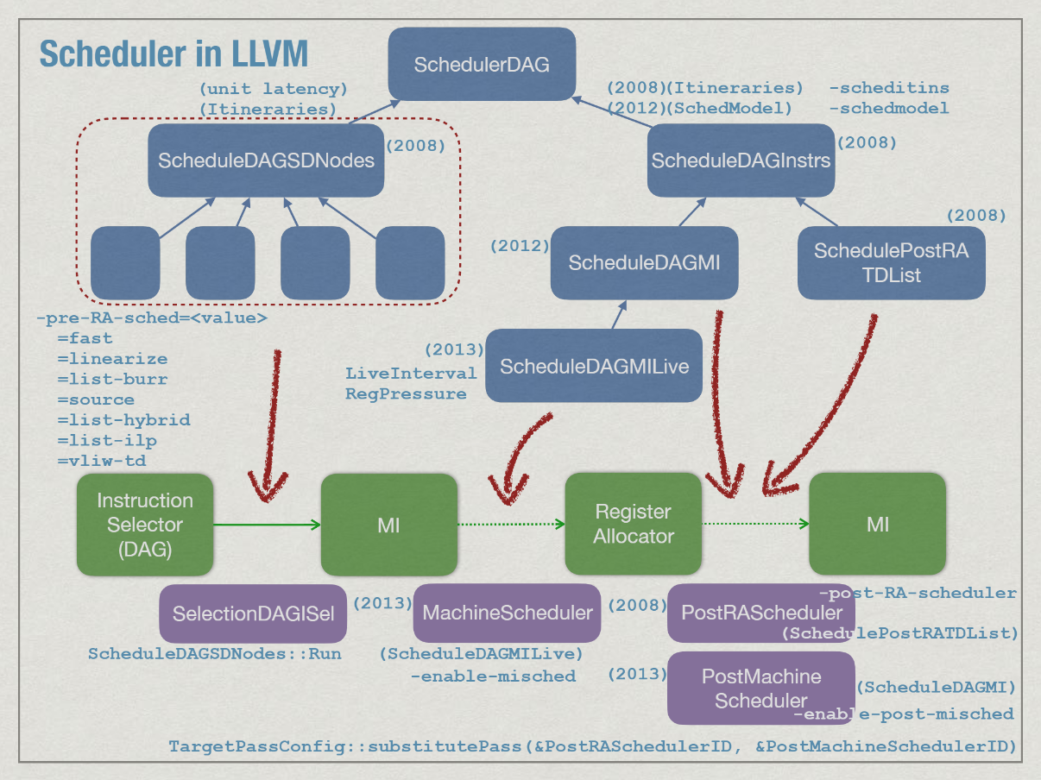
LLVM的指令调度
From:https://github.com/CatSystemWorkshop/COSCUP2019/blob/master/Instruction%20Scheduler%20in%20LLVM.pdf

Slide 62
寄存器分配前的指令调度调用SelectionDAGISel
From: llvm16.0.0 llvm/include/llvm/CodeGen/SchedulerRegistry.h
/// createBURRListDAGScheduler - This creates a bottom up register usage
/// reduction list scheduler.
ScheduleDAGSDNodes *createBURRListDAGScheduler(SelectionDAGISel *IS,
CodeGenOpt::Level OptLevel);
/// createBURRListDAGScheduler - This creates a bottom up list scheduler that
/// schedules nodes in source code order when possible.
ScheduleDAGSDNodes *createSourceListDAGScheduler(SelectionDAGISel *IS,
CodeGenOpt::Level OptLevel);
/// createHybridListDAGScheduler - This creates a bottom up register pressure
/// aware list scheduler that make use of latency information to avoid stalls
/// for long latency instructions in low register pressure mode. In high
/// register pressure mode it schedules to reduce register pressure.
ScheduleDAGSDNodes *createHybridListDAGScheduler(SelectionDAGISel *IS,
CodeGenOpt::Level);

Slide 63
寄存器分配前的指令调度调用SelectionDAGISel（续）
/// createILPListDAGScheduler - This creates a bottom up register pressure
/// aware list scheduler that tries to increase instruction level parallelism
/// in low register pressure mode. In high register pressure mode it schedules
/// to reduce register pressure.
ScheduleDAGSDNodes *createILPListDAGScheduler(SelectionDAGISel *IS,
CodeGenOpt::Level);
/// createFastDAGScheduler - This creates a "fast" scheduler.
ScheduleDAGSDNodes *createFastDAGScheduler(SelectionDAGISel *IS,
CodeGenOpt::Level OptLevel);
/// createVLIWDAGScheduler - Scheduler for VLIW targets. This creates top down
/// DFA driven list scheduler with clustering heuristic to control
/// register pressure.
ScheduleDAGSDNodes *createVLIWDAGScheduler(SelectionDAGISel *IS,
CodeGenOpt::Level OptLevel);
From: llvm16.0.0 llvm/include/llvm/CodeGen/SchedulerRegistry.h

Slide 64
寄存器分配前的指令调度调用 SelectionDAGISel（续）
/// createDefaultScheduler - This creates an instruction scheduler appropriate
/// for the target.
ScheduleDAGSDNodes *createDefaultScheduler(SelectionDAGISel *IS,
CodeGenOpt::Level OptLevel);
/// createDAGLinearizer - This creates a "no-scheduling" scheduler which
/// linearize the DAG using topological order.
ScheduleDAGSDNodes *createDAGLinearizer(SelectionDAGISel *IS,
CodeGenOpt::Level OptLevel);
}
From: llvm16.0.0 llvm/include/llvm/CodeGen/SchedulerRegistry.h

Slide 65
寄存器分配前的指令调度调用 MachineSchedulerPass
From: llvm16.0.0 llvm/include/llvm/CodeGen/CodeGenPassBuilder.h
template <typename Derived>
void CodeGenPassBuilder<Derived>::addOptimizedRegAlloc(
AddMachinePass &addPass) const {
…
// The machine scheduler may accidentally create disconnected components
// when moving subregister definitions around, avoid this by splitting them to
// separate vregs before. Splitting can also improve reg. allocation quality.
addPass(RenameIndependentSubregsPass());
// PreRA instruction scheduling.
addPass(MachineSchedulerPass());
…
}

Slide 66
寄存器分配后的指令调度调用
From: llvm16.0.0 llvm/include/llvm/CodeGen/CodeGenPassBuilder.h
template <typename Derived>
Error CodeGenPassBuilder<Derived>::addMachinePasses(
AddMachinePass &addPass) const {
…
// Second pass scheduler.
if (getOptLevel() != CodeGenOpt::None &&
!TM.targetSchedulesPostRAScheduling()) {
if (Opt.MISchedPostRA)
addPass(PostMachineSchedulerPass());
else
addPass(PostRASchedulerPass());
}
…
}

Slide 67
寄存器分配
寄存器分配实质上就是如何使用处理器有限数量的寄存器。编译器所针对的目标处理器所具有的寄存器都是有限的，如何将这些有限的寄存器给指令使用，或者替换指令中之前使用的虚拟寄存器/变量，就是寄存器分配索要考虑的问题。
寄存器分配不仅要满足指令使用寄存器的需求，还要尽可能的提高寄存器的使用效率，以提高指令的运行速度，避免因为寄存器使用带来大量数据转移的指令。
From:《编译器后端理论与实践》（史宁宁，未出版）

Slide 68
寄存器分配常见的算法
寄存器分配常见的算法有图着色、线性扫描、基于SSA的寄存器分配、PBQP、线性规划、弦图分配等。其中，基于SSA的寄存器分配属于分配算法的一类，其中包含多种可应用于SSA格式的寄存器分配算法。
From:《编译器后端理论与实践》（史宁宁，未出版）

Slide 69
LLVM的寄存器分配
LLVM infrastructure provides four register allocator, namely: fast, basic, greedy and PBQP.
The Fast Register Allocator
This allocator is a local register allocator, which has the simplest strategy when compared with the others. It
scans the program linearly and assigns values to registers as they appear.
The Basic Register Allocator(linear scan)
The basic register allocator is an extension of the linear scan register allocator proposed by Poletto with
some extensions.
The Greedy Register Allocator(linear scan)
The Greedy register allocator is an implementation of the basic allocator that uses global live range.
From: <A Detailed Analysis of the LLVM's Register Allocators> P190-191
https://ieeexplore.ieee.org/document/6694089

Slide 70
LLVM的寄存器分配
The PBQP Register Allocator
The PBQP register allocator is the LLVM register allocator that performs allocation based on the Partitioned Boolean Quadratic Programming .PBQP is an algorithm that transforms the problem of register allocation into Partitioned Boolean Quadratic Problem.
分区布尔二次规划？分区布尔二次编程？
From: <A Detailed Analysis of the LLVM's Register Allocators> P190-191
https://ieeexplore.ieee.org/document/6694089

Slide 71
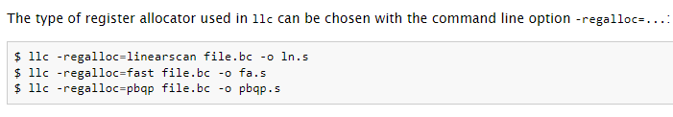
LLVM寄存器分配器的使用
From: https://www.llvm.org/docs/CodeGenerator.html#register-allocator

Slide 72
参考资料
参见具体每页下方标注。

Slide 73
Thanks!

