Slide 1
A Hierarchical Edge Cloud Architecture for Mobile Computing
Liang Tong, Yong Li and Wei Gao
University of Tennessee – Knoxville
Notes:
Thank you for your nice introduction. Good morning, everyone. It is my honour to be here to present our paper “A Hierarchical Edge Cloud Architecture for Mobile Computing”. This paper is coauthored with my lab mate Mr. Yong Li and my advisor Professor Wei Gao at the University of Tennessee

Slide 2






Cloud Computing for mobile devices
Contradiction between limited battery and complex mobile applications
Mobile Cloud Computing (MCC)
Offloading local computations to remote execution
Reduced computation delay
Increased communication delay
Notes:
I’d like to begin with the background and motivation. Current mobile apps are becoming more and more computing-intensive, such as gaming and speech recognitions. These applications increase the requirements on smartphones’ capabilities in computation, communication, and storage, and seriously reduce the smartphones’ battery lifetime. As a viable solution to bridge the gap between limited capabilities of mobile devices and the increasing users’ demand of mobile multimedia applications, Mobile Cloud computing enables mobile devices to offload the computational workloads from local devices to the cloud, that is: moving part of the mobile program execution to remote cloud. However, offloading workload to the remote Cloud also incurs long network transmission latency, which could degrade the performance of the apps.

Slide 3
The limits of Cloud Computing
Network communication latency of MCC
Can be up to 400 ms
Many mobile apps are delay-sensitive
Performance
degrades!
Round trip cities | Max(ms) | Mean(ms) | Min(ms)
Berkeley-Canberra | 174.0 | 174.7 | 176.0
Berkeley-Troudheim | 197.0 | 197.0 | 197.0
Pittsburgh-Hong Kong | 217.0 | 223.1 | 393.0
Pittsburgh-Seatle | 83.0 | 83.9 | 84.0
Pittsburgh-Dublin | 115.0 | 115.7 | 116.0
Notes:
Here is a table showing how the network communication latency may hurt apps’ performance. It shows the round trip time for transmitting data between different cities around the world. The distance between the cities are as long as the distance between mobile devices and remote cloud. By looking at the number we can find that the communication latency can be up to 400 ms. However, many mobile apps are delay sensitive, which only accept a delay less than 100 ms. I think we can clearly see that the performance of apps could be seriously degraded by the communication latency.

Slide 4







Existing solution
Small scale cloud servers at the edge
Reduce the network latency accessing data center
Support user mobility
Coffee shop
Cloudlet
Low latency
wireless network
Notes:
To reduce the network latency, the existing solution suggest to deploy small scale cloud servers at the edge, which is also called Cloudlet. These servers can be desktops and geo-distributed in different locations, such as in a coffee shop or near some hotspots. For the mobile devices nearby, they can access the Cloudlet via low latency wireless network and offload their computations instead of offloading to the remote Cloud. Therefore, the network latency accessing the data center could be reduced. As the servers are geo-distributed, they also support user mobility. The question is, can Cloudlet really reduce the apps’ response time? Our answer is NO.

Slide 5
The limits of Cloudlet
Cloudlet has limited computing resources
A large amount of peak load latency
More capacity?
Coffee shop
Cloudlet
Low latency
wireless network
Notes:
The main reason is that, in fact, the Cloudlet has limited computing resources compared to a data center, as they are desktops or small scale servers. When a large amount of peak load arrives at the server, these workload have to wait for a long time to be processed, especially when the workload exceeds the server’s computational capacity. Therefore, although the WAN latency is reduced by the Cloudlet, the computation time may significantly increase, which further degrade the performance of mobile apps. The most straight forward method is to provision more capacities on cloudlets which would help reduce such cloud access latency, but it seriously impairs the efficiency of cloud resource utilization during off-peak hours. This motivates us to design a new edge cloud architecture which improves the efficiency of resource utilization.

Slide 6




Our solution
Motivation
Peak loads at different edge cloud servers do not appear at the same time
Lunch time
Morning
Notes:
Our solution is based on our observation that peak load at different servers does not appear at the same time. This is due to the mobility pattern of the mobile users. For example, if there are two servers deployed in a school and a restaurant nearby, in the morning, most of mobile users will stay in the school campus thus the server there meets the peak load. However, during lunch time, most of the mobile users will move to the restaurant, therefore, the server at school will be in off-peak time but the server in the restaurant will have peak load. This phenomenon reminds us that whether we can opportunistically aggregate the peak load from different servers by deploying a new tier of servers above the current servers. Since this new tier can aggregate all the peak load from the servers at the first tier, the required on the this tier-2 server is less than the sum of all the peak loads from the first-tier servers.
[How? Add a few sentences to summarize the “aggregation” here at a high level: deploy another second-tier server and aggregate the peak loads from multiple first-tier servers, and its required capacity will be smaller than the sum of all the peak loads at different first-tier servers. Organize these sentences to make them formal.]

Slide 7
Our solution
Key idea
Hierarchical edge cloud architecture
Opportunistically aggregate peak loads
Improve the resource utilization
Notes:
Here is our solution. The main idea is that we build a hierarchical edge cloud architecture instead of a flat edge cloud. For example as the figure shows we add a new tier above the servers in the university campus and shopping plaza. The servers located at the Knoxville city is connected with both the remote data centers and the lower tier servers via internet backbone. As a result, servers on different tiers can share run-time information of mobile workloads with each other, so as to work in a cooperative manner. If the mobile workloads received by an edge cloud server exceed its computational capacity, the excessive amount of workloads will then be further offloaded to the server at the higher tier. In this way, we can serve larger amounts of peak loads by provisioning the same amount of computational capacity in the edge cloud.
[You need one more additional slide here to outline your following slides: The key problems of designing this architecture include: 1), 2), … first, we will do xxx, second, we will do xxx, …]

Slide 8
Our solution
Key problems
How to efficiently provision edge cloud capacity?
How to appropriately place mobile workload at different tiers of servers?
Our work
Formally study the characteristics of the peak load
Analyze the efficiency of capacity provisioning
Design a workload placement algorithm to further improve the efficiency of program execution
Notes:
The key problems of designing such a hierarchical edge cloud is: 1) How to provision the edge cloud capacity in order to serve more peak load? 2) How to appropriately place the mobile workloads since they can be offloaded to different tiers. To solve the above problems, we firstly study the characteristics of the peak loads since they are the workload of the high tiers. Based on the study of the workload, we analytically evaluate the efficiency of resource utilization of the hierarchical edge cloud and flat edge cloud. We finally design a workload placement algorithm in order to further improve the efficiency of mobile program execution.

Slide 9
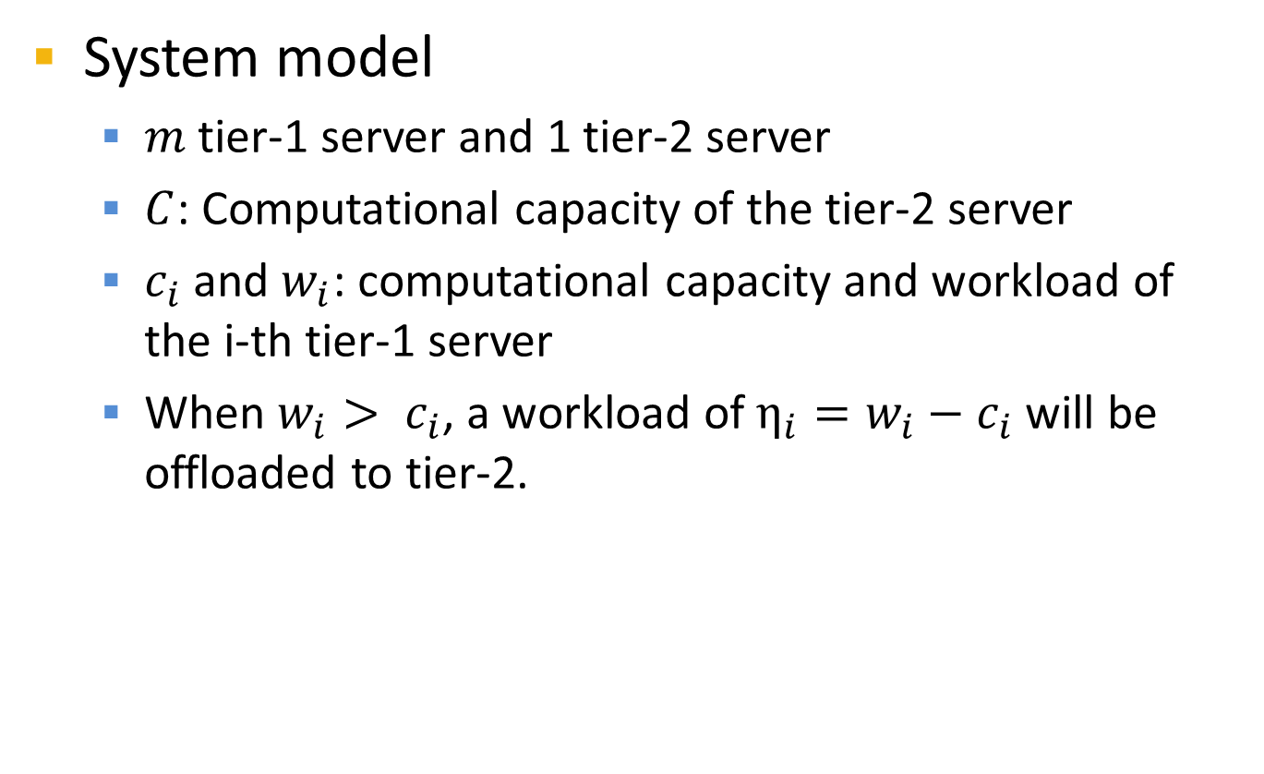
Formal study of the peak load
System model
$m$ tier-1 server and 1 tier-2 server
$C$: Computational capacity of the tier-2 server
$c_{i}$ and $w_{i}$: computational capacity and workload of the i-th tier-1 server
When $w_{i}> c_{i}$, a workload of $η_{i}=w_{i}−c_{i}$ will be offloaded to tier-2.
Peak load
Notes:
To study the performance of our proposed hierarchical edge cloud, we first develop an analytical model for a two-tier hierarchical edge cloud. As the figure shows, the hierarchical edge cloud has m tier-1 servers and one tier-2 server. When the amount of workload exceeds the capacity of a tier-1 server, a workload, labeled as \eta here will be offloaded to the tier-2 server, which has a capacity of C. In other words, the tier-2 server will aggregate the peak loads offloaded from all tier-1 servers

Slide 10
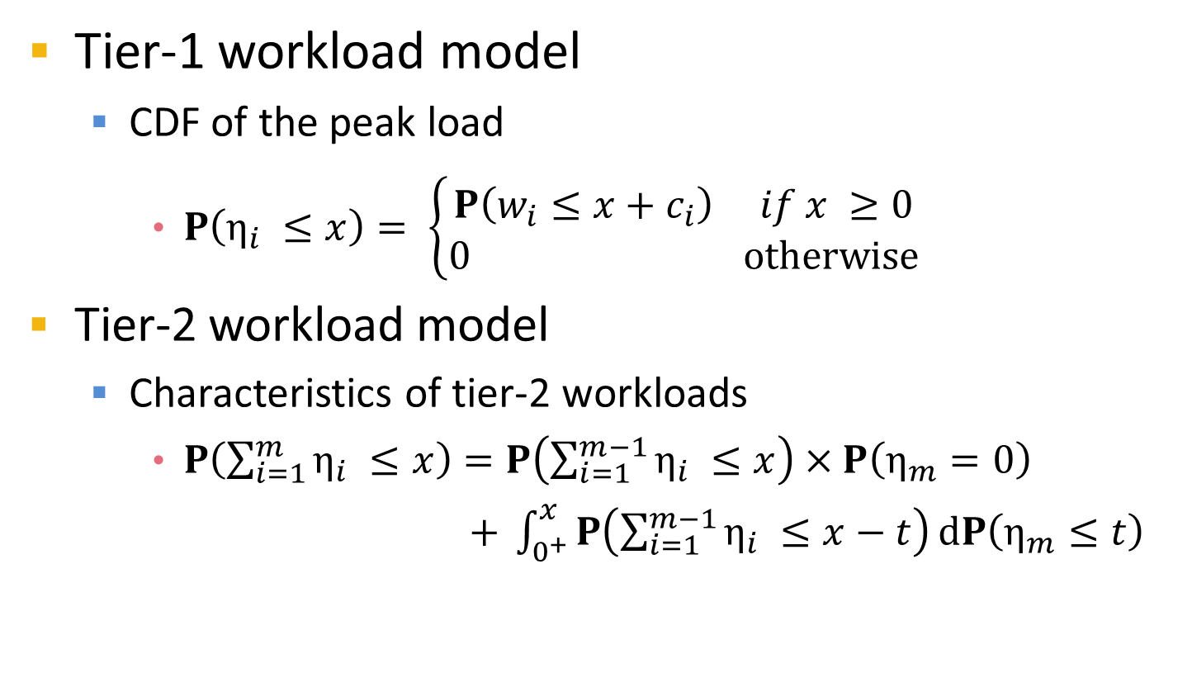
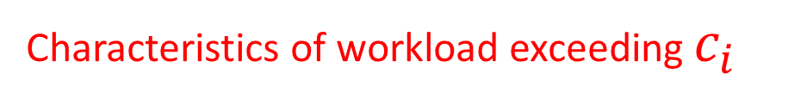
Formal study of the peak load
Tier-1 workload model
CDF of the peak load
$P\left(η_{i} ≤x\right)= \left\{\begin{aligned}P\left(w_{i}≤x+c_{i}\right) if x ≥0 \\ 0 otherwise\end{aligned}\right.$
Tier-2 workload model
Characteristics of tier-2 workloads
$P\left(\sum_{i=1}^{m}{η_{i}} ≤x\right)=P\left(\sum_{i=1}^{m−1}{η_{i}} ≤x\right)×P\left(η_{m}=0\right)$
$+ \int_{0^{+}}^{x}{P\left(\sum_{i=1}^{m−1}{η_{i}} ≤x−t\right)}dP\left(η_{m}≤t\right)$
Characteristics of workload exceeding $c_{i}$
Workload of tier-2 server
Notes:
The first step to study the performance of our design is to study the characteristics of the workload at both tie-1 and tier-2 server. The CDF of peak load at each tier-1 server describes the characteristics of workload exceeding its capacity. Note that for the tier-2 server, its workload is the aggregated peak load from all the tier-1 server. We finally get the probability that the tier-2 server can serve the peak load when it has a capacity of x. This probability is recursively deduced and reflect the capacity of the tier-2 server, since a larger capacity will have a higher probability to serve the peak load.

Slide 11
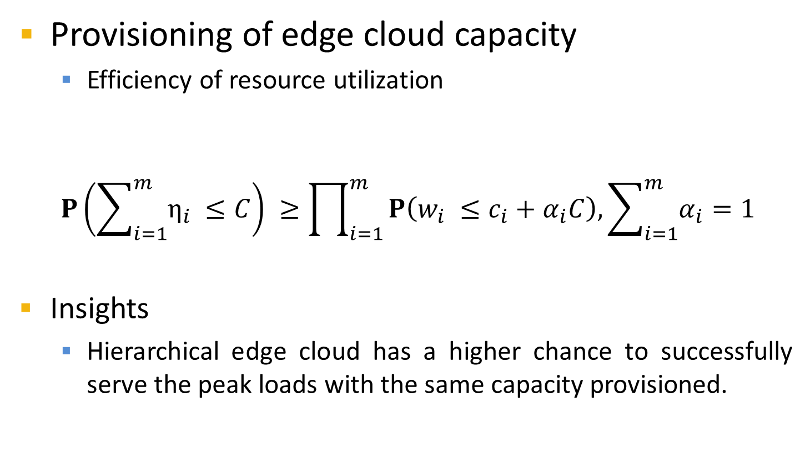
Formal study of the peak load
Provisioning of edge cloud capacity
Efficiency of resource utilization
$$P\left(\sum_{i=1}^{m}{η_{i}} ≤C\right) ≥\prod_{i=1}^{m}{P\left(w_{i} ≤c_{i}+α_{i}C\right), \sum_{i=1}^{m}{α_{i}=1}}$$
Insights
Hierarchical edge cloud has a higher chance to successfully serve the peak loads with the same capacity provisioned.
Provision C to tier-2
Provision C to tier-1
Hierarchical edge cloud
Flat edge cloud
Notes:
Based on such workload model, we are able to evaluate the efficiency of resource utilization in our proposed edge cloud design.
Based on the workload model as I introduced just now, we can evaluate the efficiency of resource utilization in an edge cloud. Here we provision the same amount of capacity to a hierarchical edge cloud as well as a flat edge cloud. For the hierarchical edge cloud, we provision all the capacity C to a tier-2 server. For the flat edge cloud, we provision the capacity to each tier-1 servers with an arbitrary ratio. Our analytical model shows that with the same amount of capacity being provisioned, the hierarchical edge cloud has a higher probability to successfully serve the peak load compared to flat edge cloud. Although this analytical result is based on a 2-tier model, it can be easily generalized to more complicated topology of the hierarchical edge cloud, for example more tiers and more servers at each tier.

Slide 12
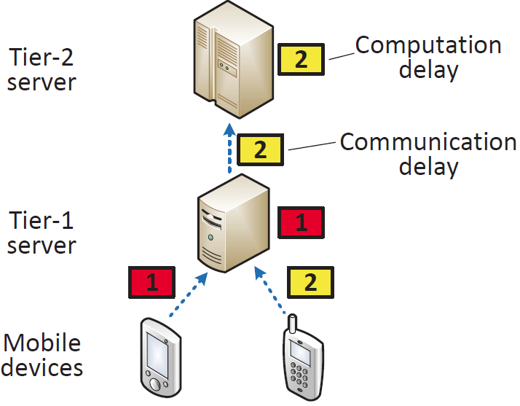
Optimal workload placement
Objective
Minimize the total delay of executing all
programs
Our focus
Where to place a mobile program
How much capacity to each program
Challenge
Computation/communication delay tradeoff
delay = computation + communication
Higher tiers: less computational delay, but more communication delay
IEEE INFOCOM 2016
Notes:
Just now I introduced our analytical model which shows the advantage of hierarchical edge cloud, however it cannot ensure efficient execution of mobile programs in the cloud. This is because it greedily consumes the resources of low-tier servers without appropriately placing mobile workloads to other tiers of the edge cloud, as a result the workload is only offloaded to higher tiers only when the amount of workload . Here, we focus on deciding which edge cloud servers mobile programs are placed on and how much computation capacity is provisioned to execute each program, so as to optimize the performance of executing all mobile programs, which means to minimize the total delay. To solve this problem, The major challenge, is that there is a tradeoff between the computation and communication delays in the edge cloud. As the figure shows, placing mobile programs at high-tier servers reduces contention on computing resources and so it improves the program execution performance, but it spends longer time on transmitting the program states.

Slide 13

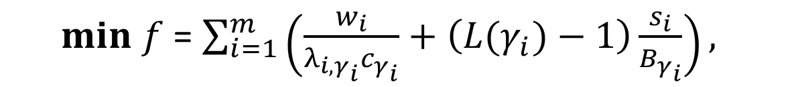

Optimal workload placement
Problem formulation
m programs at tier-1, servers in a tree-topology
Nonlinear Mixed Integer Programming
Challenge: $γ_{i}$ and $λ_{i,j}$ have interdependency
Computation
delay
Communication
delay
$min f$ = $\sum_{i=1}^{m}{\left(\frac{w_{i}}{λ_{i,γ_{i}}c_{γ_{i}}}+\left({L(γ}_{i})−1\right)\frac{s_{i}}{B_{γ_{i}}}\right), }$
$$s.t. \sum_{j ∈O_{j}}{λ_{i,j}=1, j=1,2,…,n}$$
Capacity allocation
of server j to workload i
Placement of workload i
IEEE INFOCOM 2016
Notes:
To address the challenge, we formulated the problem as a non-linear mixed integer programming problem. We aim to minimize the total delay of the mobile programs , with the workload placement of each workload and the capacity allocation on each server as variables. The total delay contains communication delay and computation delay. For each workload, its’ communication delay is related to the workload placement, the program data size and the network bandwidth between different tiers. The computation delay is determined by the workload placement, the workload size and the capacity allocated to the workload. The major challenge to solve this problem is that the value of capacity allocation vector \lambda depends on the corresponding workload placement. Thus, it is hard to explore the duality of this problem.

Slide 14




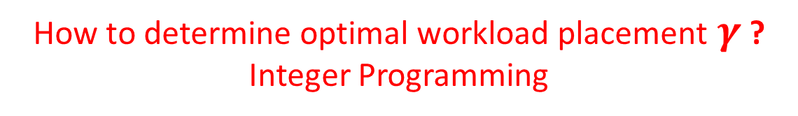
Optimal workload placement
Problem transformation
$$min f(λ,γ)$$
$$min f(λ|γ=γ^{∗})$$
$$γ=γ^{∗}$$
$$s.t. g\left(λ,γ\right)=0$$
$$s.t. g\left(λ|γ=γ^{∗}\right)=0$$
Non-linear Mixed
Integer Programming
Convex optimization with variable $λ$
How to determine optimal workload placement$γ$ ?
Integer Programming
IEEE INFOCOM 2016
Notes:
Our basic idea to solve the workload placement problem is first to transform the problem to an integer programming and then solve the problem by adopting existing framework. Note that there are two variables here, the workload placement vector \gamma and capacity allocation vector \lambda. We prove that when the workload placement vector is fixed, the problem becomes a convex optimization problem with only \lambda as the variable. Such a convex optimization problem can be solved by using KTT conditions so that we can have a determined solution for each convex optimization problem, which indicates once we determined the workload placement for each workload, the corresponding best capacity allocation vector can be also determined. Therefore the key point here is how to determine the optimal workload placement vector. Note that the member of placement vector are integers, thus we convert the problem into an integer programming problem.

Slide 15
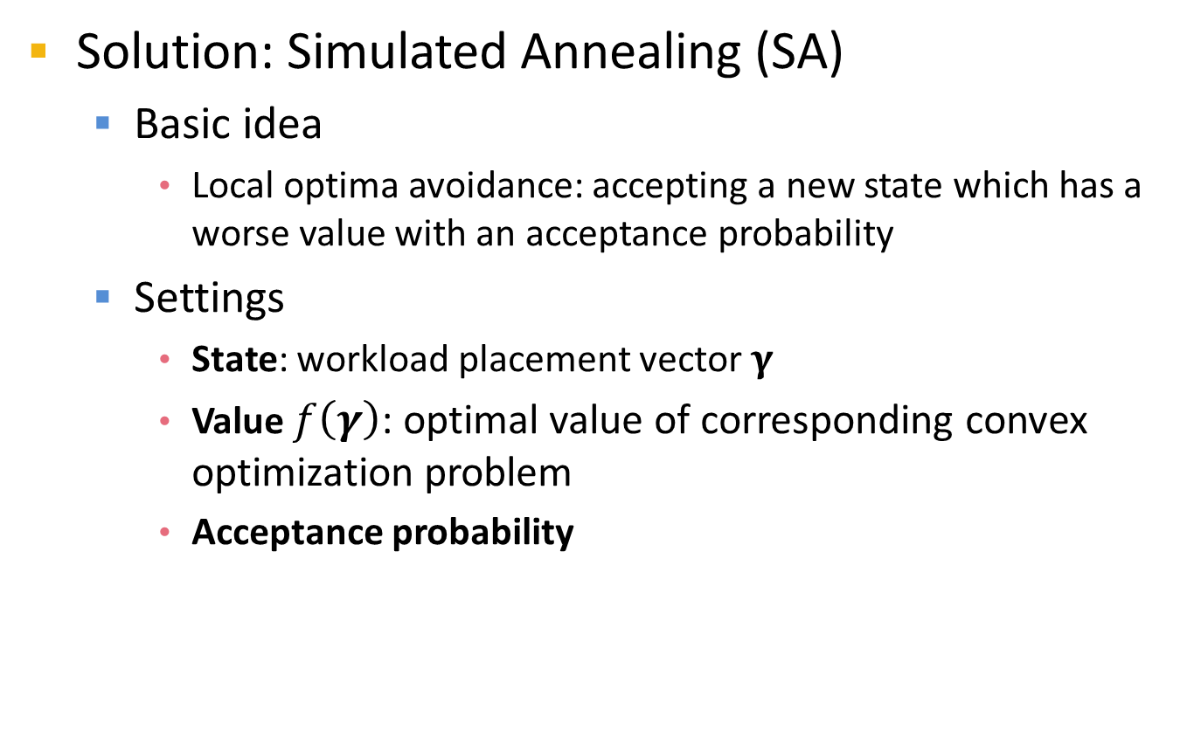
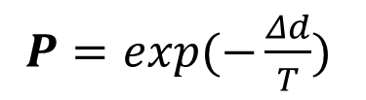
Optimal workload placement
Solution: Simulated Annealing (SA)
Basic idea
Local optima avoidance: accepting a new state which has a worse value with an acceptance probability
Settings
State: workload placement vector $γ$
Value $f\left(γ\right)$: optimal value of corresponding convex optimization problem
Acceptance probability
Convergence
$P=exp⁡(−\frac{Δd}{T})$
Annealing temperature,
decreases in each iteration
IEEE INFOCOM 2016
Notes:
Our solution to solve the integer programming problem is to adopt the simulated annealing approach. Traditional numerical methods always return a local optima. SA is different from these approaches that it can avoid local optima optima by accepting a new state which has a worse result with a probability. To incorporate SA to our problem, we define a workload placement vector as a state of the SA algorithm. The value of each state is the optimal value of the corresponding convex optimization problem under such a placement. Note that the probability to accept a worse new state decreases overtime, which indicates the probability of accepting a worse state becomes smaller of time. Therefore, the result of SA will finally converge.

Slide 16






Optimal workload placement
Solution: Simulated Annealing
Value (total delay)
State (placement)
$$γ_{1}$$
$$γ_{2}$$
$$γ_{3}$$
$$γ_{6}$$
$$γ_{4}$$
$$γ_{5}$$
IEEE INFOCOM 2016
Notes:
Here is how we incorporate SA to our solution. The SA approach finds the optimal solution iteratively. In each iteration a new state is randomly generated, which represent a new workload placement vector. Once a new state is generated, we solve the corresponding convex optimization problem under such placement and the optimal value is the value for the state. If the value of a new state is larger than the former one, which indicates a worse state and longer total delay, the new state will be accepted with a probability, such as \gamma 2 is accepted although it is worse than \gamma 1. Otherwise the new placement has a lower total delay so it is accepted with probability 1, such as \gamma3 is accepted from \gamma 2. Since the probability for accepting worse states decreases overtime so that only a better solution will be accepted, therefore, the state will converge to the optimal solution.

Slide 17
System experimentation
Comparisons
Flat edge cloud
Evaluation metric
Average completion time: indicates computational capacity
Experiment settings
Workload rate
Provisioned capacity
Notes:
Now I will introduce the performance evaluation result of our design. We first conduct a system experimentation on ([describe it (also in slides): what PCs, how are they configured] desktops connected by a low-latency Ethernet. We evaluate the performance by using average completion time as the metric. Note that a lower completion time shows a larger amount of workload being served at the edge cloud in a unit of time, which indicates a higher computational capacity. Then we compare the performance of the proposed hierarchical edge cloud to flat edge cloud.

Slide 18
Evaluation setup
Evaluation with a computing-intensive application
SIFS of images
Edge cloud topology
Flat edge cloud: two tier-1 servers
Capacity is equally provisioned to each server
Hierarchical edge cloud: two tier-1 and one tier-2 server
Capacity is provisioned to the tier-2 server and tier-1 servers
Experiments
5 minutes with different size of images
Notes:
We evaluate our system by adopting SIFS as the workload. SIFS is a algorithm to extract features of a image and is computing-intensive. We run SIFS both at the hierarchical and flat edge cloud, with the same amount of capacity being provisioned. Such capacity is measured by the unit of concurrent threads on the server. Each experiment is conducted 5 minutes with different size of images.

Slide 19
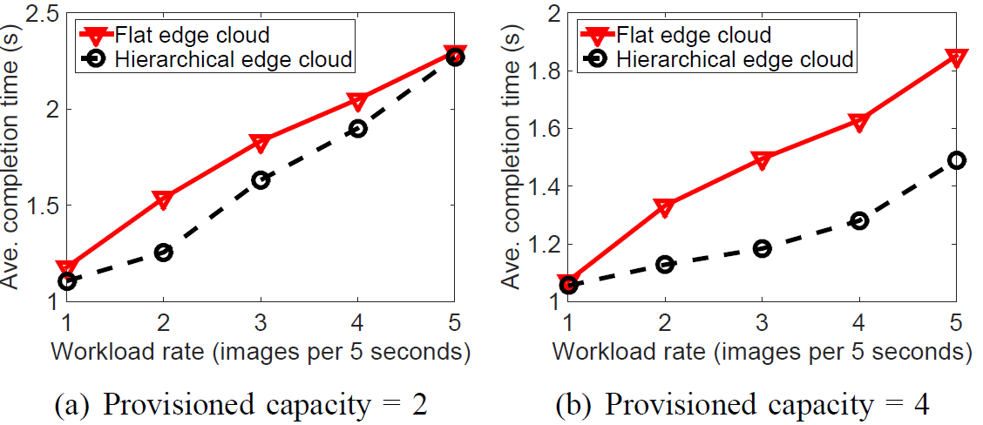
Offloading performance
Maximum capacity: 4 concurrent threads
More capacity provisioned, more improvement
25% completion time saved
35% completion time saved
Notes:
From our system evaluation result, we can see that we can get 25% reduction on completion time by provisioning capacity to the tier-2 server instead of the tier-1 servers. In particular, when more capacity is provisioned, there is more improvement of the app performance. The major reason is that when more capacity is provisioned, the hierarchical edge cloud can better aggregate the peak load.

Slide 20
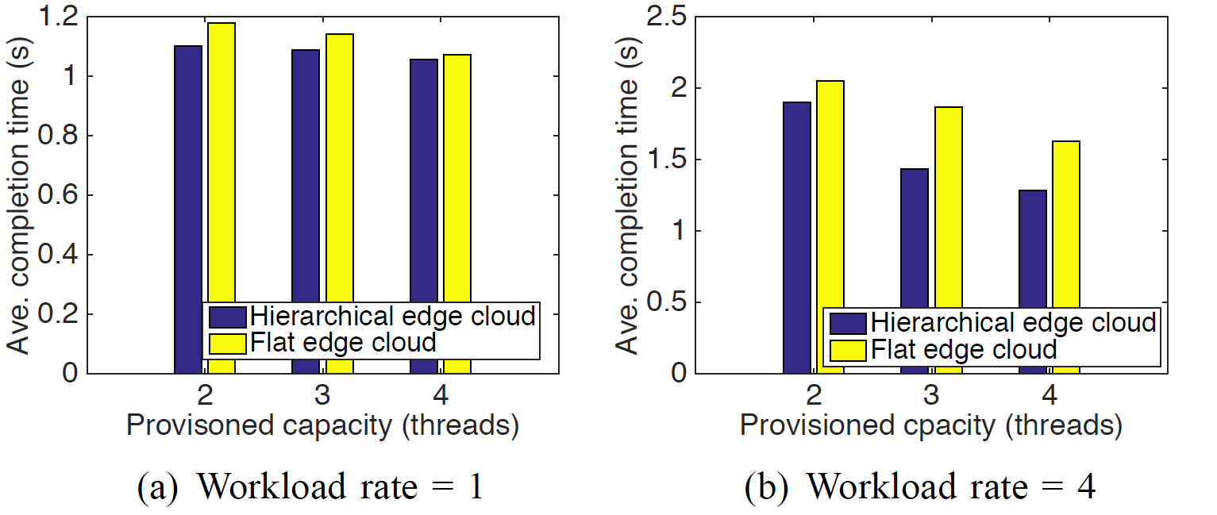
Offloading performance
Maximum capacity: 4 concurrent threads
Only limited improvement at low workload
10% completion time saved
25% completion time saved
Notes:
As shown in the figure, we can find that the hierarchical edge cloud has a better performance both in low workload rate and high workload rate. In particular, the improvement is very limited when the workload rate is low. The major reason is that when the workload rate is low, there is less opportunity that a peak load arrived at the server, therefore the hierarchical edge cloud and flat edge cloud have similar performance.

Slide 21
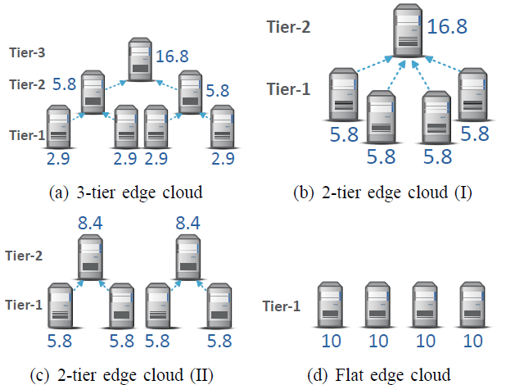
Simulation experimentation
Comparisons
Four edge clouds with different topologies and capacity provisioning
Evaluation metric
Average delay: includes both computation and communication delay
Notes:
Besides system experimentation, we also conduct large scale simulation. We evaluate the performance by using average delay as the metric. Note that the average delay contains both computation delay and communication delay. Then we compare the performance of four different topologies of edge cloud, with the proposed workload placement algorithm running on the hierarchical edge cloud.

Slide 22
Simulation setup
Evaluation with real trace from Wikipedia
Randomly select one segment
Computational capacity provisioning
40 GHz to be provisioned to each topology
Network setup
Two edge cloud servers are connected via 100 Mbps Ethernet
Experiments
1000 user requests during each simulation
Notes:
We evaluate the performance of the edge clouds by adopting a real data center trace from Wikipedia to determine the arrival of workload at each tier-1 server. We adopts 1000 user requests each time and provision 40 GHz in total to each of the four edge cloud topologies.

Slide 23
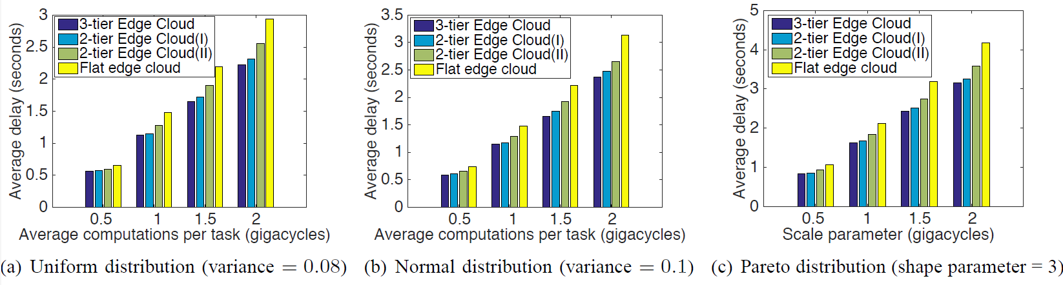
Effect of computation amounts
Workload placement algorithm is used
Data size: normal distribution with an average of 5 MB
Up to 40% delay deduction
Notes:
Here is the numerical results. As you can see from the figures, the proposed edge cloud architecture can reduce up to 40% delay compared to the flat edge cloud. Particularly the 3-tier edge cloud outperform other edge clouds with less total delay. The major reason is that the 3-tier edge cloud provisions more capacity on the higher tiers and less capacity on the first tier, therefore it has a more efficient iterative aggregation of the peak load

Slide 24
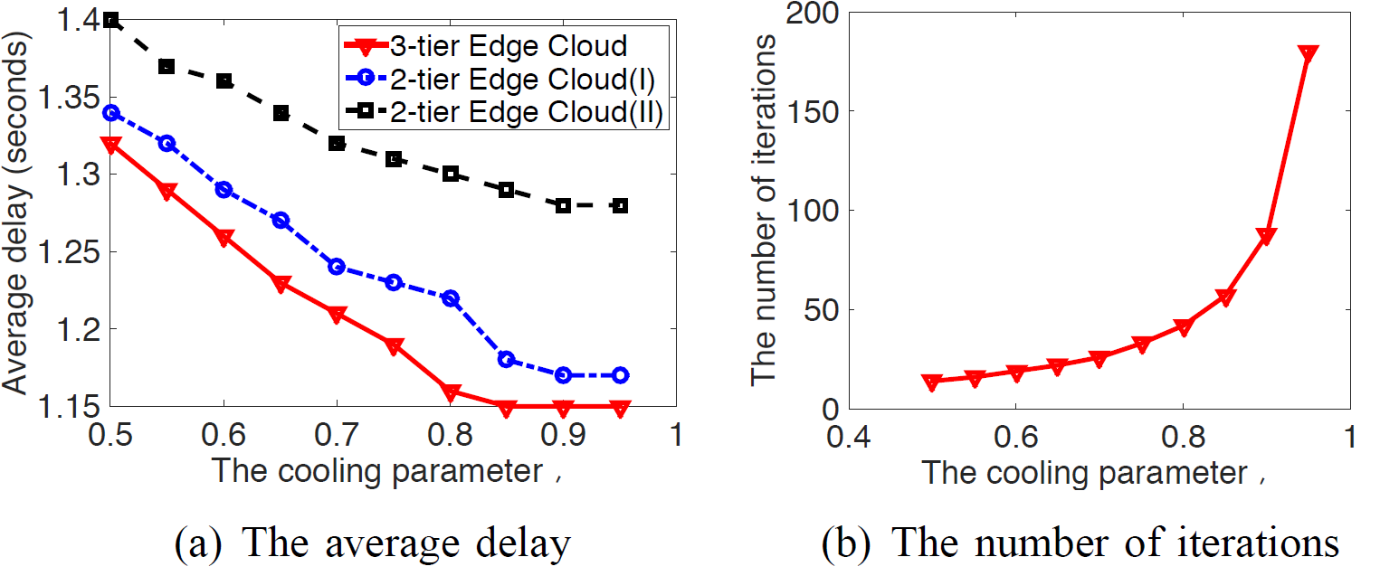
Effect SA cooling parameter
Performance when cooling parameter varies
Insights: there exists a tradeoff between performance and overhead of workload placement
Notes:
We also measure the effect of the SA cooling parameter. As shown in the figures, the t3-tier edge cloud outperforms 2-tier edge cloud at different cooling parameters. With a large cooling parameter, the performance can be improved, but more iterations are needed, which indicates a larger time complexity. Therefore, there is a tradeoff between the performance and overhead of the workload placement problem.
[Where is the summary page????]

Slide 25
Summary
Offloading computations to remote cloud could hurt the performance of mobile apps
Long network communication latency
Cloudlet could not always reduce response time for mobile apps
Limited computing resources
Hierarchical edge cloud improve the efficiency of resource utilization
Opportunistically aggregate peak loads
Notes:
Here I would like to summarize the content above shortly. First… Second…Third….Finally

Slide 26
Thank you!
Questions?
The paper and slides are also available at:
http://web.eecs.utk.edu/~weigao
Notes:
I think that's about it. I'd like to thank you all for coming in today. Do you have any questions?

