Slide 1
Application-Aware Traffic Scheduling for Workload Offloading in Mobile Clouds
Liang Tong, Wei Gao
University of Tennessee – Knoxville
Notes:
Thank you for your nice introduction. Good morning, everyone. It is my honour to be here to present our paper “Application-Aware Traffic Scheduling for Workload Offloading in Mobile Clouds”. This paper is coauthored with my advisor Professor Wei Gao at the University of Tennessee

Slide 2






Cloud Computing for mobile devices
Contradiction between limited battery and complex mobile applications
Mobile Cloud Computing (MCC)
Offloading local computations to remote execution via wireless communication
Notes:
I’d like to begin with the background and motivation. Current mobile apps are becoming more and more computing-intensive, such as gaming and speech recognitions. These applications increase the requirements on smartphones’ capabilities in computation, communication, and storage, and seriously reduce the smartphones’ battery lifetime. As a viable solution to bridge the gap between limited capabilities of mobile devices and the increasing users’ demand of mobile multimedia applications, Mobile Cloud computing enables mobile devices to offload the computational workloads from local devices to the cloud. Therefore, the local capacity of the devices is augmented and they can have a longer battery life.

Slide 3

Cloud Computing for mobile devices
Wireless communication is expensive!
A
3G/4G, WiFi
B
Application process
Partitioning workloads at the method level
B
Local execution > wireless data transmission
How to measure the cost?
Notes:
The major challenge of MCC is that data transmission between mobile devices and the remote cloud through cellular networks is expensive. Therefore, instead of offloading the entire program to the remote cloud, researchers suggest to adaptively partition the program into methods and offload a portion of methods to the remote cloud. Their motivation is to ensure that the amount of local computational energy saved is larger than the energy consumed by the wireless data transmission. Here is a question: how to measure the wireless transmission cost and what characteristics it has?

Slide 4
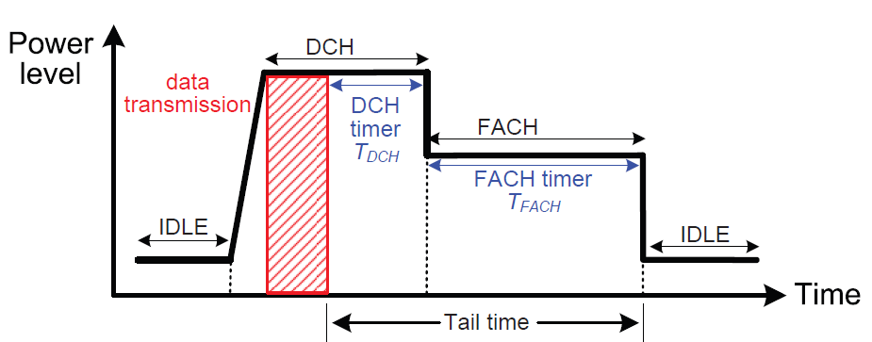
Cost of wireless transmission
Energy consumption during wireless transmission
Energy model of the UMTS cellular radio interface
High power state
Up to 10 seconds
A large portion of wireless energy consumption happens during tail times!
Notes:
To measure the cost of wireless transmission, we observe that some special network characteristics should be taken into account. Take a look at this figure. It shows the energy model of a typical data transmission over cellular networks. The cellular radio interface can work at three states: IDLE, DCH, and FACH. It stays in the IDLE state and consumes little power when the radio is turned on, once there is data transmission, it switches to the DCH state and the power level is very high. Note that when the transmission is completed, the radio will not return to IDLE immediately. Instead, it stays at the FACH state which still has a high power level even for 10 seconds. Such duration is also called tail time, and a large amount of additional energy is consumed during this tail time.

Slide 5
Existing solution
Deferral and bundling
deferral
Only one tail left
bundling
The tail time phenomenon can be alleviated
No!
Good enough?
Notes:
To alleviate the additional energy cost during tail time, the most straightforward existing solution is to defer some transmissions and then send the data by bundles. This figure here illustrates how it works. The red and blue ones represent transmissions and the green ones are tails. As you can see, by deferring and bundling, the two transmissions can be sent together, and there is only one tail left. It seems that the tail time phenomenon can be alleviated here. However, is this approach good enough considering the app performance? Our answer is NO.

Slide 6
Why?
Ignorance of mobile app characteristics
interdependency & causality?
delay constraint?
Run-time dynamics?
Application performance could be seriously degraded!
Notes:
Why? The main reason is that the existing solutions only focus on the network perspective and ignores the specific mobile app characteristics. The first one is delay constraint of mobile app. As the mobile apps are delay-sensitive, we cannot defer the transmission arbitrarily. The second characteristic is interdependency and causality between computation and communication. E.g., a method is offloaded to the remote cloud only when the methods beforehand are all executed. The third one is the run-time dynamics among different applications, as there are multiple applications running on a mobile devices, which are different in input data, user operations, and system contexts. Such run-time dynamics lead to uncertainty of the wireless transmission pattern. Therefore, ignorance of the characteristics could seriously degrade application performance, as it ignores the tradeoff between performance and energy efficiency of MCC.
the existing solutions only focuses on the networking perspective and ignores the specific mobile app characteristics

Slide 7
Our solution
Key idea:
Adaptively balancing the energy/delay tradeoff
Taking both causality and run-time dynamics of application method executions into account
Solutions
Optimal scheduling
Causality
Offline scheduling
Heuristic scheduling
Run-time dynamics
Online scheduling
Notes:
To adaptively balance the tradeoff between application performance and energy efficiency, our main idea is to take both causality and run-time dynamics of application method executions into account, to minimize the wireless energy cost while satisfying application delay constraints. By taking causality into account, we first develop efficient algorithms for offline transmission scheduling in MCC, which is based on a pre-known sequence of transmissions to be scheduled. By taking run-time dynamics into account, we incorporate the run-time dynamics of mobile application executions into transmission scheduling by developing a stochastic framework, so that we can extend the transmission scheduling algorithms to online operations.

Slide 8

System model
Multiple applications are running concurrently. For application i:
Delay constraint: $D_{i}$
Execution path: $\left\{M_{1}^{i},M_{2}^{i}, …,M_{n_{i}}^{i}\right\}$.
Offloading decisions: existing work
Causality
Notes:
I’d like to move onto the system model. We consider a generic scenario of MCC where multiple applications are running concurrently. Each application i has its own delay constraint Di. Each application is partitioned to methods and these methods can only be invoked sequentially. Here is a figure showing our system model, please note that the interdependency and causality between method executions and wireless transmissions. For example here M2 and M3 could only be executed at the remote cloud after the completion of T1. Therefore, deferring one transmission would impact other method executions and data transmissions. e.g. when T1 is deferred, T2 and T3 should also be deferred because the interval between these transmissions can not be shortened due to the method executions in between.
[explain further: if T1 is deferred, T2 and T3 should also be deferred, because the interval between T1 and T2 cannot be changed due to method executions in between].

Slide 9
Challenge
How to eliminate transmission overlaps?
deferral
cascaded
delay
transmission
overlap
Additional delay to eliminate overlaps. But how long?
Notes:
Here is an example how the deferral of one transmission would impact other transmissions, which is also the main challenge of our design. As you can see from the figure, when one transmission is deferred for d1, the posterior transmissions should also be deferred at least d1 since because of the causality between transmissions. As shown in the figure, such deferral could incur transmission overlaps, which indicates a conflict on the wireless channel. To avoid such contentions, an additional delay is needed to eliminate overlaps. But the question is, what’s the optimal value for these cascaded delay considering the tradeoff between energy efficiency and app performance?

Slide 10
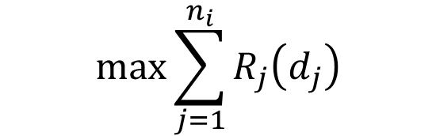
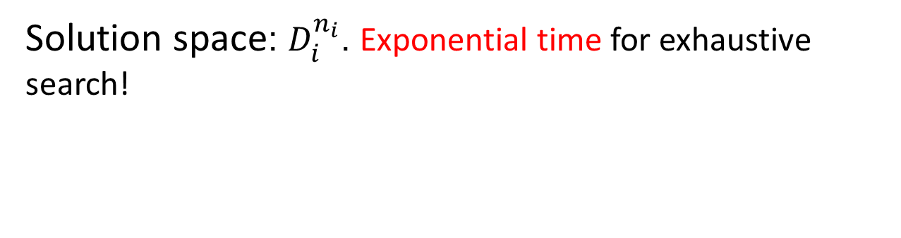


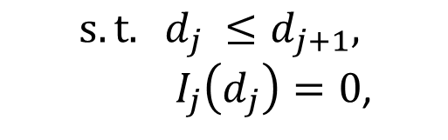
Offline transmission scheduling
Problem formulation
$$\max{\sum_{j=1}^{n_{i}}{R_{j}\left(d_{j}\right)}}$$
Total number of bundling
$${s.t. d}_{j} ≤d_{j+1},$$
${ I}_{j}\left(d_{j}\right)=0$,
transmission causality
overlap elimination
$$\text{0 }≤ d_{k} ≤ D_{i}\text{,} \left(k ≤ n_{i} \right),$$
delay constraint
$$d_{j} ∈N$$
Solution space: $D_{i}^{n_{i}}$. Exponential time for exhaustive search!
How to find optimal solution with a low complexity?
Notes:
Just now we mentioned that the objective is to maximize the total number of bundles, as more bundles there are, more tail energy could be eliminated. So how about the constraints? Firstly, each delay is subject to transmission delay, which means delay of T(j+1 ) should be at least no less than the former one. Secondly, the transmission overlaps should be eliminated, as we use an identifying function here to indicate whether a transmission will overlap with another one when it is deferred by dj. Finally, each delay is constrained by the delay constraint. As you can see, this optimization problem has an exponential solution space. Therefore, we need to design efficient algorithms to find the optimal solution.

Slide 11

Optimal transmission scheduling (OTS)
Basic idea
Solve problems by combining the solutions to subproblems
subproblem 1
subproblem 2
subproblem 3
Dynamic Programming
BUNDLE($j$, $k$): subproblem with j transmissions and delay constraint k
Guarantee of optimal solution
BUNDLE($n_{i},D_{i}$) has an optimal substructure
What are the optimal solutions for subproblems?
Notes:
Here I would like to introduce our algorithm design to solve the integer programming problem in an efficient way. As the solution space is discrete and with an exponential size, our basic idea is to solve the problems by combining the solutions to overlapping subproblems, so that we can eliminate repeated computations. Considering the causality among transmissions, we adopt dynamic programming. We first define a subproblem with j transmissions and a delay constraint k. We then formally prove that the scheduling problem has an optimal substructure, which means an optimal solution can be constructed from optimal solutions of its subproblems. Therefore, the problem has an optimal solution as the optimal substructure is a sufficient condition that a problem can be solved by dynamic programming. Right now the key point is what is the optimal solutions of the subproblems and what is their internal relationships?
[you cannot assume that everyone is familiar with DP: so what’s the state here? How DP works with the states? Explain!!!!]

Slide 12

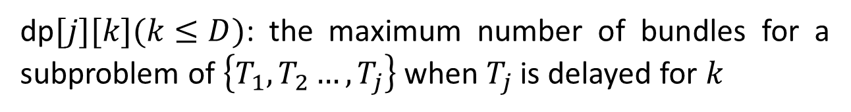

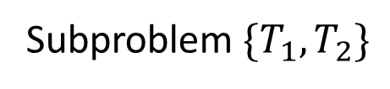

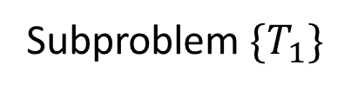
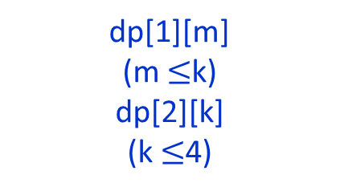
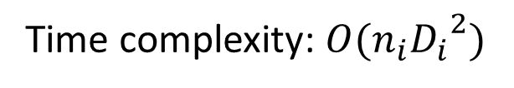
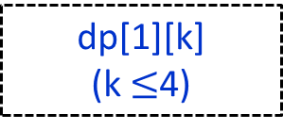
Optimal transmission scheduling (OTS)
Optimal solutions of subproblems
dp$[j][k](k≤D)$: the maximum number of bundles for a subproblem of $\left\{T_{1},T_{2}…,T_{j}\right\}$ when $T_{j}$ is delayed for $k$
$$T_{1}$$
$$T_{2}$$
$$D_{i}=4$$
Subproblem${\{T}_{1}\}$
Subproblem${\{T}_{1},T_{2}\}$
dp[1][k]
(k $≤$4)
dp[1][m]
(m $≤$k)
dp[2][k]
(k $≤$4)
Causality
Delay constraint
Time complexity: $O(n_{i}{D_{i}}^{2})$
Notes:
Here we use a two dimensional array to describe the optimal solution for a subproblem. One dimension here represents the last transmission of the subproblem, the other one stands for the delay for this transmission. I’d like you to look at this figure to show how it works. This is a scenario where two transmissions need scheduling. We first derives the maximum number of bundles when T_1 is deferred by k, where k <= 4 due to the delay constraint. We then derives the maximum number of bundles when T_2 is deferred by k as well. Each time T_2 is deferred by k, it contains the subproblem that T_1 is deferred by no larger than k. Therefore, the optimal values for subproblem {T_1} can help to recursively get the optimal values for subproblem {T1,T2}. Note that the time complexity of the algorithm is O(n_i*D_i^2)

Slide 13
Improvement of Computational Efficiency
Problem: large computational overhead of OTS
Time complexity of OTS: $O\left(n_{i}{D_{i}}^{2}\right)$
$D_{i}$ could be very large
Solution: 2-stage transmission scheduling
Eliminating transmission overlaps heuristically
Stage 1:
Posterior overlap elimination
Stage 2:
Prior overlap avoidance
Notes:
As you remember, the time complexity for the optimal transition scheduling is O(n_i D_i^2). Where n_i is the number of transmissions to be scheduled, and D_i is the delay constraint in unit of time slots. When the delay constraint is very large, then the optimal scheduling approach could incur a large amount of computational overhead. To further improve the computational efficiency, we further propose a 2-stage scheduling approach which heuristically eliminates transmission overlaps with a relatively lower time complexity and a good solution in practice. The basic idea is we first eliminate the transmission overlap in a posterior manner, then we eliminate the other overlaps left in a prior manner.

Slide 14
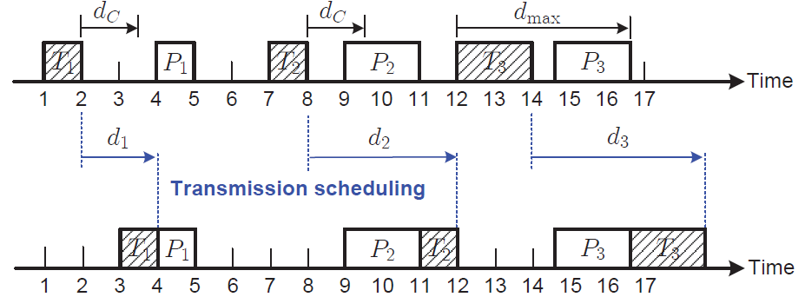

Improvement of Computational Efficiency
Posterior overlap elimination
Iteratively looking for the maximally allowed transmission delay within the application delay constraint
Eliminating the transmission overlap due to such delay in a posterior manner
$O({n_{i}}^{2})$
Notes:
In the first stage, we iteratively look for the maximally allowed transmission delay within the application delay constraint, then we eliminate the transmission overlap due to such delay in a posterior manner. As illustrated in the figure, each transmission can be deferred in front of or after an existing transmission. We can see that when T_3 is deferred behind P_3, it has the maximum allowed delay, and such a maximum delay can guarantee that all the other transmissions prior to T_3 can be deferred and bundling with other transmissions without transmission overlaps, since all the other transmissions prior to T_3 only need a shorter delay to be bundled with existing transmissions. The maximally allowed transmission delay will be iteratively looked for until it reached the delay constraint. Note that the posterior overlap elimination method only has a time complexity O(ni^2), which is much lower than the optimal scheduling approach.

Slide 15
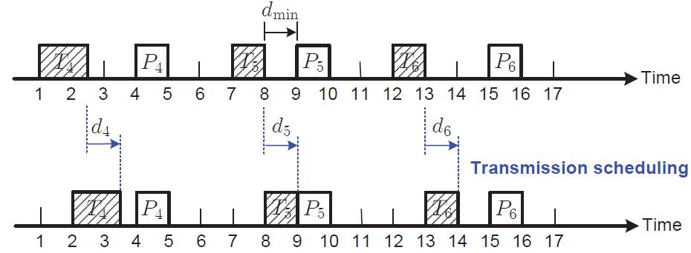

Improvement of Computational Efficiency
Prior overlap avoidance
Iteratively looking for the minimum transmission delay
Ensure that all possible overlaps could be avoided in a prior manner
$O({n_{i}}^{2})$
Notes:
In the second stage, different from stage 1, we iteratively look for the minimum transmission delay. We then use this minimum delay to defer all transmissions prior to the corresponding transmission. In this way, we avoid any overlap prior to this transmission because only the interval between this transmission and its next transmission is reduced to 0 after scheduling. As shown in the figure, the minimum delay is 1 and there is no overlaps for transmission 4, 5 and 6 after being deferred by 1. Like the posterior approach, the prior approach also has a time complexity O(n_i^2) which is also significantly improved compared to the optimal transmission scheduling approach.

Slide 16
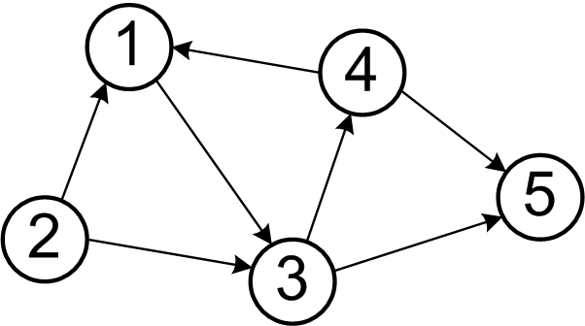
Online transmission scheduling
Prediction of application execution path
Formulating method transitions as an order-k semi-Markov model
Semi-markov: arbitrary sojourn times
between method transitions
Order-k: precise prediction of method
Invocation (k-step interdependency)
Method execution times
Incorporation of run-time dynamics
Predicting the number of future method invocations
Predicting the execution time of method to be invoked in
the future
Notes:
Just now we talked about how to schedule in an offline manner, where we have the complete knowledge of the sequence of transmissions. Here I’d like to introduce how to extend the proposed offline scheduling by incorporating run-time dynamics of application executions, without knowing the application execution pattern in the future. This means we predict the execution paths of applications in the future from the past history of their method invocations. We adopt our previous work which formulates the method transitions as an order-k semi Markov model. Note that here order-k means that the invocation of a method is determined by the former k invocations. Based on this formulation, we can furtherly predict the number of future method invocations and the execution time of method to be invoked in the future.

Slide 17
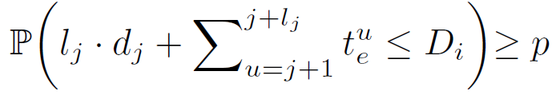
Online transmission scheduling
Probabilistic transmission scheduling
A probabilistic framework to adaptively schedule each transmission
Probabilistically estimate the cumulative transmission delay
Predicted number
of future execution
Predicted execution time
Cumulative
deferral
Cumulative
Execution time
Notes:
Based on the above formulation, we further develop a probabilistic framework to adaptively schedule each transmission by deferring d_j when it is requested by the application. Our basic idea is to probabilistically estimate the cumulative transition delay, and make it less than the delay constraint with a probability guarantee. Here the cumulative delay can be derived by adding the cumulative deferral and cumulative execution time together, where the predicted number of future execution and predicted execution time for future method invocation can be derived by our semi k-order markov model. Note that the probabilistic framework here provides an upper bound for d_j.

Slide 18
Performance evaluations
Comparisons
Bundle transmission: performance requirements and delay constraint are not considered.
Fast dormancy: the mobile device switches to IDLE quickly after data transmission
RSG: run-time causality and dynamics are ignored.
Evaluation metrics
Application completion ratio
Amount of energy saved
Computational overhead
The percentage of the energy consumption of application
executions
Notes:
Now we introduce the performance evaluation result of our system. We compare our transmission scheduling approach with bundle transmissions, fast dormancy and RSG. We evaluate our system in three metrics. The first is the application completion ratio, which is the percentage of application executions that are completed within the constraint of delay. The second metric is amount of energy saved. The last metric is the computational overhead. Which measures the percentage of the energy consumption of application executions
.

Slide 19
Evaluation setup
Evaluation against open-source Android apps
Firefox, Chess-Walk, Barcode Scanner.
Implementing the transmission scheduling approach into app codes
Offloading operations
Adopt MAUI for workload offloading decisions
Adopt CloneCloud to maintain a clone VM at the cloud server for each app
Experiments
100 times with different input data for statistical convergence
Notes:
We evaluate our system against three real Android mobile apps downloaded from Google Play – Firefox, Chess walk and barcode scanner. We embed the implementation of workload offloading and transmission scheduling approaches into the source code of each application. We also existing work to make offloading decisions and maintain a clone VM at the Cloud server. Each experiment on a mobile application is conducted 100 times with different input datasets.

Slide 20
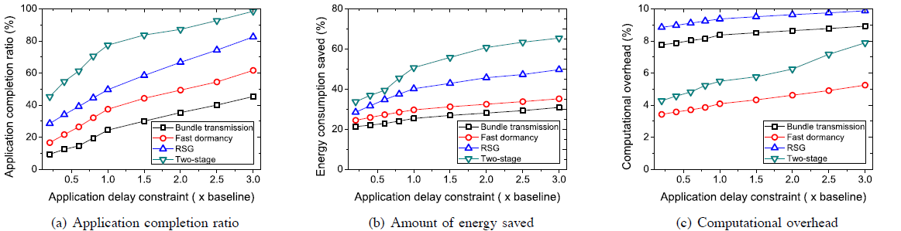
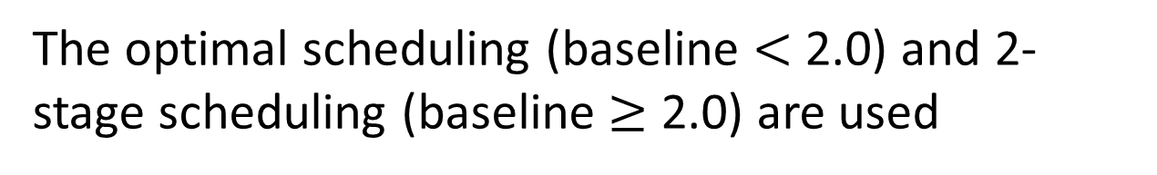
Effectiveness of offline scheduling
The optimal scheduling (baseline $<$ 2.0) and 2-stage scheduling (baseline $≥$ 2.0) are used
Baseline: completion time of local application executions
25% more completion ratio
40% more energy saved
Less than 4% overhead
Notes:
From our system evaluation result, we can see that we can get at least 25% more completion ratio. In addition, we can get 40% of energy saving in the offloaded method execution. We can also get 4% computational overhead. Note that when application delay constraint is tight, the improvement on energy efficiency is limited because the cascaded delay during scheduling incurs more overlaps among transmissions, therefore the energy efficiency of wireless network is degraded.

Slide 21
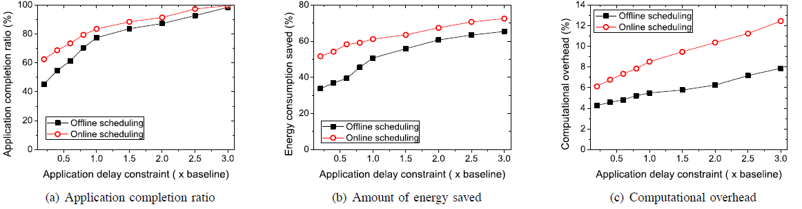
Effectiveness of online scheduling
An order-3 semi-Markov model is used
Online transmission algorithm performs better
Higher overhead is incurred
20% more completion ratio
25% more energy saved
more than 50% overhead
Notes:
We also measure the effectiveness of online scheduling. As you can see in the figures, the online scheduling approach can achieve 20% more completion ratio and save 25% more energy compared to the offline scheduling. The main reason is that the online algorithm incorporates run-time dynamics of application executions and can better predict of application executions. Note that online scheduling algorithm incurs higher computational overhead especially when the delay constraint is larger than 1.5, the online scheduling incurs 50% higher overhead. This suggest that online algorithms are more suitable with short application delay constraints. [Add the summary page]

Slide 22
Summary
Mobile Cloud Computing is critical to
Augment mobile devices’ local capabilities
Energy saving
MCC offloading energy efficiency is determined by wireless transmission scheduling
Insight: exploiting run-time causality and dynamics is the key
Offline algorithm with causality being considered
Online algorithm incorporating with run-time dynamics
Notes:
Now I'd like to summarize the above content shortly. First...Second...Our insight is that by exploiting run-time causality and dynamics, we can significantly improve the mobile apps performance while saving more energy.

Slide 23
Thank you!
Questions?
The paper and slides are also available at:
http://web.eecs.utk.edu/~weigao/
Notes:
I think that's about it. I'd like to thank you all for coming in today. Do you have any questions?

