Slide 1
Arrays
2017 first semester
Basis and Practice in Programming

Slide 2
How to use ‘Array’
Declaration
Initialization
variable_type array_name[the number of element];
example)
int score[10], map[100][100];
char gender[20];
int score[5]={0};
char gender[5]={‘F’, ’F’, ’M’, ’F’, ’M’};
char last_name[5]=“jhin”;
index
0 | 1 | 2 | 3 | 4
0 | 0 | 0 | 0 | 0
score
gender
F | F | M | F | M
last_name
j | h | i | n | \0

Slide 3
How to use ‘Array’
Set a value into an element of array
result
int score[5], i;
i=3;
score[1] = 5;
score[i] = 8;
printf(“%d %d\n”, score[1], score[i]);
index
0 | 1 | 2 | 3 | 4
? | 5 | ? | 8 | ?
score
5 8

Slide 4
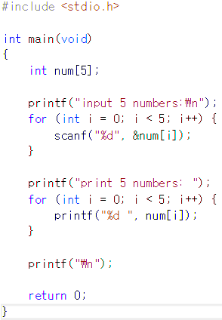
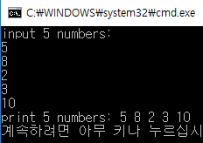
Practice 1
Declare an array with 5 elements of type int
Get 5 integer numbers using ‘scanf’ into the array
Print the values using loop
Α
RESULT
Α

Slide 5
Solution - Practice 1
RESULT

Slide 6
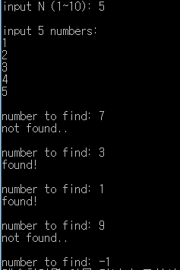
Practice 2
Declare an array with 10 elements of type int and a variable named ‘N’ of type int
Get a integer number less or equal than 10 using ‘scanf’ into ‘N’
Get N natural numbers using ‘scanf’ into the array
Get a integer number ※ if the number is equal to ‘-1’, exit the loop.
If the input number is in the array, print ‘found’. Otherwise, print ‘not found’.
RESULT
Infinite Loop

Slide 7
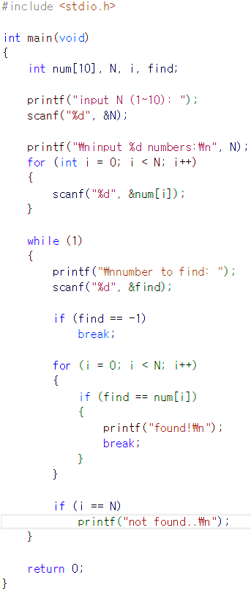
Solution - Practice 2
RESULT

Slide 8
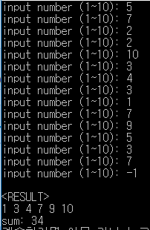
Practice 3
Find the numbers entered odd times
Input : natural numbers less than or equal to ’10’ get input number until you get ‘-1’
Output: the numbers entered odd times, and the summation of them.
RESULT

Slide 9
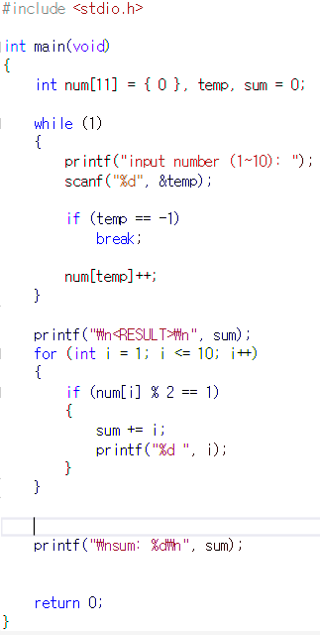
Solution – Practice 3

Slide 10

Exercise
Find the alphabets entered odd times (case sensitive)
Input : a string of alphabetic characters
Output: the alphabets entered odd times (case sensitive)
RESULT

Slide 11
Appendix
숫자 정렬: N개의 숫자들을 입력 받아 내림차순으로 정렬하여 출력
Example) input: 5 3 9 1 10 4
output: 1 3 4 9 10

Slide 12
Appendix
달팽이 수열
Example) input: 5 output:
1 | 2 | 3 | 4 | 5
16 | 17 | 18 | 19 | 6
15 | 24 | 25 | 20 | 7
14 | 23 | 22 | 21 | 8
13 | 12 | 11 | 10 | 9

Slide 13
Appendix
Calculator for BIG number
Use array!
Input: two integer number Input number can be too large or small to store in a variable example) 2220540000 -3350222947
Output: sum of the two inputs example) -1129682947

Slide 14
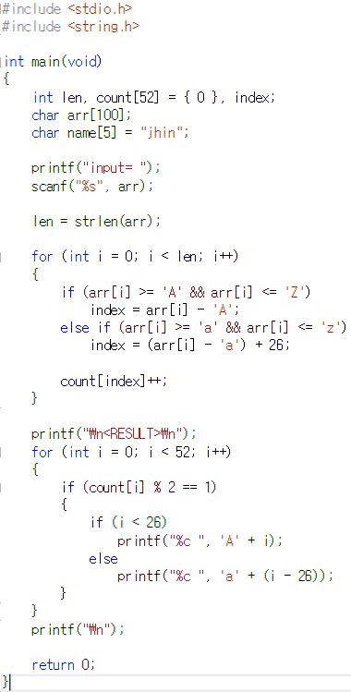
Solution - Exercise

