Slide 1
Pointers
2017 first semester
Basis and Practice in Programming

Slide 2
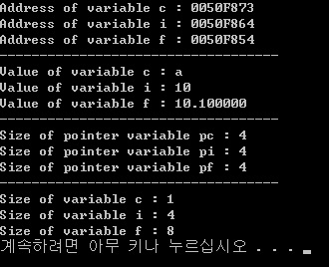
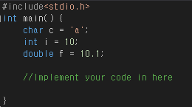
Practice 1
Declaring pointer variables pc, pi, pf
Assign the address of variables c, i and f to pc, pi and pf
Through pointer variables,
Print the address of a variable c, i and f
Print the value of a variable c, i and f
Print the size of pointer variable pc, pi and pf
Print the size of variable c, i and f

Slide 3
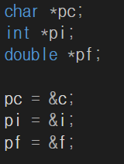


OR
c
‘a’
0050F873
pc
0050F873
(address)
i
10
0050F864
pi
0050F864
f
10.1
0050F854
pf
0050F854

Slide 4
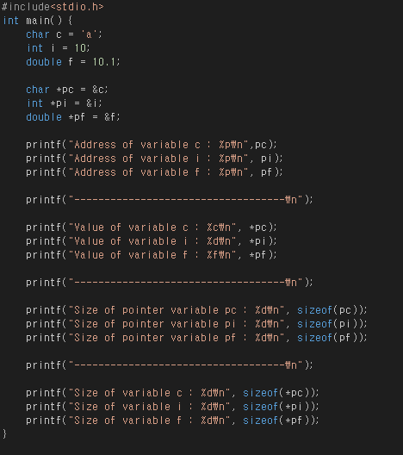
Priactice1 - Solution

Slide 5
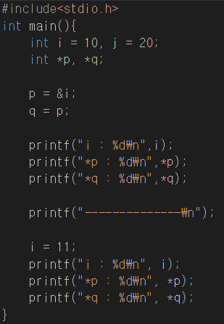
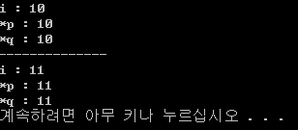
Practice 2 - 1
0050F873
p
10
i
11
0050F873
0050F873
q

Slide 6
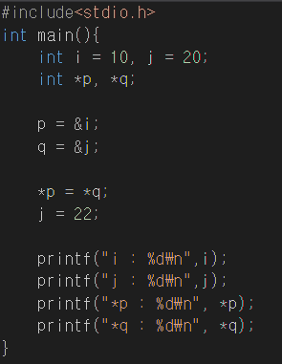

Practice 2 - 2
20
i
10
0050F873
p
0050F873
20
j
22
0050F864
q
0050F864

Slide 7
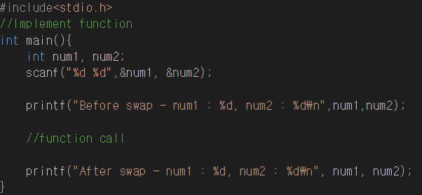

Practice 3
Request two integer numbers from the user.
Implement function
In function, swap two value.

Slide 8
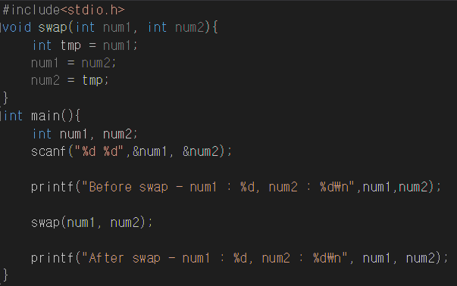
Practice 3 – Call by value ( mistake )
Memory
swap function
Address
Address
num1
3
0050F873
a
3
00F0FB78
num2
7
0050F864
b
7
00F0FB7C

Slide 9
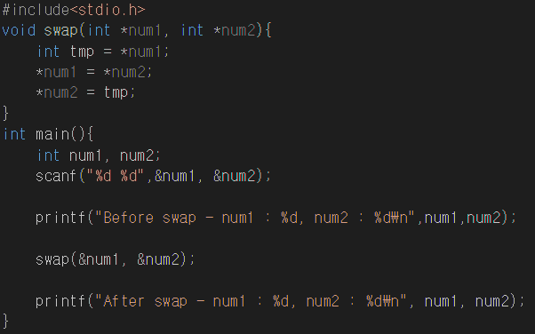
Practice3 – Call by reference ( solution )
Memory
Address
swap function
num1
3
0050F873
a
0050F873
num2
7
0050F864
b
0050F864

Slide 10
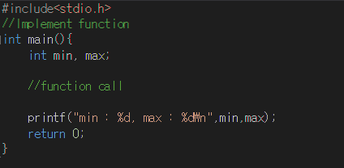
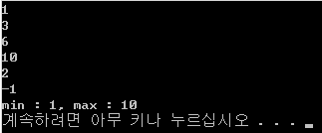
Exercise
Through function
get Integer numbers ( > 0) from user until -1 is entered.
Find minimum& maximum number and assign these values to pre-declared min & max variable.
Only function call is possible in main function. (not possible any variable declaration or operation in main function
It is assumed that at least one number is entered, except -1.

Slide 11
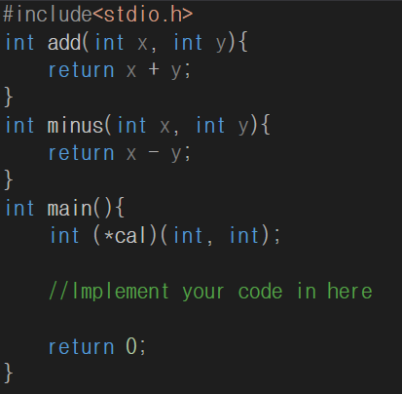

Appendix1 – function pointer
Get two integer numbers and operator(+,-) from user.
Using function pointer cal and pre-implemented function, print the result of calculation

Slide 12
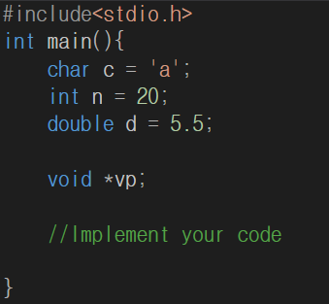

Appendix2 – void pointer
Through void pointer variable vp, print the values of c, n and d

