Slide 1
Dynamic Allocation
2017 first semester
Basis and Practice in Programming

Slide 2
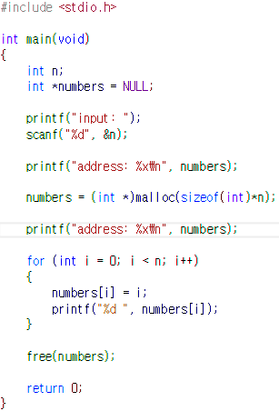

Practice 1 - 1
RESULT

Slide 3
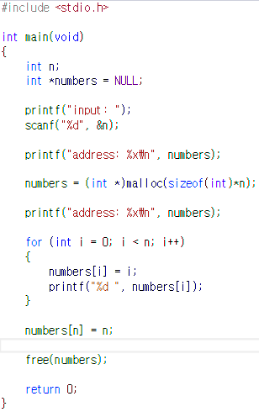
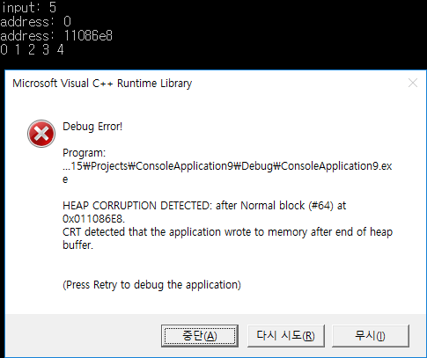
Practice 1 - 2
RESULT

Slide 4
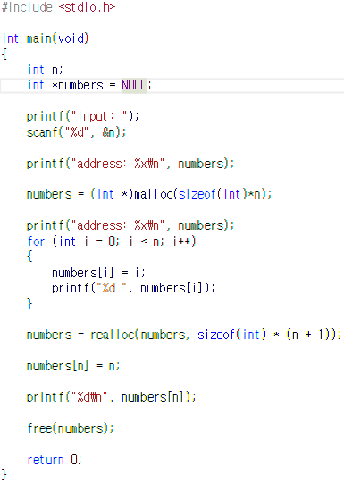

Practice 1 - 3
RESULT

Slide 5
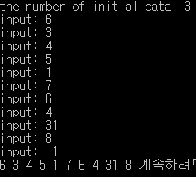
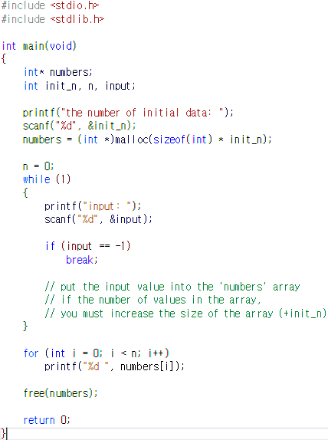
Practice 2
RESULT
Get an natural number ‘init_n’
Dynamically allocate an array of which the size is equal to ‘init_n’
Get natural numbers and put the value into the array until you enter ‘-1’
If the number of values in the array, you must increase the size of the array as ‘init_n’

Slide 6
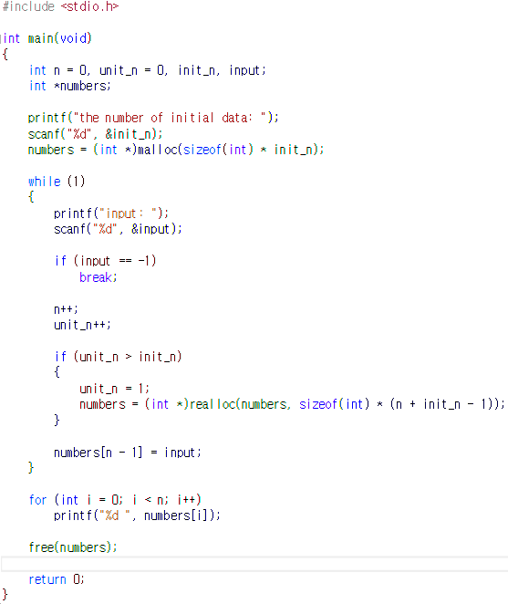
Solution(1) - Practice 2
RESULT

Slide 7
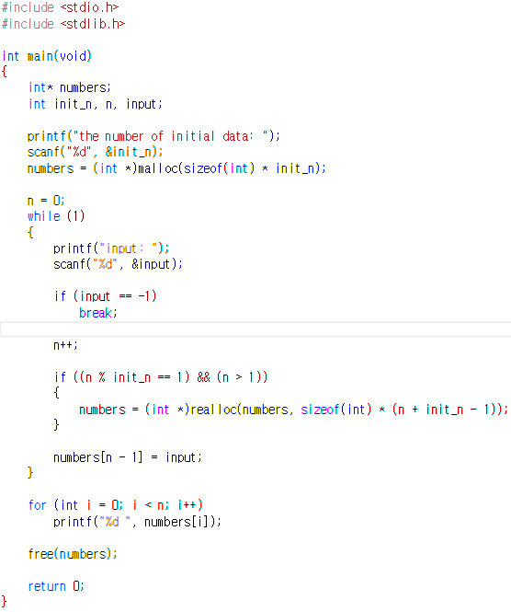
Solution(2) - Practice 2
RESULT

Slide 8
Practice 3
int a = 3;
int *pa = &a;
pa
1000
a
3
Address: 1000
int *pa = (int *) malloc(sizeof(int)*3);
pa[0] = 0; pa[1] = 1; pa[2] = 2;
pa
2000
0
1
2
Address: 2000

Slide 9
Practice 3
p
1000
2000
int a = 3; int b = 5;
int *p[2];
p[0] = &a; p[1] = &b;
a
3
b
3
Address: 1000
Address: 2000
int *p[2];
p[0] = (int *) malloc(sizeof(int)*3);
p[1] = (int *) malloc(sizeof(int)*2);
p[0][0] = 1; p[0][1] = 2; p[0][2] = 3;
p[1][0] = 6; p[1][1] = 4;
Address: 2000
p
1000
2000
6
4
p
1
2
3
6
4
1
2
3
Address: 1000

Slide 10
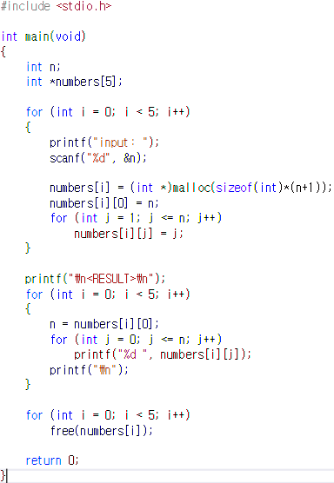
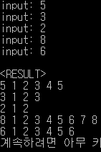
Practice 3
RESULT
5
1
2
3
4
5
3
1
2
3
2
1
2
?
8
1
2
3
4
5
6
7
8
6
1
2
3
4
5
6

Slide 11
Practice 3
RESULT

Slide 12
Appendix 1
Implement myrealloc
Parameters: address of memory space dynamically allocated, the size of increased memory
Return Value: address of increased memory
In the solution code of practice 2, Replace ‘realloc’ function with ‘myrealloc’.

Slide 13
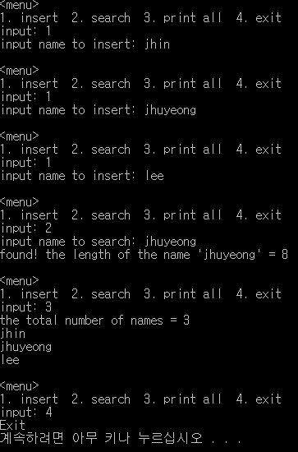
Appendix 2
Get several names until the number of input names is equal to 20
Search one of them and Print it with its length
Print them all
When you terminates this program, free all memory that you allocated
RESULT

Slide 14
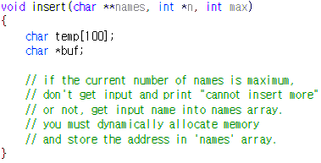
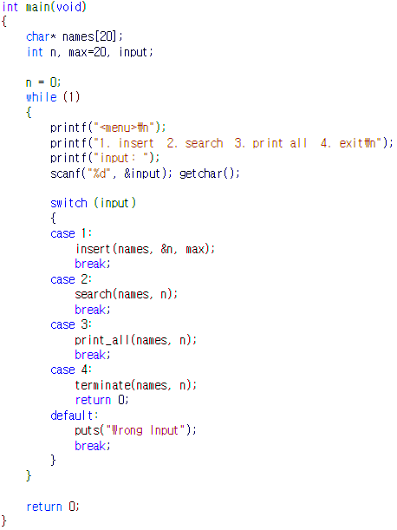
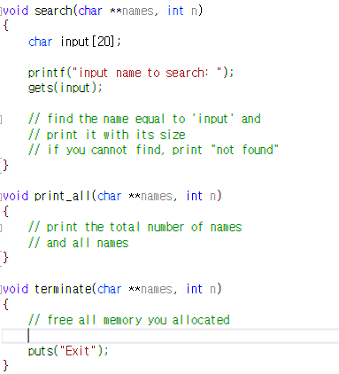
Appendix 2 - Template

