Slide 1
2026-1 Research Method in Housing and Interior Design
An Approach to Quantifying
Placeness Using Spatial
Review Text Data
Using User Reviews of Cafés in Seoul
Ji-Won Shin
Department of Interior Architecture, Yonsei University
Placeness
Review text data
Quantification

Slide 2
BACKGROUND
Research Focus
This study aims to quantify placeness,
a qualitative and subjective concept.

Slide 3
BACKGROUND
Research Highlights
• Placeness has mostly been evaluated through subjective methods such as surveys and observation, which motivates a data-based and LLM-assisted quantitative approach.
• Placeness is structured into three dimensions and ten detailed factors based on placeness theory and prior studies.
• A logical scoring framework is proposed to extract, classify, and quantify placeness factors from spatial review data.
• The empirical analysis uses Google Maps reviews collected from cafés in Seoul.
• The quantified results can be extended to place recommendation, search, and comparison.
Contribution: converting qualitative place experience into comparable placeness indicators

Slide 4
LITERATURE REVIEW
Placeness Theory
Placeness is understood as a multidimensional concept formed through the interaction of physical environment, human activity, and meaning.
Physical characteristics
Activity-related characteristics
Meaning-related characteristics
Observable spatial and environmental qualities
Behaviors, uses, and social interactions within space
Memory, preference, symbolism, and identity formed through experience

Slide 5
LITERATURE REVIEW
Components of Placeness
Physical
Spatial form
Environment
Accessibility
Activity
Staying
Working
Meeting
Interacting
Meaning
Memory
Preference
Symbolism
Identity
Placeness
Placeness emerges through the interaction of these three components.

Slide 6
LITERATURE REVIEW
Relph’s Core Components of Placeness
Relph explains the identity of place through the relationship among physical setting, activities, and meanings.
Relph’s definition
Physical setting
Activities
Meanings
Material and spatial conditions that form the setting of experience.
Actions and patterns of use that occur in the place.
Values, memories, and interpretations attached to the place.
Reference: Edward Relph, Place and Placelessness (1976)

Slide 7
LITERATURE REVIEW
Placeness Factors in Prior Studies
Placeness factors were selected and similar items were integrated according to the environmental characteristics of commercial spaces.
 | Author | Title | Target space | Placeness factors
1 | Guo, Hwang & Lee (2025) | User perception analysis of museum spatial design based on place characteristics | Museum | [Physical] accessibility, territoriality, attractiveness, comfort [Activity] interactivity, convenience [Meaning] symbolism, educational value
2 | Na, Lee & Lee (2025) | Analysis of placeness of major places in Seoul using text mining and large language models | 71 major places in Seoul | Symbolism, culturality, everydayness, specificity, vitality, quietness, naturalness
3 | Sun & Yu (2021) | Dimension and formation of placeness of commercial public space in city center | Commercial space | [Physical] traffic convenience, visibility, safety, comfort, openness [Activity] activity, seating, environmental pleasure [Meaning] regional landmarkness, functional context
4 | Lyu (1996) | A study on embodiment factors of sense of place in interior space | Residential space | Centrality, boundary, control, safety, comfort, symbolism, orientation, sociality, interior design elements
5 | Lee & Kim (2025) | Spatial design strategy of large cafés from the perspective of complex cultural space | Eight large cafés | Complexity, accessibility, participation, symbolism, expertise, historicity, experience, diversity, aesthetics, culture, openness, continuity
6 | Waxman (2008) | The Coffee Shop: Social and physical factors influencing place attachment | Three cafés in Alabama | [Physical] hygiene, scent, lighting, furniture, exterior view, seating layout [Activity] staying, territoriality, stability, anonymity, productivity, interaction [Meaning] emotional bond
Integrated into 3 dimensions and 10 placeness factors for commercial spaces

Slide 8
LITERATURE REVIEW
Reconstructed Placeness Factors for Commercial Spaces
Detailed placeness factors were reconstructed according to the spatial environmental characteristics of commercial spaces.
Formative elements of placeness
Spatial environmental characteristics of commercial spaces
Aesthetics
Openness
Physical characteristics
─
Sensory experience
Comfort
Accessibility
Activity-related characteristics
Activity
─
Interactivity
Symbolism
Meaning-related characteristics
─
Memory and preference
Local identity

Slide 9
LITERATURE REVIEW
Definitions and Keywords of Placeness Factors
Aesthetics
visual quality, design, atmosphere
Activity
work, reading, staying, gathering
Openness
large windows, views, spaciousness
Interaction
staff, companions, social exchange
Sensory experience
light, smell, sound, taste, tactile comfort
Symbolism
landmark, uniqueness, representative image
Accessibility
location, transit, parking, entry
Memory & preference
revisit intention, attachment, favorite place
Comfort
cleanliness, seating, temperature, crowding
Local identity
neighborhood character, local context

Slide 10
LITERATURE REVIEW
Review Expressions by Placeness Factor
Each factor was defined so that it can be identified through expressions that appear in user reviews.
Openness
“The space feels open because the windows are large.”
Accessibility
“Parking was inconvenient.”
Comfort
“The restroom was clean and well managed.”
Activity
“It is good for studying or working.”
Memory & preference
“I want to visit this café again.”
…

Slide 11
RESEARCH SCOPE
Research Target and Scope
The empirical target is cafés in Seoul, selected as a case for testing the review-based placeness quantification approach.
Study area
Spatial target
Scope limitation
Seoul, South Korea
Cafés and bakery/café-related commercial spaces
The result should be interpreted as an empirical case, not a generalization to all space types.

Slide 12
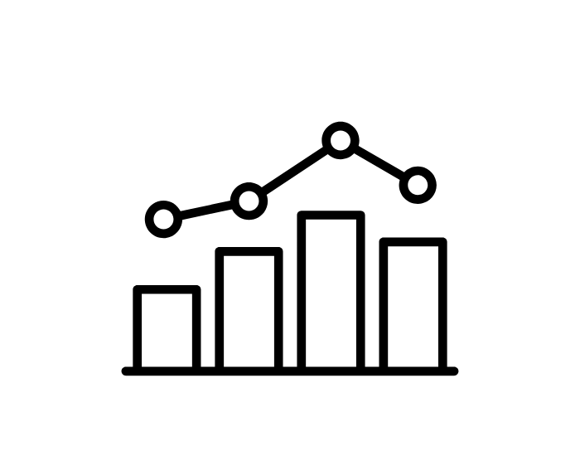


METHOD
Overview of Research
Input
Text review data
Placeness
Quantification System
Placeness factor extraction and quantification
Output
Placeness scores
Figure 1. Overview of placeness-based text review quantification approach

Slide 13
METHOD
Internal Modules of the Quantification System
Input
Text review data
Placeness
Quantification System
Placeness factor extraction and quantification
Output
Placeness scores
Placeness factor mapping module
Placeness factor scoring module
Identifies review phrases that serve as evidence and maps them to the ten placeness factors.
→
Classifies the evaluation direction of mapped evidence and calculates factor-level scores.

Slide 14
METHOD
Placeness Factor Mapping Module
The GPT-4o-mini API is used to map review phrases to placeness factors through an instruction prompt.
Task
Definitions
Keywords
Map review phrases to one or more placeness factors.
Provide definitions of the ten placeness factors.
Provide keywords and review-observable expressions.
Examples
Output
Provide positive and negative examples for each factor.
Return mapped factor and supporting phrase.

Slide 15
METHOD
Input: “창이 커서 개방감이 좋고, 주차는 불편했다.”
Placeness Factor Mapping Module Example
Instruction Prompt
Task
Definition
The GPT-4o-mini API is used to map review phrases to placeness factors through an instruction prompt.
“리뷰 문장에서 다음 10가지 장소성 요인 중 어떤 요인을 언급하는지 다중 라벨로 매핑한다. …”
개방성: 공간의 배치와 시야 구성이 외부 조망과 시각적 연결을 확보하여 확장감과 낮은 폐쇄감을 느끼게 하는 특성, …
Kewords
Examples
개방성: 공간 배치, 시야 연속성, 채광, 외부 조망, 통창, 넓다, 답답하다, 좌석 간격, …
positive_examples: "공간이 넓고 답답하지 않아서 좋다.", "창이 커서 개방감이 좋고 외부 뷰가 잘 보인다.“…,
negative_examples: "좌석 간격이 좁아서 답답하다.", "창이 작고 내부가 폐쇄적으로 느껴진다.“…
LLM(GPT-4o-mini)
Output:
매핑 요인 1) 개방성, 근거 구절: “창이 커서 개방감이 좋고”
매핑 요인 2) 접근성, 근거 구절: “주차는 불편했다”

Slide 16
METHOD
Placeness Factor Scoring Module
Phrase-level score
Factor score
Mention share -> Weight
Positive phrase: +1
Neutral or mixed phrase: 0
Negative phrase: -1
(positive evidence count - negative evidence count) / total evidence count for the factor
Evidence count for each factor / all placeness evidence for the place
Score range: -1 to +1. Negative values are preserved when negative evidence is dominant.

Slide 17
DATA
Data Used in This Study
1. Public commercial data
2. Sample places
3. Google Maps reviews
4. Placeness mappings
→
2,500 cafés were sampled by selecting 100 places from each of Seoul’s 25 districts.
→
34,671 reviews were collected from places with available reviews.
→
Café and bakery/donut businesses in Seoul were filtered from public commercial district data.
17,641 reviews were mapped to placeness factors across 1,486 places.
Data may be updated as review collection expands.

Slide 18
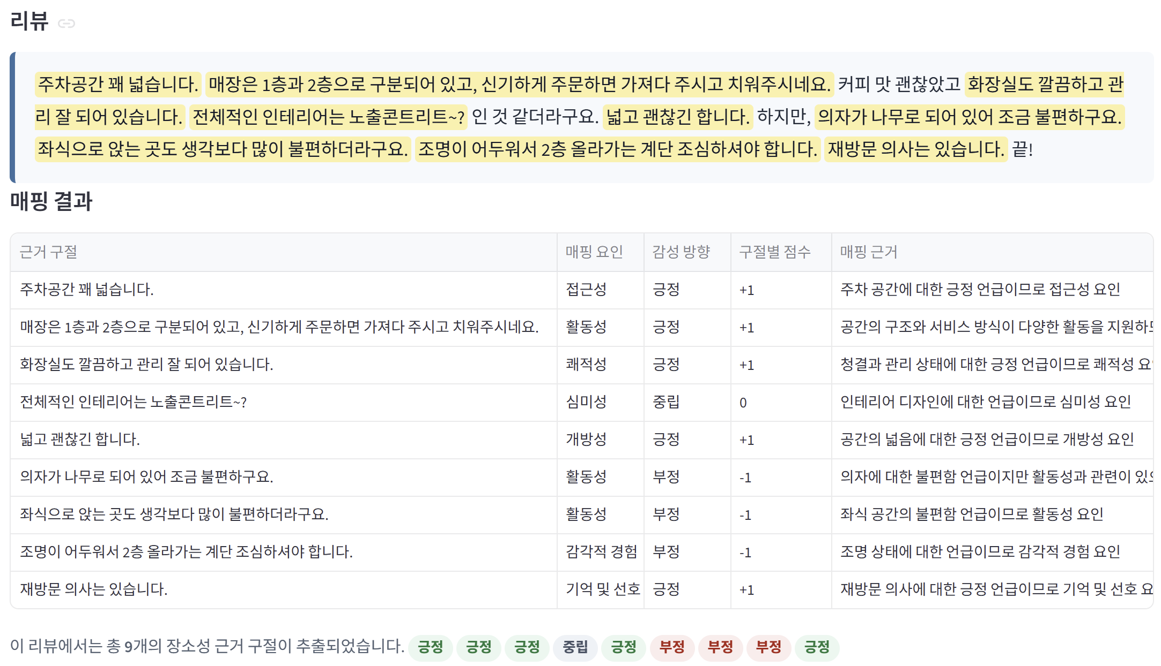
Demo and Application
https://space-agent.streamlit.app/
• Shows the process from the placeness factor framework to review mapping results and score calculation.
• Allows users to examine which review phrases support each factor score.

Slide 19
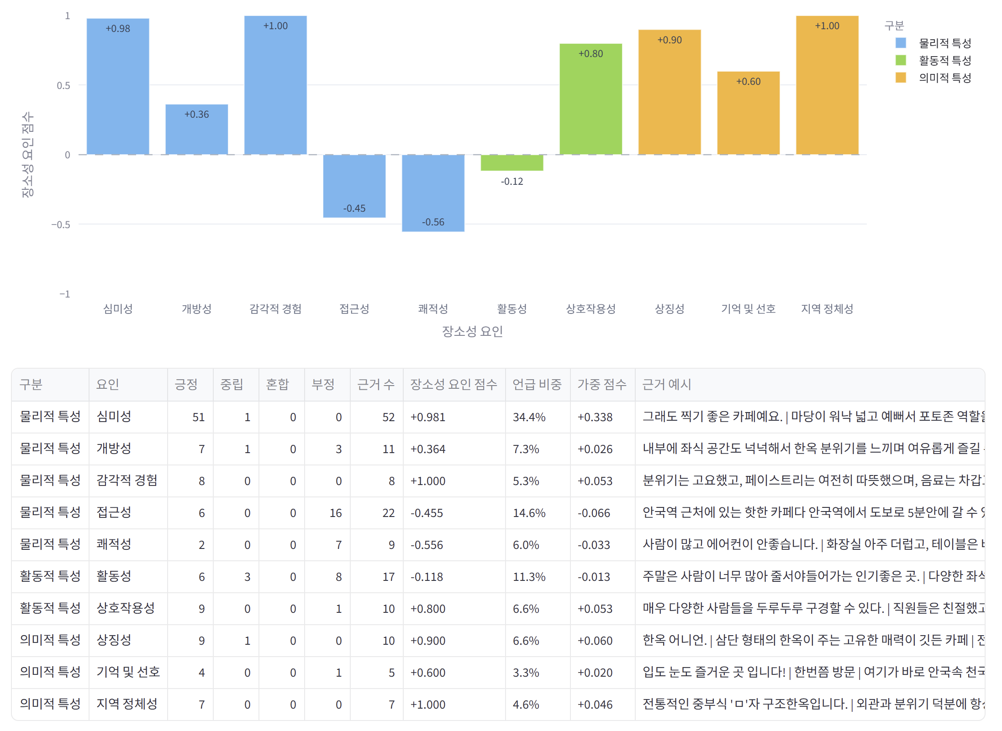
Demo and Application
https://space-agent.streamlit.app/
• Shows the process from the placeness factor framework to review mapping results and score calculation.
• Allows users to examine which review phrases support each factor score.
• Can be extended to place comparison, spatial search, and personalized recommendation.

Slide 20
CONCLUSION
Conclusion and Limitations
• This study confirmed that placeness can be quantified using user-generated text review data.
• The proposed scoring framework produces comparable indicators based on placeness factors.
• Review-based quantification can complement fieldwork- and survey-based evaluation methods.
• The system can be extended to place recommendation, spatial search, and place comparison.
• Limitations remain because the empirical target is cafés in Seoul and online reviews do not represent every user experience.
From qualitative place experience to comparable quantitative placeness indicators

Slide 21
References
References
1. Relph, E. (1976). Place and placelessness. Pion.
2. Tuan, Y. F. (1977). Space and place: The perspective of experience. University of Minnesota Press.
3. Norberg-Schulz, C. (1971). Existence, space and architecture. Praeger.
4. Lukermann, F. (1964). Geography as a formal intellectual discipline and the way in which it contributes to human knowledge. The Canadian Geographer, 8(4), 167–172.
5. Trancik, R. (1986). Finding lost space: Theories of urban design. Van Nostrand Reinhold.
6. Canter, David. (1977). The Psychology of Place.
7. Oldenburg, R. (1989). The great good place: Cafés, coffee shops, community centers, beauty parlors, general stores, bars, hangouts, and how they get you through the day. Paragon House.
8. Yoo, Y., & Lee, J.-K. (2025). Quantification and analysis methods of architectural styles using image-text AI models. Journal of the Architectural Institute of Korea, 41(5), 93–101.
9. Na, H., Lee, D., & Lee, S. (2025). Analysis of placeness of major places in Seoul, Korea using text mining and large language models. Journal of Korea Planning Association, 60(5), 21–42.
10. Lee, J., & Son, Y. (2021). Perception and appraisal of urban park users using text mining of Google Maps reviews: Cases of Seoul Forest, Boramae Park, and Olympic Park. Journal of the Korean Institute of Landscape Architecture, 49(4), 15–29.
11. Hwang, H., Lee, J., & Son, Y. (2025). User perception and spatial attractiveness of Hangang parks using Google Maps reviews: Focused on Mangwon Hangang Park, Banpo Hangang Park, Yeouido Hangang Park, and Jamsil Hangang Park. Journal of the Korean Institute of Landscape Architecture, 53(3), 16–30.
12. Sun, S., & Yu, Y. (2021). Dimension and formation of placeness of commercial public space in city center: A case study of Deji Plaza in Nanjing. Frontiers of Architectural Research, 10(2), 229–239.
13. Lyu, H. (1996). A study on the embodiment factors of the sense of place in interior space focused on residential environment. Journal of the Korean Institute of Interior Design, (7), 56–63.
14. Guo, F., Hwang, Y., & Lee, J. (2025). User perception analysis of museum spatial design based on place characteristics. Journal of the Korea Institute of Spatial Design, 20(5), 181–190.
15. Hwang, Y., & Hwang, Y. (2025). A case study of culturally regenerated idle spaces applying the formative factors of placeness. Proceedings of the Korean Institute of Interior Design Conference, 27(1), 363–366.
16. Choi, S., & Lee, K. (2023). A study on the user perception of the place of space expression. Journal of the Architectural Institute of Korea, 39(6), 3–14.
17. Hong, S., Park, J., & Lim, S. (2011). Study on the definition and concept for sense of place. Journal of the Korea Landscape Council, 2011(1), 39–52.
18. Kwon, Y., & Im, S. (2014). A Type Classification of Representative Places’ Sense of Place in Seoul through the Adjective Indexs for Measuring the Sense of Place. Journal of the Urban Design Institute of Korea Urban Design, 15(3), 135-150.
19. Lee, Jihye and Kim Jihyun. (2025). A Study on Spatial Design Strategies for Large-Scale Cafes from the Perspective of Complex Cultural Spaces. Journal of Korea Intitute of Spatial Design, 20(8), 415-428.
20. Waxman, L. (2006). The coffee shop: Social and physical factors influencing place attachment. Journal of Interior Design, 31(3), 35–53.
21. Steele, F. (1981). The sense of place. CBI Publishing Company.
22. Shamai, S. (1991). Sense of place: An empirical measurement. Geoforum, 22(3), 347–358. https://doi.org/10.1016/0016-7185(91)90017-K
23. Stedman, R. C. (2003). Is it really just a social construction? The contribution of the physical environment to sense of place. Society & Natural Resources, 16(8), 671–685. https://doi.org/10.1080/08941920309189
24. Zhang, F., Zhou, B., Liu, L., Fung, H. H., Lin, H., & Ratti, C. (2018). Measuring human perceptions of a large-scale urban region using machine learning. Landscape and Urban Planning, 180, 148–160. https://doi.org/10.1016/j.landurbplan.2018.08.020
25. Kwon, Y. K., Jeung, Y. H., & Im, S. B. (2011). A study on the structural equation modeling of Insa-dong street’s sense of place. Journal of Korea Planning Association, 46(2), 139–151.
26. Im, S. B., Jeong, Y. H., Hue, Y. S., Kwon, Y. K., Byeon, J.-S., & Choi, H. S. (2011). A study on the types of experiences related to sense of place in cities. Journal of the Korean Institute of Landscape Architecture, 39(6), 46–56.
27. Gilardi, F., Alizadeh, M., & Kubli, M. (2023). ChatGPT outperforms crowd workers for text-annotation tasks. Proceedings of the National Academy of Sciences, 120(30), e2305016120. https://doi.org/10.1073/pnas.2305016120
28. Pangakis, N., & Wolken, S. (2024). Knowledge distillation in automated annotation: Supervised text classification with LLM-generated training labels. Proceedings of the Sixth Workshop on Natural Language Processing and Computational Social Science. https://doi.org/10.48550/arXiv.2406.17633
29. Wang, Z., Xie, Q., Feng, Y., Ding, Z., Yang, Z., & Xia, R. (2023). Is ChatGPT a good sentiment analyzer? A preliminary study. arXiv. https://doi.org/10.48550/arXiv.2304.04339
30. 소상공인시장진흥공단. (n.d.). 상권정보데이터[데이터셋]. 공공데이터포털. https://www.data.go.kr/data/15083033/fileData.do

