Slide 1
Data Structures & Algorithms
Instructor: Phan Thi Thanh Tra
Student: Nguyen Van Hieu
Le Minh Trung
Class: GCD0819

Slide 2
Content
Stack ADT, First In First Out (FIFO) queue
Sorting algorithms
Network shortest path algorithms

Slide 3
Table of Content
Stack ADT and Queue ADT ( P1, P2 , M1)………………………….………4 - 12
Sorting algorithms (M2)……………………………………………..……………13 – 17
Network shortest path algorithms (D1)……………………………………18 - 23

Slide 4
Stack ADT and Queue ADT

Slide 5
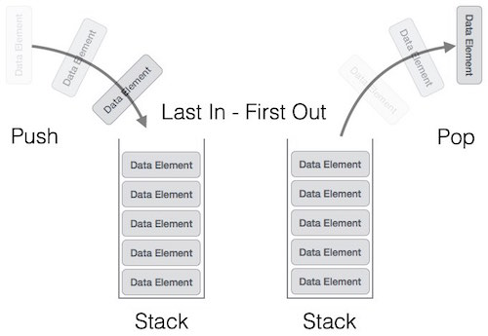
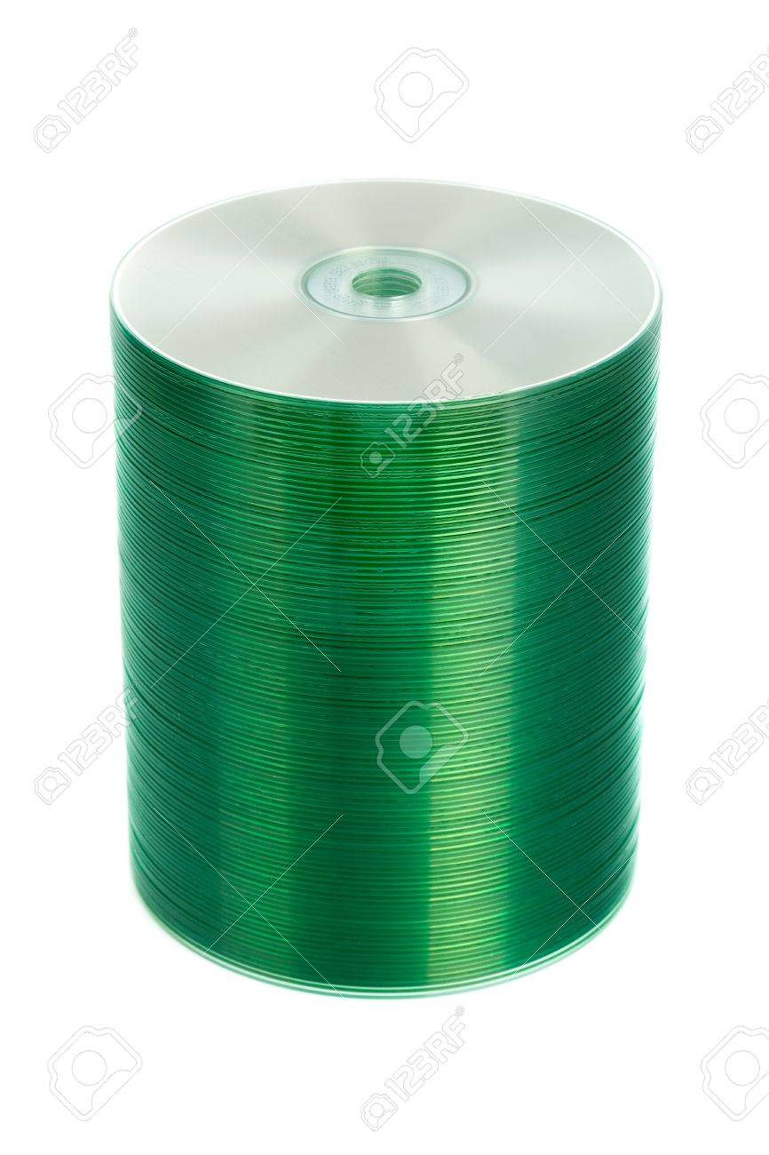
Stack ADT
A Stack is a collection of objects inserted and removed according to the Last In First Out (LIFO) principle. Think of a stack of dishes.

Slide 6
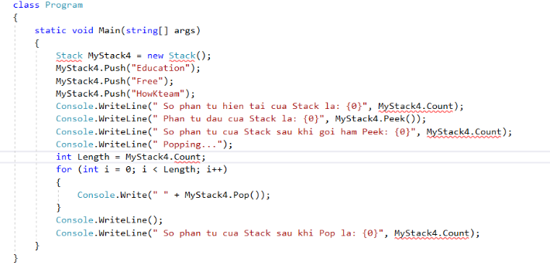
Data Structure

Slide 7
Operations
Stack() creates a new stack that is empty. It needs no parameters and returns an empty stack.
push(item) adds a new item to the top of the stack. It needs the item and returns nothing.
pop() removes the top item from the stack. It needs no parameters and returns the item. The stack is modified.
peek() returns the top item from the stack but does not remove it. It needs no parameters. The stack is not modified.
isEmpty() tests to see whether the stack is empty. It needs no parameters and returns a boolean value.
size() returns the number of items on the stack. It needs no parameters and returns an integer

Slide 8
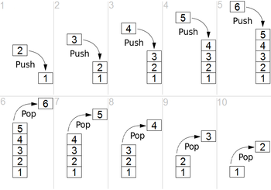
Example

Slide 9
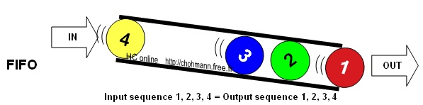
Queue ADT
A Queue is a linear structure which follows a particular order in which the operations are performed. The order is First In First Out (FIFO). A good example of a queue is any queue of consumers for a resource where the consumer that came first is served first. The difference between stacks and queues is in removing. In a stack we remove the item the most recently added; in a queue, we remove the item the least recently added.

Slide 10
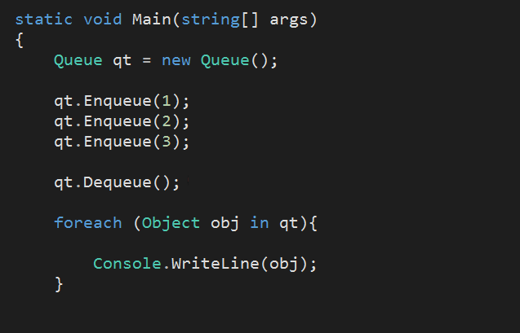
Data Structure

Slide 11
Operations
enqueue() − add (store) an item to the queue.
dequeue() − remove (access) an item from the queue.
peek() − Gets the element at the front of the queue without removing it.
isfull() − Checks if the queue is full.
isempty() − Checks if the queue is empty

Slide 12
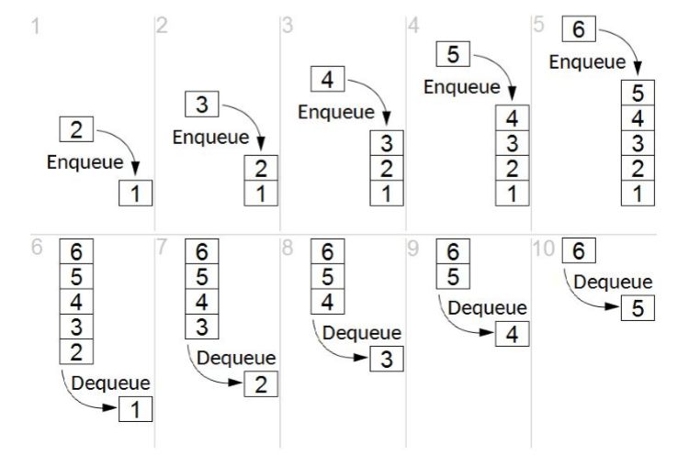
Example

Slide 13
Sorting Algorithms

Slide 14
Sorting Algorithms
A Sorting Algorithm is used to rearrange a given array or list elements according to a comparison operator on the elements. The comparison operator is used to decide the new order of element in the respective data structure.
Basic Sorting Algorithm
Selection Sort
Insertion Sort
Bubble Sort
Advanced Sorting Algorithm (Efficient Sorting Algorithm)
Shell sort Radix Sort
Tim Sort Quick Sort
Gnome Sort Merge Sort
Gravity Sort Heap sort

Slide 15
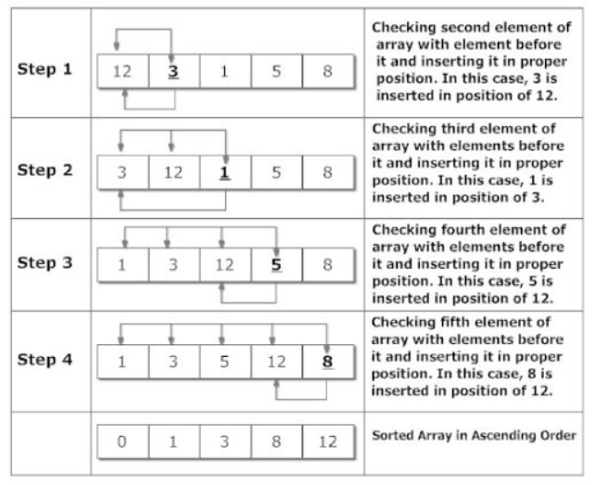
Insertion Sort Algorithm
Insertion sort is a simple sorting algorithm that builds the final sorted array (or list) one item at a time. It is much less efficient on large lists than more advanced algorithms such as quicksort, heapsort, or merge sort.
How insertion sort Algorithm work?

Slide 16
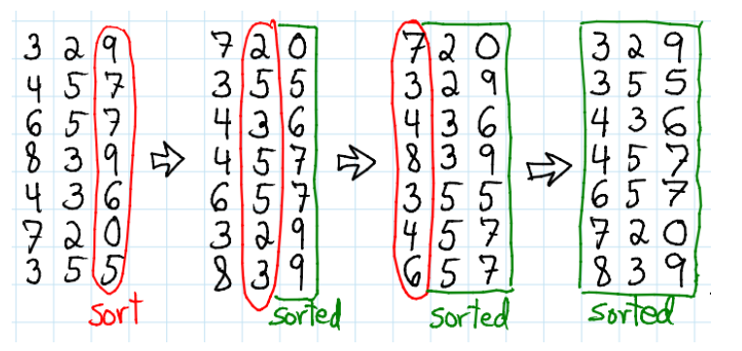
Radix sort
In computer science, radix sort is a non-comparative integer sorting algorithm that sorts data with integer keys by grouping keys by the individual digits which share the same significant position and value
How radix sort Algorithm work?

Slide 17
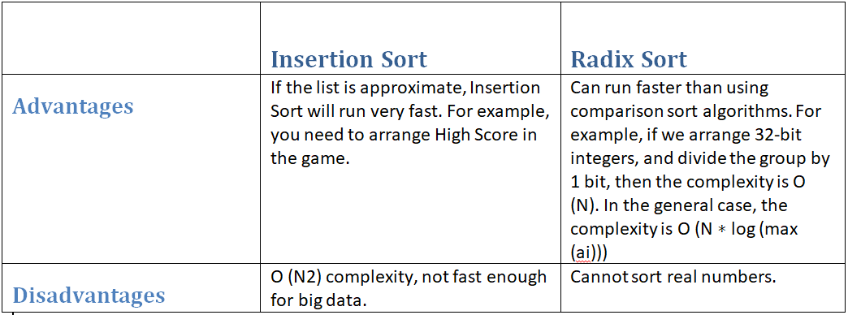
The performance of two sorting algorithms comparison

Slide 18
Dijkstra and Bellman-ford Algorithms

Slide 19
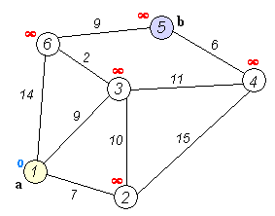
Dijkstra’s algorithm
Dijkstra's algorithm (or Dijkstra's Shortest Path First algorithm, SPF algorithm) is an algorithm for finding the shortest paths between nodes in a graph, which may represent, for example, road networks. It was conceived by computer scientist Edsger W. Dijkstra in 1956 and published three years later
Example

Slide 20
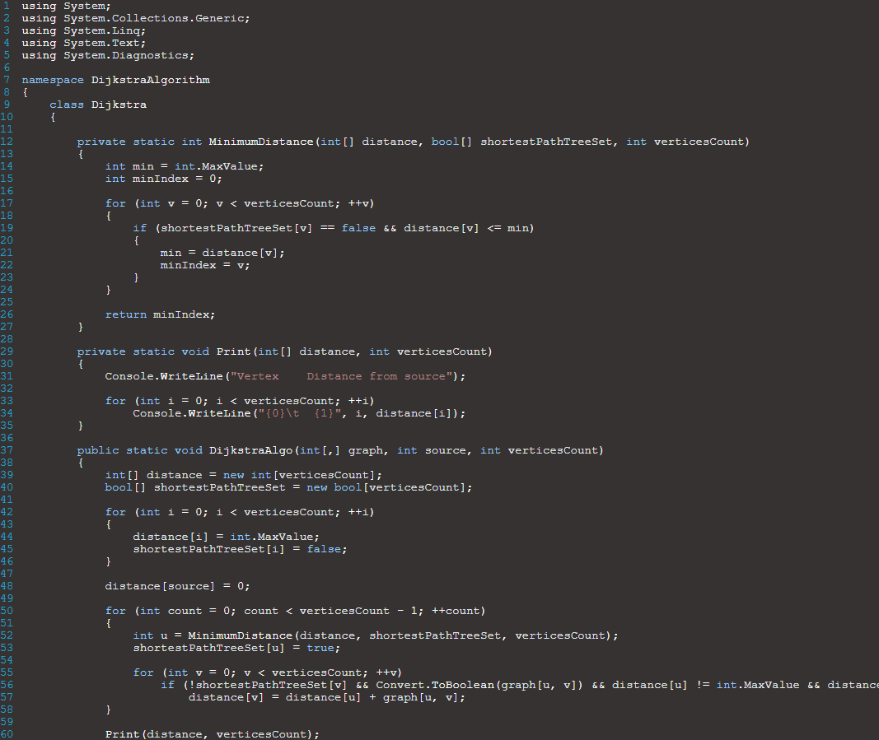
Implementation

Slide 21
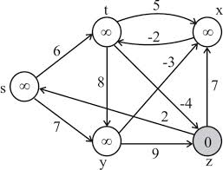
Bellman-ford Algorithm
The Bellman–Ford algorithm is an algorithm that computes shortest paths from a single source vertex to all of the other vertices in a weighted digraph.It is slower than Dijkstra's algorithm for the same problem, but more versatile, as it is capable of handling graphs in which some of the edge weights are negative numbers
Example

Slide 22
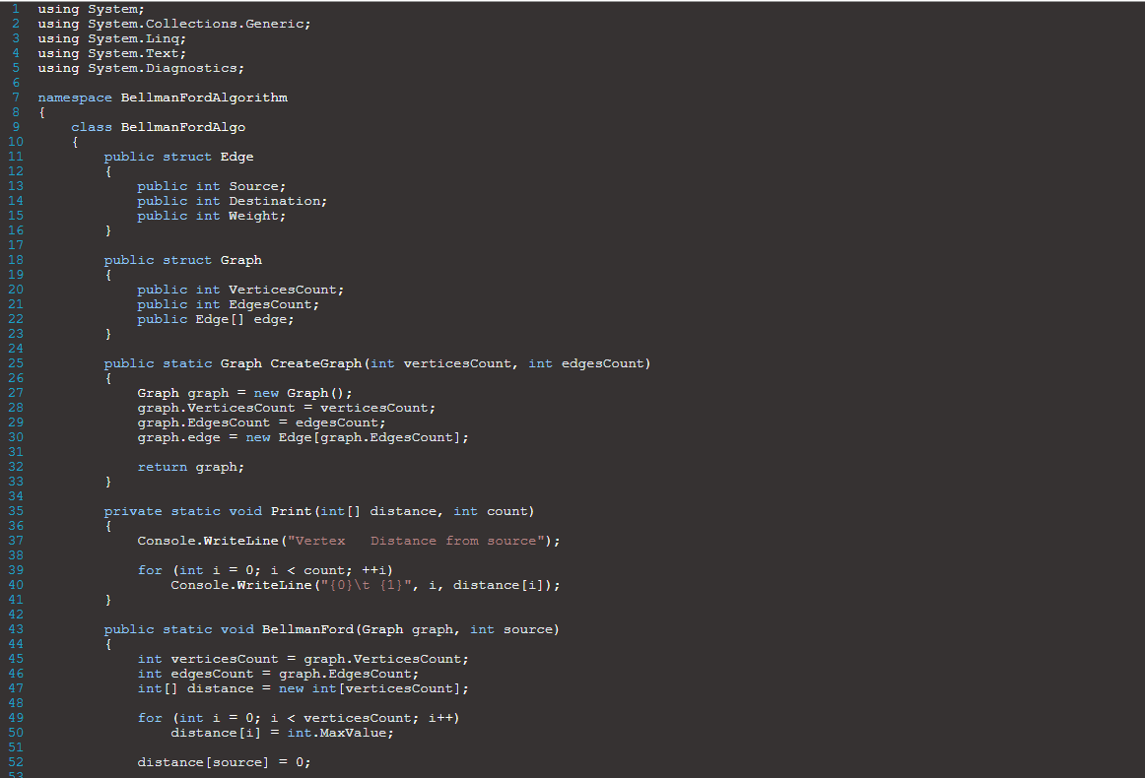
Implementation

Slide 23
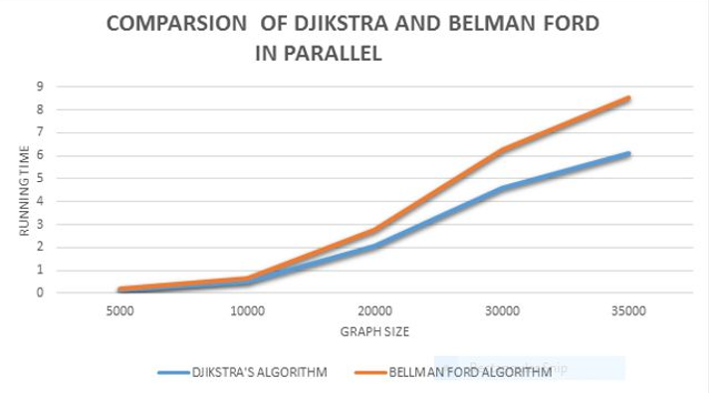
Dijkstra vs Bellman-Ford

Slide 24
Thanks for listening

