Slide 1



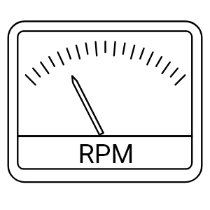

Dashboard/Interface
100
0
0
1000
0
14
START
STOP
35.0℃
200
6.205

