Slide 1
Game Theory and Strategy
Week 1 –
Instructor: Dr Shino Takayama

Slide 2
Agenda for Week 1
Course Outline (Syllabus)
Introduction to Game Theory
A Strategic Game
Nash Equilibrium
Examples:
  Prisoner’s Dilemma
  Bach or Stravinsky
  Matching Pennies

Slide 3
My Info
Name: Shino (McLennan) Takayama
Hometown: Osaka/Kyoto, Japan
Ph.D in Economics from U MN, USA
Arrival in AU: September, 2005
Moved from Sydney Uni.
Financial Economics, Game Theory, Public Economics
Website: http://www.shino.info/
Email: s.takayama@economics.uq.edu.au
Office: 617 @Colin Clark
Office Hour: 11:00 to 12:00, Mondays

Slide 4
Econ3050 Course Description
Book
  An Introduction to Game Theory by Martin Osborne
Course description: The purpose of this class is to provide an introduction to game theoretic modeling, focusing in particular on non-cooperative game theory. Topics include: Normal Form Game; Hotelling's Model; Auction Theory; Mixed Strategy; Extensive Form Game; Sequential Game; Bayesian Game.

Slide 5
What is Game Theory?
Game theory analyzes social environments in which rational individuals interact directly.
  Here ”rational” means, in effect, that we assume that agents’ goals are coherent, and take them as given.
  ”Directly” is in contrast with competitive markets, in which each individual is affected only by the price, and no individual has a non-negligible influence on the price.
There will be a mathematical description of the environment including:
  Agents or players.
  For each agent, a set of strategies (actions).
  For each agent, a payoff function.
Predictions are derived by applying a solution concept to the game.

Slide 6
History of Game Theory
Daniel Bernoulli (1738)
  distinction between wealth and utility.
Ernst Zermelo (1912)
  first mathematical paper studying optimal play in a game.
John von Neumann (1903-1957):
  Mini-max theorem for zero sum games. (1928)
  (with Oscar Morgenstern) Theory of Games and Economic Behavior. (1944)
John Nash (1928 - )
  the concept of Nash equilibrium.
Nobel Prize winning game theorists:
  John Nash.
  John Harsanyi.
  Reinhardt Selten.
  Robert Aumann.

Slide 7
Application Areas of Game Theory
Application areas in economics:
  Imperfect competition.
  Bargaining.
  International trade.
  Auctions.
  Mechanism design.
Other disciplines currently applying game theory:
  Political science.
  International relations/military strategy.
  Psychology.
  Evolutionary biology.
  Computer science.

Slide 8
A Strategic Games
A strategic game consists of
  a set of players;
  for each player, a set of actions;
  for each player, preferences over the set of action profiles.

Slide 9
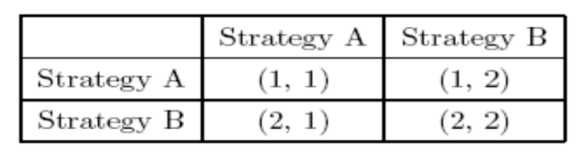
A Strategic Game of Complete Information
Normal Form Representation
  The first column shows strategies which are available for Player 1 and the first row shows strategies which are available for Player 2. The first number in each parenthesis shows payoff for Player 1 and the second number shows payoff for Player 2 for given combination of strategies.
Player 2
Player 1

Slide 10
Nash Equilibrium
The action profile a* in a strategic game with ordinal preferences is a Nash equilibrium if for every player i,
u_{i}(a*) ≥ u_{i}(a_{i}, a_{-i}*),
for every action a_{i} of player i, where u_{i} is a payoff function that represents player i’s preferences.

Slide 11
The Prisoner’s Dilemma
Two suspects in a major crime are held in separate cells.
There is enough evidence to convict each of them of a minor offense but not enough evidence of the major crime unless one of them confesses.
If both stay quiet, each will be convicted of the minor offense and spend one year in prison.
If one and only one finks, she will be freed and used as a witness against the other, who will spend four years in prison.
If they both fink, each will spend three years in prison.

Slide 12
The Prisoner’s Dilemma: Game Form
Players: The two suspects
Actions: {Quiet, Fink}
Preferences: Suspect 1’s ordering of the action profiles, from best to worst:
  (Fink, Quiet), (Quiet, Quiet), (Fink, Fink), (Quiet, Fink)
 | Quiet | Fink
Quiet | (2, 2) | (0, 3)
Fink | (3, 0) | (1, 1)

Slide 13
Bach or Stravinsky?
Two people wish to go out together.
There are two options: Bach or Stravinsky.
One person prefers Bach and the other prefers Stravinsky.
 | Bach | Stravinsky
Bach | (2, 1) | (0, 0)
Stravinsky | (0, 0) | (1, 2)

Slide 14
Matching Pennies
Two people choose, simultaneously, whether to show the head or the tail of a coin.
If they show the same side, person 2 pays person 1 a dollar.
If they show the different side, person 1 pays person 2 a dollar.
 | Head | Tail
Head | (1, -1) | (-1, 1)
Tail | (-1, 1) | (1, -1)

