Slide 1
Game Theory and Strategy
- Week 11 -
Instructor: Dr Shino Takayama

Slide 2
Agenda for Week 11
Chapter 9: Bayesian Games
  BoS with imperfect information
  Cournot's duopoly game
  Second price auctions with independent valuations

Slide 3
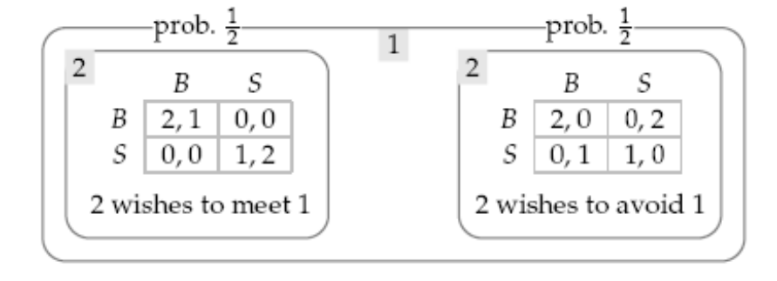
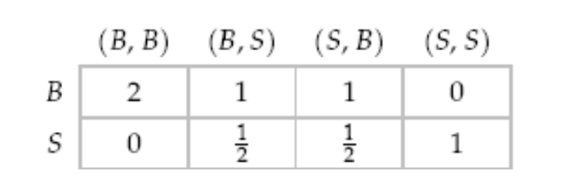
BoS with imperfect information
Suppose that player 1 thinks that with probability 1/2 player 2 wants to go out with her, and with probability 1/2 player 2 wants to avoid her.
Claim: (B, (B, S)), where the first component is the action of player 1 and the other component is the pair of actions of the two types of player 2, is a Nash equilibrium.

Slide 4
State & Signal
Each state is a complete description of one collection of the players’ relevant characteristics, including both their preferences and their information.
At the start of the game a state is realized.
The players do not observe this state.
Each player receives a signal that may give her some information about the state.
Denote the signal player i receives in state ω by τ_{i}(ω).
If τ_{i}(ω) is different for each value of ω, then player i knows the state that has occurred.
If there are three states ω₁, ω₂, and ω₃ and τ_{i}(ω₁) ≠ τ_{i}(ω₂) = τ_{i}(ω₃)
then player knows when the state is ω₁, it is ω₁
but when the state is either ω₂ or ω₃ , then she only knows it is one of these two states.

Slide 5
Type & Belief
The states that generate any given signal t_{i} are said to be consistent with t_{i}.
We refer to player i in the event that she receives the signal t_{i} as type t_{i} of player i.
If t_{i} = τ_{i}(ω₁) = τ_{i}(ω₂), type t_{i} of player i assigns probabilities to ω₁ and ω₂.
A player who receives a signal consistent with only one state assigns probability 1 to that state.
After receiving a signal, each player forms a belief about the states consistent with the signal.

Slide 6
Set-up 1
Players: The pair of people.
States: The set of states is {meet, avoid}.
Actions: The set of actions of each player is {B, S}.
Signals: Player 1 may receive a single signal, say z; her signal function τ₁ satisfies:
τ₁(meet) = τ₁(avoid) = z.
Player 2 receives one of two signals, say m and v; her signal function τ₂ satisfies:
τ₂(meet) = m and τ₂(avoid) = v.

Slide 7
Set-up 2
Beliefs: Player 1 assigns probability 1/2 to each state after receiving the signal z. Player 2 assigns probability 1 to the state meet after receiving the signal m, and probability 1 to the state avoid after receiving the signal v.
Payoffs: The payoffs u_{i}(a, meet) of each player i for all possible action pairs are given in the left panel of Figure 274.1, and the payoffs
u_{i}(a, avoid) are given in the right panel.

Slide 8
A Bayesian game
a set of players
a set of states
for each player
  a set of actions
  a set of signals that she may receive and a signal function that associates a signal with each state
for each signal that she may receive,
  a belief about the states consistent with the signal (a probability distribution over the set of states with which the signal is associated)
  a Bernoulli payoff function over pairs (a, w), where a is an action profile and w is a state, the expected value of which represents the player's preferences among lotteries over the set of such pairs.

Slide 9

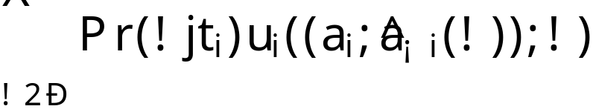


More general game
In a general game, denote the probability assigned by the belief of type τ_{i} of player i to state w by Pr(w|t_{i}).
Denote the action taken by each type t_{j} of each player j by a(j, t_{j}). Player j's signal in state w is τ_{j}(w), so her action in this state is
a(j, τ_{j}(w),).
For each state w and each player j, let .
Then the expected payoff of type t_{j} of player i when she chooses the action a_{i} is
(281.1)
where Ω is the set of states and is the action profile in which player i chooses the action a_{i} and every other player j chooses .

Slide 10
Nash Equilibrium in Bayesian Games
A Nash equilibrium of a Bayesian game is a Nash equilibrium of the strategic game (with vNM preferences) defined as follows.
Players: The set of all pairs (i, t_{i}) where i is a player in the Bayesian game and t_{i} is one of the signals that i may receive;
Actions: The set of actions of each player (i, t_{i}) is the set of actions of player i in the Bayesian game;
Preferences: The Bernoulli payoff function of each player (i, t_{i}) is given by (281.1).

Slide 11
Cournot’s Duopoly Game
Two firms compete in selling a good; one firm does not know the other firm's cost function
How does the imperfect information affect the firms' behavior?
Assume that both firms can produce the good at constant unit cost.
Assume also that they both know that firm 1's unit cost is c, but only firm 2 knows its own
unit cost; firm 1 believes that firm 2's cost is c_{L} with probability q and c_{H} with probability 1 - q, where 0 < q < 1 and c_{L} < c_{H}.

Slide 12
Set-up 1
Players: Firm 1 and firm 2.
States: {L, H}.
Actions: Each firm's set of actions is the set of its possible outputs (nonnegative numbers).
Signals: Firm 1's signal function τ₁ satisfies
τ₁(H) = τ₁(L) (its signal is the same in both states); firm 2's signal function τ₂ satisfies
τ₂(H) ≠ τ₂(L) (its signal is perfectly informative of the state).

Slide 13
Set-up 2
Beliefs: The single type of firm 1 assigns probability θ to state L and probability 1 - θ to state H. Each type of firm 2 assigns probability 1 to the single state consistent with its signal.
Payoff functions: If the actions chosen are (q₁, q₂) and the state is I (either L or H) then firm 1's profit is q₁(P(q₁ + q₂) - c) and firm 2's profit is q₂(P(q₁ + q₂) - c_{I}), where P(q₁, q₂) is the market price when the firms' outputs are q₁ and q₂.

Slide 14
Example: Constant unit cost and linear inverse demand
Each firm’s cost function is given by
C_{i}(q_{i}) = c_{i}q_{i},
where c₁ = c and c₂ in {c_{L}, c_{H}}
The inverse demand function is given by:
α − Q if Q ≤ α
P(Q) =
0 if Q > α,
where α > 0 and c_{i} > 0 are constant.

Slide 15
Nash Equilibrium
Given firm 1's beliefs, its best response
b₁(q_{L}, q_{H}) to (q_{L}, q_{H}) chooses q*₁ to
max θ(P(q₁ + q_{L}) - c)q₁ + (1 - θ)(P(q₁ + q_{H}) - c)q₁.
Firm 2's best response b_{L}(q₁) to q₁ when its cost is c_{L} chooses q*_{L} to
max (P(q₁ + q_{L}) - c_{L})q_{L},
and its best response b_{H}(q₁) to q₁ when its cost is c_{H} chooses q*_{H} to
max (P(q₁ + q_{H}) - c_{H})q_{H}.
A Nash equilibrium is a triple (q*₁, q*_{L}, q*_{H} ) such that
q*₁ = b₁(q*_{L}, q*_{H} ), q*_{L} = b_{L} (q*₁), and q*_{H} = b_{H} (q*₁).

Slide 16
Best Response Functions
We want to find a Nash equilibrium in which each player produces positive amount of products.
We obtain the best response as:
½(α − c − θq_{L} - (1 - θ)q_{H}) if θq_{L} - (1 - θ)q_{H} ≤ α – c;
b₁(q_{L}, q_{H}) =
0 otherwise
and
½(α − c_{I} − q₁) if q₁ ≤ α – c_{I};
b_{I}(q₁) =
0 otherwise
for I = L, H.

Slide 17
Nash equilibrium
For values of c_{H} and c_{L} close enough, there is a Nash equilibrium in which all outputs are positive
q*₁ = 1/3 (α - 2c + θc_{L} + (1 - θ)c_{H});
q*_{L} = 1/3 (α - 2 c_{L} + c) – 1/6 (1 - θ)(c_{H} - c_{L});
q*_{H} = 1/3 (α - 2c_{H} + c) + 1/6 θ(c_{H} - c_{L}).

Slide 18
Auctions
Assume that a single object is for sale;
that bidders are not perfectly informed about each others’ valuations;
that each bidder independently receives some information (a signal) about the value of the object to her.
If each bidder’s signal is simply her valuation, we say that the bidders’ valuations are private.
If each bidder’s valuation depends on other bidders’ signal as well as her own, we say that the valuations are common.

Slide 19


Second-price auctions with independent private valuations
Each bidder knows that all other bidders' valuations are at least ≥ 0, and at most .
She believes that the probability that any given bidder's valuation is at most v is F(v), independent of all other bidders' valuations, where F is a continuous increasing function.
Denote by P(b) the price paid by the winner of the auction when the profile of bids is b.

Slide 20

Set-up
Players: The set of bidders, say 1, . . . , n.
States: The set of all profiles (v₁, . . . , v_{n}) of valuations, where for all i.
Actions: Each player's set of actions is the set of possible bids (nonnegative numbers).
Signals: The set of signals that each player may observe is the set of possible valuations. The signal function τ_{i} of each player i is given by τ_{i}(v₁, . . . , v_{n}) = v_{i}.
Beliefs: Each type of player i assigns probability
F(v₁)F(v₂)…F(v_{i-1}) x F(v_{i+1})…F(v_{n})
to the event that the valuation of every other player j is at most v_{j}.

Slide 21
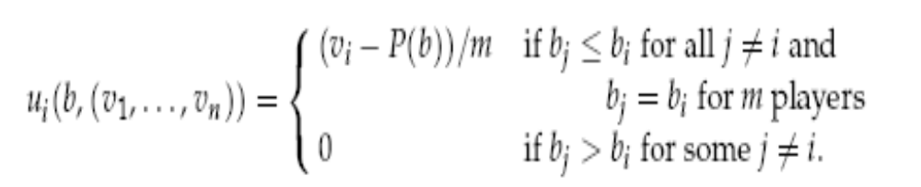
Set-up: Payoff functions
Player i's Bernoulli payoff in state
(v₁, . . . , v_{n}) is 0 if her bid b_{i} is not the highest bid, and (v_{i} - P(b))/m if no bid is higher than b_{i} and m bids (including b_{i}) are equal to b_{i} .

Slide 22

Exercise 294.1
Show that for each type v_{i} of each player i in a second-price sealed-bid auction with imperfect information about valuations the bid v_{i} weakly dominates all other bids.
Let denote the highest bid among other bids.

Slide 23

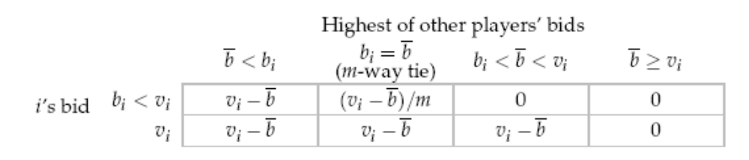

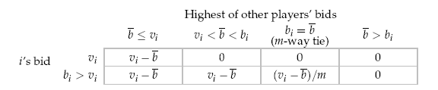
Proof:

