Slide 1
Game Theory and Strategy
- Week 12 -
Instructor: Dr Shino Takayama

Slide 2
Agenda for Week 12
Answer for HW2
Chapter 10
  Extensive games with imperfect information
  BoS
  Entry game
Handout for Mixed-Strategy Nash Equilibrium

Slide 3
Information Sets
To describe an extensive game with perfect information, we need to specify the set of players, the set of terminal histories, the player function, and the players‘ preferences.
To describe an extensive game with imperfect information, we need to add a single item to this list: a specification of each player's information about the history at every point at which she moves.
Denote by H_{i} the set of histories after which player i moves.
We specify player i's information by partitioning (dividing up) H_{i} into a collection of information sets.
This collection is called player i's information partition.
When making her decision, player i is informed of the information set that has occurred, but is not informed of which history within that set has occurred.

Slide 4
Example: information sets
Suppose, for example, that player i moves after the histories C, D, and E (i.e. H_{i} = {C, D, E}), and is informed only that either the history is C, or that it is either D or E.
Then player i's information partition consists of two information sets: {C} and {D, E}.
If instead she is not informed at all about which history has occurred, then her information partition consists of a single information set, {C, D, E}.
If instead she is informed precisely about the history then her information partition consists of three information sets, {C}, {D}, and {E}.

Slide 5
An extensive game with imperfect information
a set of players
a set of sequences (terminal histories) with the property that no sequence is a proper subhistory of any other sequence
a function (the player function) that assigns either a player or “chance” to every sequence that is a proper subhistory of some terminal history

Slide 6
An extensive game with imperfect information
a function that assigns to each history that the player function assigns to chance a probability distribution over the actions available after that history, with the property that each such probability distribution is independent of every other distribution
for each player, a partition (the player's information partition) of the set of histories assigned to that player by the player function
for each player, preferences over the set of lotteries over terminal histories.

Slide 7
Example: BoS
Players: The two people, say 1 and 2.
Terminal histories: (B, B), (B, S), (S, B), and (S, S).
Player function: P(φ) = 1, P(B) = P(S) = 2.
Chance moves: None.
Information partitions: Player 1's information partition contains a single information set, φ (player 1 has a single move, and when moving she is informed that the game is beginning); player 2's information partition also contains a single information set, {B, S} (player 2 has a single move, and when moving she is not informed whether the history is B or S).
Preferences: As given in the description of the situation.

Slide 8
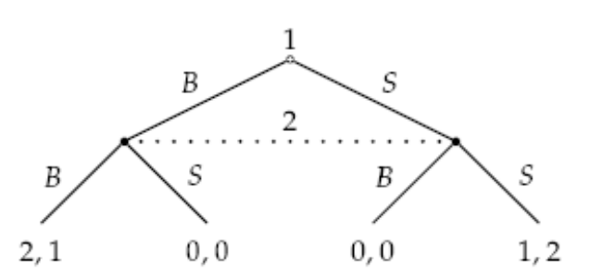
BoS as an extensive game

Slide 9
Nash equilibrium
Each player has two strategies, B and S.
The strategic form of the game is exactly the strategic game BoS.
Thus the game has two pure Nash equilibria, (B, B) and (S, S), and a mixed equilibrium in which player 1 uses B with probability 2/3 and player 2 uses B with probability 1/3.

Slide 10
Entry Game
An incumbent faces the possibility of entry by a challenger, as the 10th lecture.
The challenger has three choices: it may stay out, prepare itself for combat and enter, or enter without making preparations.
Preparation is costly, but reduces the loss from a fight.
The incumbent may either fight or acquiesce to entry.
A fight is less costly to the incumbent if the entrant is unprepared, but regardless of the entrant's readiness the incumbent prefers to acquiesce than to fight.
The incumbent observes whether the challenger enters, but not whether an entrant is prepared.

Slide 11
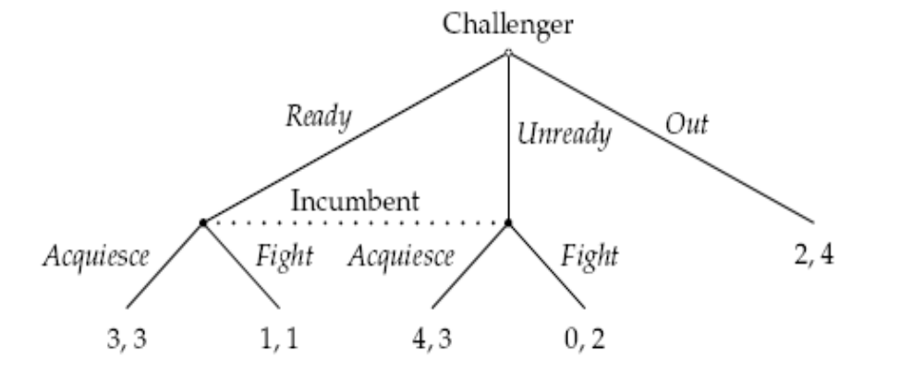
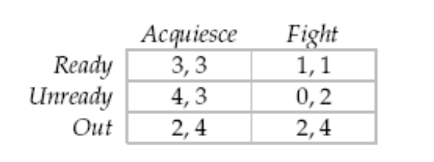
Entry Game as an Extensive Game

Slide 12
Nash equilibrium
We see that the game has two Nash equilibria in pure strategies, namely (Unready, Acquiesce) and (Out, Fight).
In the perfect information case, we used subgame perfect equilibrium.
The natural extension of this idea to games with imperfect information requires that each player's strategy be optimal at each of her information sets.
The implementation of the idea in other games is less straightforward because the optimality of an action at an information set may depend on the history that has occurred.
A solution for extensive games including the players' beliefs as part of an equilibrium is needed → Sequential equilibrium.

Slide 13
Variant of Entry Game
0, 3
0, 3

Slide 14
Nash equilibrium
A (pure) strategy of player i in an extensive game is a function that assigns to each of i's information sets I_{i} an action in A(I_{i}) (the set of actions available to player i at the information set I_{i}).
A mixed strategy of a player in an extensive game is a probability distribution over the player's pure strategies.
The mixed strategy profile α in an extensive game is a (mixed strategy) Nash equilibrium if, for each player i and every mixed strategy α_{i} of player i, player i's expected payoff to α is at least as large as her expected payoff to (α_{i}, α_{-i} ) according to a payoff function whose expected value represents her preferences over lotteries.

