Slide 1
Game Theory and Strategy
- Week 13 -
Instructor: Dr Shino Takayama

Slide 2
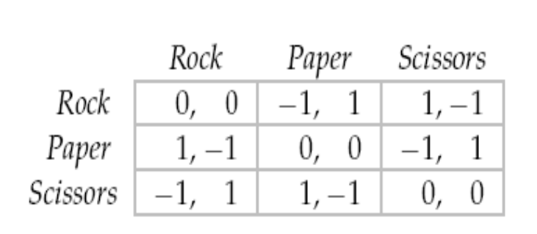
Handout: Mixed Strategy Equilibrium
No Pure Strategy NE
Two Actions are used in NE? – No.
  Rock: - (1 – q), Paper: q, Scissors: 1 – 2q
  Is there any p satisfying: - p + (1 – p) = - (1-p)? –1 – 2p = -1 + p? -- No.

Slide 3
Rock-Paper-Scissors
The remaining possibility is that each player assigns positive probability to all three of her actions.
Denote the probabilities player 1 assigns to her three actions by (p₁, p₂, p₃) and the probabilities player 2 assigns to her three actions by (q₁, q₂, q₃).
Player 1's actions all yield her the same expected payoff if and only if there is a value of c for which
- q₂ + q₃ = c; q₁ - q₃ = c; - q₁ + q₂ = c.
In conclusion, the game has a unique mixed strategy equilibrium, in which each player uses the strategy
(1/3 , 1/3, 1/3). Each player's equilibrium payoff is 0.

Slide 4
Final Examination
Consultation Hours: 10am – Midday (Mondays)
Format: 50MC & Short Answer Qs
ECON3050 -- 01/11 -- 11:15AM
26-GYMNASIUM

Slide 5
Chapter 2
Strict and Nonstrict Equilibria
Best Response Functions
Dominated Actions
  Strict Domination
  Weak Domination
Illustration
  Contributing to a public good
  Voting
Symmetric Games
HW1

Slide 6
Chapter 3
Classic Models
  Cournot’s model of oligopoly
  Bertrand’s model of oligopoly
  Hotelling’s model of electoral competition
  The War of Attrition
  Auctions
  Accident Law

Slide 7
Chapter 4
Mixed Strategy Equilibrium
  Randomization in Strategic Games
  vNM utility representation
  Expected Utility
  Mixed Strategy Equilibrium
  Handout
Midsemester examination

Slide 8
Chapter 5
Extensive Games with Perfect Information
  Entry Game
  Definitions for Extensive Games
  Strategy and Action
  Nash Equilibrium
  Subgame and Subgame Perfect Equilibrium
HW2

Slide 9
Applications of extensive games
Chapter 6
  The ultimatum game
  The holdup game
  Stackelberg’s model of duopoly
  Buying Votes
Chapter 7
  Allowing for simultaneous moves
  Entry into a monopolized industry

Slide 10
Imperfect information
Chapter 9: Bayesian Games
  – BoS with imperfect information
  Cournotʹs duopoly game
  Second price auctions with independent valuations
Chapter 10: Extensive games with imperfect information
  Information sets and definition
  BoS
  Entry game

