Slide 1
Game Theory and Strategy
Week 3 –
Instructor: Dr Shino Takayama

Slide 2
Agenda for Week 3
Review from Chapter 2
Chapter 3
  Cournot’s model of oligopoly
  Bertrand’s model of oligopoly
  Hotelling’s model of electoral competition

Slide 3
Review from Chapter 2
Nash Equilibrium
Strict and Nonstrict Equilibria
Best Response Functions
Dominated Actions
  Strict Domination
  Weak Domination
Illustration
  Contributing to a public good
  Voting

Slide 4
Illustration 1: contributing to a public good
Denote person i’s wealth by w_{i}, and the amount she contributes to the public good by c_{i} (0 ≤ c_{i} ≤ w_{i}). She spends her remaining wealth w_{i} - c_{i} on private goods. The amount of the public good is equal o the sum of the contributions.
Suppose that person preferences are represented by the payoff function v_{i}(c₁ + c₂) + w_{i} - c_{i}, where v_{i} is an increasing function.

Slide 5
Illustration 1: Analysis
The strategic game:
  Players: The Two People
  Actions: Nonnegative numbers less than or equal to w_{i}
  Preferences are represented by the payoff function:
  u_{i}(c₁, c₂) = v_{i}(c₁ + c₂) – c_{i} .
Suppose that u₁(c₁, 0) increases up to its maximum and then decreases.
Consider the two cases:
  c₂ = 0;
  c₂ = k.

Slide 6
Graphical Illustration 1
Utility
u₁(c₁, k)
k
k
u₁(c₁, 0)
u₂(0, c₂)
0
b₂(0)
b₁(k)
b₁(0)
c₁

Slide 7
Graphical Illustration 2
c₂
Nash equilibrium is (b₁(0), 0): player 2 contributes nothing.
b₁(0)
k
k
b₂(0)
b₁(c₂)
k
k
b₂(c₁)
0
b₂(0)
b₁(0)
c₁

Slide 8
Symmetric Games
A two-player strategic game with ordinal preferences is symmetric if the players’ sets of actions are the same and the players’ preferences are represented by payoff functions u₁ and u₂ for which
u₁(a₁, a₂) = u₂(a₂, a₁),
for every action pair (a₁, a₂) .
An action profile a_{i}* in a strategic game in which each player has the same set of actions is a symmetric Nash equilibrium if it is a Nash equilibrium and a_{i}* is the same for every player i.

Slide 9
Cournot’s model of oligopoly
Story
  A single good is produced by n firms.
  The cost to firm i of producing q_{i} units of the good is C_{i}(q_{i}), where C_{i} is an increasing function.
  If the firms’ total output is Q, then the market price is P(Q).
Players: The firms
Actions: The set of its possible outputs (nonnegative numbers)
Preferences: Each firm’s profit

Slide 10
Example: Duopoly in Cournot
There are two firms. (Duopoly)
Each firm’s cost function is given by C_{i}(q_{i}) = cq_{i}.
The inverse demand function is given by:
α − Q if Q ≤ α
P(Q) =
0 if Q > α,
where α > 0 and c > 0 are constant.

Slide 11
Analysis: Duopoly Cournot
The firms’ payoffs are:
π₁(q₁, q₂) = q₁(P(q₁+q₂) – c)
q₁(α − c − q₁ − q₂) if q₁+q₂ ≤ α;
=
− cq₁ if q₁+q₂ > α.
We obtain the best response as:
½(α − c − q₂) if q₂ ≤ α – c;
b₁(q₂) =
0 if q₂ > α - c.
½(α − c − q₁) if q₁ ≤ α – c;
b₂(q₁) =
0 if q₁ > α - c.

Slide 12
Graphical Illustration
q₂
α - c
b₁(q₂)
½(α – c)
1/3(α – c)
(q₁*, q₂*)
b₂(q₁)
q₁
0
1/3(α – c)
½(α – c)
α - c

Slide 13
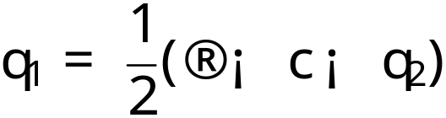
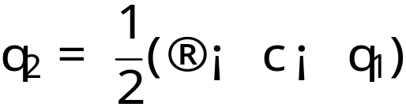
Nash Equilibrium in Cournot Duopoly
Nash equilibrium:
In Cournot’s game, each firm chooses an output.
In Bertrand’s game, each firm chooses a price.

Slide 14
Bertrand’s model of oligopoly
Story
  A single good is produced by n firms.
  The cost to firm i of producing q_{i} units of the good is C_{i}(q_{i}), where C_{i} is an increasing function.
  If the good is available at p, then the market price is D(p) = α − p for p ≤ α and D(p) = 0 for p > α.
Players: The firms
Actions: The set of its possible price (nonnegative numbers)
Preferences: Each firm’s profit.

Slide 15
Example : Duopoly in Bertrand
The firm i’s payoffs are:
π_{i}(p₁, p₂)
(p_{i} − c)(α - p_{i}) if p_{i} < p_{j} ;
= ½ (p_{i} − c)(α - p_{i}) if p_{i} = p_{j} ;
0 if p_{i} > p_{j} ,
where j is the other firm.

Slide 16
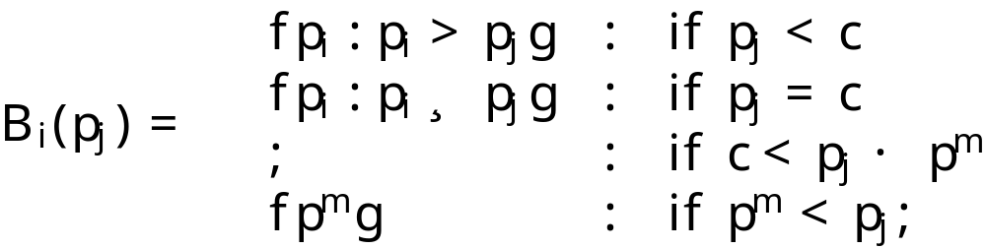

Nash Equilibrium in Bertrand Duopoly
Denote by p^{m} the value of its price that maximizes (p - c)(α - p).
Firm i’s best response function is given by:
where denotes the set with no members, the empty set.
Nash equilibrium:

Slide 17
Graphical Illustration: p_{j} < c
π_{i}
p_{j}
0
c
p^{m}
α
p_{i}
If p_{i} ≤ p_{j}, firm i’s profit π_{i} < 0.
If p_{i} > p_{j}, π_{i} = 0.

Slide 18
Graphical Illustration: c < p_{j} < p^{m}
π_{i}
p_{j}
0
c
p^{m}
α
p_{i}
Firm i’s profit π_{i} increases as p_{i} increases to p_{j}, then drops abruptly at p_{j}. For any price less than p_{j}, there is a higher price that is also less than p_{j}, so there is no best price.

Slide 19
Graphical Illustration: p_{j} > p^{m}
π_{i}
p_{j}
0
c
p^{m}
α
p_{i}
If p_{j} > p^{m}, p^{m} is the unique best response for firm i.

Slide 20
Electoral competition
Hotelling’s model is popularized in political science by a 1957 book An Economic Theory of Democracy by Downs. Sometimes it is called Downsian elections.
Problem Description
  Players: Two political candidates
  Actions: Policy positions x_{i}
  Preference: Each candidate cares only about winning -- > Voters’ preference is defined in the next page.

Slide 21
Voters in Hotelling’s Model
There is a continuum of voters, each with a favorite position (“bliss point”).
The distribution of these favorite positions over the set of all possible positions is arbitrary.
The key player: Median Voter
  The bliss point m of median voter has the property that exactly half of the voters’ bliss points are at most and at least m.
Each voter’s distaste for any position is given by the distance between that position and her bliss point.

Slide 22
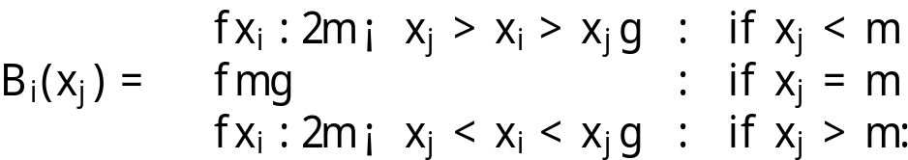
Example: 2 candidates case
Fix the position x₂ of candidate 2 and consider the best position for candidate 1.
Consider ½(x₁ + x₂).
Candidate i’s best response function is given by:
The unique Nash equilibrium: (m, m)
– a tie !

Slide 23
Graphical Explanation
½(x₁ + x₂) < m → x₁ < 2m - x₂
x₂
m
x₁
½(x₁+x₂)
Votes for 2
Votes for 1

