Slide 1
Game Theory and Strategy
Week 4 –
Instructor: Dr Shino Takayama

Slide 2
Agenda for Week 4
Review from the Last Week
  Bertrand’s Duopoly
  Hotelling’s Model
Chapter 3
  The War of Attrition
  Auctions
  Accident Law
  Review of the Chapter

Slide 3
Plan for Future
Week 5 – 6: Chapter 4 (Mixed Equilibrium)
Week 7: Midterm (~ Chapter 4, inclusive)
Week 8 – 9: Chapter 5 (Extensive Games)
Week 10: Chapter 6 & 7 (Application of Extensive Games)
Week 11 – 12: Chapter 9 (Bayesian Games)
Week 13: Chapter 10 (Extensive Games with Imperfect Information)

Slide 4
Review: Bertrand’s model of oligopoly
Story
  A single good is produced by n firms.
  The cost to firm i of producing q_{i} units of the good is C_{i}(q_{i}), where C_{i} is an increasing function.
  If the good is available at p, then the market price is D(p) = α − p for p ≤ α and D(p) = 0 for p > α.
Players: The firms
Actions: The set of its possible price (nonnegative numbers)
Preferences: Each firm’s profit.

Slide 5
Example : Duopoly in Bertrand
The firm i’s payoffs are:
π_{i}(p₁, p₂)
(p_{i} − c)(α - p_{i}) if p_{i} < p_{j} ;
= ½ (p_{i} − c)(α - p_{i}) if p_{i} = p_{j} ;
0 if p_{i} > p_{j} ,
where j is the other firm.

Slide 6
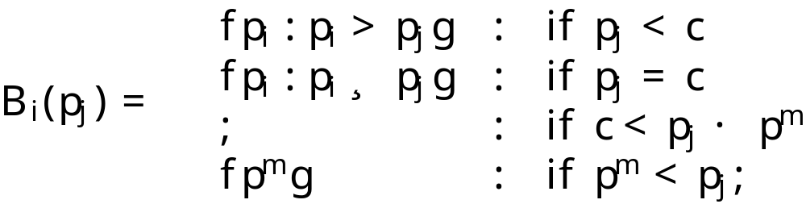

Nash Equilibrium in Bertrand Duopoly
Denote by p^{m} the value of its price that maximizes (p - c)(α - p).
Firm i’s best response function is given by:
where denotes the set with no members, the empty set.
Nash equilibrium:

Slide 7
Graphical Illustration: p_{j} < c
π_{i}
p_{j}
0
c
p^{m}
α
p_{i}
If p_{i} ≤ p_{j}, firm i’s profit π_{i} < 0.
If p_{i} > p_{j}, π_{i} = 0.

Slide 8
Graphical Illustration: c < p_{j} < p^{m}
π_{i}
p_{j}
0
c
p^{m}
α
p_{i}
Firm i’s profit π_{i} increases as p_{i} increases to p_{j}, then drops abruptly at p_{j}. For any price less than p_{j}, there is a higher price that is also less than p_{j}, so there is no best price.

Slide 9
Graphical Illustration: p_{j} > p^{m}
π_{i}
p_{j}
0
c
p^{m}
α
p_{i}
If p_{j} > p^{m}, p^{m} is the unique best response for firm i.

Slide 10
Graphical Illustration
p₂
p^{m}
c
0
c
p^{m}
p₁

Slide 11
Review: Electoral competition
Players: Two political candidates
Actions: Policy positions x_{i}
Preference: Each candidate cares only about winning
There is a continuum of voters, each with a favorite position (“bliss point”).
Each voter’s distaste for any position is given by the distance between that position and her bliss point.

Slide 12
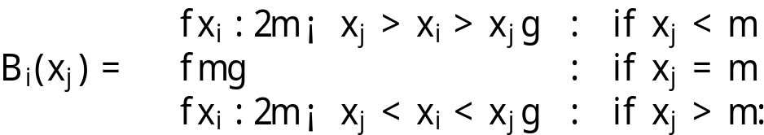
Example: 2 candidates case
Fix the position x₂ of candidate 2 and consider the best position for candidate 1.
Consider ½(x₁ + x₂).
Candidate i’s best response function is given by:
The unique Nash equilibrium: (m, m)
– a tie !

Slide 13
Graphical Explanation
½(x₁ + x₂) < m → x₁ < 2m - x₂
x₂
m
x₁
½(x₁+x₂)
Votes for 2
Votes for 1

Slide 14
Graphical Illustration
x₂
B₁(x₂)
m
B₂(x₁)
0
m
x₁

Slide 15
Chapter 3: The War of Attrition
Story Description
  Two animals are fighting over a prey.
  Each animal chooses the time at which it intends to give up.
  When an animal gives up, its opponent obtains all the prey.
  If both animals give up at the same time, then each has an equal change of obtaining the prey.
Some Notation
  Time: t_{i} ~ [0, ∞)
  The value i attached to the object in dispute: v_{i} > 0

Slide 16
The Strategic Game Form
Players: The two parties to a dispute
Actions: The set of possible concession times (non-negative numbers)
Preferences: Player i’s preferences are represented by the payoff function
u_{i}(t₁, t₂)
- t_{i} if t_{i} < t_{j} ;
= ½ v_{i} - t_{i} if t_{i} = t_{j} ;
v_{i} - t_{j} if t_{i} > t_{j} ,
where j is the other firm.

Slide 17
Graphical Illustration: t_{j} < v_{i}
u_{i}
t_{j}
v_{i}
0
t_{i}

Slide 18
Graphical Illustration: t_{j} = v_{i}
u_{i}
t_{j} = v_{i}
0
t_{i}

Slide 19
Graphical Illustration: t_{j} > v_{i}
u_{i}
v_{i}
t_{j}
0
t_{i}

Slide 20
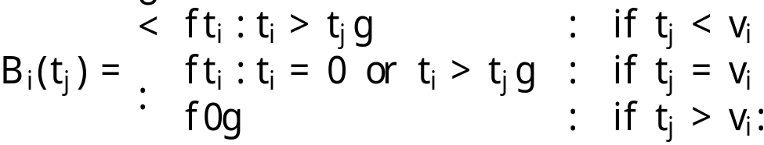
Nash Equilibrium in The War of Attrition
Player i’s best response function is given by
(t₁, t₂) is a Nash equilibrium of the game if and only if
either t₁ = 0 and t₂ ≥ v₁
or t₂ = 0 and t₁ ≥ v₂ .

Slide 21
Graphical Illustration
t₂
B₂(t₁)
v₁
B₁(t₂)
0
t₁
v₂
v₁

Slide 22
Three Features of the Equilibria
In no equilibrium is there any fight: one player always concedes immediately.
Either player may concede first, regardless of the players’ valuations.
The equilibria are asymmetric, even when v₁ = v₂, in which case the game is symmetric.

Slide 23
Auctions
Auctions are very old.
Auctions are increasingly important.
  Government procurement
  Privatization, including spectrum
  Internet auctions
  Fish, flower, wine, art, etc.
Types of Auctions
  First price sealed bid
  English
  Second price sealed bid
  Dutch

Slide 24


Second-price Sealed-bid Auctions
Each player i = 1, . . . , n has a value v_{i}.
Each player submits a bid b_{i}.
The object is awarded to the player submitting the highest bid, who pays the second highest bid:
if , and otherwise,

Slide 25
Analysis
Bidding your value is a weakly dominant strategy
  Your bid affects only whether you win, and not how much you pay when you win.
  b_{i} < v_{i} rather than b_{i} = v_{i} risks losing when winning would be profitable.
  b_{i} > v_{i} rather than b_{i} = v_{i} risks paying too much
There are many equilibria.

Slide 26

First-price Sealed-bid Auctions
Each player i = 1, . . . , n has a value v_{i}.
Each player submits a bid b_{i}.
The object is awarded to the player submitting the highest bid, and the person pays their bid:
if , and otherwise,

Slide 27
Analysis
If the values v₁ > … > v_{n} are known by everyone, in Nash equilibrium b₁ = v₂ and bidder one wins the object with probability one.
Variants
  Common valuations
  Multiunit auctions
  First-price auction
  Menu auction

Slide 28
Accident Law
Story
  A victim suffers a loss that depends on the amounts of care taken by both her and an injurer.
Agent 1 (the injurer ) and agent 2 (the victim) choose levels of care a₁ and a₂ that are nonnegative real numbers.
The loss (on average) resulting from these choices is L(a₁, a₂).
Assume that the function L is:
  positive for all (a₁, a₂) ;
  decreasing in each variable:
  L(a₁, a₂) > L(a’₁, a₂) and
  L(a₁, a₂) > L(a₁, a’₂)
  whenever a’₁ > a₁ and a’₂ > a₂.
A rule of law is a function ρ(a₁, a₂) ∈ [0, 1] assigning a share of the loss to the injurer.

Slide 29
Accident Law: Set-up
Players: The injurer and the victim
Actions: The set of possible levels of care
Preferences: The payoff functions are:
u₁ (a₁, a₂) = − a₁ − ρ (a₁, a₂) L (a₁, a₂);
u₂ (a₁, a₂) = − a₂−(1−ρ (a₁, a₂))L (a₁, a₂).

Slide 30
Negligence with contributory negligence
It requires the injurer to compensate the victim for a loss if and only if both the victim is sufficiently careful and the injurer is sufficiently careless.
The required compensation is the total loss.
The rule specifies the standards of care X₁ for the injurer and X₂ for the victim.
Under this rule,
1 if a₁ < X₁ and a₂ ≥ X₂
ρ(a₁, a₂) =
0 if a₁ ≥ X₁ or a₂ < X₂ .

Slide 31
Analysis
Suppose that the pair of actions is socially desirable.
maximizes −a₁ − a₂ - L (a₁, a₂).
Claim: is the unique Nash equilibrium.
Sketch of Proof:
Prove that it is a Nash equilibrium
Prove that there is no other Nash equilibrium

Slide 32
Nash equilibrium
Injurer’s Action
− a₁ − L (a₁, ) if a₁ <
u₁(a₁, ) =
− a₁ if a₁ ≥ .
Victim’s Action
u₂( , a₂) = − a₁ − L ( , a₂).

Slide 33
Uniqueness of equilibrium
Injurer’s Action
− a₁ − L (a₁, a₂) if a₁ <
u₁(a₁, a₂ ) = and a₂ ≥
− a₁ if a₁ ≥ and a₂ < .
a₂ <
a₂ =
a₂ >

Slide 34
Review from Chapter 3
Cournot’s model of oligopoly
Bertrand’s model of oligopoly
Hotelling’s model of electoral competition
Auctions
Accident Law

