Slide 1
Game Theory and Strategy
Week 6
Instructor: Dr Shino Takayama

Slide 2
Agenda for Week 6
Chapter 3
  Review: Accident Law
Chapter 4
  Expected Utility
  Mixed Strategy Equilibrium

Slide 3
Mixed strategy Nash equilibrium
We allow each player to choose a probability distribution over her set of actions rather than restricting her to choose a single deterministic action.
We refer to such a probability distribution as a mixed strategy.

Slide 4
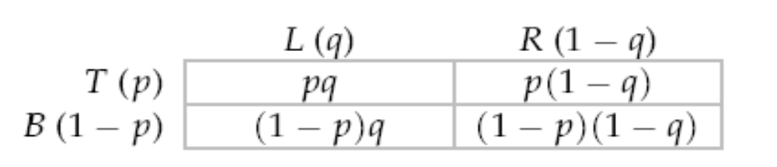
How to Solve for Mixed Strategy Nash Equilibrium
Probability Distribution: (α₁, α₂).
  α₁(T) = p & α₁(B) = 1 – p.
  α₂(L) = q & α₂(R) = 1 – q.
The expected payoff of Player 1
  Strategy T: E₁(T, α₂) = qu₁(T, L) + (1 - q)u₁(T, R)
  Strategy B: E₁(B, α₂) = qu₁ (B, L) + (1 - q)u₁(B, R)

Slide 5
Best Response Functions
E₁(T, α₂) > E₁(B, α₂) : Player 1's unique best response is the pure strategy T.
E₁(T, α₂) = E₁(B, α₂) : all mixed strategies of player 1 yield the same expected payoff, and hence all are best responses.
E₁(T, α₂) < E₁(B, α₂) : Player 1's unique best response is the pure strategy B.

Slide 6
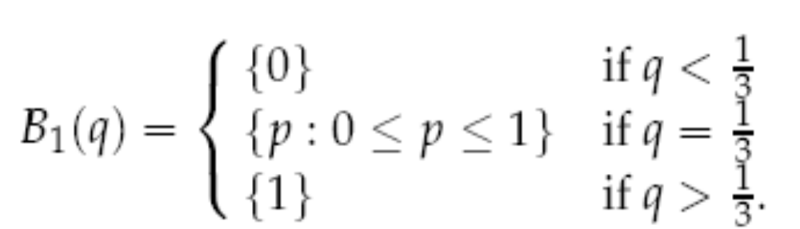
Example: Bach and Stravinsky
 | B | S
B | (2, 1) | (0, 0)
S | (0, 0) | (1, 2)
Suppose that player 2
assigns probability q to B.
E₁(B, q) = 2q + 0(1 - q) = 2q.
E₁(S, q) = 0q + 1(1 - q) = 1 - q.
Player 1's best response function is

Slide 7
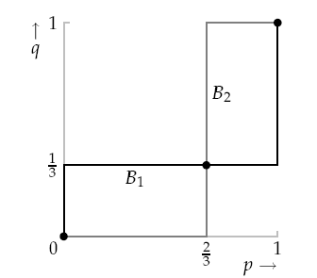
Graphical Illustration
There are three NE: (p, q) = (0, 0); (1, 1); (2/3, 1/3).
Two pure strategy NE and one mixed strategy NE.

Slide 8
Def: Mixed Strategy Nash Equilibrium
The mixed strategy profile α* in a strategic game with vNM preferences is a (mixed strategy) Nash equilibrium if, for each player i,
U_{i}(α*) ≥ U_{i}(α_{i}, α_{-i}*)
for every mixed strategy α_{i} of player i, where U_{i}(α) is player i's expected payoff to the mixed strategy profile α.
Equivalently, the mixed strategy profile α* is a mixed strategy Nash equilibrium if and only if α_{i} is in B_{i}(α_{-i}*) for every player i.

