Slide 1
Game Theory and Strategy
- Week 8 -
Instructor: Dr Shino Takayama

Slide 2
Agenda for Week 8
Chapter 5: Extensive Games with Perfect Information
  Entry Game
  Definitions for Extensive Games
  Strategy and Action
  Nash Equilibrium
  Subgame and Subgame Perfect Equilibrium

Slide 3
Entry Game
An incumbent faces the possibility of entry by a challenger.
The challenger may, for example, be a firm considering entry into an industry currently occupied by a monopolist.
The challenger may enter or not.
If it enters, the incumbent may either acquiesce or fight.
We may model this situation as an extensive game with perfect information in which
  the terminal histories are (In, Acquiesce), (In, Fight), and Out,
  the player function assigns the challenger to the start of the game and the incumbent to the history In.

Slide 4
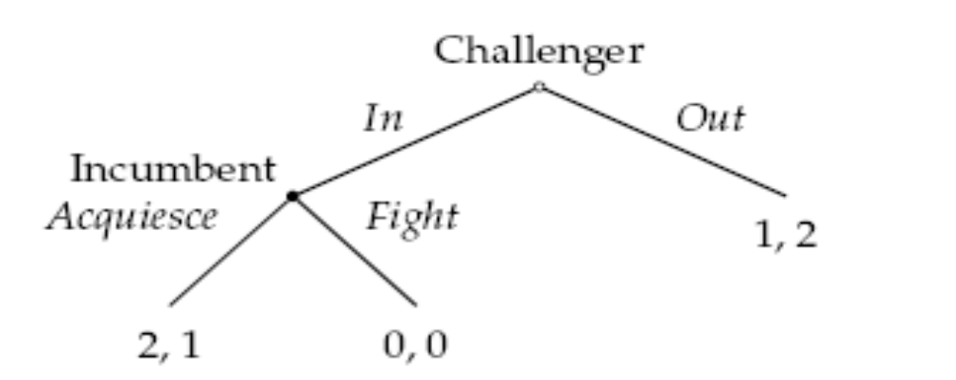
Extensive Form Game for Entry Game
The subhistories of (In, Acquiesce) are the empty history φ and the sequences In and (In, Acquiesce).
The proper subhistories are the empty history φ and the sequence In.

Slide 5
History
Define the subhistories of a finite sequence (a¹, a², . . . , a^{k}) of actions to be the empty sequence consisting of no actions, denoted φ (representing the start of the game), and all sequences of the form (a¹, a², . . . , a^{m}) with 1 ≤ m ≤ k.
A subhistory not equal to the entire sequence is called a proper subhistory.
A sequence of actions that is a subhistory of some terminal history is called simply a history.

Slide 6
Extensive Game
An extensive game with perfect information consists of:
  a set of players;
  a set of sequences (terminal histories) with the property that no sequence is a proper sub-history of any other sequence;
  a function (the player function) that assigns a player to every sequence that is a proper sub-history of some terminal history;
  for each player, preferences over the set of terminal histories.

Slide 7
History, Strategy and Action
The set of all actions available to the player who moves after h is A(h) = {a: (h, a) is a history}.
A strategy of player i in an extensive game with perfect information is a function that assigns to each history h after which it is player i's turn to move (i.e. P(h) = i, where P is the player function) an action in A(h) (the set of actions available after h).
A strategy profile determines the terminal history that occurs.
We refer to this terminal history as the outcome of a strategy profile s, and denote it O(s).

Slide 8
Example: Entry Game
  In entry game, the histories are φ, In, Out, (In, Acquiesce), and (In, Fight).
  The set of actions available to the challenger is
  A(φ) = {In, Out};
  The set of actions available to the incumbent is
  A(In) = {Acquiesce, Fight}.

Slide 9
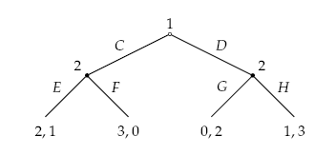
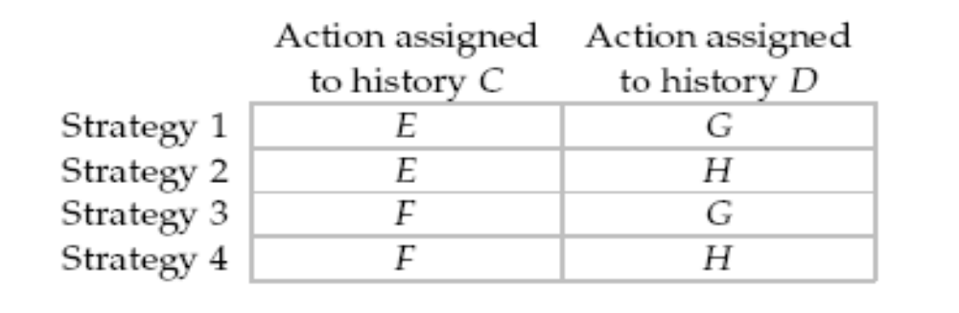
Example: Strategy and Action

Slide 10
Example: Strategy and Action
Each of player 2's strategies in the game may be interpreted as a plan of action or contingency plan.
It specifies what player 2 does if player 1 chooses C, and what she does if player 1 chooses D.
In every game, a player's strategy provides sufficient information to determine her plan of action: the actions she intends to take, whatever the other players do.

Slide 11
Nash Equilibrium in Extensive Form Game
The strategy profile s in an extensive game with perfect information is a Nash equilibrium if, for every player i and every strategy r_{i} of player i, the terminal history O(s) generated by s is at least as good according to player i's preferences as the terminal history O(r_{i}, s_{-i}*) generated by the strategy profile (r_{i}, s_{-i}*) in which player i chooses r_{i} while every other player j chooses s_{j}.
Equivalently, for each player i,
U_{i}(O(s)) ≥ U_{i}(O(r_{i}, s_{-i}*))
for every strategy r_{i} of player i, where u_{i} is a payoff function that represents player i's preferences and O is the outcome function of the game.

Slide 12
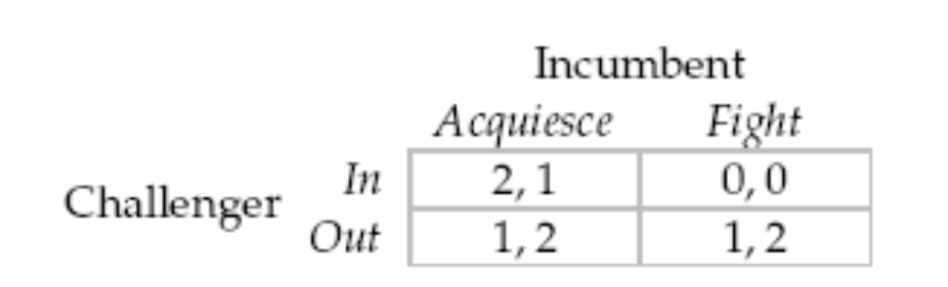
Strategic Game for Entry Game

Slide 13
Sub-games
Let G be an extensive game with perfect information, with player function P. For any nonterminal history h of G, the subgame G(h) following the history h is the following extensive game.
  Players: The players in G.
  Terminal histories: The set of all sequences h’ of actions such that (h, h’) is a terminal history of G.
  Player function: The player P(h, h’) is assigned to each proper subhistory h’ of a terminal history.
  Preferences: Each player prefers h’ to h’’ if and only if she prefers (h, h’) to (h, h’’) in G.

Slide 14
Sub-game Perfect Equilibrium
<Definition>
A subgame perfect equilibrium is a strategy profile s* with the property that in no subgame can any player i do better by choosing a strategy different from s_{i}*, given that every other player j adheres to s_{j}*.
Every subgame perfect equilibrium is a Nash equilibrium.
<Alternative Definition>
A subgame perfect equilibrium is a strategy profile that induces a Nash equilibrium in every subgame.

Slide 15
Backward Induction
Define the length of a subgame to be the length of the longest history in the subgame.
Index the subgames by j, and denote by S_{j}(k) the set of optimal actions in subgame j with length k.

Slide 16
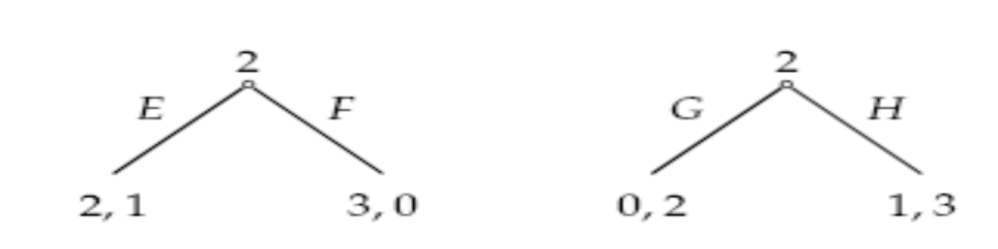
Example: Subgame
The two proper subgames

Slide 17
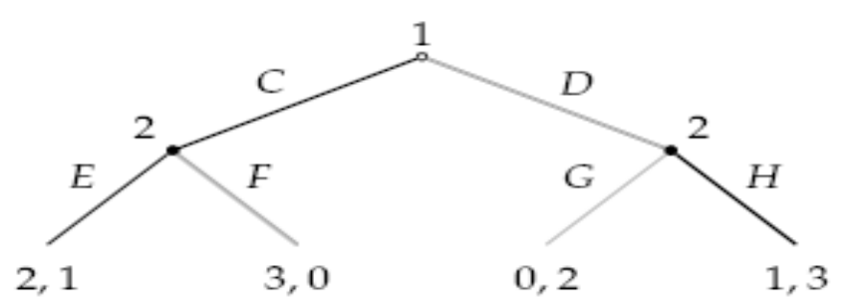
Explanation for Example
The game has two such subgames, in both of which player 2 moves. In the subgame following the history C, player 2's optimal action is E, and in the subgame following the history D, her optimal action is H.
Consider subgames of length 2. Given the optimal actions in the subgames of length 1, player 1's choosing C at the start of thegame yields her a payoff of 2, whereas her choosing D yields her a payoff of 1. Thus player 1's optimal action at the start of the game is C.
This procedure yields (C, EH).

Slide 18
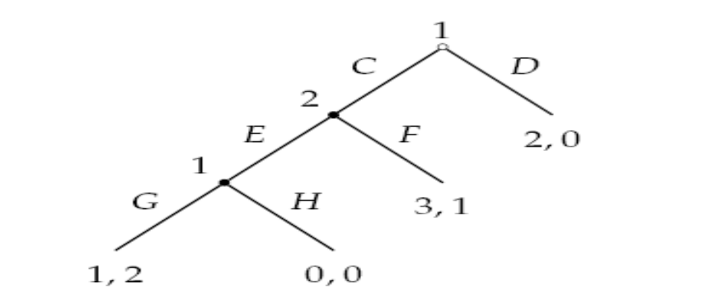
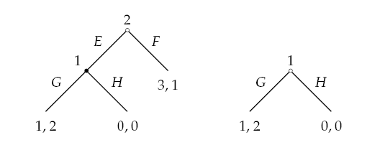
More Complicated Example
The two proper subgames

Slide 19
Optimal Choice in Subgames
We first deduce that in the subgame of length 1 following the history (C, E), player 1 chooses G; then that at the start of the subgame of length 2 following the history C, player 2 chooses E; then that at the start of the whole game, player 1 chooses D.
S*(1) = {G}, S*(2) = {E}, and S*(3) = {D}.
Thus the procedure of backward induction in this game yields the strategy pair (DG, E).

Slide 20
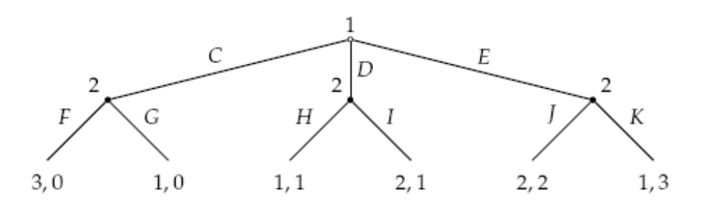
More & More Complicated Example
S₁*(1) = {F, G}, S₂*(1) = {H, I}, and S₃*(1) = {K}.
There are four lists of actions consisting of one action from each set: FHK, FIK, GHK, and GIK.
For FHK and FIK, the action C of player 1 is optimal at the start of the game.
For GHK, the actions C, D, and E are all optimal
For GIK, the action D is optimal.

Slide 21
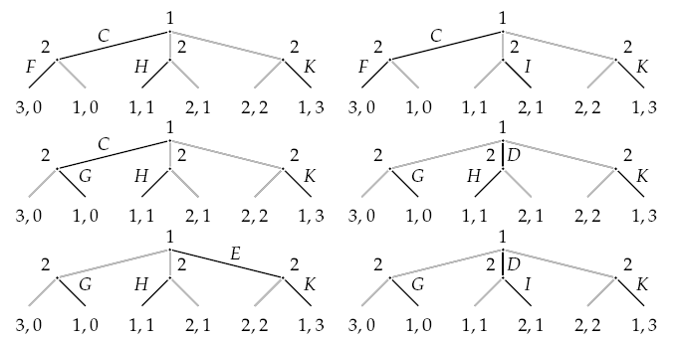
Therefore…
The set S*(2) of strategy profiles consists of
(C, FHK), (C, FIK), (C, GHK), (D, GHK),
(E, GHK), and (D, GIK).

