Slide 1
Game Theory and Strategy
- Week 9 -
Instructor: Dr Shino Takayama

Slide 2
Agenda for Week 9
Chapter 5
  Review of Backward Induction
Chapter 6
  The ultimatum game
  The holdup game
  Stackelberg’s model of duopoly
Hints for HW2

Slide 3
Review: Subgame Perfect Equilibrium
A subgame is a smaller game embedded in the complete game; starting from some point in the original game, a subgame includes all subsequent choices that must be made if the players actually reached that point in the game.
A strategy profile is a subgame perfect (Nash) equilibrium if the strategies are a Nash equilibrium in every subgame.

Slide 4
Review: Backward Induction
Backward induction involves first identifying the smallest possible subgames – those do not have any subgames within them.
In each node, consider “What is the optimal choice for the player?”
Then replace these subgames with the implied payoffs.

Slide 5
More Formally, backward induction
Find, for each subgame of length 1, the set of optimal actions of the player who moves first. Index the subgames by j, find denote by S_{j}*(1) the set of optimal actions in subgame j.
For each combination of actions consisting of one from each set S_{j}*(1), find, for each subgame of length two, the set of optimal actions of the player who moves first, which we denote by S_{j}*(2) the set of strategy profiles in subgame.
Continue by examining successively longer subgames until reaching the start of the game. At each stage k, for each combination of strategy profiles consisting of one from each set S_{p}*(k - 1) constructed in the previous stage, find, for each subgame of length k, the set of optimal actions of the player who moves first, and hence a set of strategy profiles for each subgame of length k.

Slide 6
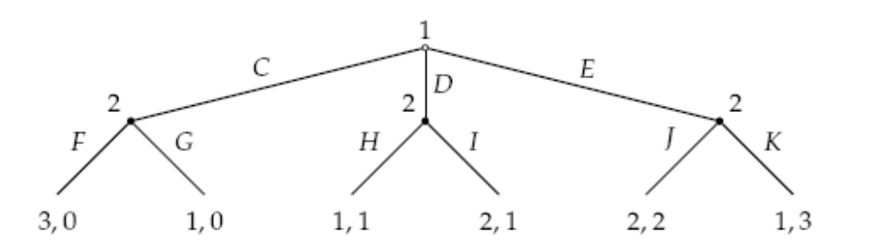
More & More Complicated Example
S₁*(1) = {F, G}, S₂*(1) = {H, I}, and S₃*(1) = {K}.
There are four lists of actions consisting of one action from each set: FHK, FIK, GHK, and GIK.
For FHK and FIK, the action C of player 1 is optimal at the start of the game.
For GHK, the actions C, D, and E are all optimal
For GIK, the action D is optimal.

Slide 7
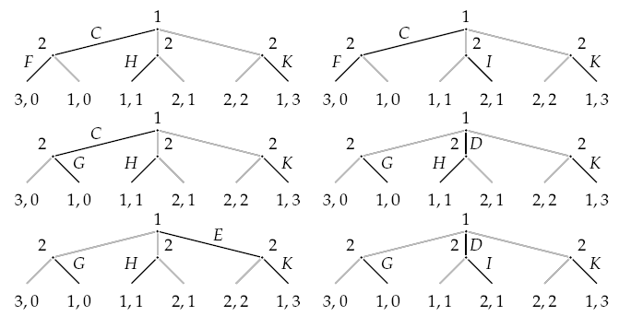
Therefore…
The set S*(2) of strategy profiles consists of
(C, FHK), (C, FIK), (C, GHK), (D, GHK),
(E, GHK), and (D, GIK).

Slide 8
The ultimatum game
Two people use the following procedure to split $c.
  Person 1 offers person 2 an amount of money up to $c
  If 2 accepts this offer, then 1 receives the remainder of the $c.
  If 2 rejects the offer, then neither person receives any payoff.
Each person cares only about the amount of money she receives, and prefers to receive as much as possible.

Slide 9
Set-up
Players: The two people.
Terminal histories: The set of sequences (x, Z), where x is a number with 0 ≤ x ≤ c (the amount of money that person 1 offers to person 2) and Z is either Y (“yes, I accept”) or N (“no, I reject”).
Player function: P(φ) = 1 and P(x) = 2 for all x.
Preferences: Each person's preferences are represented by payoffs equal to the amounts of money she receives. For the terminal history (x, Y) person 1 receives c - x and person 2 receives x; for the terminal history (x, N) each person receives 0.

Slide 10
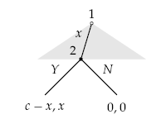
Backward Induction in this Game
The only subgame perfect equilibrium is the strategy pair in which person 1 offers 0 and person 2 accepts all offers.

Slide 11
Proof:
If x > 0, S_{x}*(1)={Y}. If x = 0, S_{x}*(1) = {Y, N}.
Then, S*(2) = {x = 0}.
So, if player 2’s action is Y, player 1 should offer x = 0.
If player 2’s action is N, player 1 offers x > 0 but in this case there is no optimal offer for player 1, because always we can find better offer for him (for example, x/2).

Slide 12
The holdup game
Before engaging in an ultimatum game, person 2 takes an action that affects the size c of the pie to be divided.
She may exert little effort, resulting in a small pie, of size c_{L}, or great effort, resulting in a large pie, of size c_{H}.
Assume that her payoff is x - E if her share of the pie is x, where E = L if she exerts little effort and E = H > L if she exerts great effort.
The extensive game that models this situation is known as the holdup game.

Slide 13
Exercise 186.1
Players: Two people, person 1 and person 2.
Terminal histories: The set of all sequences (low, x, Z), where x is a number with 0 ≤ x ≤ c_{L} (the amount of money that person 1 offers to person 2 when the pie is small), and
(high, x, Z), where x is a number with 0 ≤ x ≤ c_{H} (the amount of money that person 1 offers to person 2 when the pie is large) and Z is either Y (“yes, I accept”) or N (“no, I reject”).
Player function: P(φ) = 2, P(low) = P(high) = 1, and P(low, x) = P(high, x) = 2 for all x.
Continued…

Slide 14
Exercise 186.1 Continued
Preferences:
Person 1's preferences are represented by payoffs equal to the amounts of money she receives, equal to c_{L} - x for any terminal history (low, x, Y) with 0 ≤ x ≤ c_{L}, equal to c_{H} - x for any terminal history (high, x, Y) with 0 ≤ x ≤ c_{H}, and equal to 0 for any terminal history (low, x, N) with 0 ≤ x ≤ c_{L} and for any terminal history (high, x, N) with 0 ≤ x ≤ c_{H}.
Person 2's preferences are represented by payoffs equal to x - L for the terminal history (low, x, Y), x - H for the terminal history (high, x, Y), -L for the terminal history (low, x, N), and -H for the terminal history (high, x, N).

Slide 15
Subgame Perfect Equilibrium
Each subgame that follows person 2's choice of effort is an ultimatum game, and thus has a unique subgame perfect equilibrium, in which person 1 offers 0 and person 2 accepts all offers.
Now consider person 2's choice of effort at the start of the game.
  If she chooses L then her payoff, given the outcome in the following subgame, is -L.
  If she chooses H then her payoff is -H.
Consequently she chooses L.
Thus the game has a unique subgame perfect equilibrium, in which person 2 exerts little effort and person 1 obtains all of the resulting small pie.

Slide 16
Stackelberg’s Model of Duopoly
Consider a market in which there are two firms, both producing the same good. Firm i's cost of producing q_{i} units of the good is C_{i}(q_{i}); the price at which output is sold when the total output is Q is P_{d}(Q).
Each firm's strategic variable is output, as in Cournot's model, but the firms make their decisions sequentially, rather than simultaneously: one firm chooses its output, then the other firm does so, knowing the output chosen by the first firm.

Slide 17
Example: Constant unit cost and linear inverse demand
Each firm’s cost function is given by
C_{i}(q_{i}) = cq_{i}.
The inverse demand function is given by:
α − Q if Q ≤ α
P(Q) =
0 if Q > α,
where α > 0 and c > 0 are constant.

Slide 18
Backward induction: Firm 2
The firms’ payoffs are:
π₂(q₁, q₂) = q₂(P(q₁+q₂) – c)
q₂(α − c − q₁ − q₂) if q₁+q₂ ≤ α;
=
− cq₂ if q₁+q₂ > α.
We obtain the best response as:
½(α − c − q₁) if q₁ ≤ α – c;
b₂(q₁) =
0 if q₁ > α - c.

Slide 19
Backward induction: Firm 1
Firm 1’s strategy is the output q₁ that maximizes
π₁(q₁, q₂) = q₁(α - c - (q₁ + 1/2 (α - c - q₁)))
= 1/2 q₁(α - c - q₁).
Its maximizer is q₁ = ½(α - c).

Slide 20
Contrast with Cournot’s model
The unique subgame perfect equilibrium is: q₁* = ½(α − c) and q₂* = ¼(α − c).
π₁(q₁*, q₂*) = q₁*(P_{d}(q₁*+ q₂*) - c) = 1/8(α − c)²
π₂(q₁*, q₂*) = q₂(P_{d}(q₁*+ q₂*) - c) = 1/16(α − c)²

Slide 21
Comparison with Cournot’s case
Cournot’s case:
q₁^{C} = q₂^{C} = 1/3(α − c)
π₁(q₁^{C}, q₂^{C}) = π₂(q₁^{C}, q₂^{C}) = 1/9 (α − c)²

