Slide 1
Game Theory and Strategy
~ Electoral Competition and Hotelling’s Model ~
Guest Lesture
Dr Shino Takayama

Slide 2

Electoral competition
~ 2 candidates case ~
Players: Two political candidates
Actions: Policy positions
Preference: Each candidate cares only about winning. The candidate prefers to win than to tie for first place, which is preferred to lose.
There is a continuum of voters, each with a favorite position (“bliss point”).
Each voter’s distaste for any position is given by the distance between that position and her bliss point.

Slide 3
Median Favorite Position
Let m denote the median favorite position.
The position m has the property that exactly half of the voters’ favorite positions are at most m, and half of the voters’ favorite positions are at least m.
The candidate who obtains the most votes wins.
m

Slide 4
Best Position for Candidate 1
Fix the position x₂ of candidate 2 and consider the best position for candidate 1.
Consider the midpoint ½(x₁ + x₂).
Each candidate attracts the votes of all citizens whose favorite positions are closer to her position than to the position of other candidate.
Assume that citizens whose favorite position is ½(x₁ + x₂) divide their votes equally between the two candidates.

Slide 5
Best Position for Candidate 1
Suppose that x₂ < m.
x₂ < x₁ and ½(x₁ + x₂) < m → x₁ < 2m - x₂
Suppose that x₂ = m. The unique position is x₁ = m.
Suppose that x₂ > m. x₁ < x₂ and x₁ > 2m - x₂
x₂
½(x₁+x₂)
m
x₁
Votes for 2
Votes for 1
x₁
m
½(x₁+x₂)
x₂
Votes for 1
Votes for 2

Slide 6
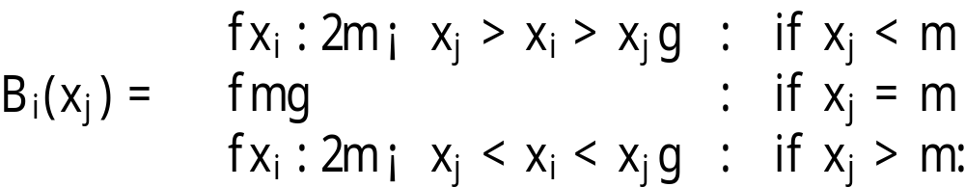
Best Response for Each Candidate
Candidate i’s best response function is given by:
The unique Nash equilibrium: (m, m)
– a tie !

Slide 7
Graphical Illustration
x₂
B₁(x₂)
m
B₂(x₁)
0
m
x₁

Slide 8
A Variant of Hotelling’s Model
This captures features of a US presidential election.
Voters are divided between two districts.
District 1 is worth more electoral college votes than is district 2.
The candidate who obtains the most electoral college votes wins.
Denote by m_{i} the median favorite position among the citizens of district i, for i = 1, 2; assume that m₂ < m₁.

Slide 9
Voting and Winning Rule
Each of two candidates chooses a single position.
Each citizen votes for the candidate whose position is closest to her favorite position.
The candidate who wins a majority of the votes in a district obtains all the electoral college votes of that district.
If the candidates obtain the same number of votes in a district, they each obtain half of the electoral college votes of that district.

Slide 10
Nash Equilibrium is…
The game has a unique equilibrium, in which the both candidates choose the position m₁ (the median favorite position in the district with the most electoral college votes). The outcome is a tie.
If a candidate deviates to a position less than m₁, she loses in district 1 and wins in district 2, and thus loses overall.
If a candidate deviates to a position greater than m₁, she loses in both districts.
m₁
District 1
m₂
District 2

Slide 11
No other Nash equilibrium?
If the candidates' positions are either different, or the same and different from m₁, either candidate can win outright rather than tying for first place by moving to m₁.
Consider a pair of positions for which candidate 1 loses in district 1, and hence loses overall.
By deviating to m₁, she either wins in district 1, and hence wins overall; or if candidate 2's position is m₁, ties in district 1, and ties overall.
Thus her deviation induces an outcome she prefers.
The same argument applies to candidate 2.

