Slide 1
Industrial Economics
(Econ3400)
Week 14
Instructor: Shino Takayama

Slide 2
Agenda for Week 13
Review of Main Points from Each Week
  One Problem for Incomplete Contract
  Discount Factor
  Monopoly, Efficiency and Duopoly
  Cournot and Bertrand

Slide 3
Summary of Chapter 2
Profit-maximizing firms produce where their MR equals MC.
If markets are perfectly competitive, the allocation of resources is Pareto optimal.
A firm with market power can profitably raise price above MC
Monopoly pricing results in DWL.
DWL provides an economic rationale for state intervention

Slide 4
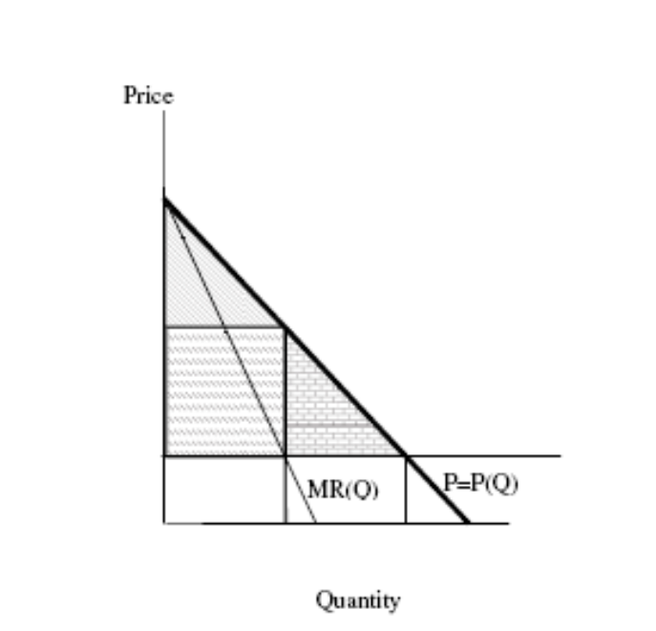
Graphical Description for Monopoly

Slide 5
Summary of Chapter 3
The advantages from being large arise from economies of scale and economies of scope.
The three advantages of using spot markets to source inputs are efficient adaptation.
Holdup problem.
How to construct the optimal incentive contract in a simple setting.

Slide 6
Summary for Chapter 4 & 5
Entry barriers created by governments and structural characteristics.
The market power of a durable goods monopolist is constrained today by the expectations of consumers tomorrow of lower prices.
The Coase conjecture & Pacman strategy
X-inefficiency
Mechanism for Capturing Surplus
Price Discrimination & Applications

Slide 7
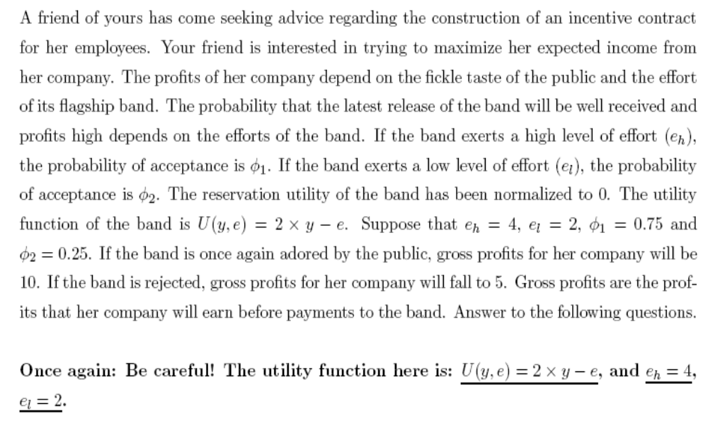
Incomplete Contract

Slide 8
Net Present Value & Interest Rate
Consider a bond which gives you $1 in every period indefinitely.
What is the net present value of the bond S?
Interest rate: r
NPV of $1 in period t = 1 / (1+r)^{t}
S_{t} = 1 + … + 1 / (1+r)^{t}.
S∞ = (1+r)/r.

Slide 9
Summary of Chapter 6
Search Goods & Experience Goods
Lemons Problem & Adverse Selection
A Dynamic Model of Reputation for Quality
Advertising as a Signal of Quality
Warranty as a Signal of Quality

Slide 10
Summary of Chapter 7
Basic Structure of Game Theory
Iterative Elimination of Dominated Strategies
Rationalizable Strategies
Equilibrium Concepts
  Maxmin Criterion
  Nash Equilibrium
Mixed Strategies

Slide 11
Summary of Chapter 8
Classic Models of Duopoly
Cournot Competition
Herfindahl-Hirschman index
Bertrand Model
Bertrand Competition
Cournot vs. Bertrand

Slide 12
Summary of Chapter 9
Structure of Extensive Form Games
Subgame Perfect NE
The Centipede Game
Two Stage Games
Infinitely/Finitely Repeated Stage Games

Slide 13
Summary of Chapter 10
Review of Cournot Equilibrium
Dynamic Models of Oligopoly
Cartel
Free-entry Cournot Equilibrium

Slide 14
Cournot vs. Collusion
Demand in a market is given by P = 10 – Q. The cost function is C(Q) = 2Q and marginal cost of production is 2.
  What are the monopoly output and profits?
  Suppose that there are two firms in the market and the cost function for each of the two firms is C(q) = 2q. If they were to agree to maximize industry profits, how much would each produce?
  What would the profits of each firm and industry profits be?
  Is the collusive agreement a Nash equilibrium?

