Slide 1
Industrial Economics
(Econ3400)
Week 2
Instructor: Dr Shino Takayama

Slide 2
Agenda for Week 2
Review of Efficiency
Market Power
Monopoly Pricing
The Determinants of Deadweight Loss
Market Power and Public Policy

Slide 3
Efficiency
Measures of Gains from Trade
  Consumer Surplus
  Producer Surplus
  Total Surplus
Pareto Optimality
  If it is not possible to make one person better off without making another worse off.

Slide 4
Market Power: Supply side substitution
A firm has market power
  if it finds it profitable to raise price above marginal cost.
Supply side substitution
  relevant when products are homogeneous.
Example
  NutraSweet Company
  OPEC

Slide 5
Demand side substitution
Demand side substitution
  relevant when products are differentiated.
Example
  Microsoft
  The Rolling Stones
Price Maker
  A Firm with Market Power

Slide 6
The Story from the Textbook
Suppose that you have a cousin who has the exclusive license to sell alcoholic beverages in Eureka, a prosperous mining town in a remote part of Alaska. Her tavern is called Top of the World (TW).
If your cousin is interested in maximizing her income, what price should she charge for her beverages?

Slide 7
Market Power and Pricing
Monopolist
  The sole supplier
  If there are no close substitutes for its product
Cross-price elasticities of demand
Are they monopolist?
  The Rolling Stones
  Microsoft
  OPEC

Slide 8
Monopoly Pricing
For a monopolist,
π(Q) = P(Q)Q – C(Q).
Thus,
MR(Q) = P(Q) + (dP(Q)/dQ)Q,
  where dP(Q)/dQ: the rate of change of price w.r.t. quantity.
Finally,
MC(Q^{m}) = P(Q^{m})+(dP(Q^{m})/dQ)Q^{m}.

Slide 9
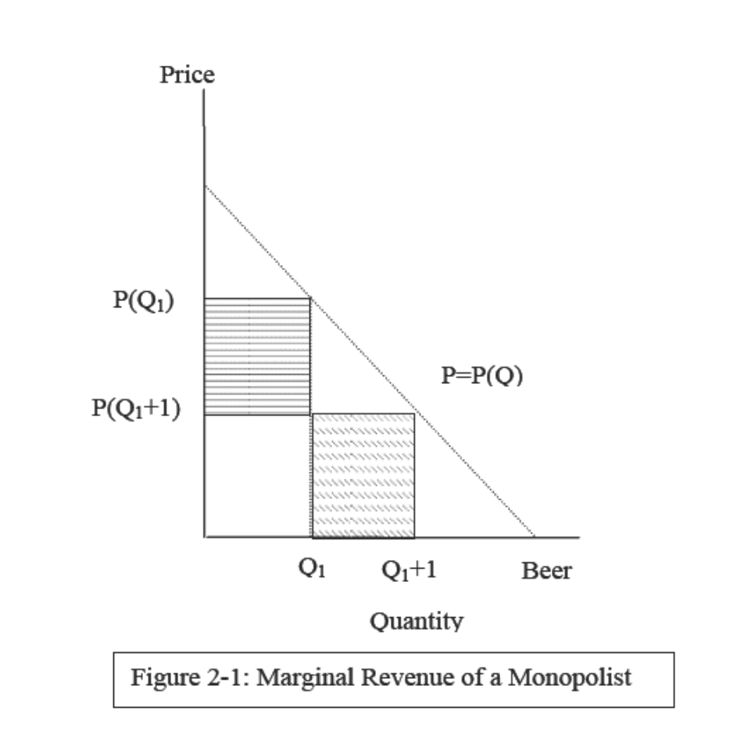
Marginal Revenue for a Monopolist

Slide 10
Inefficiency of Monopoly Pricing
Deadweight Loss
  A fall in total surplus that results from a market distortion
Exercise: Monopoly Pricing
  Suppose that (i) demand is linear P(Q) = A – b X Q, where A and b are both positive parameters, and (ii) that marginal cost is constant and equal to c. Find the monopoly price and output.

Slide 11
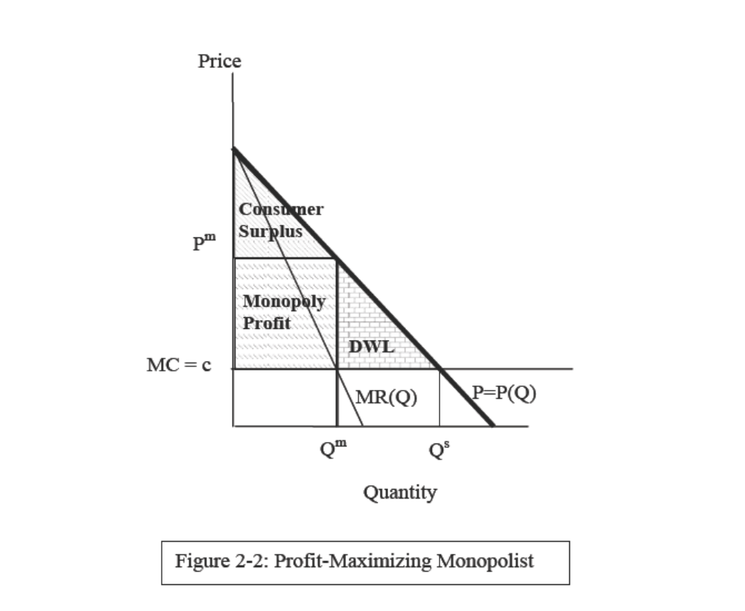
Deadweight Loss

Slide 12
Determinants of Market Power
What factors determine the extent of a monopolist’s market power?
The price elasticity of demand
  measures the responsiveness of demand to a change in price
  ε= - ΔQ/ΔP
  The Key Determinant
The Lerner Index
  the ratio of the firm’s profit margin and its price
  Measures market power because it increases if price distortion increases.

Slide 13
The Key Determinant
The elasticity of its demand
The time frame
  Consumer response
  New entrants
  New technology
Barriers to entry
Notes:
The long-run response of consumers to a price increase is often greater.
If there are sufficiently large entries by other firms, a monopolist can become a price taker.
Technological change can generate new products and services. The introduction of these products reduces the market power.
The last two factors suggest that the ability of a firm to exercise market power in the long run will depend on barrier to entry. If it is significant, then the firm will be able to exercise market power even in the long run.

Slide 14
Determinants of Deadweight Loss
DWL = ½ X dP X dQ
  dP and dQ are the difference in price and quantity b/w the CE and the monopoly outcome.
The size of the DWL depends on:
  The Lerner index
  The quantity/price distortion
  The elasticity of its demand
Assuming dP = P^{m} – P^{c},
DWL = - ½ X ε X P^{m} X Q^{m} X L²
  We cannot really determine what factor enlarges DWL.
  Estimates show DWL ~ 0.1% of GNP

Slide 15
DWL: Case Study
The Telecommunications Act of 1996 in the US
The seven regional Bell Operating Companies were created.
MacAvoy’s estimates
  The total annual gain to consumers in the market for MTS is almost $24 billion.

Slide 16
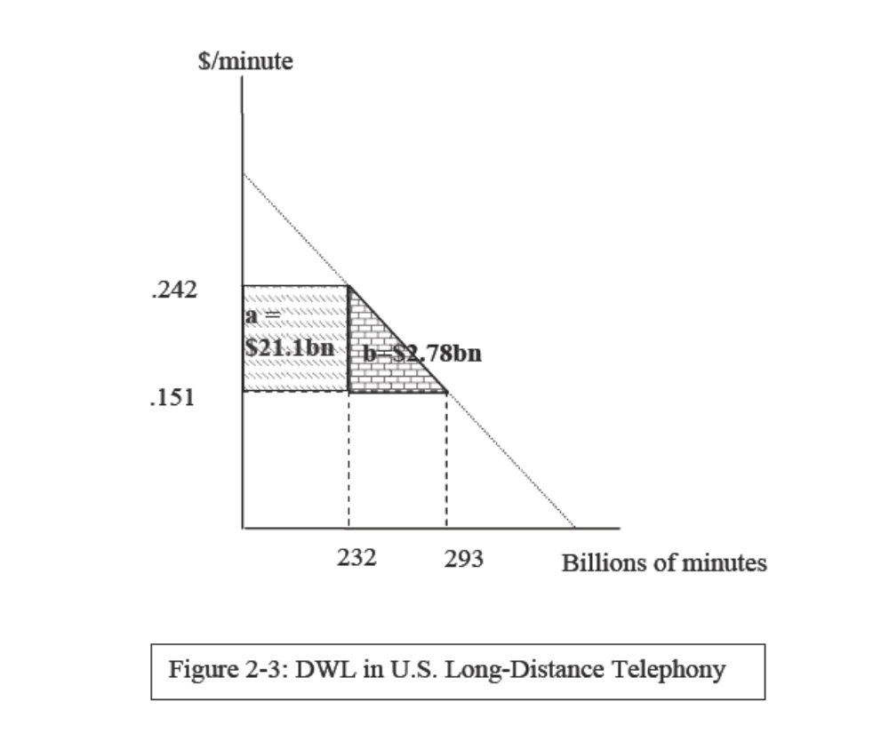
MacAvoy’s estimates

Slide 17
Market Power and Public Policy
Case Study: Price Fixing and Music Publishing
  ASCAP (American Society of Composers, Authors, and Publishers) and BMI (Broadcast Music Incorporated)
  “Blanket license” is a license which allows the music user to perform any or all of over 8.5 million songs in the ASCAP repertory as much or as little as they like. Licensees pay an annual fee for the license.

Slide 18
The rule of reason
A doctrine developed by the United States Supreme Court in its interpretation of the Antitrust Act.
The rule is that only combinations and contracts unreasonably restraining trade are subject to actions under the anti-trust laws.
The Supreme Court observed that a “middleman” that offered a blanket license would significantly reduce the transaction costs associated with the licensing and enforcement of performance rights.

Slide 19
Summary of the Chapter
Profit-maximizing firms produce where their MR equals MC.
If markets are perfectly competitive, the allocation of resources is Pareto optimal.
A firm with market power can profitably raise price above MC
Monopoly pricing results in DWL.
DWL provides an economic rationale for state intervention

