Slide 1
Industrial Economics
(Econ3400)
Week 3
Instructor: Shino Takayama

Slide 2
Agenda for Week 3
The Determinants of Deadweight Loss
Market Power and Public Policy
Theory of the Firm
Alternative Economic Organizations
Spot Markets
Holdup Problem

Slide 3
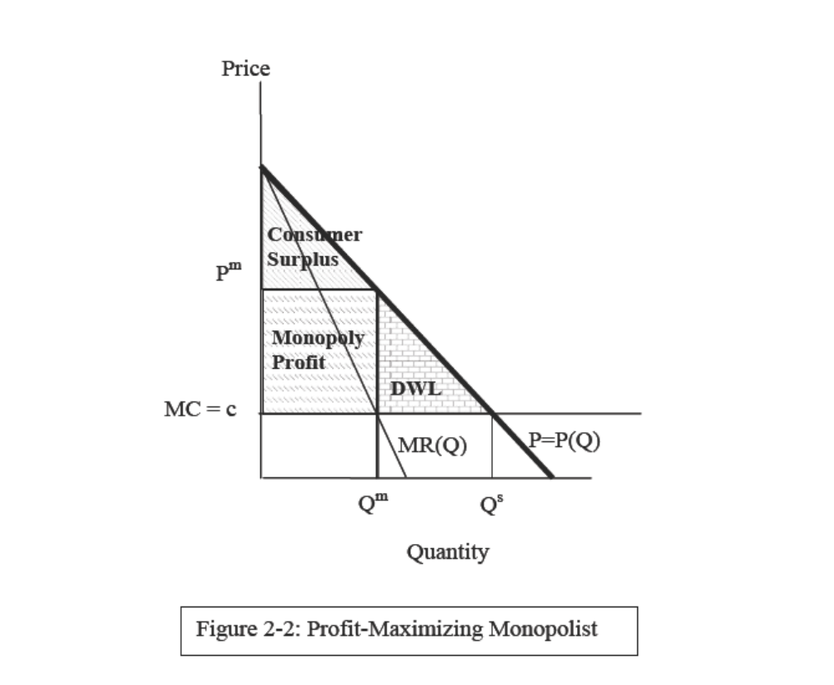
Deadweight Loss

Slide 4
Determinants of Deadweight Loss
DWL = ½ X dP X dQ
  dP and dQ are the difference in price and quantity b/w the CE and the monopoly outcome.
The size of the DWL depends on:
  The Lerner index
  The quantity/price distortion
  The elasticity of its demand
Assuming dP = P^{m} – P^{c},
DWL = - ½ X ε X P^{m} X Q^{m} X L²
  We cannot really determine what factor enlarges DWL.
  Estimates show DWL ~ 0.1% of GNP

Slide 5
DWL: Case Study
The Telecommunications Act of 1996 in the US
The seven regional Bell Operating Companies were created.
MacAvoy’s estimates
  The total annual gain to consumers in the market for MTS is almost $24 billion.

Slide 6
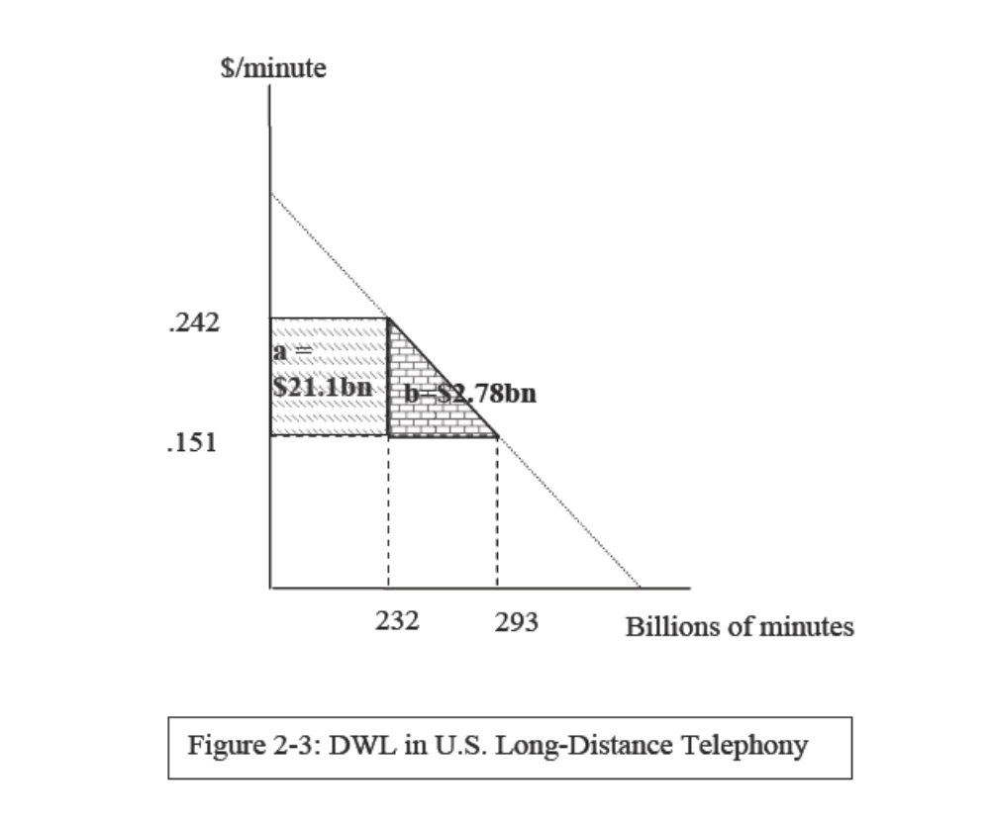
MacAvoy’s estimates

Slide 7
Market Power and Public Policy
Case Study: Price Fixing and Music Publishing
  ASCAP (American Society of Composers, Authors, and Publishers) and BMI (Broadcast Music Incorporated)
  “Blanket license” is a license which allows the music user to perform any or all of over 8.5 million songs in the ASCAP repertory as much or as little as they like. Licensees pay an annual fee for the license.

Slide 8
The rule of reason
A doctrine developed by the United States Supreme Court in its interpretation of the Antitrust Act.
The rule is that only combinations and contracts unreasonably restraining trade are subject to actions under the anti-trust laws.
The Supreme Court observed that a “middleman” that offered a blanket license would significantly reduce the transaction costs associated with the licensing and enforcement of performance rights.

Slide 9
Summary of the Chapter
Profit-maximizing firms produce where their MR equals MC.
If markets are perfectly competitive, the allocation of resources is Pareto optimal.
A firm with market power can profitably raise price above MC
Monopoly pricing results in DWL.
DWL provides an economic rationale for state intervention

Slide 10
Plan for the Future
Chapter 3 – 6
  Incentive Contracts
  Strategic Consumers/Durable Goods Monopoly
  Price / Quality Discrimination
  Lemons Problem / Signalling High Quality
Midterm Examination: Chapter 1 - 6
Chapter 7 – 10
  Nash Equilibrium, Rationalizable Strategy
  Classic Models
  Dynamic Games / Extensive-form Games
  Coalition-Proofness / Supergames
  Antitrust and Collusion

Slide 11
Ch.3 Theory of the Firm
Review of Neoclassical Theory of the Firm
  → Handouts
Economies of Scale
  Economies of scale exist if long-run average cost declines as the rate of output increases.
Economies of Scope
  Economies of scope exist if it is cheaper to produce the two output levels together in one plant than to produce similar amounts of each good in single-product plants.

Slide 12
Questions by Coase
In traditional microeconomics, the existence of firms is taken as given.
In a model, firms are production functions.
No explanation for the two basic questions.
Why do firms exist?
What determines the size of firms?

Slide 13
Alternative Economic Organizations
Consider a production process that consists of only two separate stages, A and B.
  Process B: Raw Material → Intermediate Goods
  Process A: Intermediate Goods → Output Goods
What is coordination of
Producers of A and B?

Slide 14
Possibilities are…
Spot Markets
  Producers of A source their requirements for input B in the market.
Long-Term Contracts
  Producers of A enter into contracts with suppliers of B.
Vertical Integration
  Producers of A produce B in-house by integrating.

Slide 15
Spot Markets
Suppose that there are many firms involved in stages A and B so that the markets for A and B are competitive.
The advantage of using spot markets to source input B
  Efficient Adaptation
  Cost Minimization
  Realization of Economies of Scale

Slide 16
Efficient Adaptation
The use of the market results in efficient adaptation to changes in demand and cost.
Equilibrium prices and quantities adjust to reflect changes in demand and cost and realize maximum total surplus.

Slide 17
Cost Minimization: Exercise
Suppose that the profits of a price-taking input supplier are given by:
π(q, e) = p X q – c(q, e) – e,
where the costs of production c(q, e) depend not only on the output level but also its investment in cost reduction e.
Find the profit-maximizing effort and output.

Slide 18
Cost Minimization: Solution
The profit-maximizing output for a price-taking firm as always equates price equal to marginal cost. The firm will invest in cost reduction until the marginal benefits of cost reduction equal the marginal cost:
- dc(q*,e*)/ de = 1,
where q* and e* are the profit-maximizing quantity and effort level.
Suppliers of the input have the correct incentives to invest in cost reduction since they reap all of the marginal benefit and bear marginal cost.

Slide 19
Economies of Scale
The final advantage to using markets to source inputs is the potential for minimizing costs of production where there are economies of scale.
If the demand for an input by a firm is less than minimum efficient scale, then by buying the input in the market it might still be able to realize the cost advantages of production at minimum efficient scale.
Supplier Switching

Slide 20
Holdup Problem I
Consider the problem of sourcing bottles for a firm that produces soda pop.
  F: Fixed Cost of the Machinery necessary to make bottles
  TVB: Total Variable Costs
  R: Anticipated Revenue from Soda Pop Sales
  TVP: Variable Costs of Making Pop Excluding the Costs of Bottles
  S: Salvage Value of the Machinery
  T: Cost of Searching Alternative Bottle Suppliers on Short-Notice

Slide 21
Holdup Problem II
The Gain From Trade After F has been committed:
V = R – TVB – TVP.
The Return of Soda Pop Company by sourcing another firm for bottles:
V – F – T.
The Outside Surplus
  The Aggregate Surplus by Terminating the Relationship
O = (V – F – T) + S.

Slide 22
Holdup Problem III
The Advantage of Maintaining the Relationship: “V – O”
-- The Total Amount of Quasi-Rent
Q = F – S + T
F – S: Supplier (Bottle Making Company)
T: Buyer (Pop Making Company)
If Q > 0, there are advantages to maintaining a trading relationship once established.

Slide 23
Holdup Problem: “Renegotiation”
The creation of quasi-rents gives each side an incentive to try and appropriate the quasi-rents of their trading partner.
For instance…
  After the bottle maker acquired the bottle-making equipment by spending F, the soda pop firm has an incentive to renegotiate.
  Instead of Paying F + TVB, offer to pay only
  S + TVB + $1.
The bottle maker can also renegotiate.
  Requiring F + T + TVB - $1 instead of
  F + TVB.
The risk of having your quasi-rents expropriated by an opportunistic trading partner is called the holdup problem.

