Slide 1
Industrial Economics
(Econ3400)
Week 9
Instructor: Shino Takayama

Slide 2
Agenda for Week 9
Basic Structure of Game Theory
Iterative Elimination of Dominated Strategies
Rationalizable Strategies
Equilibrium Concepts
  Maxmin Criterion
  Nash Equilibrium
Mixed Strategies

Slide 3
Why Game Theory?
Payoff interdependency
  Payoff interdependency exists when the optimal choice by an agent depends on the actions of others.
  Non cooperative game theory is a set of tools that is used to model the choices of players when the payoff of a choice depends on the choice of other individuals.

Slide 4
The Basic Elements of a Game
Player
  Those playing the game
Rules
  Timing, Strategies, Actions, Information available to the players
Outcomes
Payoffs

Slide 5
Types of Games 1
The timing of moves
  Dynamics and Static games
Uncertainty about the payoffs of rivals
  Perfect information: All players know the entire history of the game when it is their turn to move.
  Imperfect information: Some players have only a partial idea of the history of the game.

Slide 6
Types of Games 2
Incomplete information: Players know their own payoffs but there are some players who do not know the payoffs of some of the other players.
  Static games of complete information
  Dynamic game of complete information
  Static games of incomplete information
  Dynamic game of incomplete information

Slide 7
Equilibrium Concept
An equilibrium concept is a solution to a game.
By this, we mean that the equilibrium concepts identifies, out of the set of all possible strategies, the strategies that players are actually likely to play.

Slide 8
Fundamental Assumptions
Rationality
  Game theory assumes that players are interested in maximizing their payoffs.
Common Knowledge
  All players know the structure of the game and their opponents are rational. All players know that all players know the structure of the game and their opponents are rational, and so on.

Slide 9
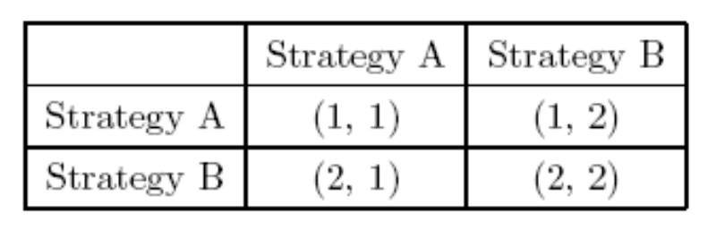
Static Games of Complete Information
Normal Form Representation
  The first column shows strategies which are available for Player 1 and the first row shows strategies which are available for Player 2. The first number in each parenthesis shows payoff for Player 1 and the second number shows payoff for Player 2 for given combination of strategies.
Player 2
Player 1

Slide 10
The maximin criterion
The maximin criterion: Requiring you to select the strategy that yields the maximum payoff on the assumption that your opponent will do as much damage to you as s/he can.
The strategy that Player 1 should take by the maximin criterion is Strategy B. Similarly, Player 2 should take Strategy B by the maximin criterion.

Slide 11
Strictly Dominant Strategy
A strategy s_{i} is a strictly dominant strategy for player i if for all s’_{i}  S_{i},
π(s_{i} , s_{-i} ) > π(s’_{i}, s_{-i} ),
for all possible s_{-i} = (s₁, …, s_{i-1}, s_{i+1},…, s_{I}).
Figure 7.2 Normal Form with Strictly Dominant Strategies
 | C1 | C2 | C3
R1 | (4,3) | (5,1) | (6,4)
R2 | (2,1) | (3,4) | (3,6)
R3 | (3,0) | (4,6) | (2,8)

Slide 12
Iterative Elimination of Dominated Strategies
A strategy of player i is strictly dominated if there exists another strategy s’_{i}  S_{i} such that for all possible s_{-i} ,
π(s’_{i} , s_{-i} ) > π(s_{i}, s_{-i} ).
Figure 7.3 Normal Form with no Strictly Dominant Strategies
 | C1 | C2 | C3
R1 | (4,3) | (5,1) | (6,2)
R2 | (2,1) | (3,4) | (3,6)
R3 | (3,0) | (9,6) | (2,8)

Slide 13
Best Response
The strategy s_{i} is a best response for player i to s_{-i} if
π(s_{i}, s_{-i} ) ≥ π(s’_{i} , s_{-i} )
for all s’_{i}  S_{i}.
This simply says that there is some strategy profile of i’s rivals for which s_{i} is the best choice.

Slide 14
Rationalizable Strategies
For player 1, L or M → U & R → D
For player 2, U → M & D → L
  R is never a best response.
  D will not be played.
  (U, M) will be played.
 | L | M | R
U | (2, 0) | (3, 5) | (4, 4)
D | (0, 3) | (2, 1) | (5, 2)

Slide 15
Multiple Rationalizable Strategies
The set of rationalizable strategy is the set of strategies survives iterated elimination of never-best responses.
 | C1 | C2 | C3 | C4
R1 | (0, 7) | (2, 5) | (7, 0) | (6, 6)
R2 | (5, 2) | (3, 3) | (5, 2) | (2, 2)
R3 | (7, 0) | (2, 5) | (0, 7) | (4, 4)
R4 | (6, 6) | (2, 2) | (4, 4) | (10, 3)

Slide 16
Nash Equilibrium
A Nash Equilibrium is a strategy profile such that every player’s strategy is a best response to the strategies of all the other players.
Formal Definition:
The strategy s*_{i} is a Nash equilibrium if
π(s*_{i}, s*_{-i} ) ≥ π(s’_{i} , s*_{-i} )
for all s’_{i}  S_{i} and for all i  I.
No player has ex-post regret.

Slide 17
Example 1: Multiple NE
Figure 7.7 The Battle of the Sexes
(Game between Father and Daughter)
 | Hockey Game | Ballet
Hockey Game | (3, 1) | (0, 0)
Ballet | (0, 0) | (1, 3)

Slide 18
Pure and Mixed Strategy
The strategy of a player is said to be mixed if he randomizes over some or all of the strategies in his strategy set S_{i}.
Pure strategies are degenerate cases of mixed strategies.
A Nash equilibrium involving mixed strategies still requires that no player can increase her payoff by unilaterally deviating.
  She must be indifferent to the pure strategies she is mixing over.
  Any strategies that is not played with positive probability must be inferior to those that are part of the mixed strategy.

Slide 19
Mixed Strategies
Figure 7.9 Matching Pennies
 | Heads | Tails
Heads | (1, -1) | (-1, 1)
Tails | (-1, 1) | (1, -1)

Slide 20
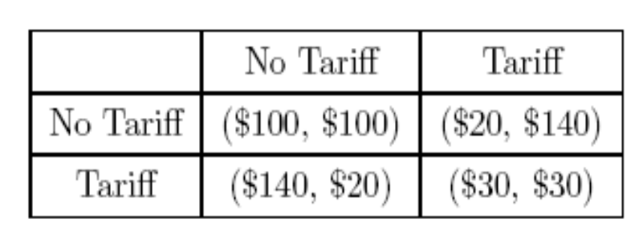
Example: International Trade
The game matrix given here describes the situation where there are two counties and both countries are trying to set up the trading policy.

Slide 21
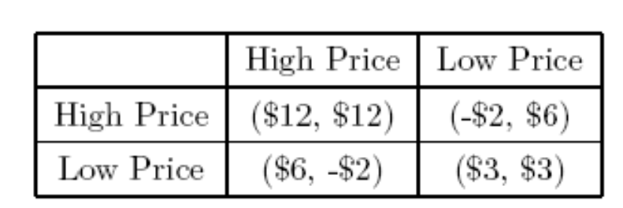
Example: Competition between Two Companies
Suppose, in the computer industry there are two companies. Each company has two strategies.

