Slide 1
Ch 12. Market Efficiency and Behavioural Finance
Shino Takayama
The University of Sydney
Faculty of Business and Economics

Slide 2
Efficient Market Hypothesis (EMH)
Do security prices reflect information ?
Why look at market efficiency?
  Implications for business and corporate finance
  Implications for investment

Slide 3
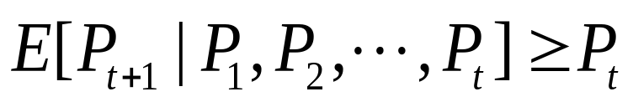
Random Walk and the EMH
Random Walk - stock prices are random
  Actually submartingale
    A submartingale is that the current value of the random variable is always less than or equal to the expected future value. Formally, this means:
    Expected price is positive over time
    Positive trend and random about the trend

Slide 4
Random Walk with Positive Trend
Security
Prices
Time

Slide 5
Random Price Changes
Why are price changes random?
  Prices react to information
  Flow of information is random
  Therefore, price changes are random

Slide 6
EMH and Competition
Stock prices fully and accurately reflect publicly available information.
Once information becomes available, market participants analyze it.
Competition assures prices reflect information.

Slide 7
Forms of the EMH
Weak
  Stock prices already reflect all information that can be derived by examining market trading data.
Semi-strong
  All publicly available information is reflected in the price.
Strong
  All relevant information is reflected in the price.

Slide 8
Types of Stock Analysis
Technical Analysis - using prices and volume information to predict future prices.
  Weak form efficiency & technical analysis
Fundamental Analysis - using economic and accounting information to predict stock prices.
  Semi strong form efficiency & fundamental analysis

Slide 9
Passive Management
Passive Management
  A passive strategy aims only at establishing a well-diversified portfolio of securities without attempting to find under or overvalued stocks.
  Index Funds: a fund designed to replicate the performance of a broad-based index of stocks.
  Buy and Hold

Slide 10
Active Management
Active Management
  Security analysis
  Timing

Slide 11
Empirical Study of MEH: Event Studies
Event study: A technique of empirical financial research that enables an observer to assess impact of a particular event on a stock price.
Abnormal Return: The return beyond what would be predicted from market movements alone.

Slide 12
How Tests Are Structured I
Examine prices and returns over time

Slide 13
Returns Over Time
-t
0
+t
Announcement Date

Slide 14
How Tests Are Structured II
2. Returns are adjusted to determine if they are abnormal.
  Market Model approach
    a. R_{t} = a_{t} + b_{t}R_{mt} + e_{t}
    (Expected Return)
    b. Excess Return =
    (Actual - Expected)
    e_{t} = Actual - (a_{t} + b_{t}R_{mt})

Slide 15
How Tests Are Structured III
3. Concern: information leakage
    c. Cumulate the excess returns over time:
-t
0
+t

