Slide 1
Foundations for financial economics
Shino Takayama
Notes:
Finance, week 1
Semester II 2005
Shino Takayama

Slide 2
Overview
Week 1-6: Asset Pricing
  present value
  choice under uncertainty
  portfolio theory
  CAPM
Week 7-13: Corporate Finance and Market Structure
  market efficiency
  derivatives
  capital structure
  dividend policy
  market structure

Slide 3
Lecture 1 - Overview
Choice under uncertainty
  expected utility
  measures of risk aversion
The value of insurance
Trading of simple securities
A general model of portfolio choice and asset pricing

Slide 4
Choice under uncertainty
Certainty: choose between goods x and y
Uncertainty: instead of goods, you choose lottery or gamble X and Y
x₁
y₁
p
q
X
Y
1-p
1-q
x₂
y₂

Slide 5
Choice under uncertainty
Certainty: utility function assigns number to all possible choices
  U: set of goods → real numbers
  x → U(x)
  U(x) > U(y) ⇔ x preferred over y
Uncertainty: expectation of utility value
  EU(X) = pU(x₁) + (1-p)U(x₂) = p_{i}U(x_{i})
  EU(X) > EU(Y) ⇔ gamble X preferred over gamble Y

Slide 6
Choice under uncertainty
Certainty
  objects of choice: goods
  decision criterion
  U(x) > U(y)
  ⇔
  x preferred over y
Uncertainty
  objects of choice: gambles
  decision criterion
  EU(X) > EU(Y)
  ⇔
  X preferred over Y

Slide 7
Choice under uncertainty
Risk aversion
  concave utility function
  EU(X) < U(E(X))
  i.e. prefer certain outcome over actuarially fair gamble
U(x)
U(E(X))
EU(X)
x₁
E(X)
x₂
x

Slide 8
Choice under uncertainty
Certainty equivalent:
  certain payoff z, such that indifferent between gamble and z:
  U(z) = EU(X)
Markowitz risk premium
  E(X) - z
  wealth agent would give up to avoid gamble
U(x)
U(z)
x₁
z
E(X)
x₂
x

Slide 9
Remark 1: RISK PREMIUM
We can use the expected utility framework in order to work out how much extra return an investor requires to take extra risk.

Slide 10
Choice under uncertainty
Arrow-Pratt measure
  measures curvature locally at wealth W
  absolute r.a.
  ARA(W)= - U'' (W)/U'(W)
  relative r.a.
  RRA(W) =
  - W·U'' (W)/U'(W)
U(x)
U_{A}(x)
U_{B}(x)
W
x
U_{B} more risk averse than U_{A}

Slide 11
Choice under uncertainty
Arrow-Pratt measure of risk aversion
  if ARA_{A}(W) > ARA_{B}(W), then A accepts less gambles expressed in $ terms than B
  if RRA_{A}(W) > RRA_{B}(W), then A accepts less gambles expressed in fractions of wealth than B
  How would you expect ARA and RRA to depend on W?

Slide 12
Insurance
How much is a person willing to pay in order to avoid exposure to risk?
  Certainty equivalent
Who is willing to sell insurance, i.e. take on the risk that insured person evades?
  Agent who
    is less risk averse (e.g. risk neutral)
    has smaller risk exposure (risk sharing)

Slide 13
Remark 2: TRADE
We can use the expected utility framework in order to understand why and at what price people exchange / share risks, i.e., TRADE.

Slide 14
Insurance
x₁ = W (nothing happens)
π
1- π
x₂ = W-L (car gets stolen)
Insurance: pay q for coverage S
⇒ x₁ = W - q , x₂ = W - q + S - L

Slide 15
Insurance
When insurance priced fairly, agent buys full insurance
When insurance priced above fair value, agent buys partial (or no) insurance
-π /(1-π)
x₂
W-L
W
x₁

Slide 16
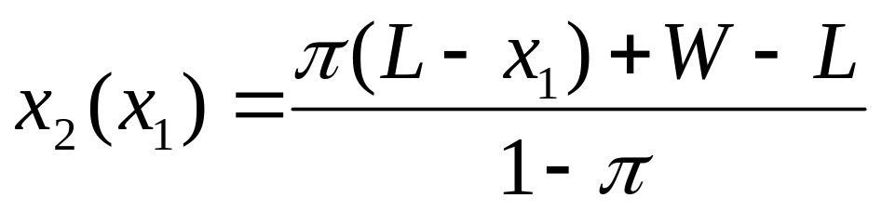
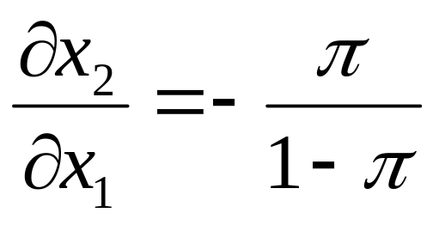
Insurance
Fair price: πW+(1-π)(W-L) = π x₁+(1-π)x₂
⇒
⇒

Slide 17
Insurance
Slope of indifference curve in x₁=x₂
  indifference curve:
  πU(x₁)+(1-π)U(x₂(x₁)) = constant
  slope:
  πU'(x₁)+(1-π)U' (x₂)·∂x₂/ ∂x₁ = 0
  at x₁=x₂ we get:

Slide 18
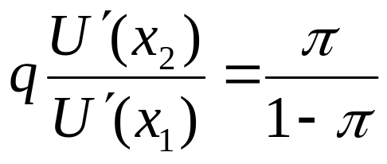
Insurance
Insurance at actuarially unfair rates
  suppose you can trade off 1 unit of x₁ consumption against q units of x₂ , i.e. ∂x₂/ ∂x₁ = -q
  slope of budget line is -q
  suppose q <π/(1-π), i.e. you get less than what you could get under ‘fair’ insurance
  optimality condition
  ⇒ x₂ < x₁

Slide 19
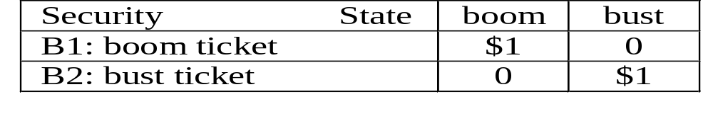
Trading securities
Instead of writing insurance contracts, agents can trade financial securities
Financial securities are state contingent claims
Simple security: payoff in exactly one state of the world

Slide 20
Trading securities
Instead of insuring the car, you buy the security that pays off in the state in which your car gets stolen (bust) and sell security that pays off when car is not stolen (boom)
relative prices of securities determine budget line
⇒ optimisation problem identical to insurance case

Slide 21
Trading securities
Different scenario: two risk averse agents
Example:
  Agent A (investment banker) has payoffs $1,000 if state is ‘boom’ and $250 if ‘bust’
  Agent B (lecturer) has payoffs $500 in both states
  Agents can trade securities before learning the state

Slide 22
Trading securities
Example (continued)
  Each state occurs with 50%
  s₁ is units of boom bond, s₂ bust bonds
  p₁ (p₂) is price of one unit of boom (bust) bond
  We want to know
    what are prices of the bonds?
    what trades occur and what degree of insurance is achieved?

Slide 23
x₁^{B}
B
x₂^{A}
f₂^{A}
250
x₂^{B}
A
1.000
f₁^{A}
x₁^{A}

Slide 24
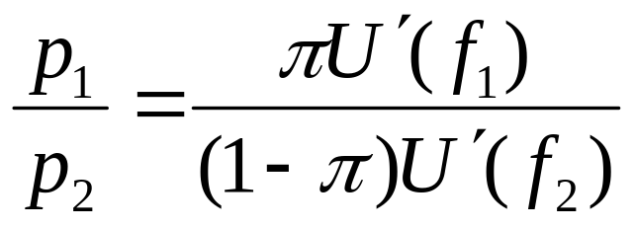
Trading securities
Tangency condition for equilibrium
insurance: f₁^{A} < 1,000, f₂^{A} > 250
p₁/p₂ < π /(1-π) , therefore f₂<f₁,
Agent B is compensated for increased risk
⇒ demands risk premium

Slide 25
Trading securities
Previous example displayed aggregate shock: total income in state 1 higher than in state 2
Homework: what happens when there is no aggregate shock, i.e. Edgeworth box is a square?

Slide 26
Speculation
So far: all agents knew the correct probabilities of a state occuring
Now: suppose agents have different beliefs about the likelihood of states
agent A believes π_{A} for state 1
agent B believes π_{B} for state 1
π_{A} > π_{B}

Slide 27
f₁^{B}
x₂^{A}
f₁^{A} > f₁^{B}, f₂^{A} < f₂^{B}
⇒ speculate on the state that you believe to be relatively more likely compared to other agent’s belief
f₂^{A}
f₂^{B}
f₁^{A}
x₁^{A}

Slide 28
Summary
Expected utility theory
Risk aversion and insurance contracts
Motives for trade:
  insurance between
    risk neutral and risk averse agents
    risk averse agents with differing exposure to shocks
  speculation (see week 4 for more detail)

Slide 29
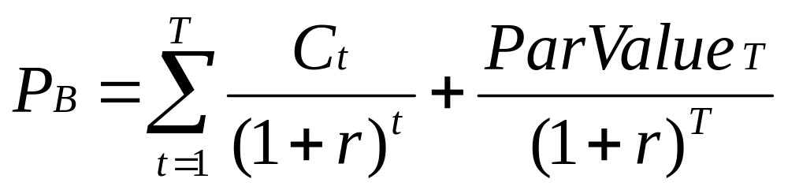
Bond Prices and Yields
P_{B}= price of the bond
C_{t}=interest or Coupon Payments
T=number of periods to maturity
r=semi-annual discount rate or the semi-annual yield to maturity

