Slide 1
Convolutional neural networks
Lecture 10
Changho Suh
Oct. 22, 2020
TexPoint fonts used in EMF.
Read the TexPoint manual before you delete this box.: AAAAAAAAAAAAAAAAAAAA

Slide 2
Convolutional neural networks (CNNs) and history
TexPoint fonts used in EMF.
Read the TexPoint manual before you delete this box.: AAAAAAAAAAAAAAAAAAAA

Slide 3
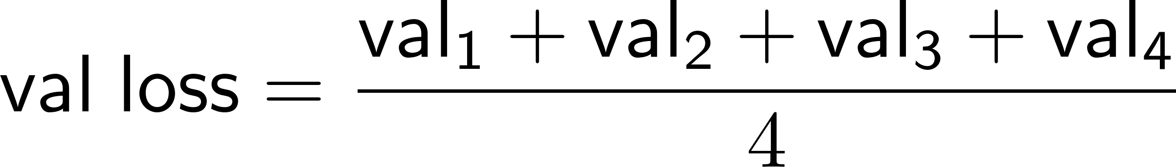
Recap: Data organization & evaluation
m is a deciding factor for the ratio of data split:
4 regimes: Small, middle, large and ultra-large
val set dist. ~ test set dist.
~ target dist.
Cross validation for evaluation:
Choose a hyperparameter that minimizes the average validation loss:

Slide 4
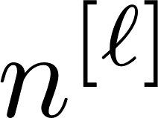
Recap: Techniques for DNNs
Weight initialization: Xavier’s, He’s
Training stability: Batch normalization
Hyperparameter search:
# L of layers, # of hidden neurons, activation

Slide 5
Recap: DNNs
Work well with enough data.
Otherwise, we may face the overfitting problem.
This motivates the use of generalization techniques:
Regularization; data augmentation;
Early stopping; drop out

Slide 6
Recap: Tensorflow coding
Data split and cross validation:
from sklearn.model_selection import train_test_split, StratifiedKFold
Weight init, BN, activation, dropout, early stopping:
from keras.initializers import he_norm
from keras.layers import BatchNormalization, Activation, Dropout
from keras.callbacks import EarlyStopping

Slide 7
What is next?
One important question:
Can DNNs be specialized?
CNNs: Image data
RNNs: Text/audio data (language) and any sequential data

Slide 8
Outline of today’s lectures
Focus on CNNs.
Specifically we will:
1.
Investigate how CNNs were developed;
2.
Study the two key building blocks;
Conv layer
Pooling layer
3.
Discuss popular CNN architectures.

Slide 9
Focus of Lecture 7
Focus on CNNs.
Specifically we will:
1.
Investigate how CNNs were developed;
2.
Study the two key building blocks;
Conv layer
Pooling layer
3.
Discuss popular CNN architectures.

Slide 10
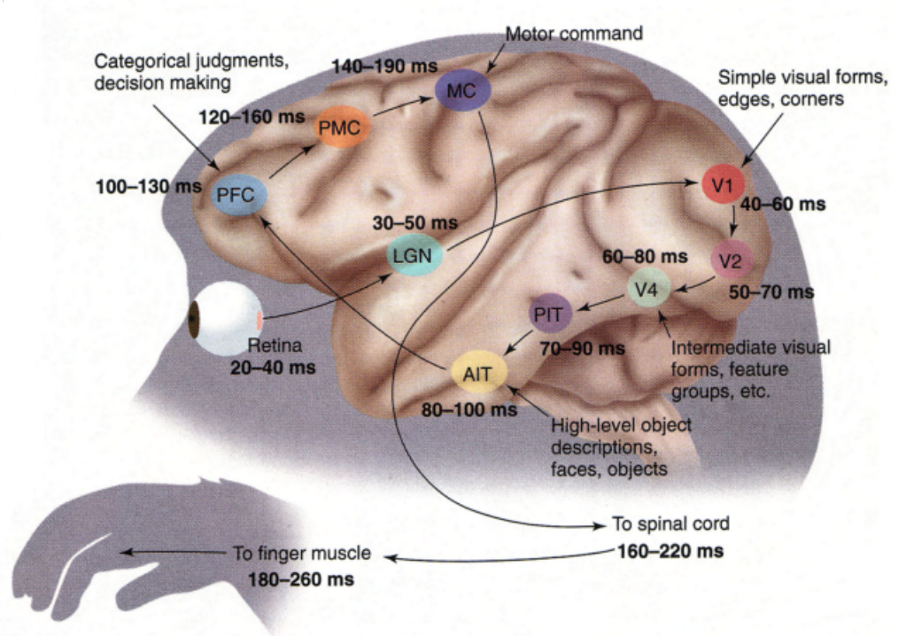
Visual cortex (시각피질)
primary visual cortex
Hubel & Wiesel ’58/’59 observed:
1.
React only to a limited region (receptive field)
2.
Higher-level neurons are based on lower-level ones.
*Won them the Nobel Prize in Physiology or Medicine in ‘81.

Slide 11
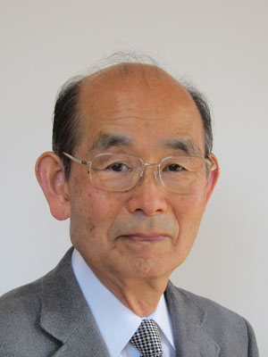
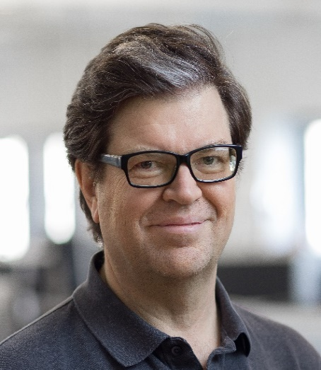
Led to a birth of CNNs
Inspired Fukushima to propose the first CNN in 1980: Neocognitron
Kunihiko Fukushima
1980
Developed another CNN in 1988: LeNet-5
Commercialized for handwritten check numbers recognition.
Yann LeCun 1988

Slide 12
Two building blocks of CNNs
1. Convolutional layer (Conv layer)
Role: Mimick neurons’ behaviors: Reacting only to receptive fields.
2. Pooling layer
Role: Downsample to reduce complexity (# parameters & memory size).

Slide 13
Conv layer
(or kernel)
(or filter)
receptive field
weights
neuron
A function of values in the receptive field
= Cross-correlation btw receptive field & weights
input
conv
Convolution operation is very similar to cross-correlation.

Slide 14
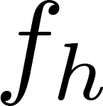
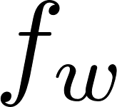
Abstraction via grids
receptive field
filter
neuron
input
conv

Slide 15

What about for next right neuron?
stride
same filter
neuron
Later will see why we share the same filter
input
conv

Slide 16

What about for next below neuron?
input
conv

Slide 17
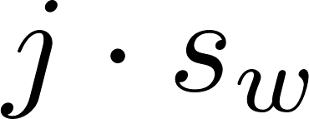

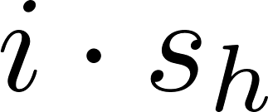

In general …
input
conv

Slide 18

What if a receptive field is out of range?
neuron
zero padding
padding = “SAME” type
input
conv

Slide 19

What if a receptive field is out of range?
neuron
Another option: Ignore the last columns/rows to avoid out-of-range.
padding = “VALID” type
input
conv

Slide 20
Feature map
Called: feature map
filter
Role: Detect a certain pattern (feature).
Note: Filter type depends on a target pattern that we wish to detect.
This is why we share the same filter for computations of other neurons within the same feature map.

Slide 21
Look ahead
1.
Will study further on “feature map”.
2.
Will study 2nd building block: Pooling layer

