Slide 1
Convolutional neural networks
Lecture 11
Changho Suh
Oct. 22, 2020
TexPoint fonts used in EMF.
Read the TexPoint manual before you delete this box.: AAAAAAAAAAAAAAAAAAAA

Slide 2
Conv layer and Pooling layer
TexPoint fonts used in EMF.
Read the TexPoint manual before you delete this box.: AAAAAAAAAAAAAAAAAAAA

Slide 3
Outline
1.
Will study further on “feature map”.
2.
Will study 2nd building block: Pooling layer

Slide 4
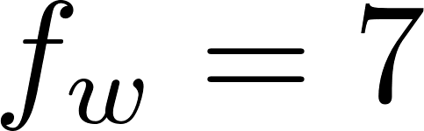


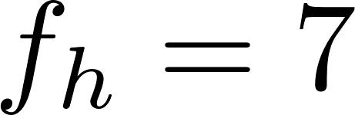
A filter example
Vertical filter
Role: Detect a vertical line pattern.

Slide 5
Visualization
vertical filter
input
feature map
Will check this in PS.

Slide 6
Use of multiple filters
Recall the role of a filter: Detect a certain pattern.
Note: May wish to detect multiple patterns.
Hence: Employ multiple filters, e.g., vertical filter, horizontal filter, edge-detect filter, …

Slide 7
Visualization examples
Vertical
Horizontal
Will also check this in PS.

Slide 8



Stacking multiple feature maps
filter
3D tensor
Horizontal
Vertical
input
conv
3D tensor

Slide 9
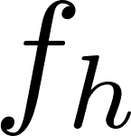

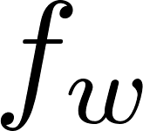
Channels
3D tensor
filter
neuron
G
B
R
input
conv
3D tensor

Slide 10
Pooling layer
TexPoint fonts used in EMF.
Read the TexPoint manual before you delete this box.: AAAAAAAAAAAAAAAAAAAA

Slide 11
Serious memory issue
For training: Employ backpropagation.
Backpropagation requires:
Caching everything computed before.
Each conv layer requires ~ 10MB for one example.
Suppose a training batch contains 100 examples.
→ Requires ~ 1GB per conv layer.
→ Requires much more with many layers.

Slide 12
Motivates us to reduce complexity
This is where Pooling layer kicks in.
Role of Pooling layer: Downsample to reduce # parameters and therefore memory size.
Two types of Pooling:
1.
Max Pooling
(most common!)
2.
Average Pooling

Slide 13











Max Pooling
pooling filter (or kernel)
Suppose: stride=2
A feature map
max pooling

Slide 14
Visualization example
2*2 pooling filter
stride=2
no zero padding
input
max pooling
Note: Works on each channel independently!
Will check this in PS.

Slide 15
Typical CNN architecture
Repeat the following stack module:
stack
[Conv] + [ReLU] + [Pooling]
As the network gets deeper:
1.
Feature map size gets smaller;
2.
# of feature maps gets bigger.
At the end of the stacks:
Fully-connected (FC) layers + output layer (e.g., softmax activation)

Slide 16
Typical CNN architecture in picture
ReLU
input
conv
pooling
conv
pooling
softmax
FC
output

Slide 17


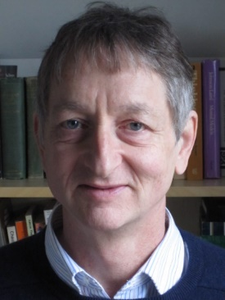

Two popular CNNs
1.
AlexNet (2012)
Won the ImageNet competition.
Alex Krizhevsky
Ilya Sutskever
Geoffrey Hinton
Anchored the start of deep learning revolution.
2.
ResNet (2015)
Winner of the 2015 ImageNet competition.
Currently most powerful & arguably the simplest!
Kaiming He

Slide 18
Look ahead
Will study details on AlexNet & ResNet.

