Slide 1
Recurrent neural networks
Lecture 13
Changho Suh
Oct. 23, 2020
TexPoint fonts used in EMF.
Read the TexPoint manual before you delete this box.: AAAAAAAAAAAAAAAAAAAA

Slide 2
Recurrent neural networks and motivation
TexPoint fonts used in EMF.
Read the TexPoint manual before you delete this box.: AAAAAAAAAAAAAAAAAAAA

Slide 3
Recap: DNNs
Work well with enough data & computing power.
Otherwise, we may face:
(1) Overfitting problem and/or (2) Very long training time.
This motivates simplifying DNNs, being tailored for tasks of interest.

Slide 4
Recap: CNNs
A model specialized for image data
Two key building blocks:
1. Conv layer (mimicking neurons in visual cortex) 2. Pooling layer (mainly for reducing complexity)
Design principles: As a network gets deeper:
1. Feature map size gets smaller;
2. # of feature maps gets bigger.

Slide 5
Recap: Tensorflow coding
import tensorflow.keras as keras
from keras.models import Sequential
from keras.layers import Conv2D, MaxPool2D, Flatten, Dense
model_lenet = Sequential()
#1st layer ([Conv]+[ReLU]+[Pool])
model_lenet.add(Conv2D(input_shape=(28,28,1),kernel_size=(5,5), strides=(1,1), filters=32, padding=‘same’, activation=‘relu’))
model_lenet.add(MaxPool2D(pool_size=(2,2),strides=(2,2),padding=‘valid’))
#2nd layer ([Conv]+[ReLU]+[Pool])
model_lenet.add(Conv2D(kernel_size=(5,5), strides=(1,1), filters=48,
padding=‘same’, activation=‘relu’))
model_lenet.add(MaxPool2D(pool_size=(2,2),strides=(2,2),padding=‘valid’))
#3rd layer (Fully-connected)
model_lenet.add(Flatten())
model_lenet.add(Dense(256,activation=‘relu’))
#4th layer (Fully-connected)
model_lenet.add(Dense(84,activation=‘relu’))
#5th layer (output layer)
model_lenet.add(Dense(10,activation=‘softmax’))

Slide 6
Applications of CNNs
Image recognition
Image inpainting
Object detection
Coloring
Defect detection
Style transfer
Medical diagnosis (e.g., cancer detection)
Super-resolution image synthesis
Any decision or manipulation w.r.t. image data

Slide 7
Limitations
Not well applicable to time series data.
This is where recurrent neural networks (RNNs) kick in.

Slide 8
Outline of today’s lectures
1.
Talk about RNN’s applications and history.
2.
Study two key building blocks of RNNs.
Recurrent neurons
A memory cell
3.
Investigate basic RNNs.
4.
Study LSTM (Long Short-Term Memory) cells.

Slide 9
Focus of Lecture 10
1.
Talk about RNN’s applications and history.
2.
Study two key building blocks of RNNs.
Recurrent neurons
A memory cell
3.
Investigate basic RNNs.
4.
Study LSTM (Long Short-Term Memory) cells.

Slide 10
Applications
t
h
t
h
e
삼성밤도체
삼성반도체
Don’t worry
(감정)
+1

Slide 11
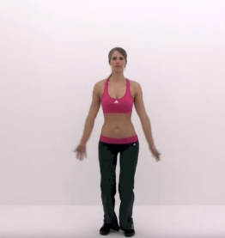
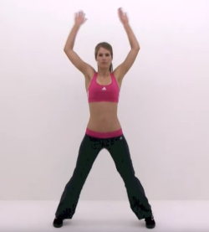
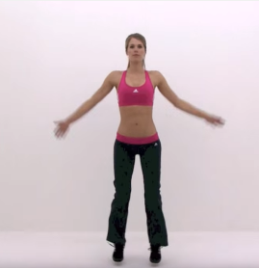
Applications
(한국어)
I like machine learning
나는 머신러닝을 좋아해

Slide 12
A common feature in such applications
Memory!
DNNs and CNNs do not contain layers that preserve some states.
Hence: They do not capture such memory-feature.
This motivated the use of RNNs.

Slide 13
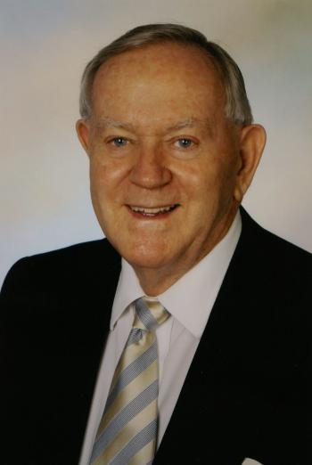
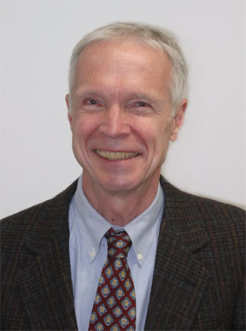
A birth of RNNs
Pondered on the thought process: Series of many thoughts & logics
Led him to conjecture existence of neurons preserving memory
→ Invented the first RNN.
William Little 1974
The first RNN was popularized by John Hopfield, hence called: The Hopfield network
John Hopfield 1982

Slide 14
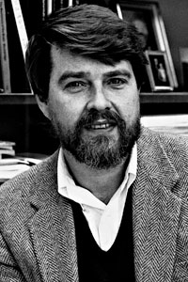
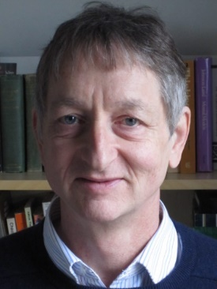
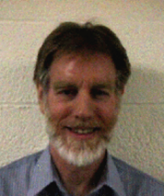
Another RNN in 1986 (Nature)
David Rumelhart
Geoffrey Hinton
Ronald Williams
Developed another RNN which looks very similar to nowadays RNNs.
Side note: Also developed backprop in the paper.

Slide 15
Two building blocks of RNNs
1. Recurrent neurons
Role: Mimick conjectured neurons’ behavior: having a loop.
2. A memory cell
Role: Preserve some state (memory).

Slide 16


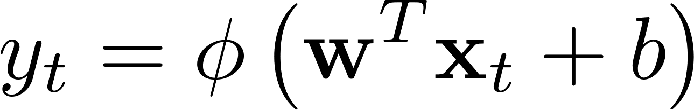
Revisit: A conventional neuron
A neuron
vector
scalar
activation

Slide 17
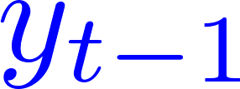
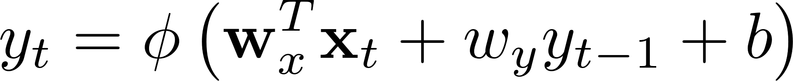
A recurrent neuron
A recurrent neuron
vector
scalar
feedback
(tanh)

Slide 18
Simplified description
A recurrent neuron
A single arrow: Can also represent the vector signal flow!

Slide 19



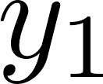
A recurrent neuron: Unrolled version

Slide 20
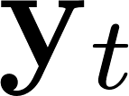
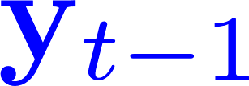
Recurrent neurons
neurons
vector
vector
feedback

Slide 21
Recurrent neurons: Simplified description
vector
vector

Slide 22

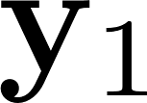
Recurrent neurons: Unrolled version

Slide 23
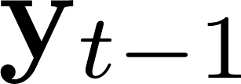
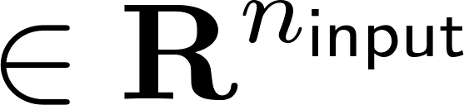
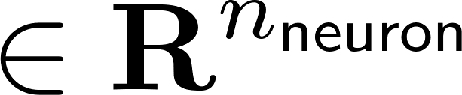
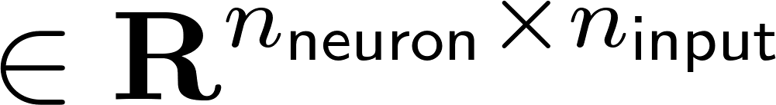
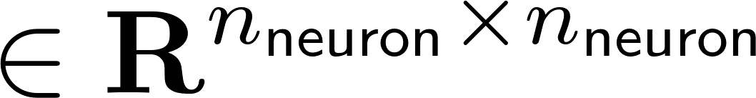
Mathematical expression

Slide 24
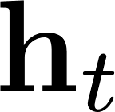
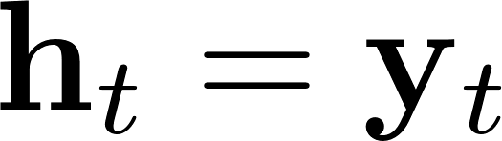
A memory cell
An entity that preserves some state (memory) across time steps.
Simply called a cell.
state = output
A basic cell: A cell such that
Basic RNNs: RNNs with basic cells.

Slide 25
Look ahead
Next lecture: Will explore details on basic RNNs.

