Slide 1
Recurrent neural networks
Lecture 14
Changho Suh
Oct. 23, 2020
TexPoint fonts used in EMF.
Read the TexPoint manual before you delete this box.: AAAAAAAAAAAAAAAAAAAA

Slide 2
Basic RNNs
TexPoint fonts used in EMF.
Read the TexPoint manual before you delete this box.: AAAAAAAAAAAAAAAAAAAA

Slide 3
Outline
Will explore details on basic RNNs.
1.
Discuss one implementation issue.
2.
Study how to train basic RNNs;
3.
Emphasize one challenge that basic RNNs face during training.

Slide 4







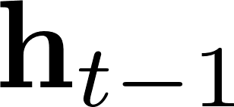

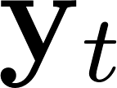

Recall: Basic RNNs
basic cell
In PS: Will implement a simple basic RNN.

Slide 5
An implementation issue
With a static unrolling method: we may get an OOM error for significantly large time steps.
Hence: In practice, we adopt a dynamic unrolling method which can avoid such issue.
Will check in PS.

Slide 6



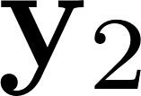

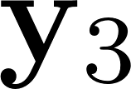
Unrolled version of Basic RNNs
parameterized by:
Recall:

Slide 7

Unrolled version of basic RNNs
Why sharing the same parameters?

Slide 8
How to train?

Slide 9
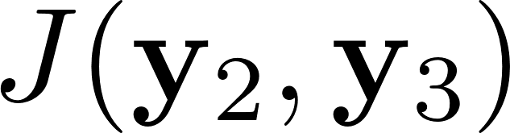
Idea: BackProp Through Time
3. Backprop
2. Compute a cost function:
1. Select a few last outputs.

Slide 10

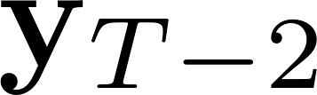

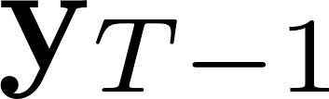
A challenge
For large T, we often face:
Vanishing gradient problem!

Slide 11
The simplest and most common solution
Reduce T!
This is called: Truncated BPTT

Slide 12
Problem of truncated BPTT
The model cannot learn long-term patterns.
Even worse: If not well keeping memory, the states fade away quickly.
As an effort to address such problems, various types of cells with long-term memory have been introduced.
The most popular one is:
Long Short-Term Memory (LSTM) cell

Slide 13
Look ahead
Next lecture: Will study LSTM cells in details.

