Slide 1
Recurrent neural networks
Lecture 15
Changho Suh
Oct. 23, 2020
TexPoint fonts used in EMF.
Read the TexPoint manual before you delete this box.: AAAAAAAAAAAAAAAAAAAA

Slide 2
LSTM
TexPoint fonts used in EMF.
Read the TexPoint manual before you delete this box.: AAAAAAAAAAAAAAAAAAAA

Slide 3
Outline
Will study LSTM in details.
1.
Discuss a brief history and key aspects of LSTM.
2.
Discuss the key idea of LSTM.
3.
Study how it works.

Slide 4
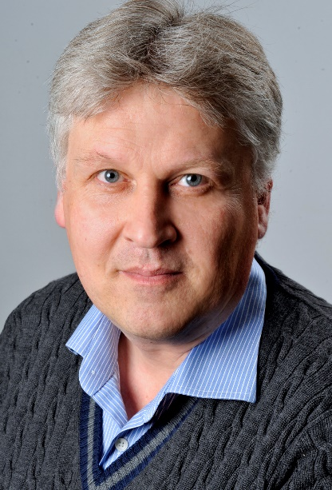
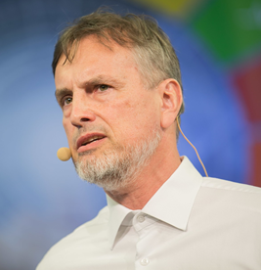
LSTM cell (1997)
Invented by:
Sepp Hochreiter
Jürgen Schmidhuber
Performs much better by simply replacing a basic cell.
Offers faster training and detects long-term dependencies in data.

Slide 5
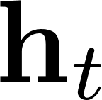

Idea of LSTM cell
Split a state into two:
1. Short-term state
2.
Long-term state
Design a cell so that the network can learn:
1.
What to throw away (forget);
2.
What to remember (input);
3.
What to read (output).

Slide 6
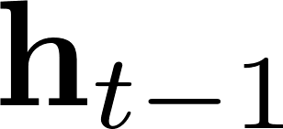
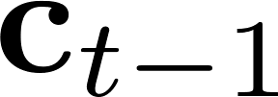


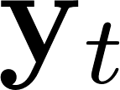
Structure of LSTM cell
(short-term)
(long-term)
FC
logit
(forget)

Slide 7


Structure of LSTM cell
(short-term)
(long-term)
FC
logit
(forget)
FC
tanh
(input)
FC
logit

Slide 8
Structure of LSTM cell
(short-term)
(long-term)
FC
logit
(forget)
FC
tanh
(input)
FC
logit

Slide 9

Structure of LSTM cell
(short-term)
(long-term)
FC
logit
(forget)
FC
tanh
(input)
FC
logit
tanh
FC
logit
(output)

Slide 10
Mathematical expression

Slide 11
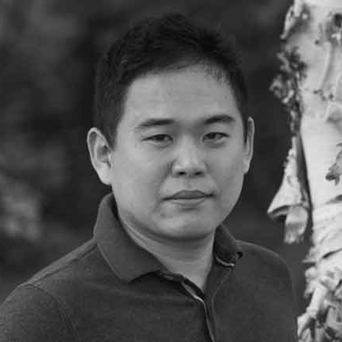
A simplified version of LSTM
A simplified version was developed in 2014:
Both states are merged into one.
Yet it performs just as well.
Kyunghyun Cho

Slide 12
Applications
Turns out: LSTM and/or its variants work well in many applications:
Machine translation
Text generation
Grammar correction
Any natural language processing (NLP) applications

Slide 13
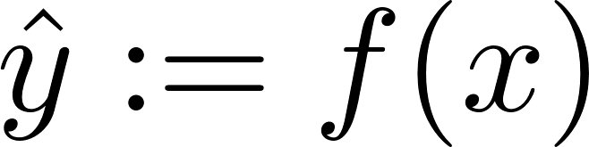



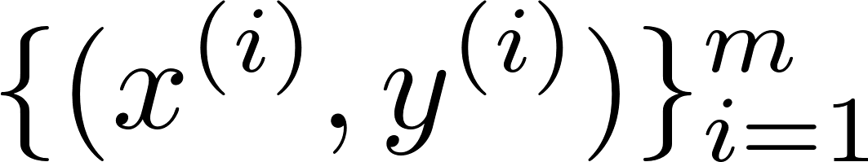
Summary of Day 1’s lectures
machine
Perceptron architecture
Linear activation + squared-error loss: LS classifier
Logistic acti. + cross entropy loss: Logistic regression

Slide 14
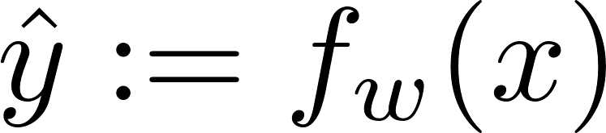
Summary of Day 2’s lectures
machine
DNN architecture
Rule of thumb: ReLU (@hidden); Logistic (@output)
Cross-entropy loss
Algorithm: Gradient descent
via backprop

Slide 15
Summary of Day 3’s lectures
Advanced techniques:
1.
Generalization techniques
2.
Data organization
3.
Weight initialization
4.
Techniques for training stability
5.
Hyperparameter search
6.
Cross validation

Slide 16
Summary of Day 4’s lectures
machine
CNN architecture
Two key building blocks: Conv layer & Pooling layer
Design principles: As a network is deeper,
1. Feature map sizes gets smaller.
2. # of feature maps gets bigger.

Slide 17
Summary of today’s lectures
machine
RNN architecture
Key building blocks: Recurrent neurons & memory cell
Basic RNNs: Trained via truncated BTTP.
LSTM: Offers great performance and faster training.

Slide 18
Many remaining issues
What if labels are not available?
Unsupervised learning:
Generative Adversarial Networks (GANs)
Autoencoder, Variational Autoencoder (VAE)
Clustering, ranking, anomaly detection
Feature learning, matrix completion, …

Slide 19
Many remaining issues
What if big data is unavailable?
Small-data techniques:
Decision trees, random forests, boosting
Semi-supervised learning, few shot learning
Transfer learning, domain adaptation
Simulator-based learning

