Slide 1
Project overview
Lecture 16
Changho Suh
Oct. 26, 2020
TexPoint fonts used in EMF.
Read the TexPoint manual before you delete this box.: AAAAAAAAAAAAAAAAAAAA

Slide 2
Three components
Common project (Days 6,7):
1.
Learn about basic tools required.
Group-based project (Days 8,9):
2.
Use the techniques (that we learned so far) to design a model achieving a target performance.
Proposal (Days 9,10):
3.
Write you own proposal of interest based on the knowledge that you learned.

Slide 3
Common projects
(Days 6, 7)
TexPoint fonts used in EMF.
Read the TexPoint manual before you delete this box.: AAAAAAAAAAAAAAAAAAAA

Slide 4


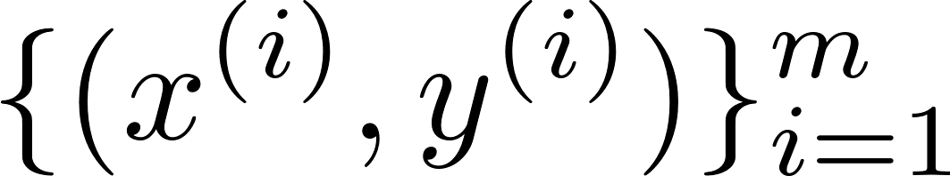
Task
Car test-time classification
car options
model
testing time:
“1”
(< a certain thres.)
or
“0”
(> a certain thres.)
Notes:
Machine learning이 특정 task를 수행하는 시스템을 학습하는거를 복습하면서 프로젝트에서 할려는 task알려주기
Task:
Input: car feature들 (e.g., 자동차 여러 옵션들)
Output: 특정 test를 시간내에 통과하는지 못하는지
Machine learning이 시스템을 데이터로부터 학습한다는거 복습하면서 어떤 데이터셋 사용하는지 알려주기

Slide 5


Dataset
Source: Mercedes-Benz provides 4209 examples
Data: anonymized 376 car options
Label: testing time
Raw data is in csv file.
x1 | x2 | x3 | y
K | v | at | 130.81
K | t | av | 88.53
az | w | n | 76.26
dataset.csv
How to load data in csv file?
Notes:
376개의 option
한 개의 option은 53개의 category 중 하나 선택 (8개 column)
나머지 column: binary (알 수 없다 – anonymized)

Slide 6


Data load
Recall:
tensorflow
keras
datasets
from tensorflow.keras.datasets import mnist
(X_train,y_train),(X_test,y_test) = mnist.load_data()
Instead will employ another library useful for csv data:
Notes:
1. 복습: 기존에 벤치마크 데이터셋 불러올 때 어떻게 했었나? Tensorflow 공장안에 keras 공장안에 datasets 공장안에

Slide 7
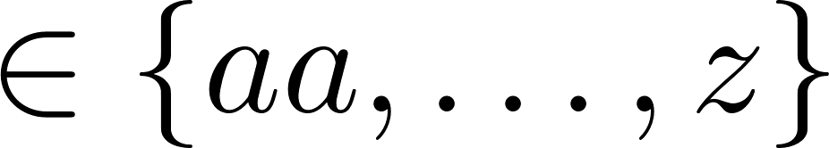
Pre-processing
for data manipulation & analysis
Will next do pre-processing:
1. One hot encoding of categorical data
2. Binary label w/ median threshold
x1 | … | y
K | … | 130.81
K | … | 88.53
x1_aa | … | x1_K | … | x1_z | … | y
0 | … | 1 | … | 0 | … | 0
0 | … | 1 | … | 0 | … | 1

Slide 8
Train/val/test sets
# of examples: 4209
Recall: It belongs to the middle range:
Hence: Will take the following split ratio:
80:10:10

Slide 9



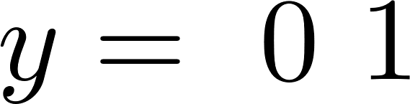
Transformation to numpy array data
for large, multi-dimensional arrays and matrices
x1_aa | … | x1_K | … | y
0 | … | 1 | … | 0
0 | … | 1 | … | 1

Slide 10
Model
Will try LS, LR and DNN.
1. LS:
Target: 88% accuracy (w/o regularization)
89% (w/ regularization)
2. LR:
Target: 89% (w/o regularization)
89% (w/ regularization)
Notes:
원하는 task 정했고, 데이터셋 준비 됐으면 이제 뭐하죠?
모델 결정해줍니다. 모델을 결정하기 위해서 가장 간단한 모델부터 적용해봅니다.
(둘 다 convex optimization이라 regularization technique만 적용했습니다.)
w/o regularization: 86

Slide 11
Model
3. DNN:
Target: 89% (w/o any advanced techniques)
92% (w/ some techniques)
Techniques that we will employ:
Regularization, early stopping
He’s initialization
Hyperparameter search w/ cross validation:
# of layers, learning rate, batch size, …

Slide 12
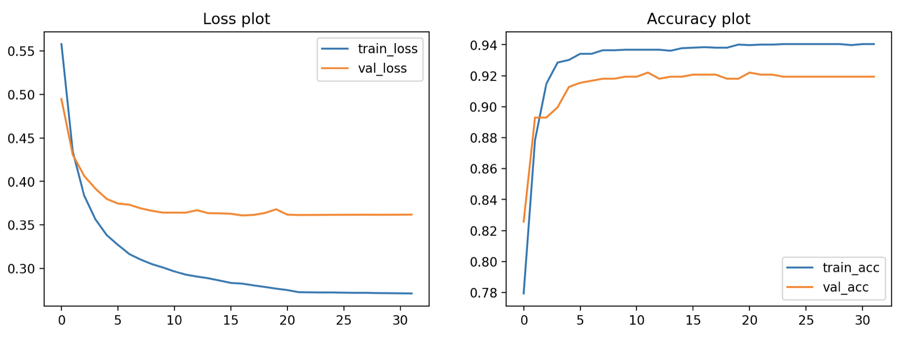
Plotting
import matplolib.pyplot as plt
loss
accuracy
epoch
epoch

Slide 13
Logging
Tracking intermediate results during training
Example:
(LR) regularization_factor=0.9 → acc: 89%
(DNN) learning rate: 0.01, batch size: 512 → acc: 91%
Notes:
Python log module 사용하기

Slide 14
Saving
Saving parameters of trained models
Notes:
Python log module 사용하기

Slide 15
Checkpoints
Day 7 morning (Tue):
Log files and saved models
Performance of LS and LR
Day 8 morning (Wed):
Log files and saved models
Performance of DNN

Slide 16
Summary
1.
Organize dataset in csv file.
2.
Select models and apply advanced techniques.
3.
Plot “loss” and “acc”.
4.
Save log files and trained models.

Slide 17
Group-based project (GP)
(Days 8, 9)
TexPoint fonts used in EMF.
Read the TexPoint manual before you delete this box.: AAAAAAAAAAAAAAAAAAAA

Slide 18
5 groups
Group | 수강생 | Project
A (서기원) | 서정호, 김주완, 방인완, 오규환 | GP1
B (안준형) | 정은총, 장용석, 이재원 | GP1
C (조제웅) | 문성균, 유건호, 한국진 | GP2
D (황경조) | 정경훈, 최선호, 이창병 | GP2
E (강민근) | 엄기문, 안성호, 김대영, 김도희 | GP3
Notes:
빨간색: 프로젝트 안 정함

Slide 19
GP1 (Groups A & B)
TexPoint fonts used in EMF.
Read the TexPoint manual before you delete this box.: AAAAAAAAAAAAAAAAAAAA

Slide 20


Task
Image classification
model
image pixels
“cloth class”
“0”
(t-shirt)
…
“9”
(ankle boots)

Slide 21
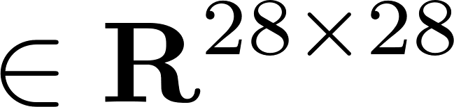
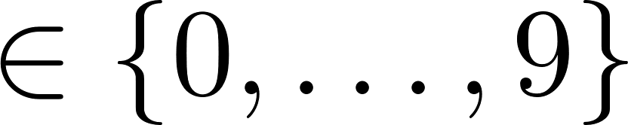

Dataset
Source: Fashion MNIST
Data: grey scale image pixels
Label: human-annotated labels
(10 classes)
Example:
( , 0 )
“t-shirt”

Slide 22
Data organization
Import data from tensorflow.keras.datasets
Recall:
Split this part into train/val sets with:
5:1
Will use StratifiedKFold for cross validation
(from sklearn.model_selection import StratifiedKFold)
Will check data distribution via visualization
(import matplolib.pyplot as plt)
Notes:
Test set이 주어져있는 상황이라서, 알려주신 rule대로 validationa을 나눌 수 없음

Slide 23
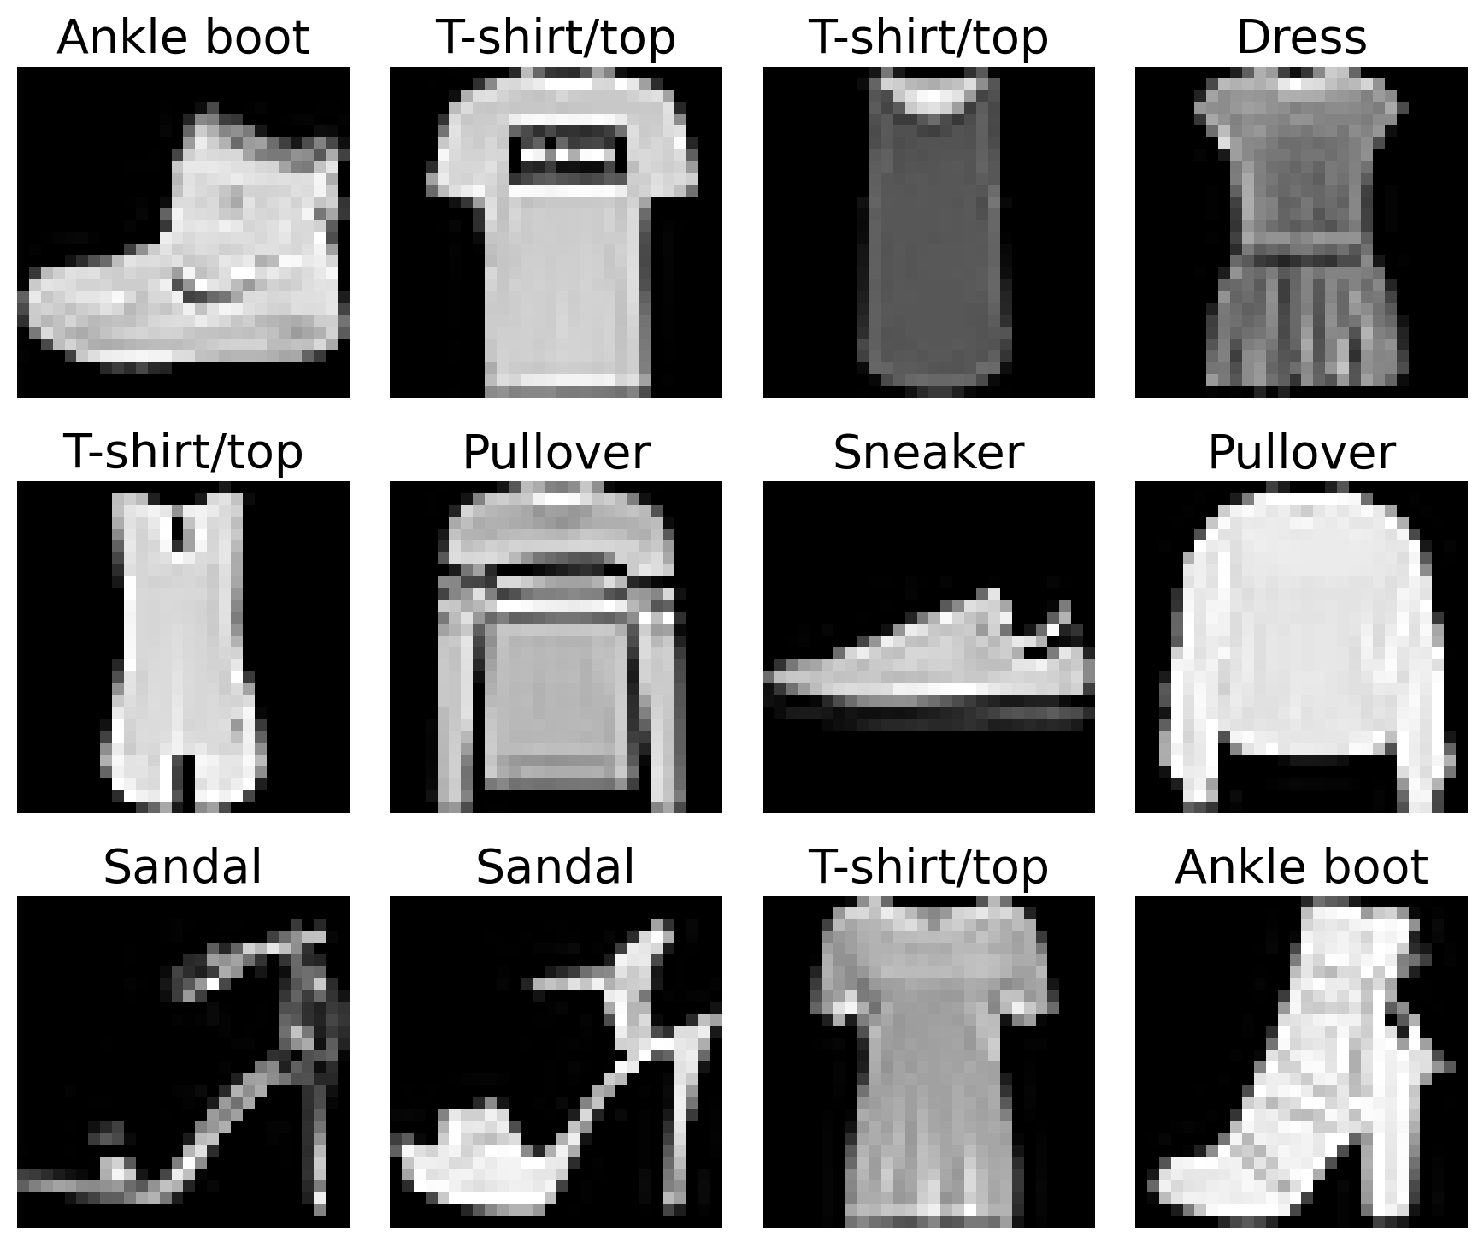
Visualization

Slide 24
Model
Will try DNN and CNN.
1. DNN:
Target: 88% accuracy (w/o any advanced techniques)
89% (w/ some techniques)
2. CNN:
Target: 90% (w/o any advanced techniques)
93% (w/ some techniques)
Notes:
원하는 task 정했고, 데이터셋 준비 됐으면 이제 뭐하죠?
모델 결정해줍니다. 모델을 결정하기 위해서 가장 간단한 모델부터 적용해봅니다.
(둘 다 convex optimization이라 regularization technique만 적용했습니다.)
w/o regularization: 86

Slide 25
Techniques that we will use
Regularization, early stopping
He’s initialization
Hyperparameter search w/ cross validation:
# of layers, learning rate, batch size, …
+
learning rate decay, batch normalization, dropout
Notes:
원하는 task 정했고, 데이터셋 준비 됐으면 이제 뭐하죠?
모델 결정해줍니다. 모델을 결정하기 위해서 가장 간단한 모델부터 적용해봅니다.
(둘 다 convex optimization이라 regularization technique만 적용했습니다.)
w/o regularization: 86

Slide 26
Saving
1.
“loss” and “acc” curves
2.
log files
3.
parameters of trained models

Slide 27
Checkpoints
Day 9 morning (Thur):
Log files and saved models
Performance of DNN
Day 10 morning (Fri):
Log files and saved models
Performance of CNN

Slide 28
GP2 (Groups C & D)
TexPoint fonts used in EMF.
Read the TexPoint manual before you delete this box.: AAAAAAAAAAAAAAAAAAAA

Slide 29
Task
Image recognition
model
image pixels
“object class”
“0”
(airplane)
or
…
or
“9”
(truck)
Notes:
Image class
0: airplane,
1: automobile,
2:bird,
3:cat,
4:deer,
5:dog,
6:frog,
7:horse,
8: ship
9: truck.

Slide 30
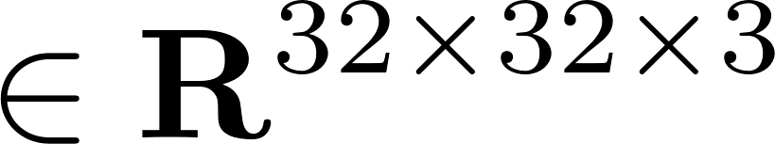


Dataset
Source: CIFAR10
Data: RGB scale image pixels
Label: human-annotated labels
(10 classes)
Example:
“frog”
( , 6)

Slide 31
Data organization
Import data from tensorflow.keras.datasets
Recall:
Split this part into train/val sets with:
4:1
Will use StratifiedKFold for cross validation
(from sklearn.model_selection import StratifiedKFold)
Will check data distribution via visualization
(import matplolib.pyplot as plt)
Notes:
Test set이 주어져있는 상황이라서, 알려주신 rule대로 validationa을 나눌 수 없음

Slide 32
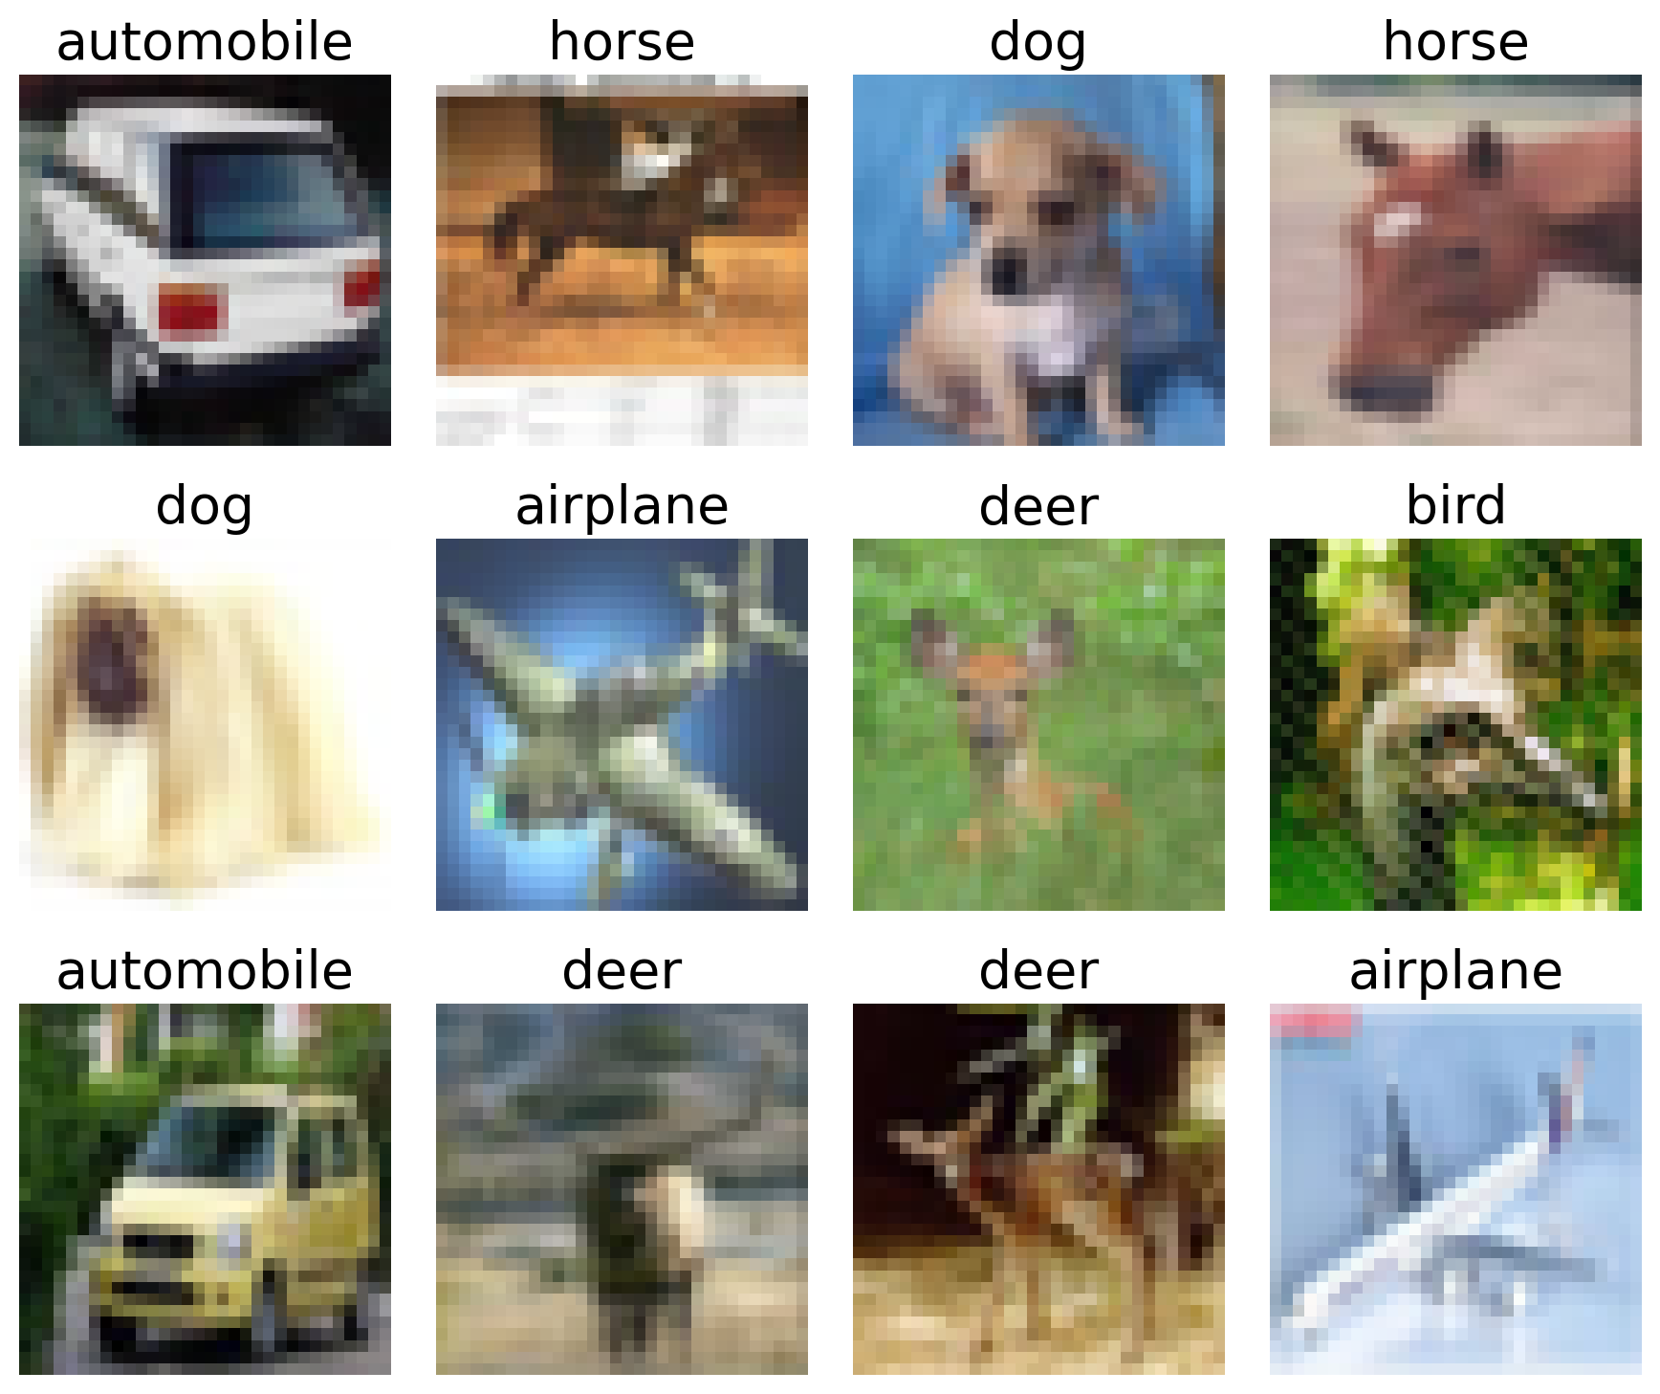
Visualization

Slide 33
Model
Will try DNN and CNN.
1. DNN:
Will figure out a poor performance:
Accuracy
< 60% (even w/ advanced techniques)
2. CNN:
Will employ ResNet.
Target:
93% (w/ some techniques)
Notes:
원하는 task 정했고, 데이터셋 준비 됐으면 이제 뭐하죠?
모델 결정해줍니다. 모델을 결정하기 위해서 가장 간단한 모델부터 적용해봅니다.
(둘 다 convex optimization이라 regularization technique만 적용했습니다.)
w/o regularization: 86

Slide 34
Techniques that we will use
Regularization, early stopping
He’s initialization
Hyperparameter search w/ cross validation:
# of layers, learning rate, batch size, …
+
Learning rate decay, batch normalization,
Data augmentation, dropout
Notes:
원하는 task 정했고, 데이터셋 준비 됐으면 이제 뭐하죠?
모델 결정해줍니다. 모델을 결정하기 위해서 가장 간단한 모델부터 적용해봅니다.
(둘 다 convex optimization이라 regularization technique만 적용했습니다.)
w/o regularization: 86

Slide 35
Saving
1.
“loss” and “acc” curves
2.
log files
3.
parameters of trained models

Slide 36
Checkpoints
Day 9 morning (Thur):
Log files and saved models
Performance of DNN
Day 10 morning (Fri):
Log files and saved models
Performance of CNN

Slide 37
GP3 (Group E)
TexPoint fonts used in EMF.
Read the TexPoint manual before you delete this box.: AAAAAAAAAAAAAAAAAAAA

Slide 38

Task
Weather forecasting
model
whather conditions
(numeric)
“temperature”
(e.g., 27℃ )
Notes:
Image class

Slide 39

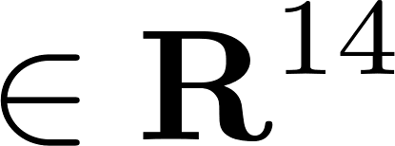

Dataset
Source: Jena Climate database
Data:
weather features collected from 2009 to 2016
Example:
Pressure, humidity, …
Label: celcius temperature

Slide 40
Data organization
Load data in csv file using pandas.
Recall:
Split this into train/val/test sets with:
7:2:1 (in chronological order)
Will use train_test_split
(from sklearn.model_selection import train_test_split)
Will check data distribution via visualization
(import matplolib.pyplot as plt)
Notes:
시간 순으로 잘라서 사용하기 때문에 train_test_split을 사용합니다

Slide 41
Visualization
temerature
humidity
date

Slide 42
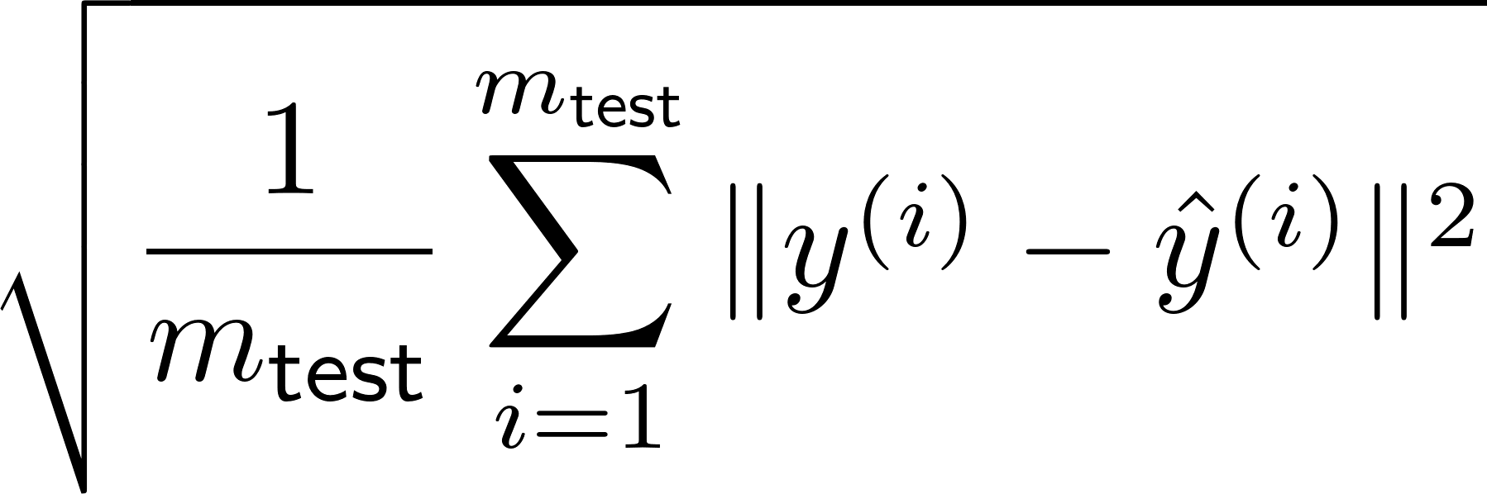
A measure
Will use another measure instead of accuracy:
Root-mean-square error (RMSE):

Slide 43
Model
Will try DNN, CNN and RNN.
1. DNN and CNN:
Will figure out a poor performance:
RMSE
> 0.70 (even w/ advanced techniques)
2. RNN:
Will employ LSTM.
Target:
0.64 (w/ some techniques)
Notes:
원하는 task 정했고, 데이터셋 준비 됐으면 이제 뭐하죠?
모델 결정해줍니다. 모델을 결정하기 위해서 가장 간단한 모델부터 적용해봅니다.
(둘 다 convex optimization이라 regularization technique만 적용했습니다.)
w/o regularization: 86

Slide 44
Techniques that we will use
Regularization, early stopping
Weight initialization
Hyperparameter search:
T (window size), learning rate, batch size, …
+
learning rate decay, batch normalization
Notes:
원하는 task 정했고, 데이터셋 준비 됐으면 이제 뭐하죠?
모델 결정해줍니다. 모델을 결정하기 위해서 가장 간단한 모델부터 적용해봅니다.
(둘 다 convex optimization이라 regularization technique만 적용했습니다.)
w/o regularization: 86

Slide 45
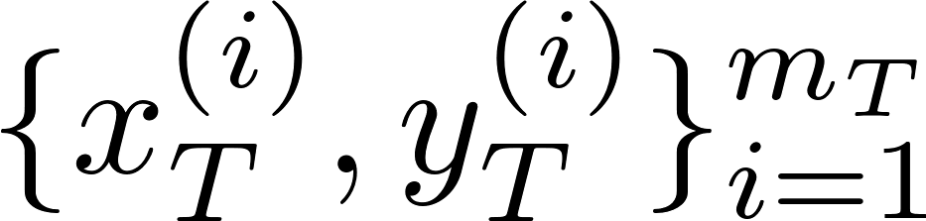

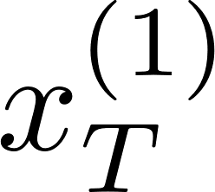
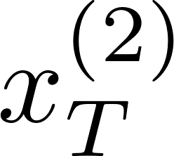
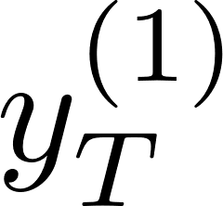
Hyperparameter: time window T
Will generate time series dataset according to T:
data:
14 features
label:
# of examples

Slide 46
Saving
1.
“loss” curves
2.
log files
3.
parameters of trained models

Slide 47
Checkpoints
Day 9 morning (Thur):
Log files and saved models
Performance of DNN and CNN
Day 10 morning (Fri):
Log files and saved models
Performance of RNN

Slide 48
Proposal
(Days 9, 10)
TexPoint fonts used in EMF.
Read the TexPoint manual before you delete this box.: AAAAAAAAAAAAAAAAAAAA

Slide 49
Guideline: Follow six steps
Step 1:
Choose one challenge that you wish to address.
Step 2:
Come up with a specific task with which you can address the challenge.
Step 3:
Plan how to collect data for the chosen task.
Notes:
MB:
Challenge: test time 길면 → cost 크고, 친환경적이지 못하다
A specific task: car options → test time 시간 예측 → 너무 길면 skip

Slide 50
Guideline: Follow six steps
Step 4:
Plan what models that you will employ for the task.
Step 5:
Set a target performance.
Step 6:
Enumerate impacts of your solution.

Slide 51
Checkpoints
Day 10 (Fri):
Proposal slides
Will give advice if any.

