Slide 1
Common project:
Daily check
Lecture 17
Changho Suh
Oct. 27, 2020
TexPoint fonts used in EMF.
Read the TexPoint manual before you delete this box.: AAAAAAAAAAAAAAAAAAAA

Slide 2


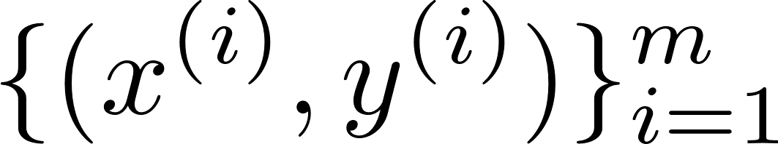
Recap: Task
Car test-time classification
car options
model
testing time:
“1”
(< a certain thres.)
or
“0”
(> a certain thres.)

Slide 3
Recap: Coding for data organization
Data load:
import pandas as pd
data=pd.read_csv("./downloads/train.csv")
Pre-processing:
# choose categorical data columns
cf = data.select_dtypes(include=['object']).columns
dummies = pd.get_dummies(data[cf])
# one hot encoding
data_del = data.drop(cf, axis=1)
data = pd.concat([data_del, dummies], axis=1)
X_df, y_df = data.drop([’y’]), data[‘y’]
import numpy as np
y_df = (y_df<np.median(y_df)).astype(float)

Slide 4
Recap: Coding for data organization
Transformation to numpy data:
X,y = X_df.values, y_df.values
Train/val/test split:
from sklearn.model_selection import train_test_split
X_train, X_test, y_train, y_test =\
train_test_split(X,y,test_size=0.1)
X_train, X_val, y_train, y_val =\ train_test_split(X_train,y_train,test_size=1/9)

Slide 5
Recap: Coding for LS and LR models
from sklearn.linear_model import RidgeClassifier
LS:
alpha_list = [0.001,0.01,0.1,1,10,100,1000,10000]
for alpha in alpha_list:
model_LS = RidgeClassifier(alpha)
model_LS.fit(X_train, y_train)
score = model_LS.score(X_test, y_test)
from sklearn.linear_model import LogisticRegression
LR:
c_list = [0.001,0.01,0.1,1,10,100,1000,10000]
for c in c_list:
model_LR = LogisticRegression(C=c)
model_LR.fit(X_train, y_train)
score = model_LR.score(X_test, y_test)
Notes:
Alpha: regularization parameter for LS
c: regularization parameter for LR

Slide 6
Recap: Coding for logging & saving model
from joblib import dump
alpha_score = pd.DataFrame()
alpha_list = [0.001,0.01,0.1,1,10,100,1000,10000]
for alpha in alpha_list:
model_LS = RidgeClassifier(alpha)
model_LS.fit(X_train, y_train)
score = model_LS.score(X_test, y_test)
alpha_score_data = pd.DataFrame([[alpha,score]],
columns=['alpha','score'])
alpha_score = alpha_score.append(alpha_score_data)
dump(model_LS,
'./model_lS_alpha_{}.joblib‘.format(alpha))
alpha_score.to_csv(‘./model_ls.csv’)
Notes:
Alpha: regularization parameter for LS
c: regularization parameter for LR

Slide 7



Checkpoint: Log files & saved model
Log files:
 | alpha | score
0 | 0.001 | 0.8765
1 | 0.01 | 0.8765
model_ls.csv
 | c | score
0 | 0.001 | 0.8646
1 | 0.01 | 0.8764
model_lr.csv
Saved models:
model_ls_alpha_0.001.joblib
model_lr_c_0.001.joblib
Notes:
Alpha: regularization parameter for LS
c: regularization parameter for LR

Slide 8
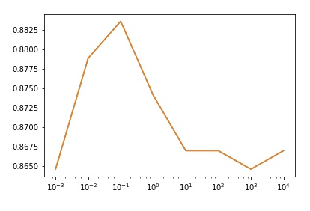
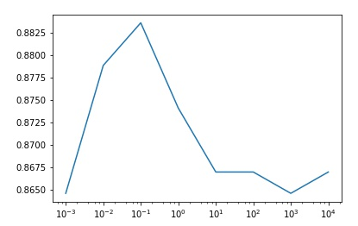
Checkpoint: Performance of LS & LR
LS:
LR:
test accuracy
regularization factor
Notes:
Alpha: regularization parameter for LS
c: regularization parameter for LR

Slide 9

Checkpoint
문성균:
정은총:
유건호:
장용석:
김주완:
이재원:
정경훈:
오규환:
이창병:
엄기문:
최선호:
안성호:
한국진:
김대영:
서정호:
김도희:
방인완:

Slide 10
Today’s contents
DNN:
Target: 88% (w/o any advanced techniques)
89% (w/ some techniques)
Techniques that we will employ:
Regularization, early stopping
He’s initialization
Hyperparameter search w/ cross validation:
# of layers, learning rate, batch size, …

Slide 11

DNN architecture
128
input size:
563

Slide 12
Coding for early stopping
from tensorflow.keras.models import Sequential
from tensorflow.keras.layers import Dense
model_NN = Sequential()
model_NN.add(Dense(16, activation=‘relu’))
model_NN.add(Dense(1, activation=‘sigmoid’))
model_NN.compile(optimizer=‘adam’, loss=‘binary_crossentropy’, metrics=[‘acc’])
from tensorflow.keras.callbacks import EarlyStopping
ES_callback
ES_callback = EarlyStopping(monitor=‘val_loss’, patience=5,
mode=‘auto’)
Model_NN.fit(X_train,y_train,
validation_data=(X_val,y_val),
epochs=50, batch_size=512,
callbacks=[ES_callback])

Slide 13
Coding for regularization & He’s init.
from keras.regularizers import l2
model.add(Dense(16,
kernel_regularizer=l2(0.01),
bias_regularizer=l2(0.01),
activation=‘relu’))
kernel_initializer=‘he_normal’,

Slide 14
Coding for cross validation
from sklearn.model_selection import StratifiedKFold
skf = StratifiedKFold(n_splits=9)
for split_idx,(train_id,val_id) in enumerate(skf.split(X,y)):
X_train, y_train = X[train_id], y[train_id]
X_val, y_val = X[val_id], y[val_id]

