Slide 1
Group-based project:
Daily check
Lecture 18
Changho Suh
Oct. 28, 2020
TexPoint fonts used in EMF.
Read the TexPoint manual before you delete this box.: AAAAAAAAAAAAAAAAAAAA

Slide 2


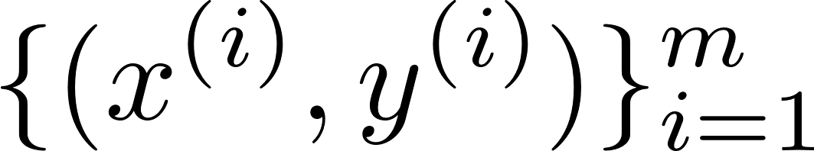
Recap: Task
Car test-time classification
car options
model
testing time:
“1”
(< a certain thres.)
or
“0”
(> a certain thres.)

Slide 3

Recap: DNN architecture
128
input size:
563

Slide 4
Recap: Coding for regularization & He’s init.
from tensorflow.keras.models import Sequential
from tensorflow.keras.layers import Dense
from tensorflow.keras.regularizers import l2
model_NN = Sequential()
model_NN.add(Dense(128, activation=‘relu’,
kernel_regularizer=l2(0.01),
bias_regularizer=l2(0.01),
kernel_initializer=‘he_normal’))
model_NN.add(Dense(1, activation=‘sigmoid’,
kernel_regularizer=l2(0.01),
bias_regularizer=l2(0.01)))
model_NN.compile(optimizer=‘adam’,
loss=‘binary_crossentropy’,
metrics=[‘acc’])

Slide 5
Recap: Coding for callbacks
Early stopping:
from tensorflow.keras.callbacks import EarlyStopping
ES_callback = EarlyStopping(monitor=‘val_loss’, patience=5,
mode=‘auto’)
Saving model:
from tensorflow.keras.callbacks import ModelCheckpoint
MC_callback = ModelCheckpoint(‘./model_save’, monitor=‘val_loss’,
save_best_only=True)

Slide 6
Recap: Coding for callbacks
Learning rate decay:
from tensorflow.keras.callbacks import LearningRateScheduler
# define scheduling rule
def scheduler(epoch, lr):
if epoch==20 or epoch==40:
lr=lr*0.1
else:
lr=lr
return lr
LRS_callback = LearningRateScheduler(scheduler)
# training w/ callbacks
Model.fit(X_train, y_train,
validation_data=(X_val,y_val), epochs=50,
callbacks=[ES_callback, MC_callback, LRS_callback])

Slide 7
Recap: Coding for cross validation
from sklearn.model_selection import StratifiedKFold
skf = StratifiedKFold(n_splits=9)
acc_list = []
for split_idx,(train_idx,val_idx) in enumerate(skf.split(X,y)):
X_train, y_train = X[train_idx], y[train_idx]
X_val, y_val = X[val_idx], y[val_idx]
model = Sequential()
model.add(Dense(16, activation='relu',
kernel_regularizer=l2(0.01),
bias_regularizer=l2(0.01)))
loss, acc = model.evaluate(X_val, y_val)
acc_list.append(acc)
avg_acc = np.mean(acc_list)

Slide 8
Recap: Coding for hyperparameter search
import pandas as pd
Results = pd.DataFrame()
# dataframe for logging
h_list = [10,128,256]
# hyperparameter(number of nodes)
for h in h_list:
acc_list = []
for split_idx,(train_idx,val_idx) in enumerate(skf.split(X,y)):
X_train, y_train = X[train_idx], y[train_idx]
X_val, y_val = X[val_idx], y[val_idx]
model = Sequential()
model.add(Dense(h, activation='relu',
kernel_regularizer=l2(0.01),
bias_regularizer=l2(0.01)))

Slide 9
Recap: Coding for hyperparameter search
loss, acc = model.evaluate(X_val, y_val)
acc_list.append(acc)
avg_acc = np.mean(acc_list)
result = pd.DataFrame([[h,avg_acc]],
columns=['h','acc'])
results = results.append(result)
results.to_csv(‘./results.csv’)

Slide 10



Checkpoint
 | h | acc
0 | 10 | 0.8851
1 | 128 | 0.8969
2 | 256 | 0.8875
Log files
results.csv
Saved model
model_save
* Code for loading model
from tensorflow.keras.models import load_model
loaded_model = load_model(‘./model_save’)

Slide 11
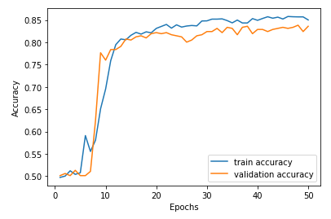
Checkpoint
accuracy
epoch

Slide 12

Checkpoint
문성균:
정은총:
유건호:
장용석:
김주완:
이재원:
정경훈:
오규환:
이창병:
엄기문:
최선호:
안성호:
한국진:
김대영:
서정호:
김도희:
방인완:

Slide 13
Today’s contents
1.
GP2: Image recognition using CIFAR 10
2.
GP3: Weather prediction using Jena Climate
3.
Dimensionality reduction techniques

Slide 14
GP2
(Groups A, B)

Slide 15

Task
Image recognition
model
image pixels
“object class”
“0”
(airplane)
…
“9”
(truck)
Notes:
Image class
0: airplane,
1: automobile,
2:bird,
3:cat,
4:deer,
5:dog,
6:frog,
7:horse,
8: ship
9: truck.

Slide 16
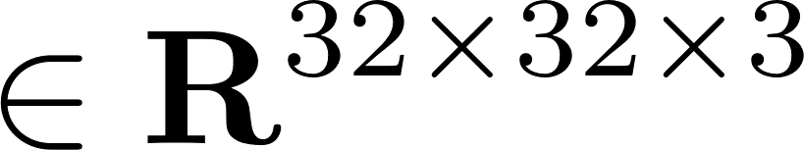
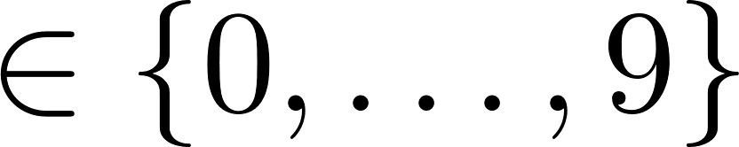

Dataset
Import data from tensorflow.keras.datasets
Data: RGB scale image pixels
Label: human-annotated labels
(10 classes)
Example:
“frog”
( , 6)

Slide 17
Data organization
Split this part into train/val sets with:
4:1
Will use train_test_split for data split
(from sklearn.model_selection import train_test_split)
Will check data distribution via visualization
(import matplolib.pyplot as plt)
Notes:
Test set이 주어져있는 상황이라서, 알려주신 rule대로 validationa을 나눌 수 없음

Slide 18
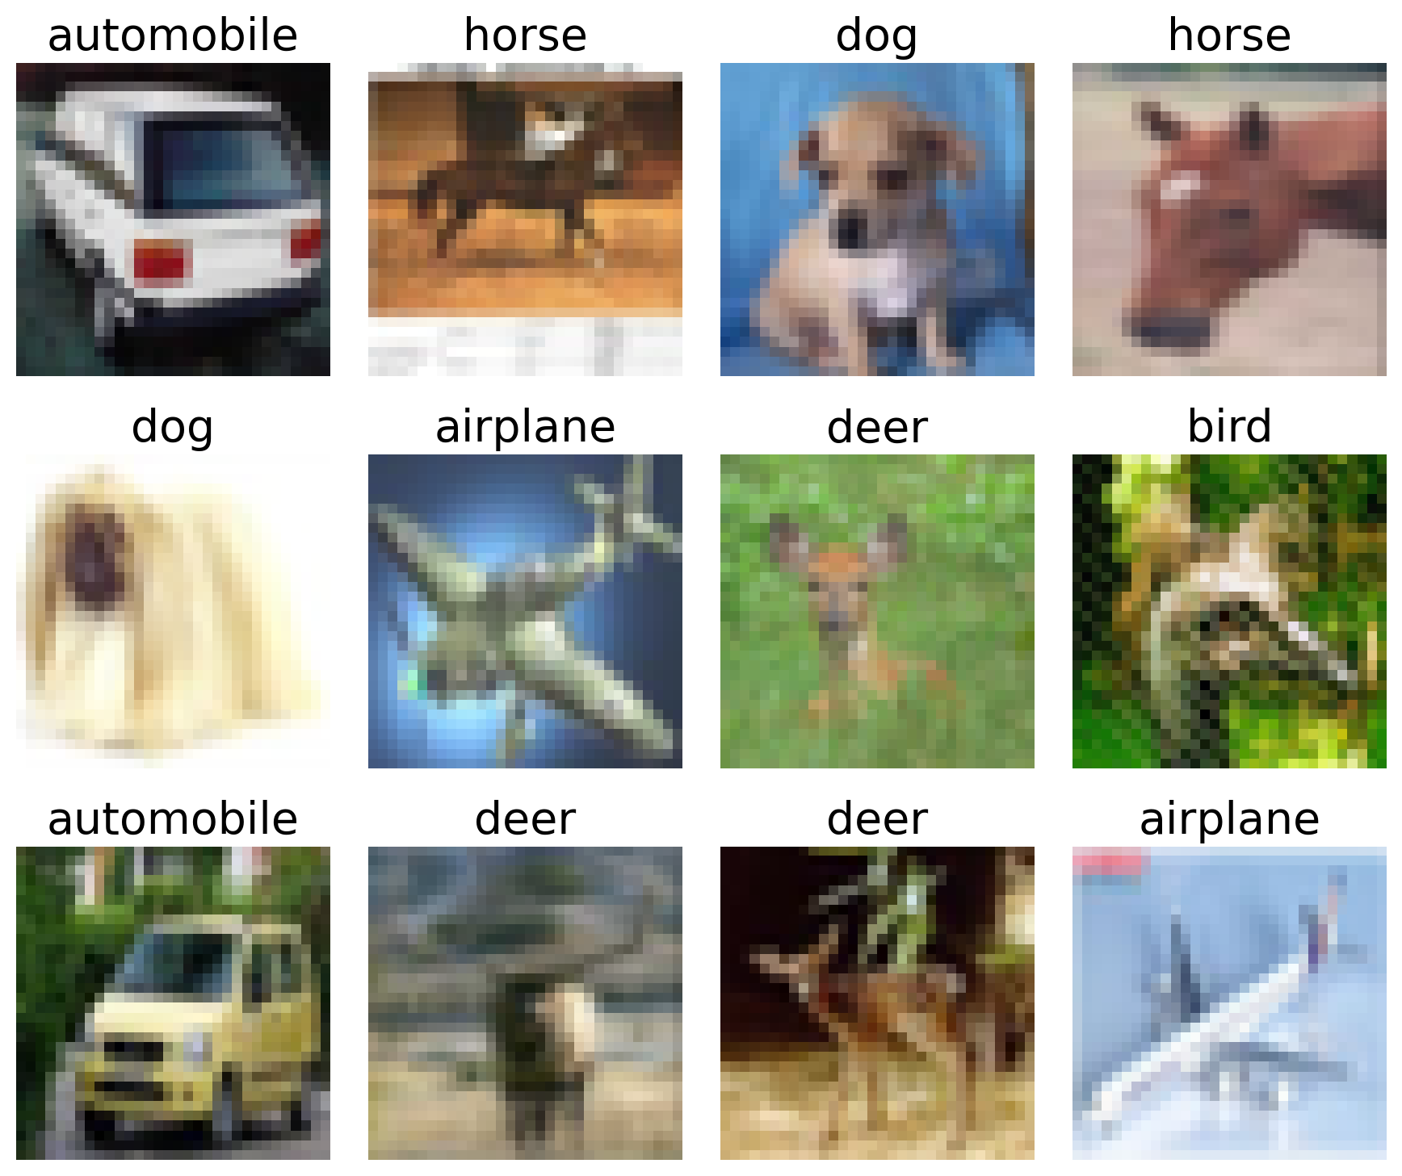
Visualization
import matplotlib.pyplot as plt
label_dict = {0: ‘airplane’, 1: ‘automobile’, 2: ‘bird’,
3: ‘cat’, 4: ‘deer’, 5: ’dog’,
6: ‘frog’, 7: ‘horse’, 8: ’ship’,
9: ‘truck’}
image_idx = 0
plt.imshow(X_train[image_idx])
plt.title(label_dict[y_train[image_idx]])

Slide 19
Data augmentation
1.
Cropping
2.
Flipping
3.
Rotation

Slide 20
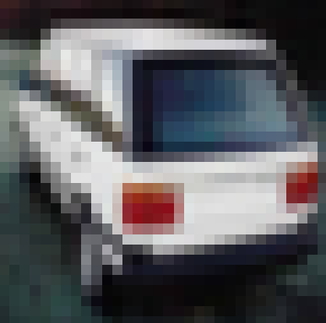
Cropping
want to crop this part
??
??
??
how to handle out-of-range?
original image
?

Slide 21
Cropping
original image
1. zero padding!
2. crop the interested region

Slide 22
Flipping and rotation
original
horizontal flip (mirror)
rotation

Slide 23
Code for data augmentation
from tensorflow.keras.models as Sequnetial
from tensorflow.keras.layers as ZeroPadding2D
from tensorflow.keras.layers.experimental.preprocessing\
import RandomCrop, RandomFlip, RandomRotation
data_augmentation = Sequential()
data_augmentation.add(ZeroPadding2D(4, input_shape=(32,32,3)))
data_augmentation.add(RandomCrop(32,32))
data_augmentation.add(RandomFlip('horizontal’))
data_augmentation.add(RandomRotation(0.05))
# A fraction of 2π

Slide 24
Model
Will try DNN and CNN.
1. DNN:
Will figure out a poor performance:
Accuracy
< 60% (even w/ advanced techniques)
2. CNN:
Will employ ResNet.
Target:
92 ~ 93% (w/ some techniques)
Notes:
원하는 task 정했고, 데이터셋 준비 됐으면 이제 뭐하죠?
모델 결정해줍니다. 모델을 결정하기 위해서 가장 간단한 모델부터 적용해봅니다.
(둘 다 convex optimization이라 regularization technique만 적용했습니다.)
w/o regularization: 86

Slide 25
Techniques that we will use
Regularization, Early stopping
He’s initialization
Hyperparameter search w/ cross validation:
learning rate, batch size, …
+
Learning rate decay, Batch Normalization,
Data augmentation

Slide 26
DNN architecture
2048
1024
10
input size:
32x32x3
= 3072
…
…
…
…

Slide 27
Simplified AlexNet architecture
ReLU
input
conv
max pool
conv
max pool
32*32*3
32*32*64
16*16*64
16*16*128
8*8*128
softmax
conv
conv
conv
4*4*256
2*2*512
1*1*1024
output 10
FC 1024
FC 256

Slide 28
ResNet-18 architecture
BN
input
conv
32*32*3
32*32*64
ReLU
conv
conv
conv
conv
32*32*64
32*32*64
32*32*64
32*32*64

Slide 29
Continue …
conv
conv
conv
conv
16*16*128
16*16*128
16*16*128
16*16*128
conv
conv
conv
conv
8*8*256
8*8*256
8*8*256
8*8*256

Slide 30
Continue …
conv
conv
conv
conv
4*4*512
4*4*512
4*4*512
4*4*512
softmax
avg pool
output 10
1*1*512
Flatten

Slide 31
Checkpoints in Day 9’s morning
Log files and saved models
Performance of DNN

Slide 32
GP3
(Groups C, D & E)

Slide 33

Task
Weather forecasting
model
whather conditions
(numeric)
“temperature”
(e.g., 27℃ )
Notes:
Image class

Slide 34
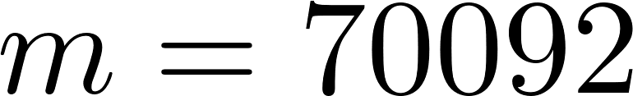
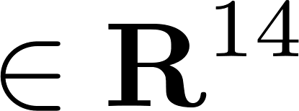

Dataset
Data:
weather features collected from 2009 to 2016
Example:
Pressure, humidity, …
Label: celcius temperature

Slide 35
Data load & visualization
Load data in csv file
import pandas as pd
data=pd.read_csv("./downloads/train.csv")
Data visualization:
T_data=data[‘T (degC)’]
date_time=pd.to_datetime(data[‘Date time’],
format=%d.%m.%Y %H:%M:%S)
import matplotlib.pyplot as plt
plt.plot(date_time, T_data)
temperature
date
Notes:
시간 순으로 잘라서 사용하기 때문에 train_test_split을 사용합니다

Slide 36
Pre-processing
data.describe() #statistics of data
 | Wv (m/s)
count | 420551
mean | 1.70
Std | 65.45
min | -9999.00
max | 28.49
# Wind velocity
# missing entry
Fill up the missing entry with a mean:
wv = data['wv (m/s)']
wv_outlier = (wv == -9999.0)
mean_wv=wv[~wv_outlier].mean()
wv[wv_outlier] = mean_wv

Slide 37
Data split
Will split dataset into train/val/test sets with:
7:2:1 (in chronological order)
from sklearn.model_selection import train_test_split
X_rest, X_test, y_rest, y_test =\
train_test_split(X,y, test_size=0.1,shuffle=False)
X_train, X_val, y_train, y_val =\
train_test_split(X_rest, y_rest, test_size=2/9,shuffle=False)

Slide 38
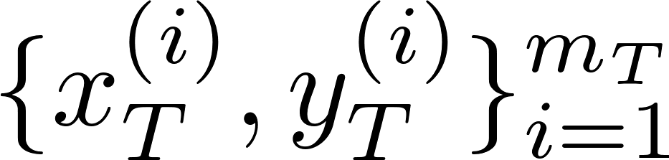

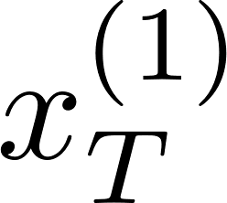
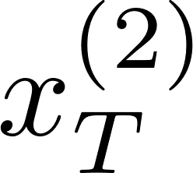

Time window T
Generate time-series dataset:
data:
14 features
label:
# of examples

Slide 39
Code for time-series data generation
data:
label:
from tensorflow.keras.preprocessing import timeseries_dataset_from_array
dataset_train = timeseries_dataset_from_array(X_train[:-T],
y_train[T:],
sequence_length=T)

Slide 40
Model
Will try DNN, CNN and RNN.
1. DNN and CNN:
Will figure out a poor performance:
RMSE
> 0.72 (even w/ advanced techniques)
2. RNN:
Will employ LSTM.
Target:
0.67 (w/ some techniques)

Slide 41
DNN architecture
32
32
input size:
14xT

Slide 42

CNN architecture
14
ReLU
input
conv
conv
conv
output
T*14*1
3*3*16
3*3*16
3*3*16
1

Slide 43
RNN architecture
LSTM
LSTM
32
32
input size:
(T, 14)
Notes:
LSTM 32 # Units
# layer 2
Dense 1

Slide 44
GP3: Checkpoints in Day 9’s morning
Log files and saved models
Performance of DNN, CNN & RNN

Slide 45
Dimensionality reduction techniques

Slide 46
Prominent techniques
1.
PCA: Principal Component Analysis
It is a linear technique.
Note:
2.
Kernel PCA (a non-linear counterpart of PCA)
3.
t-SNE: t-distribution Stochastic Neighbor Embedding

Slide 47
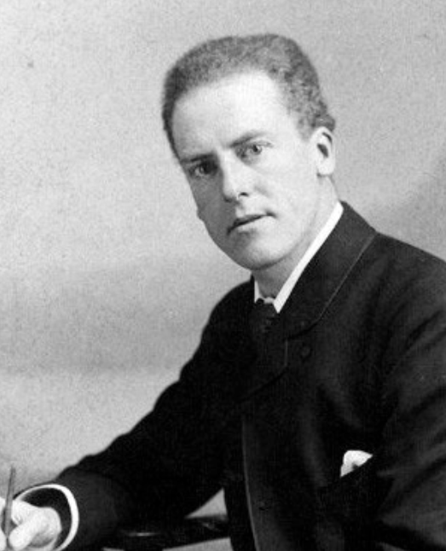
PCA
The most popular dimensional reduction technique!
Dimensional reduction:
Reducing # of variables in data by obtaining a set of principal variables.
Role:
1.
Speed up training
2.
Data visualization
Karl Pearson 1901

Slide 48




PCA in picture
Find a vector along which data points are most spread.
Similarly find another vector yet orthogonal to 1st one.
Repeat finding an orthogonal vector until reaching d.

Slide 49

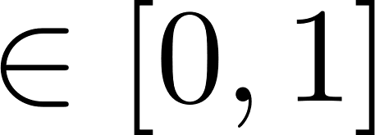
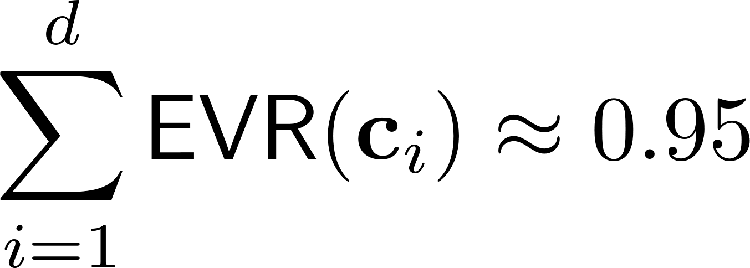
How to choose ?
Choose d (# of vectors) so as to explain a sufficiently large portion of data (e.g., 95%)
A measure that captures the proportion of data reflected in a principal component:
EVR (explained variance ratio)
Choose d such that:

Slide 50
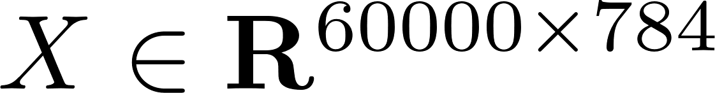
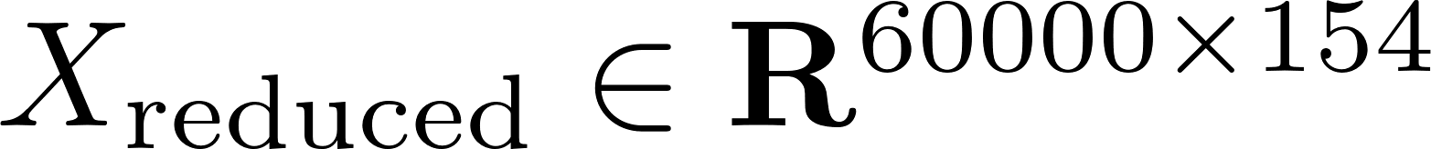
Code for PCA and Kernel PCA
from sklearn.decomposition import PCA
pca = PCA(n_components=0.95)
X_reduced = pca.fit_transform(X)
Example: MNIST
from sklearn.decomposition import KernelPCA
kpca = KernelPCA(kernel=‘rbf’)
X_reduced = kpca.fit_transform(X)
Notes:
RBF: Radial Basis Function (Gaussian), Gamma: hyperparameter for RBF kernel

Slide 51
t-SNE
Another non-linear dimensional reduction technique
Mostly used for data visualization
In particular to visualize clusters of instances

Slide 52
t-SNE in words
A technique that tries to keep:
(i) similar instances close and
(ii) dissimilar instances apart.

Slide 53
t-SNE in words
high dimensional space
low dimensional space
similar instances
very close
dissimilar instances
far apart

Slide 54
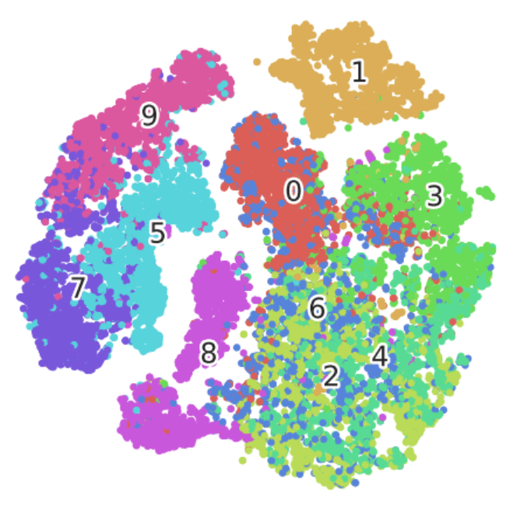
MNIST example

Slide 55
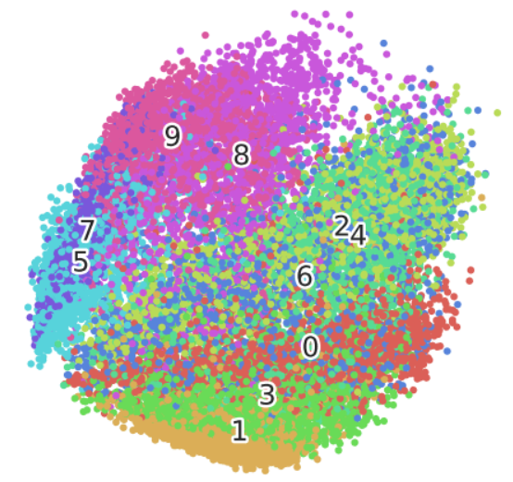
t-SNE vs PCA
t-SNE
PCA

Slide 56
Code for t-SNE
from sklearn.manifold import TSNE
tsne = TSNE(n_components=2)
X_reduced = tsne.fit_transform(X)

