Slide 1
Machine learning basics
Lecture 2
Changho Suh
Oct. 19, 2020
TexPoint fonts used in EMF.
Read the TexPoint manual before you delete this box.: AAAAAAAAAAAAAAAAAAAA

Slide 2
Least Squares problem
TexPoint fonts used in EMF.
Read the TexPoint manual before you delete this box.: AAAAAAAAAAAAAAAAAAAA

Slide 3
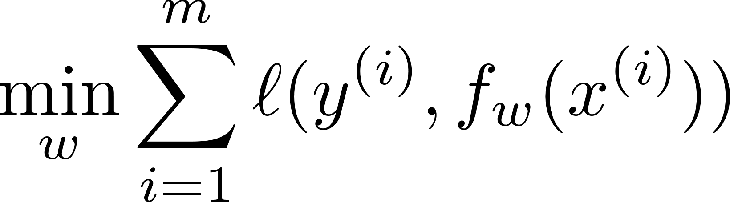
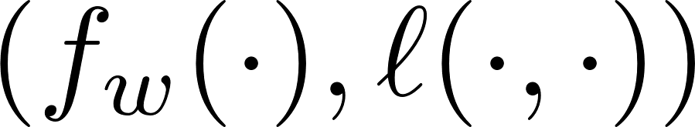
Outline
Optimization:
1.
Explore a choice of that leads to a LS problem;
2.
Study what convex opt. is & why LS is convex;
3.
Investigate how to solve the problem;
4.
Study how to evaluate performances;
5.
Discuss on optimality.

Slide 4
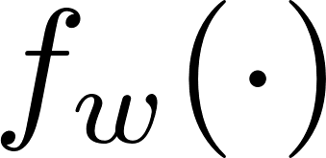
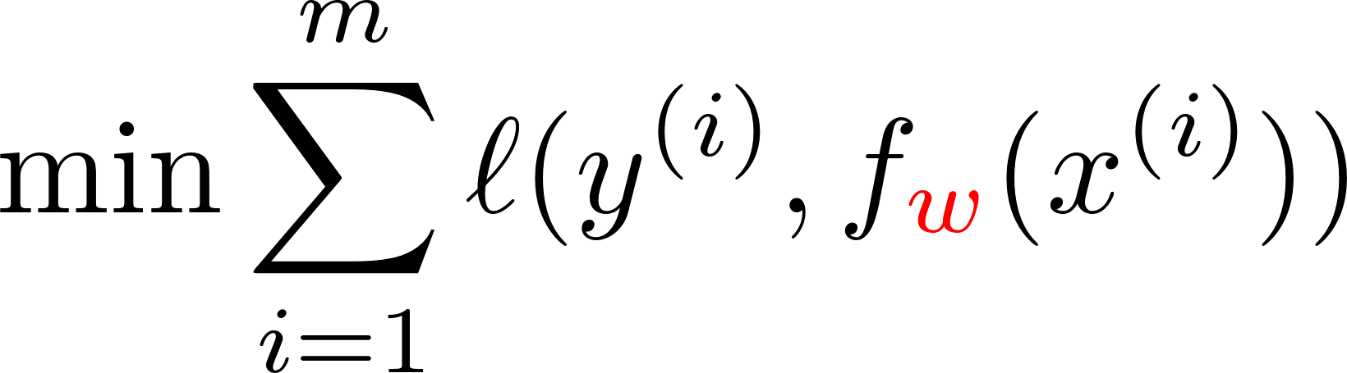



A choice for
One architecture was suggested:
Perceptron
Frank Rosenblatt ‘57
(psychologist)

Slide 5
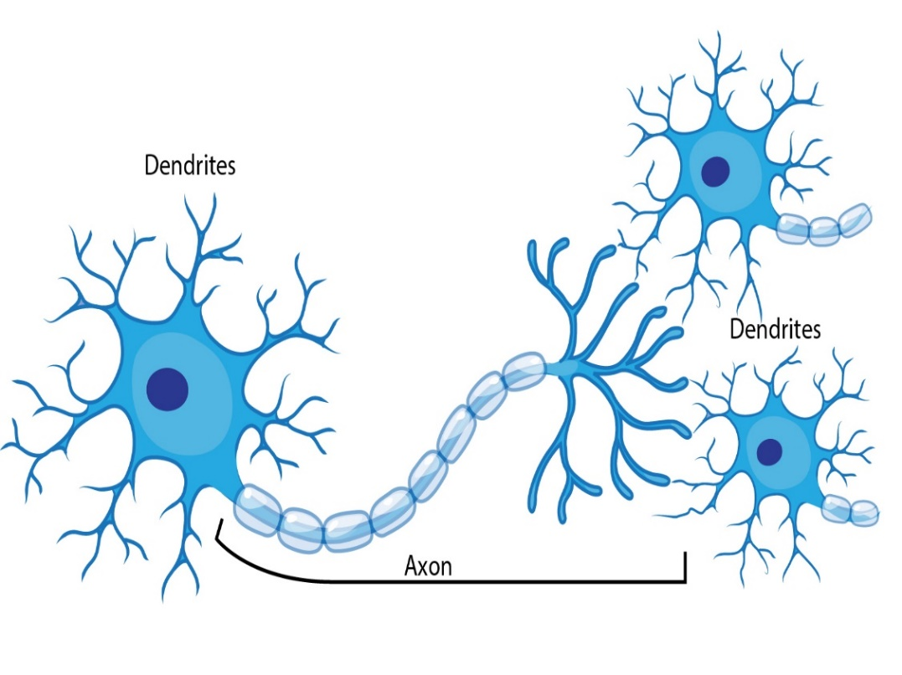




Perceptron
Inspired by: Brains of intelligent beings.
Inside brains: There are many electrically excitable cells, called neurons.
synapse
neuron
(signal delivery)
(voltage)
activation
voltage

Slide 6






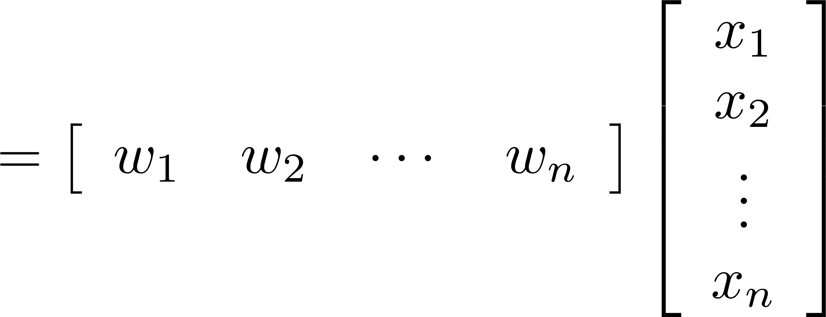


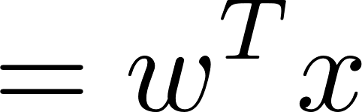
Perceptron
neuron
synapse

Slide 7
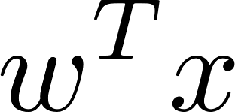
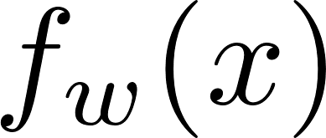
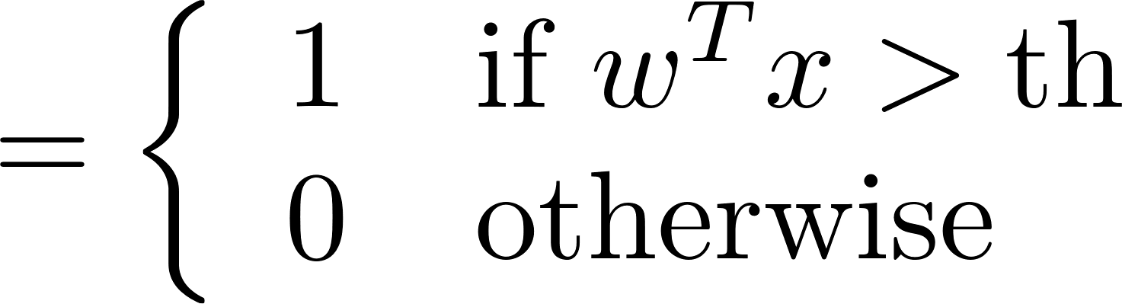
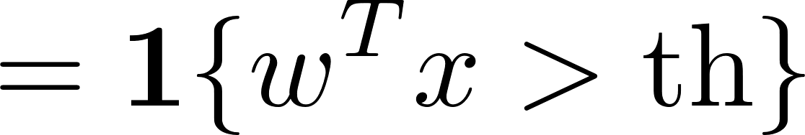
Perceptron
neuron
synapse
activation

Slide 8
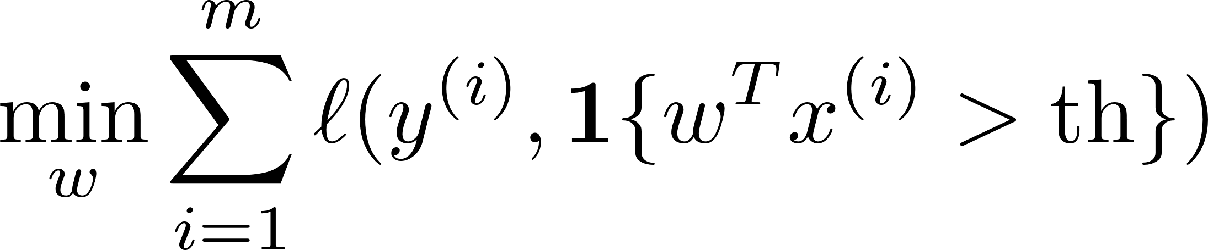
Optimization problem
Issue:
Objective function is not differentiable.
Turns out:
Non-differentiability makes the problem difficult to solve.
What can we do?

Slide 9
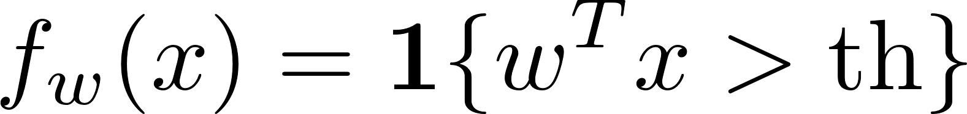
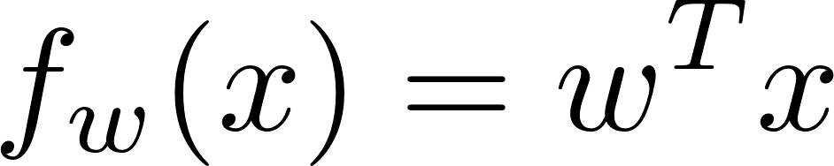
Approximate the activation!
activation
Perceptron:
Linear:
differentiable!

Slide 10

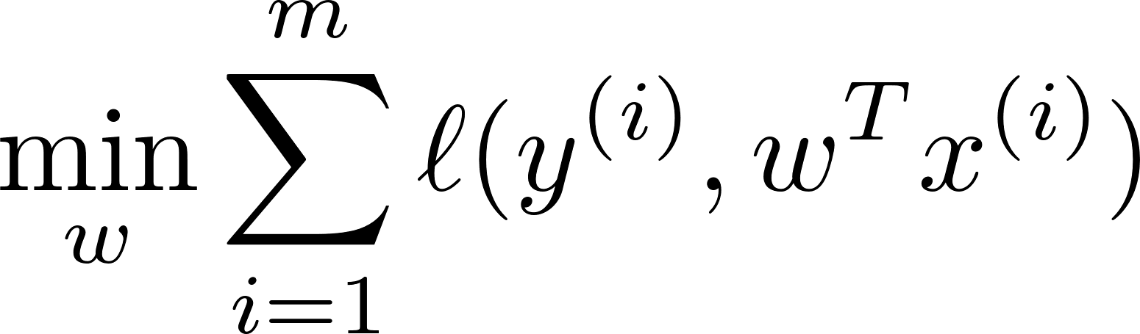
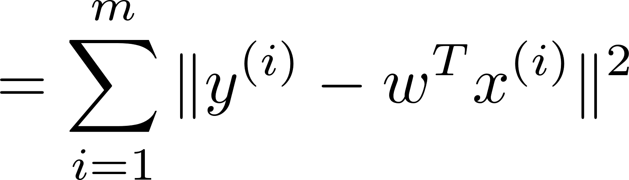
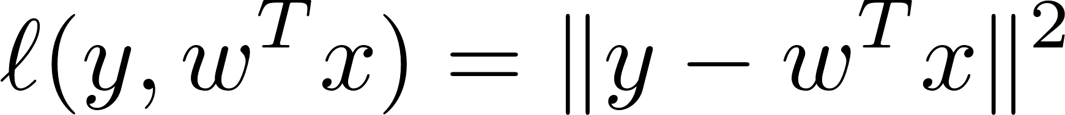
A choice for loss function ?
One popular choice is the squared error:
Turns out: The problem becomes a very well-known Least Squares problem.

Slide 11
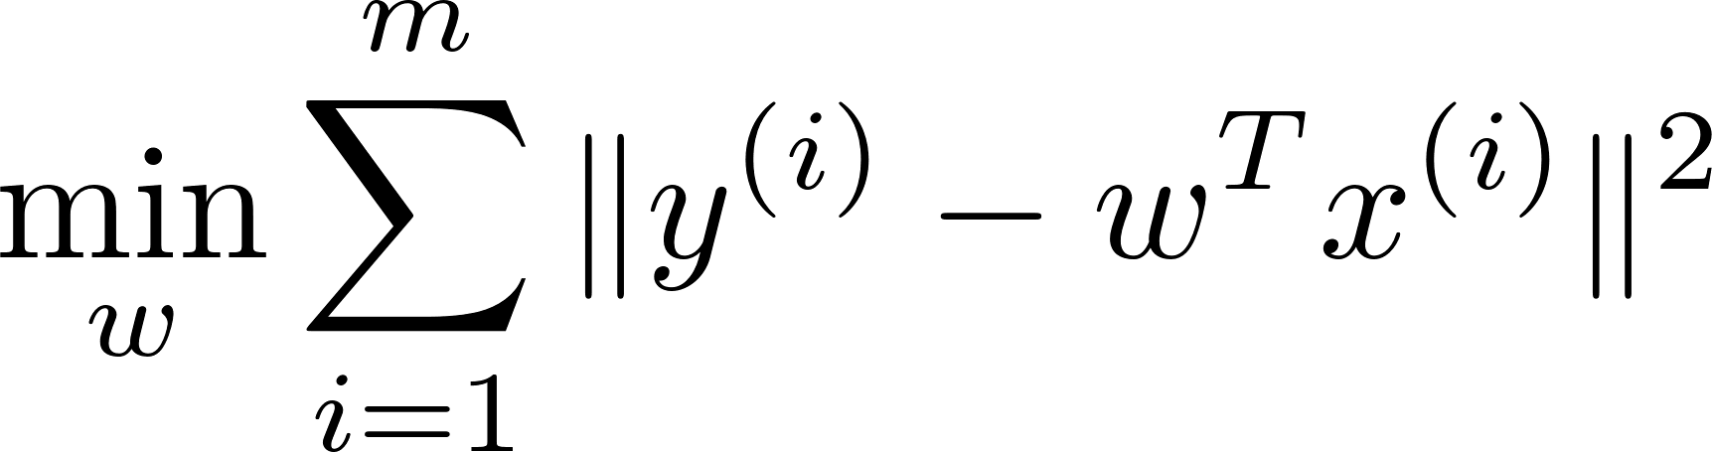
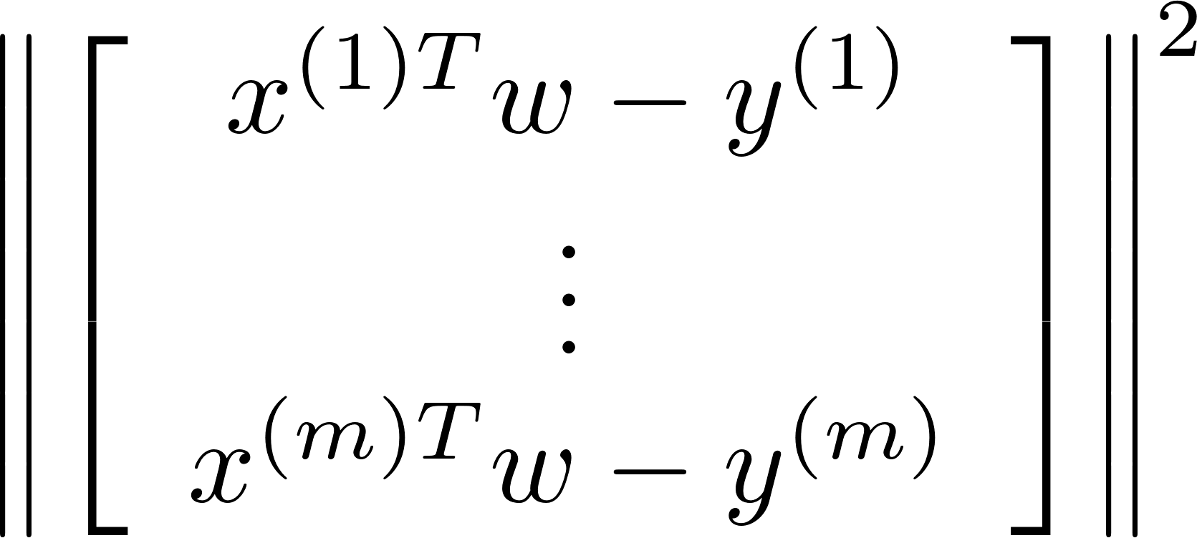
Translation to an LS problem

Slide 12
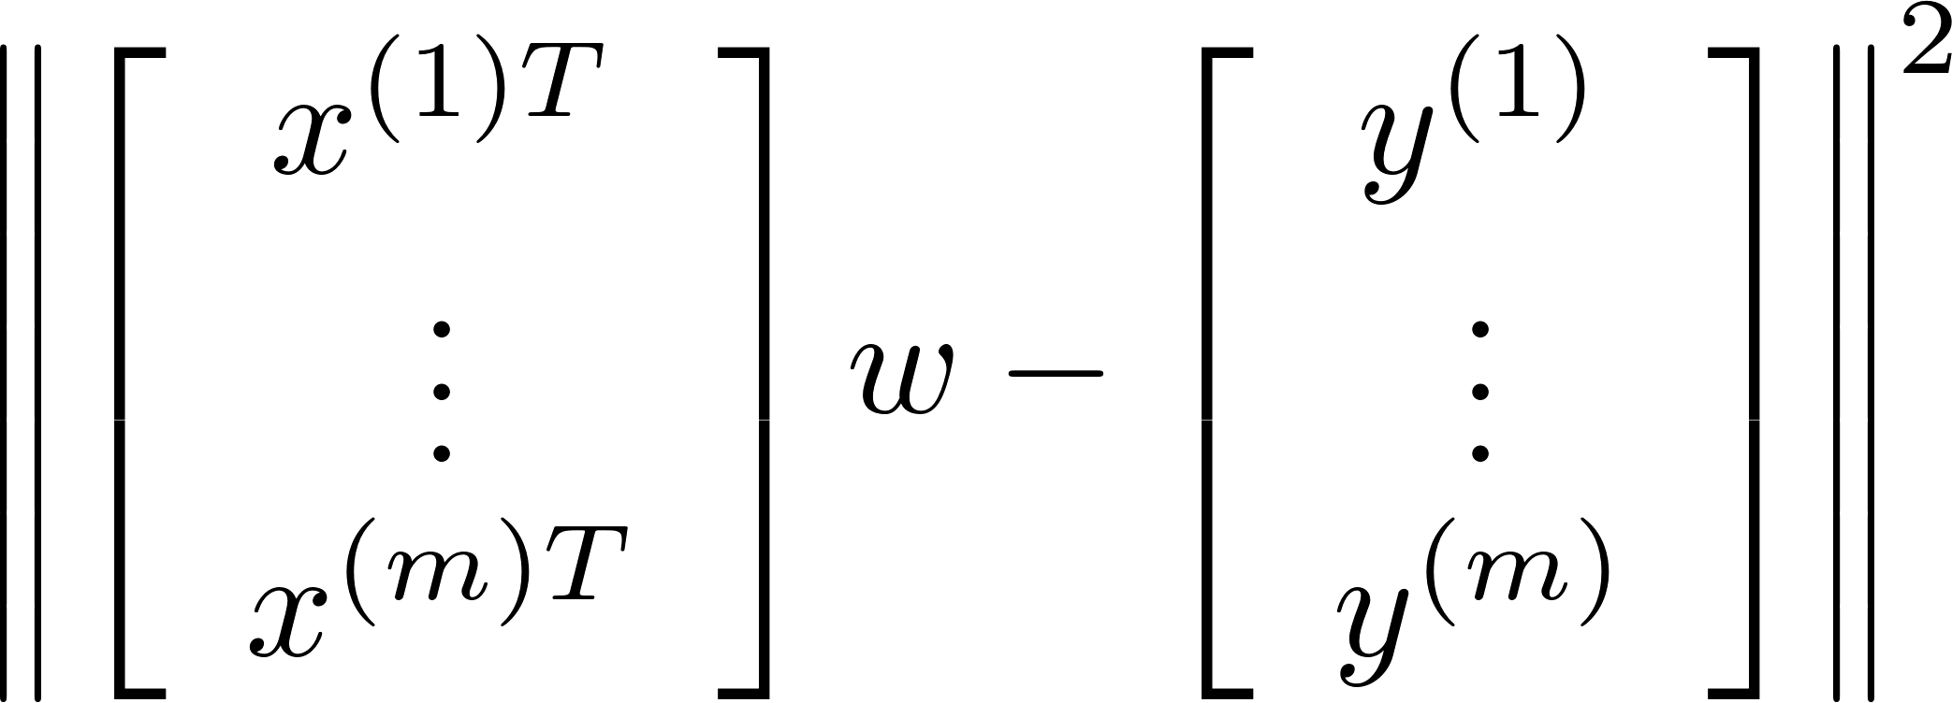


Translation to an LS problem

Slide 13
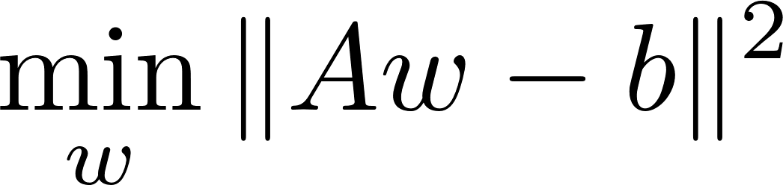
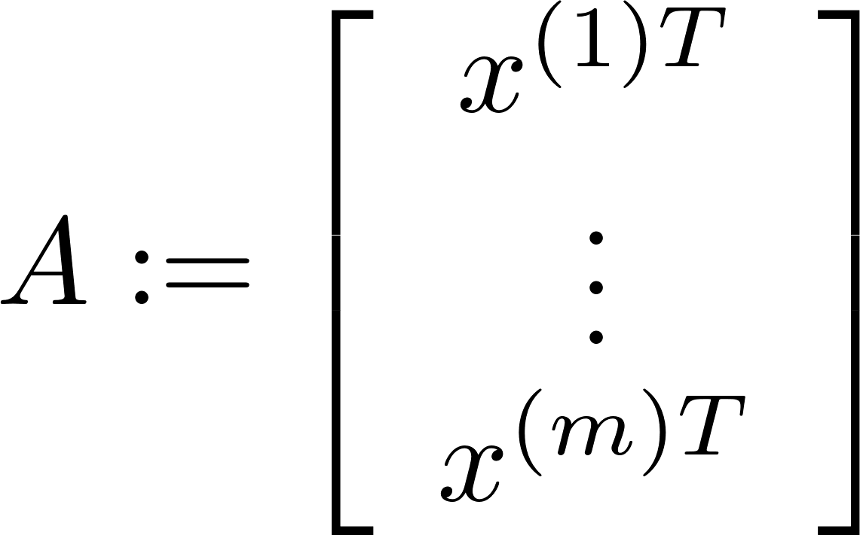
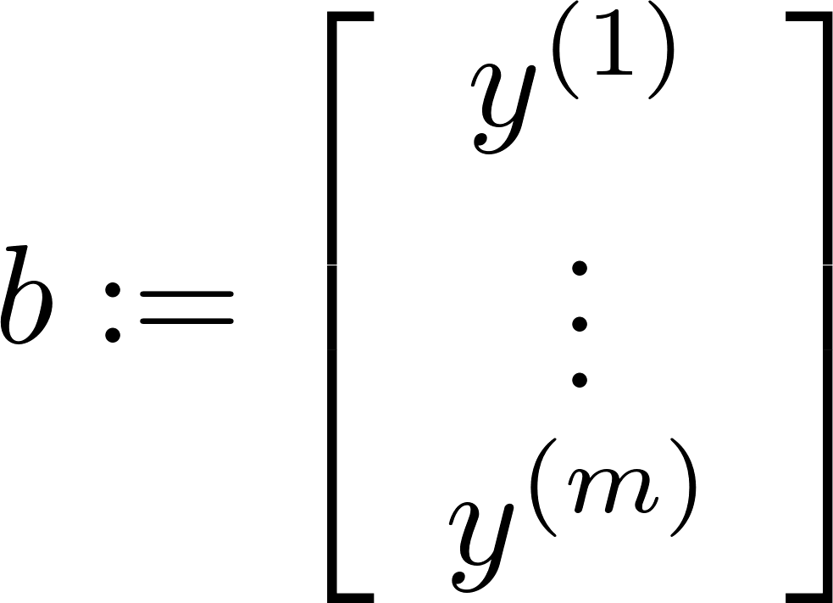
Translation to an LS problem
least
square
As claimed earlier: It is convex optimization
To show this, let us first study what convex opt. is.

Slide 14
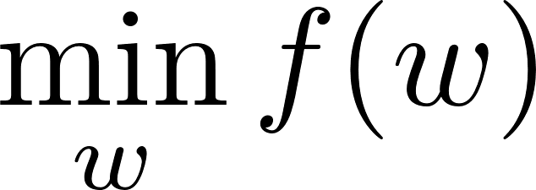
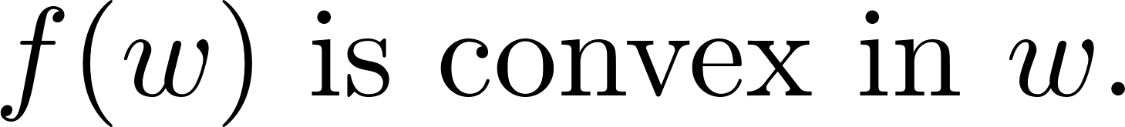
Convex optimization
Consider:
optimization variable
objective function
Definition: Say the optimization is convex if
??

Slide 15
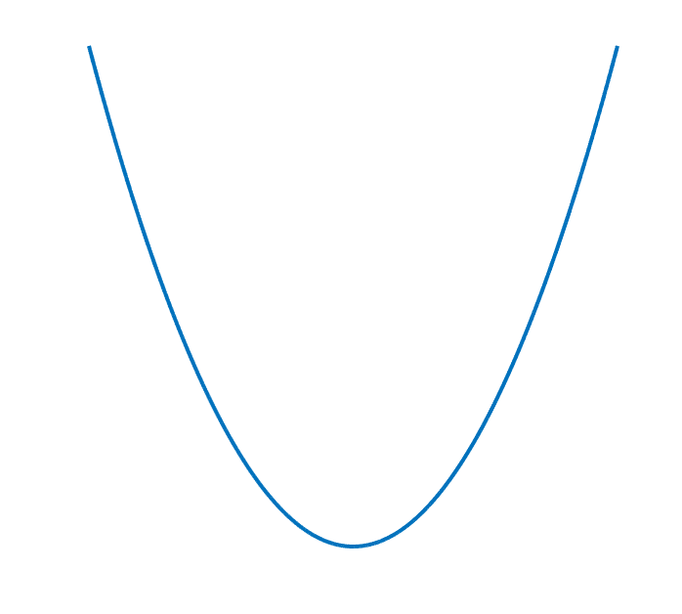
Convex function?
Informal yet intuitive definition: A function is convex if it is bowl-shaped.

Slide 16
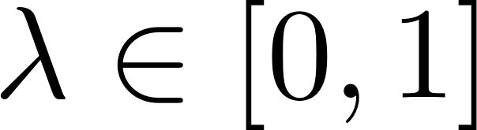
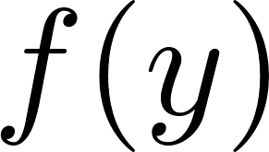
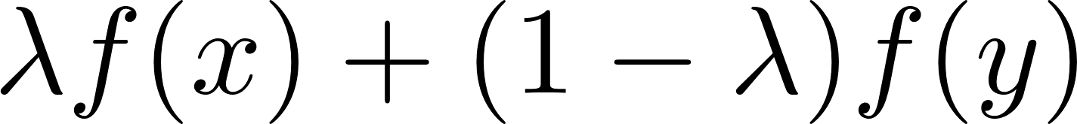
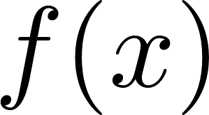

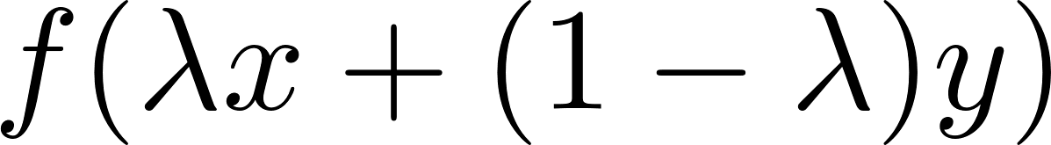
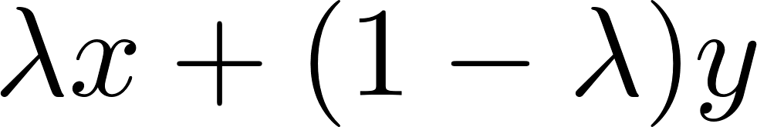

Formal definition of convex function
A function f is convex if for all :

Slide 17
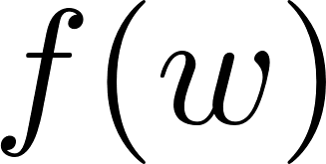

Least Squares problem is convex
Can prove it using the definition of convex function.
See Appendix for the proof.

Slide 18
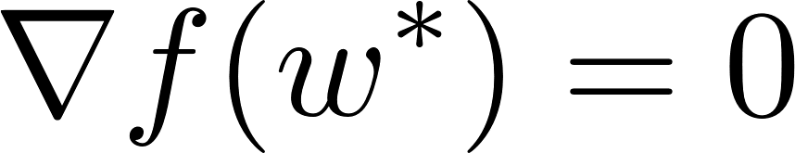

How to solve?
Recall: “convex” means “bowl-shaped”
slope = 0
Fact:

Slide 19
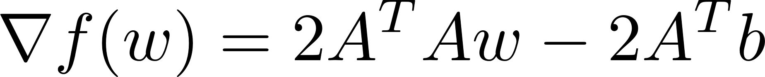
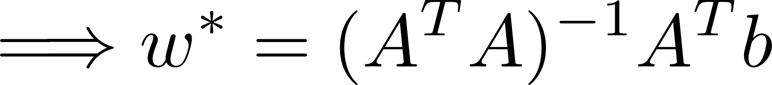
Find such that
Closed-form solution!

Slide 20
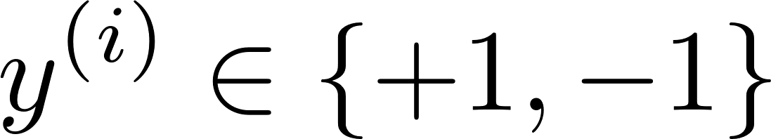
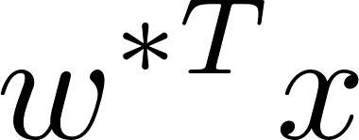
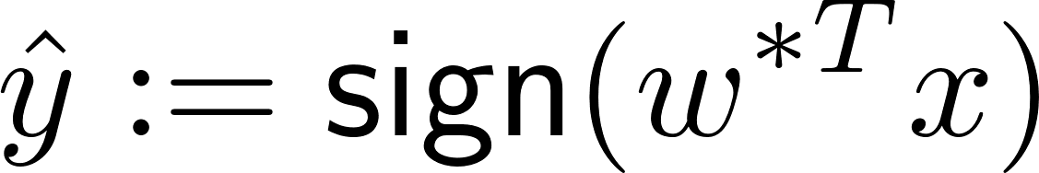
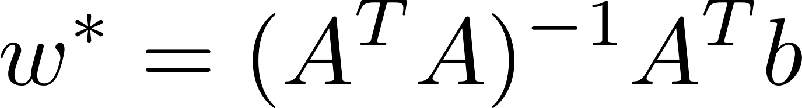
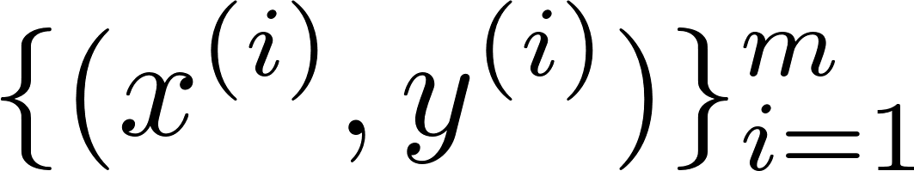
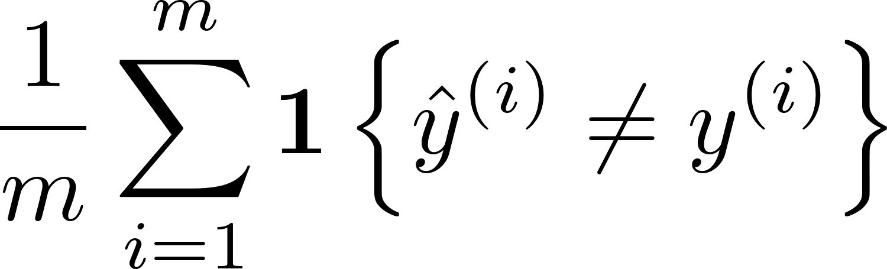
LS classifier
Suppose:
data
Least Squares
sign
How to measure performance?
What is a proper performance measure?
training data
One measure is the average error w.r.t.

Slide 21
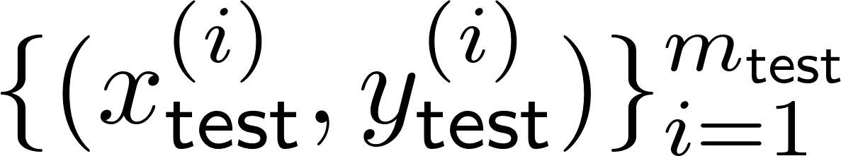
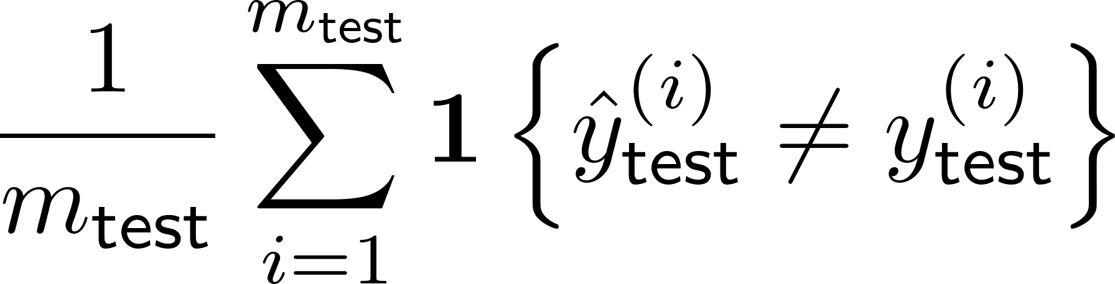
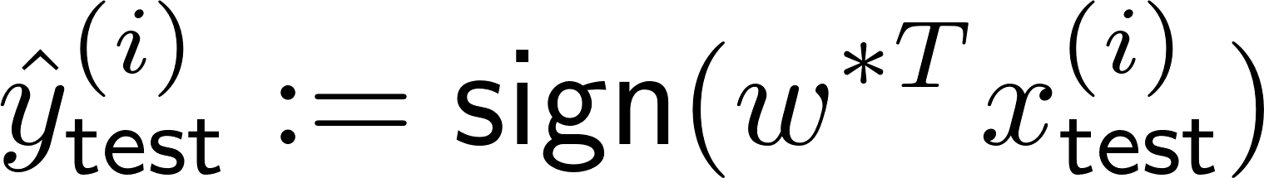
What we are more interested in …
Error w.r.t. unseen data!
test data:
Test error:
where

Slide 22
An issue
data
Least Squares
sign
In reality:
contains some noise.
Want: Classifier being robust to such noise.
Challenge that arises in the naive LS classifier:
Large values of can boost up such noise.

Slide 23
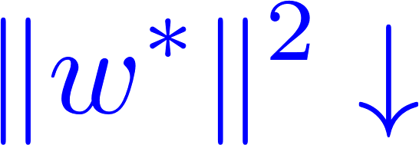

How to ensure robustness?
data
Least Squares
sign
What we want:
Note: At the same time, we also want:

Slide 24



Idea
Regulate two objectives at the same time.
This technique is called “regularization”.
regularization factor
It is a hyperparameter!
Hyperparameter: A factor that we can choose as per our design

Slide 25

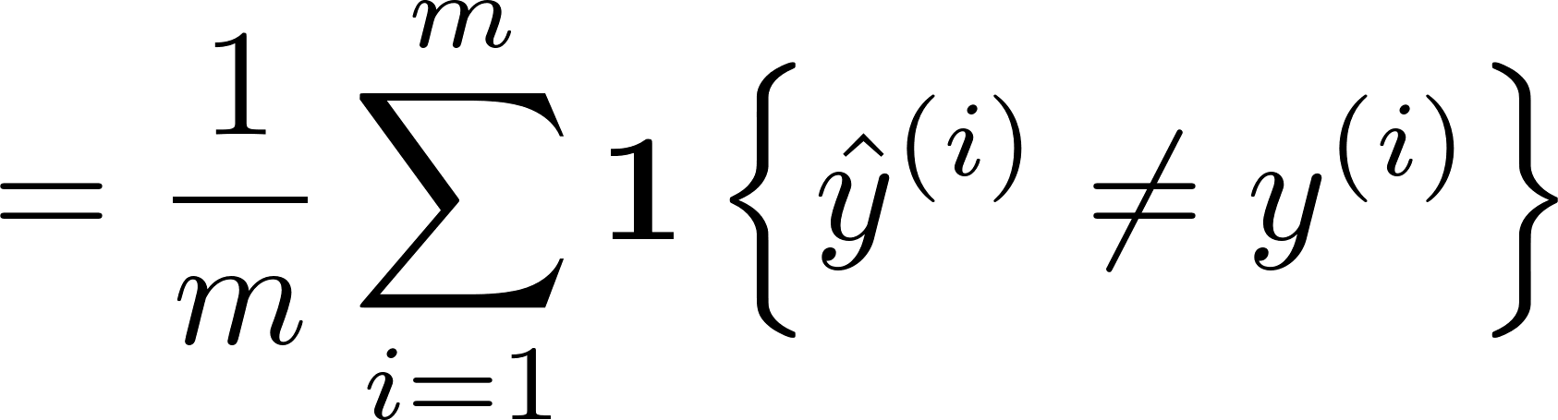
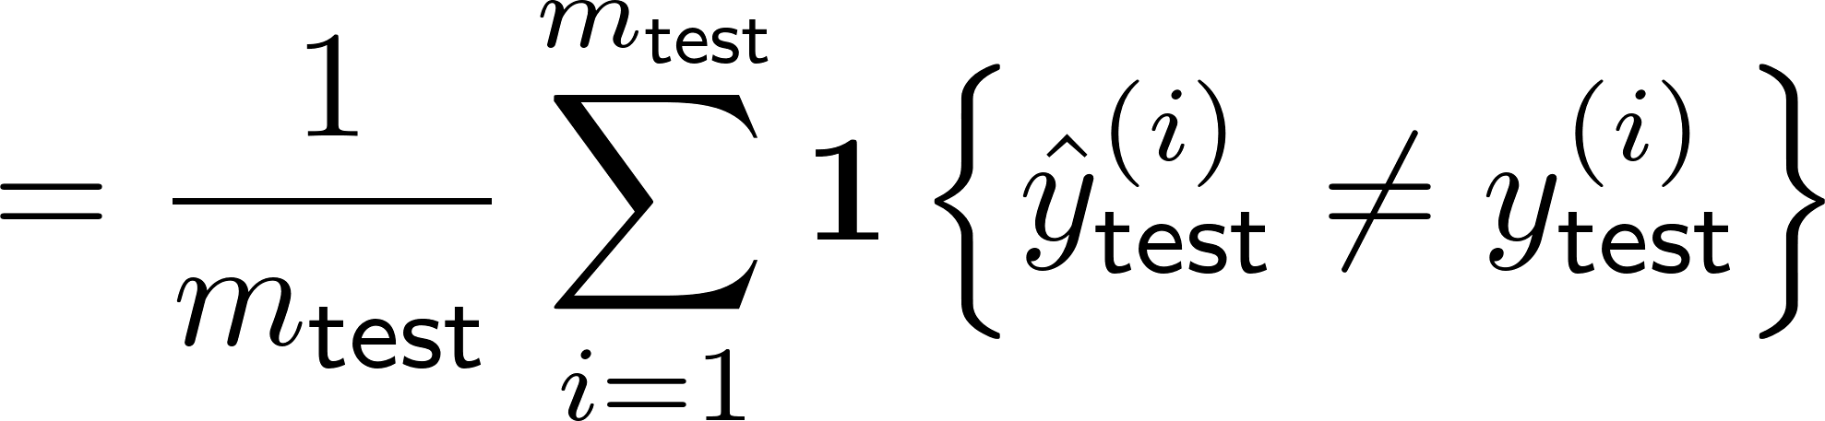
How affects performance?
error
train error
test error

Slide 26

How affects performance?
error
train error
test error
Wish to find the sweet spot that minimizes test error.

Slide 27
How to choose in practice?
error
train error
test error
Recall: Test data is unseen during training.
→ Rely on another dataset!

Slide 28
Validation dataset
Data seen during training:
train set
validation set
Role: training model parameters
Role: validating the goodness of a trained model
(hyperparameter search)
Data unseen during training:
test set

Slide 29
How to construct train/val/test datasets?
Interested in test error in the end.
The goodness of a model is validated through validation dat.
Hence: We should make sure that:
validation data distribution ~ test data distribution

Slide 30
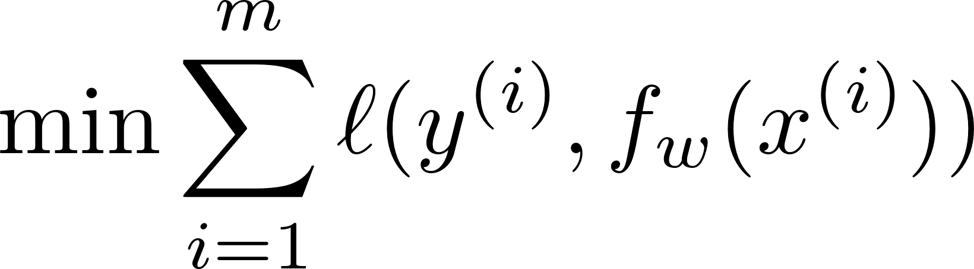
Remember …
Optimization:
LS is a particular case where:
Another choice that yields a better performance?

Slide 31
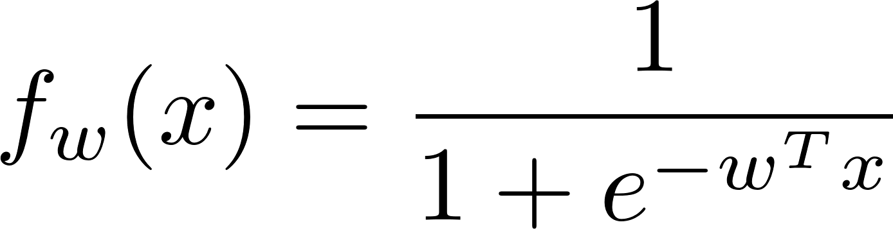

Another popular choice
Optimization:
Logistic (or sigmoid) function:
Cross entropy loss function:
Called logistic regression.

Slide 32
Turns out ...
Logistic regression offers a good performance.
It is also convex.
There is an efficient algorithm for the problem.
Next lecture: Will explore details on the above.

Slide 33
Appendix:
Proof: LS optimization is convex
TexPoint fonts used in EMF.
Read the TexPoint manual before you delete this box.: AAAAAAAAAAAAAAAAAAAA

Slide 34


Least-Squares problem is convex
Proof:

