Slide 1
Machine learning basics
Lecture 3
Changho Suh
Oct. 19, 2020
TexPoint fonts used in EMF.
Read the TexPoint manual before you delete this box.: AAAAAAAAAAAAAAAAAAAA

Slide 2
Logistic regression
TexPoint fonts used in EMF.
Read the TexPoint manual before you delete this box.: AAAAAAAAAAAAAAAAAAAA

Slide 3
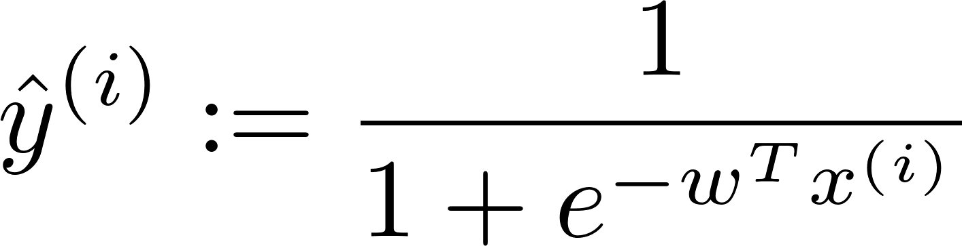
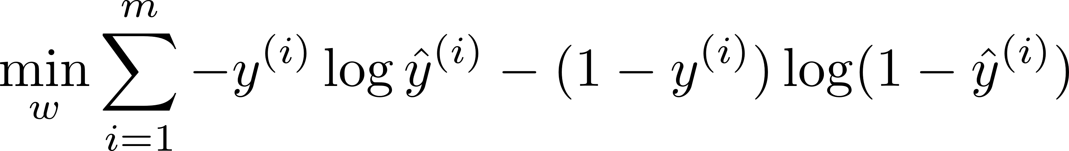
Outline
Logistic regression:
1.
Check that logistic regression opt. is convex;
2.
Investigate how to solve the problem;
3.
Explain in what sense it is optimal;
4.
Discuss on limitations.

Slide 4
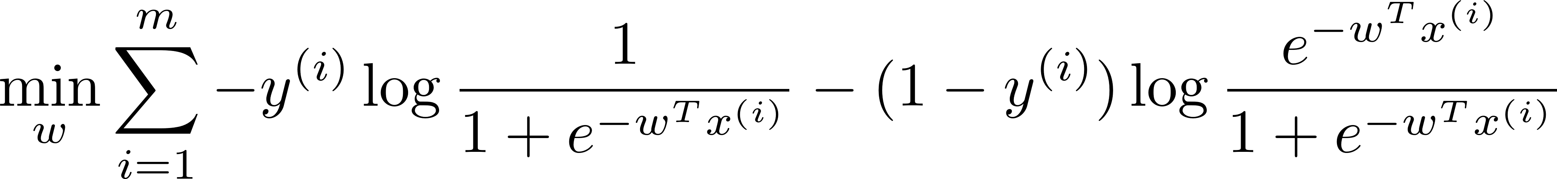
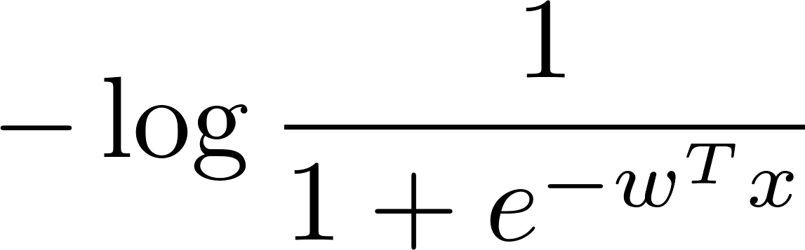

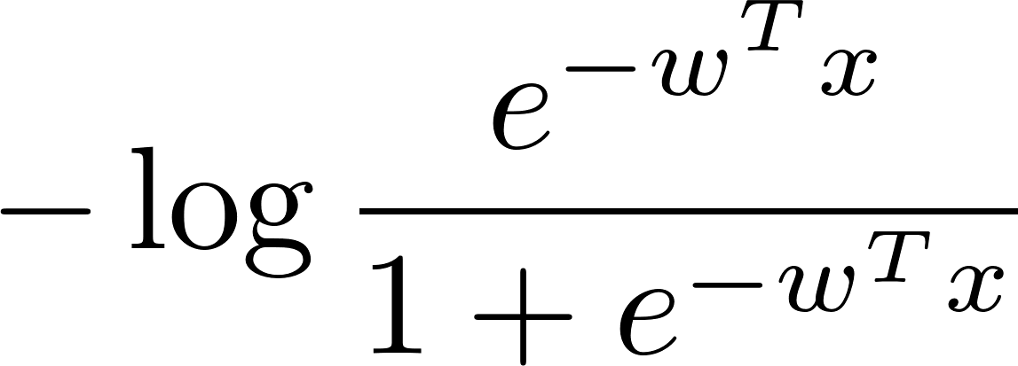
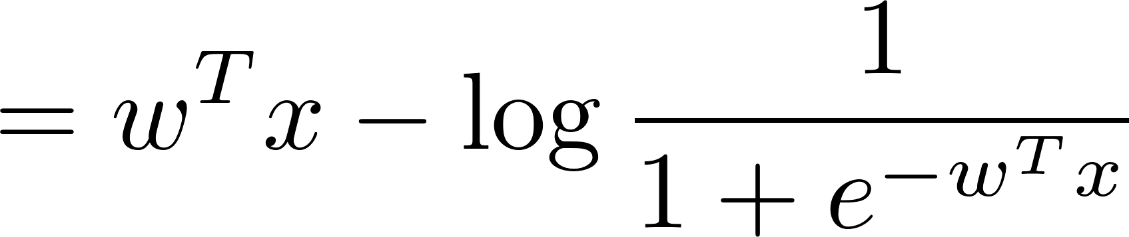
Convexity
Fact: Convexity preserves under addition.
(Why?)
Suffices to prove:
suffices to prove this only!
1.
convex in
See Appendix 1 for the proof.
2.
convex in

Slide 5


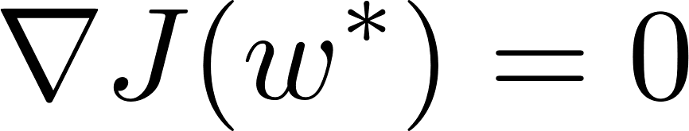
How to solve?
Logistic regression:
Hence, the minimizer is such that

Slide 6
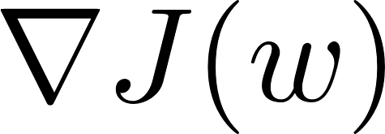
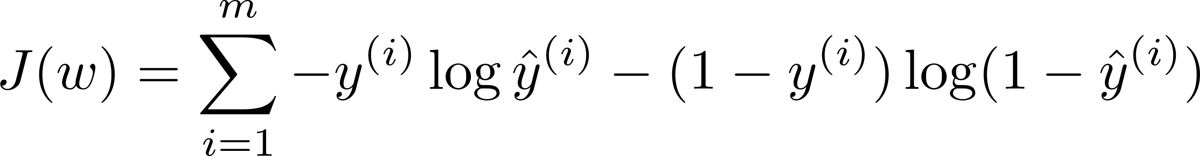
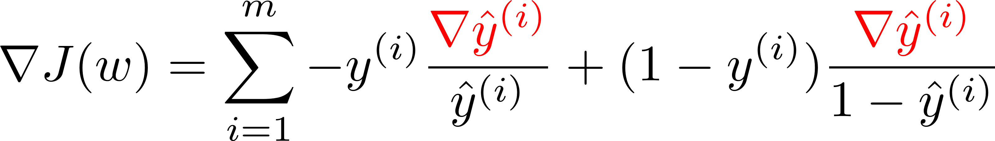
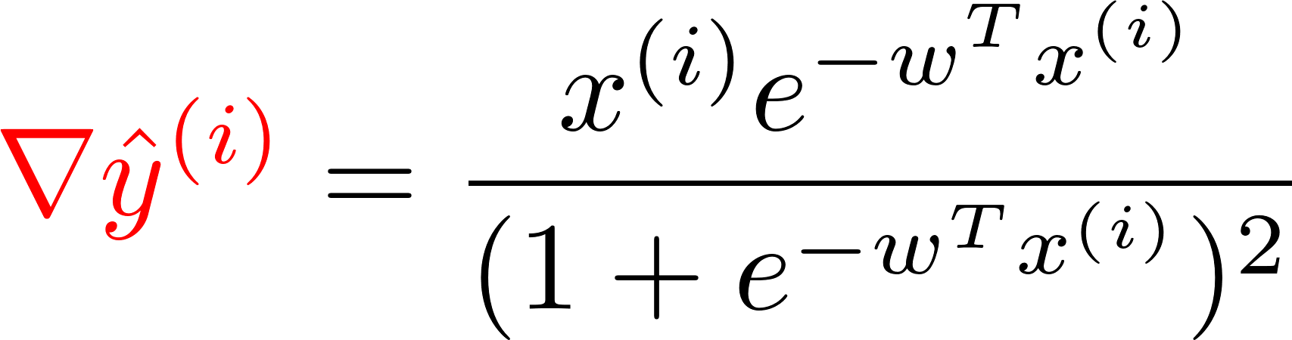
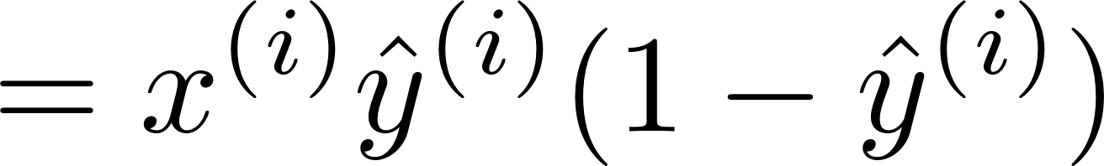
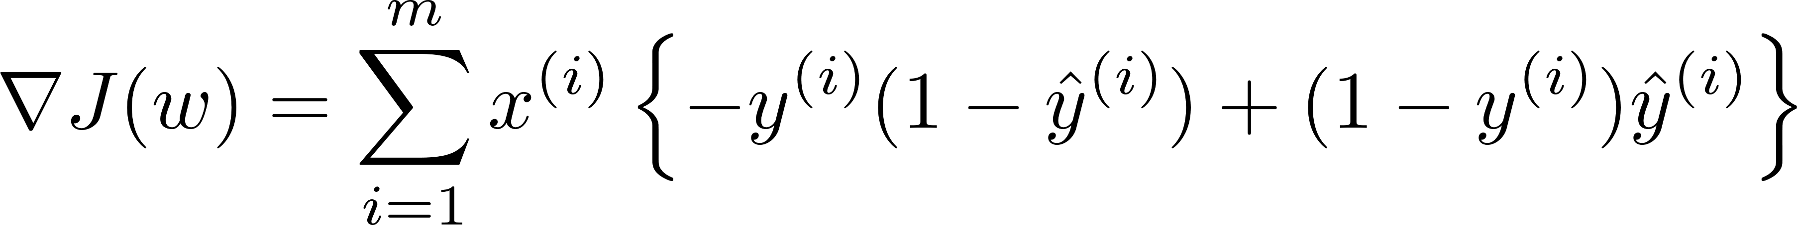
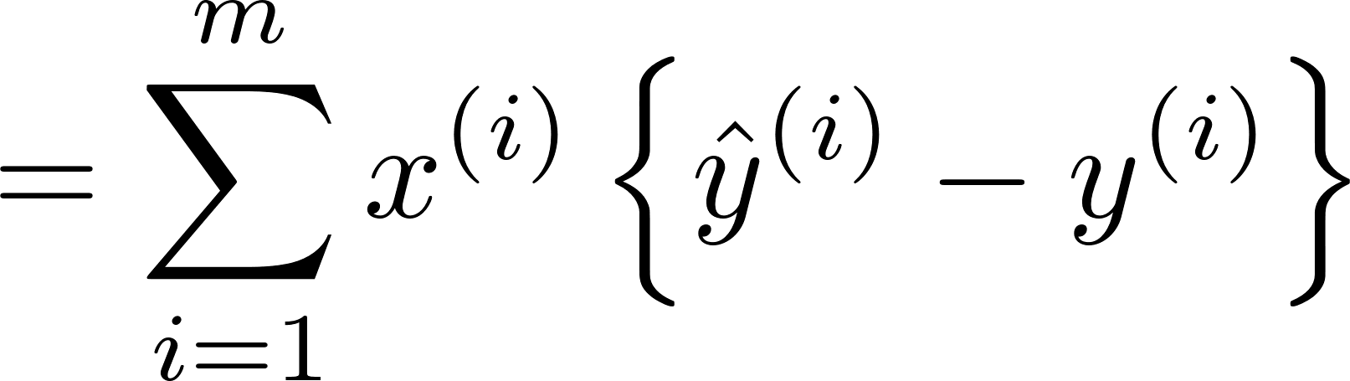
Computation of

Slide 7
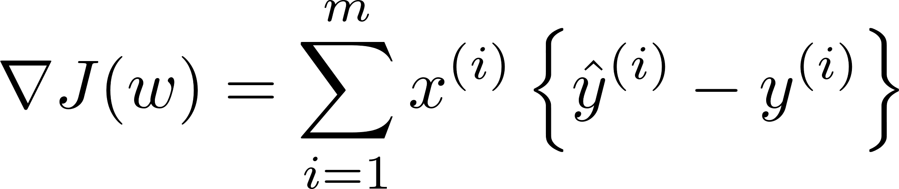
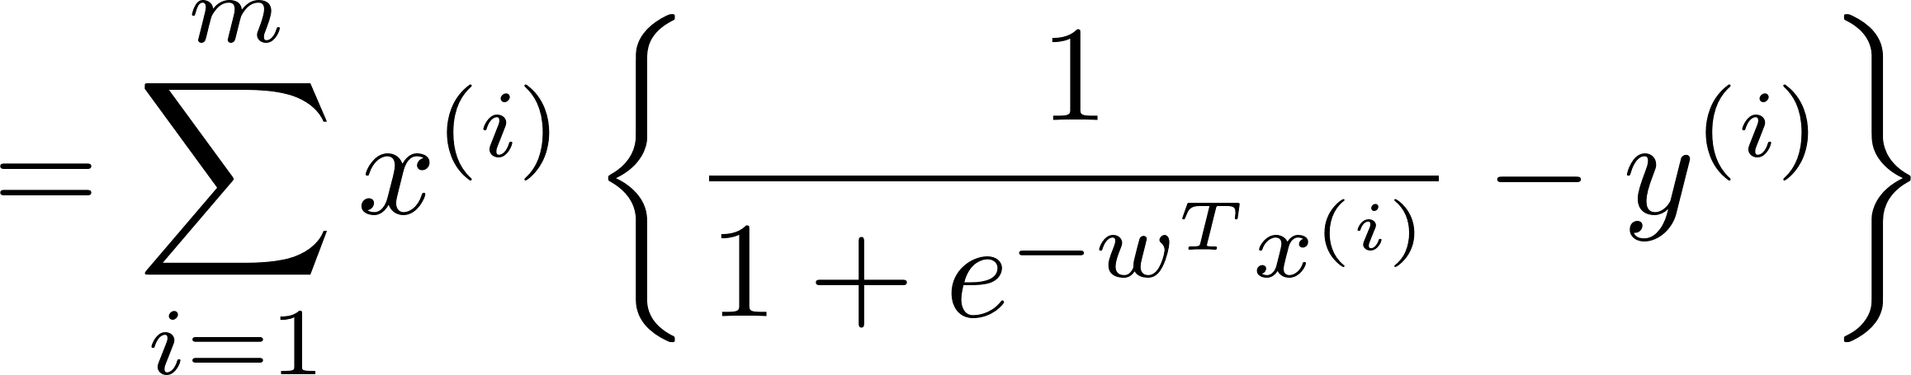
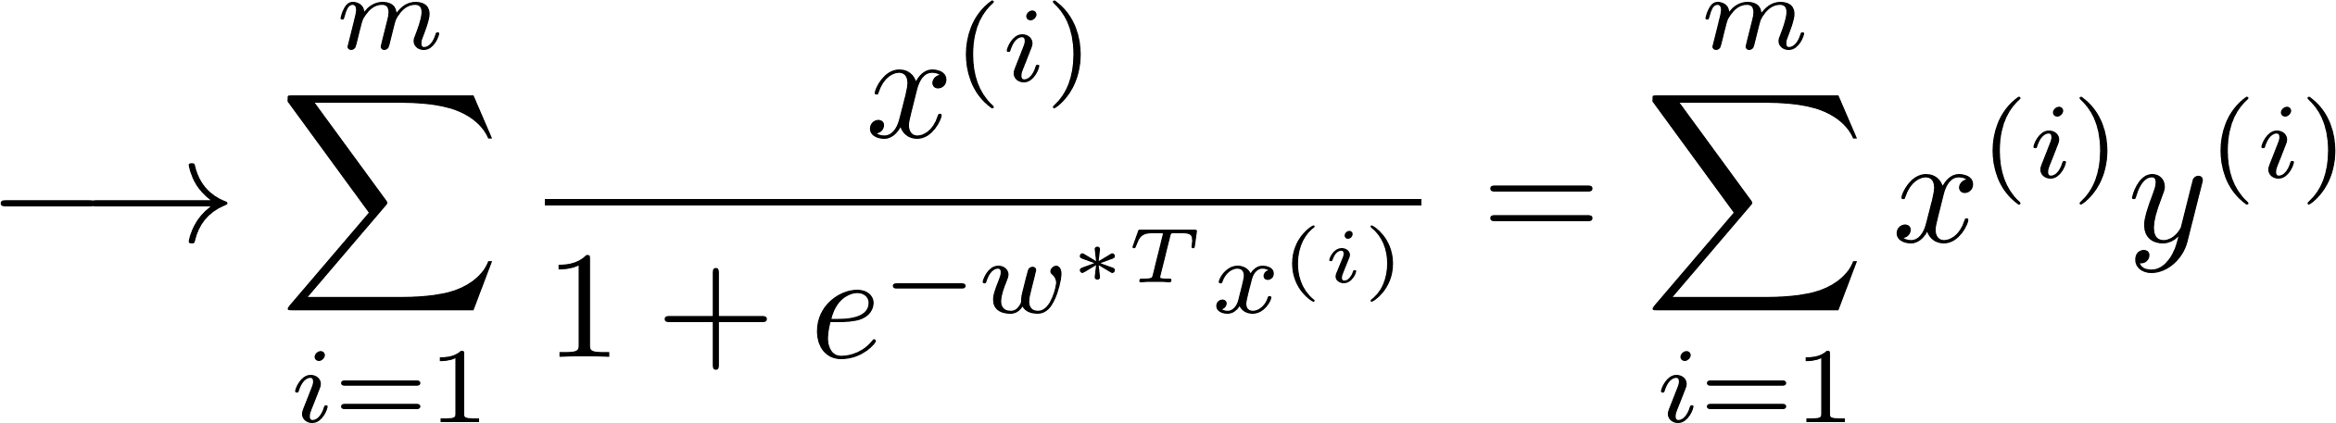
Computation of
No closed-form solution!
Fortunately: There developed algorithms which allow us to find such point efficiently.
One prominent algorithm: Gradient descent

Slide 8
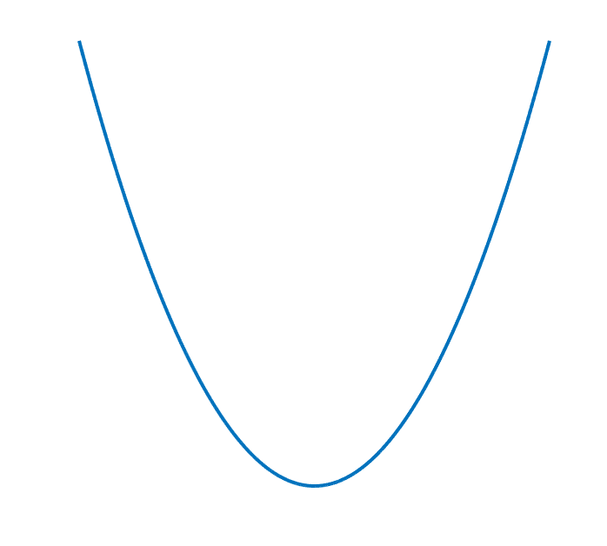
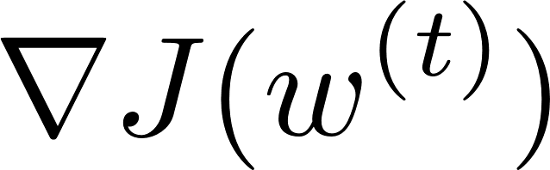
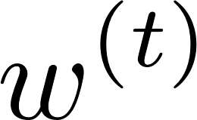
Gradient descent
Iterative algorithm
slope:
t-th estimate
move to the left!
stepsize (>0)
or called the learning rate

Slide 9
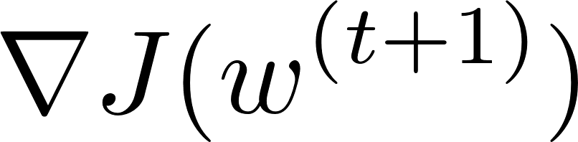
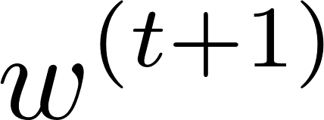


Gradient descent
(t+1)-th step:
slope:
Turns out:

Slide 10
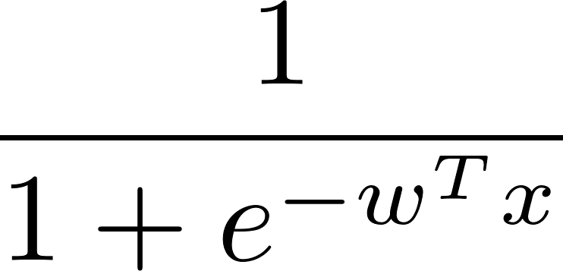

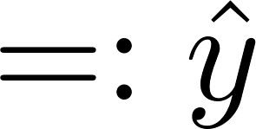
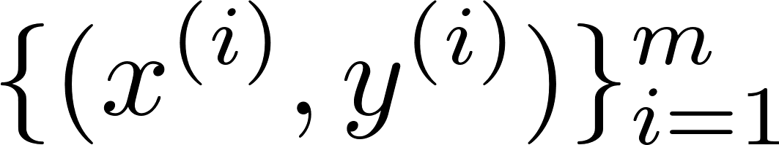
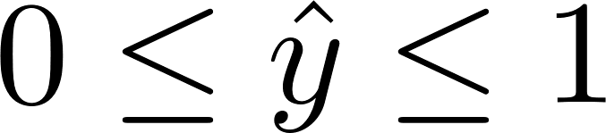
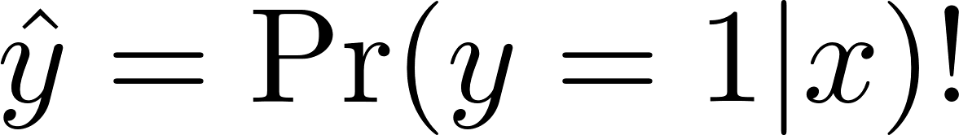
Optimality?
logistic regression
Note:
A reasonable interpretation:

Slide 11
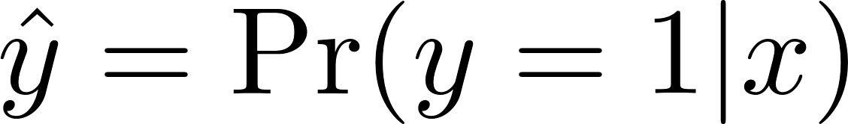
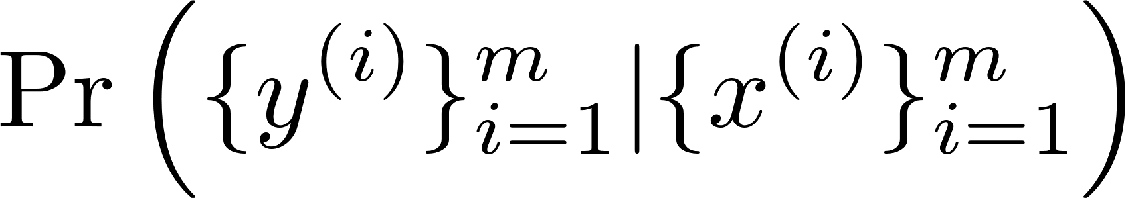
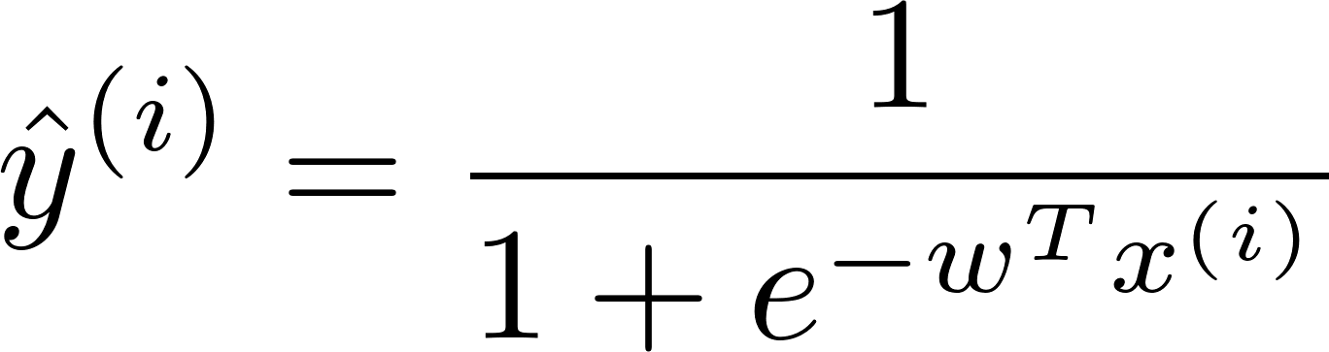
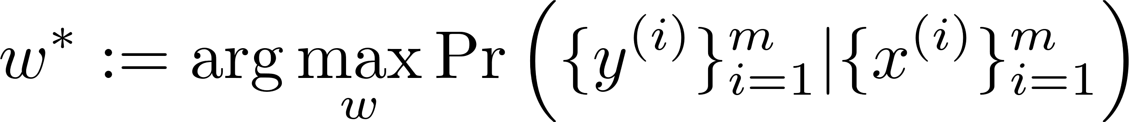
Optimality?
Assume:
Consider: the likelihood of the ground-truth system.
Note: is a function of .
Definition of optimal :

Slide 12

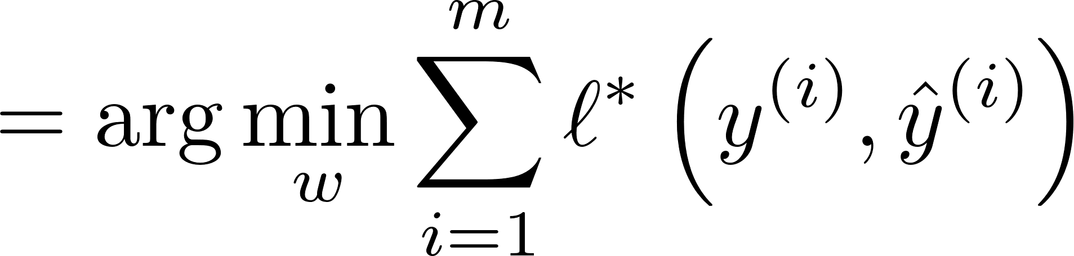
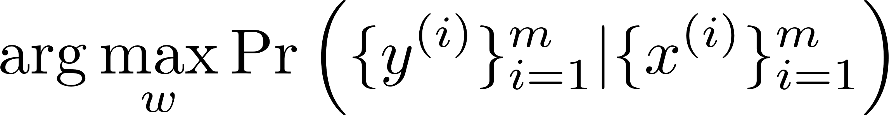
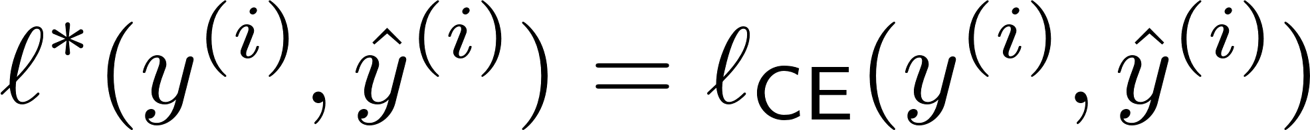
Optimal loss function
is defined as the loss function such that:
Turns out:
See Appendix 2 for the proof.

Slide 13
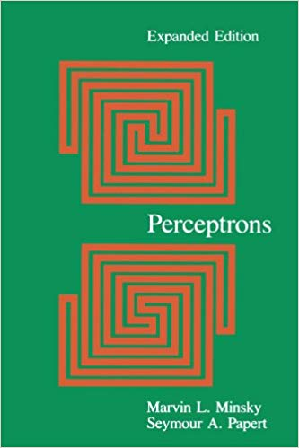

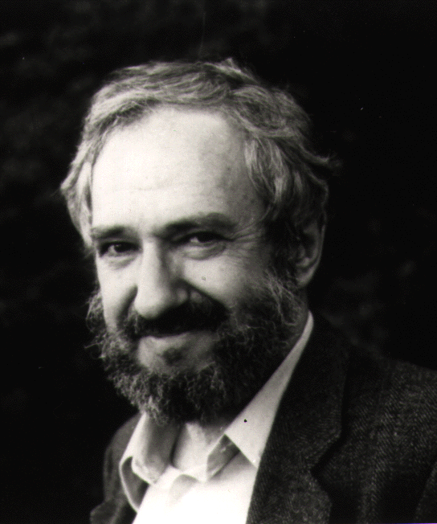
AI boomed in 1960s but …
Marvin Minsky
Seymour Papert
‘69
Demonstrated limitations of the perceptron architecture.
→ Led to the AI winter!

Slide 14


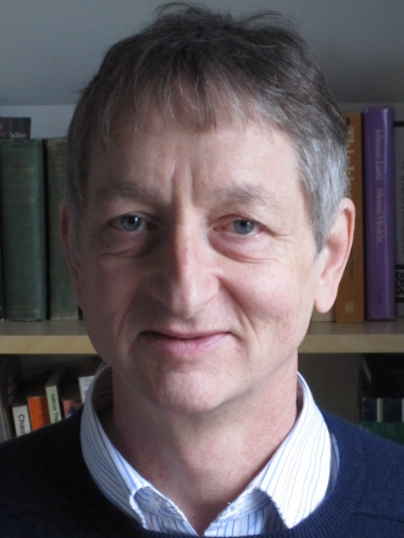
AI revived in 2012
Alex Krizhevsky
Ilya Sutskever
Geoffrey Hinton
Won the ImageNet competition in 2012!
Demonstrated: Deep neural networks can achieve human-level recognition performances!
Anchored the start of deep learning revolution!

Slide 15
Overview of Day 2’s lectures
Will investigate DNNs and advanced techniques.
Specifically we will:
1.
Study the architecture of DNNs;
2.
Formulate an corresponding optimization problem;
Explore an efficient way of solving the problem;
3.
Discuss why DNNs offer great performance.
4.
5.
Study one advanced technique: Generalization technique.

Slide 16
Appendix 1: Proof of convexity of logistic regression
TexPoint fonts used in EMF.
Read the TexPoint manual before you delete this box.: AAAAAAAAAAAAAAAAAAAA

Slide 17
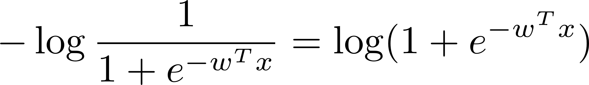
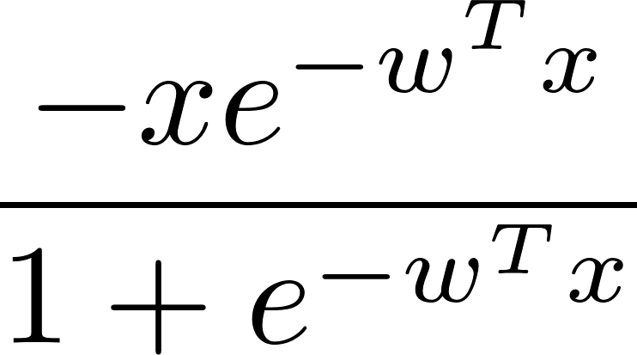
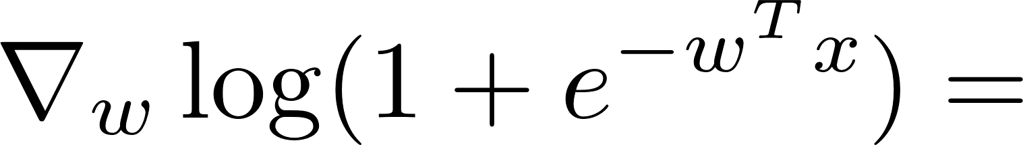
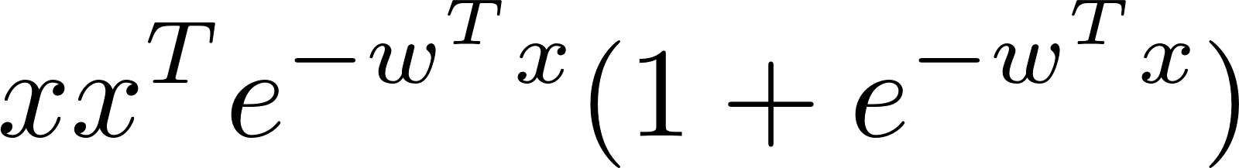
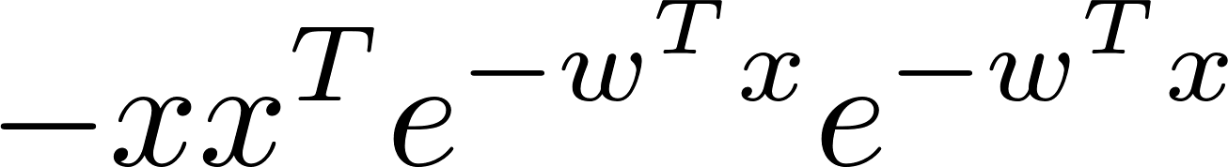
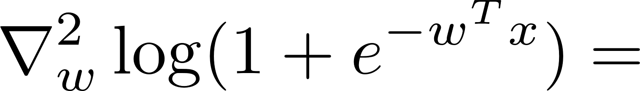
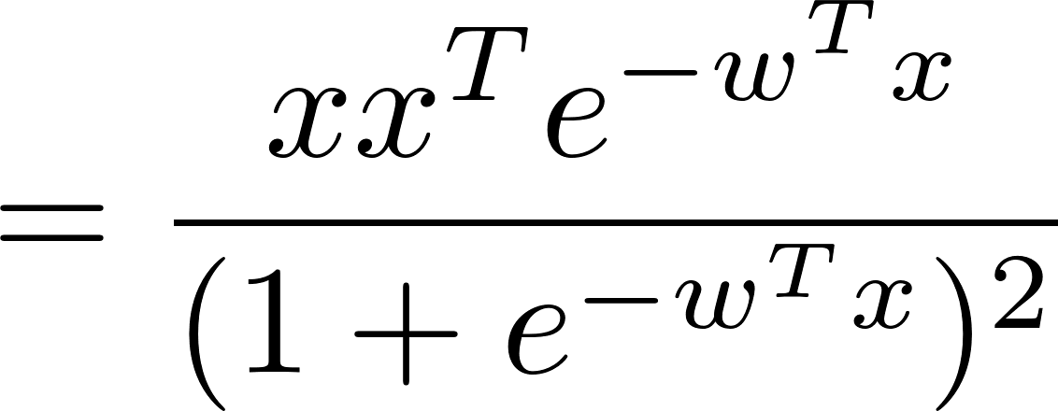

Proof:
convex in
Fact (Twice-differentiable function): If its Hessian is positive semi-definite, it is convex.
positive semi-definite!

Slide 18
Appendix 2: Proof of optimality of cross entropy loss
TexPoint fonts used in EMF.
Read the TexPoint manual before you delete this box.: AAAAAAAAAAAAAAAAAAAA

Slide 19
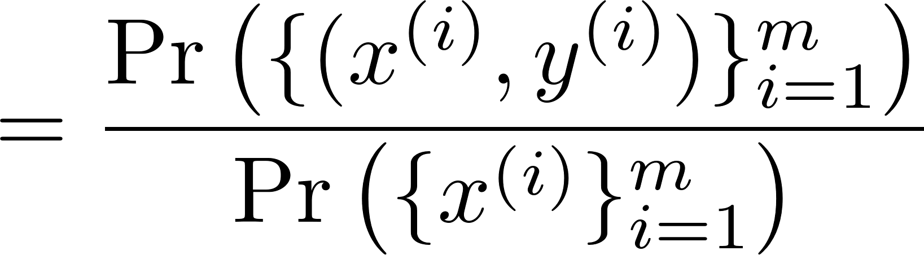
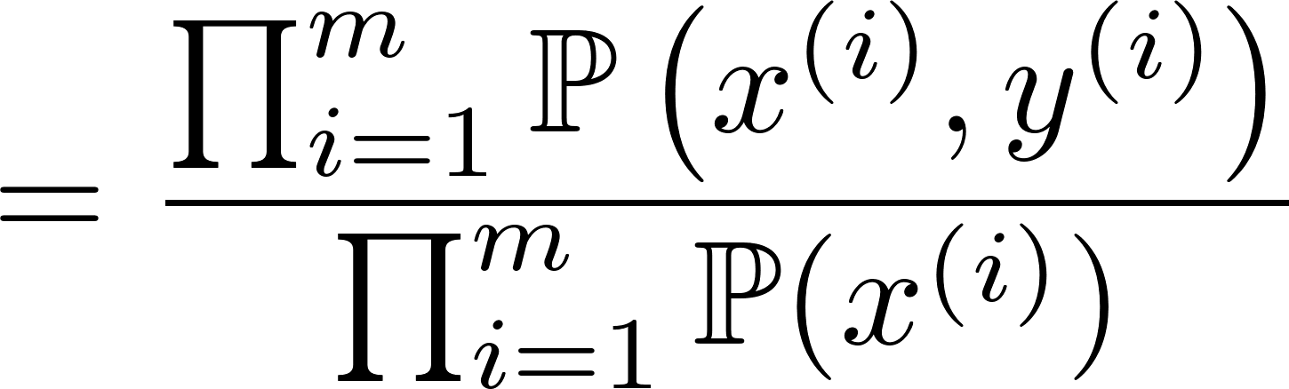
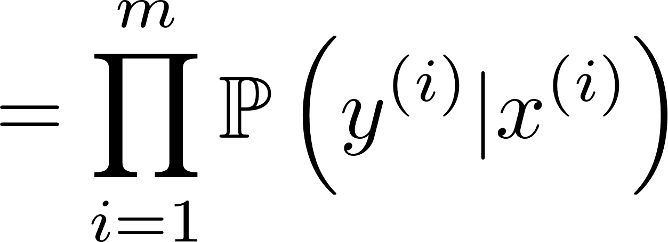
Likelihood
independent across examples
Assume:

Slide 20
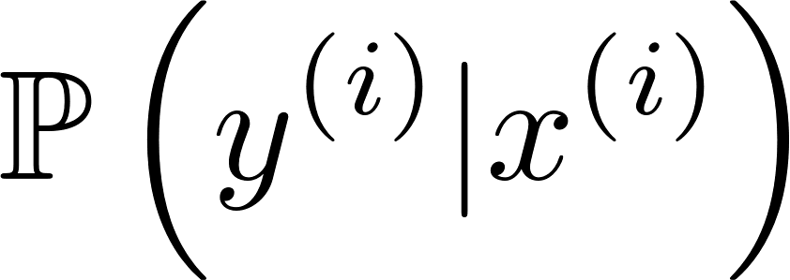
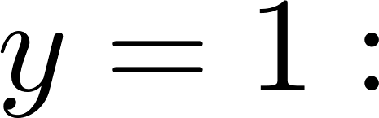
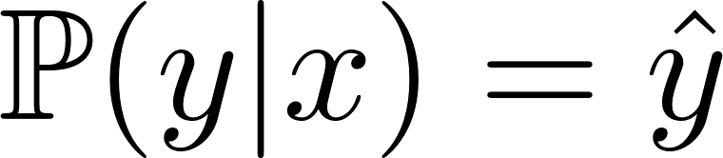


Recall:

Slide 21



Likelihood

Slide 22



Optimal w
positive
Can take an increasing function like log.
cross-entropy loss!

